Slide 1
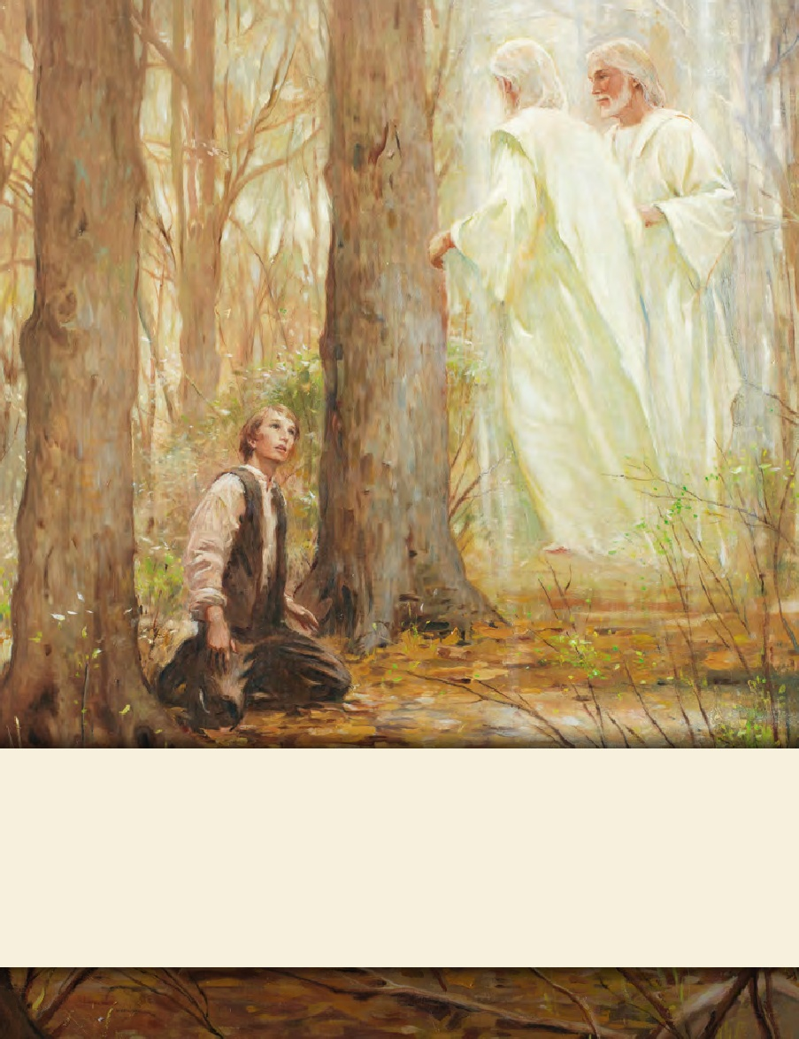
LESSON 15
SEMINARY
Doctrine and Covenants
and Church History

Slide 2
LESSON 147
“Leaving Nauvoo”

Slide 3
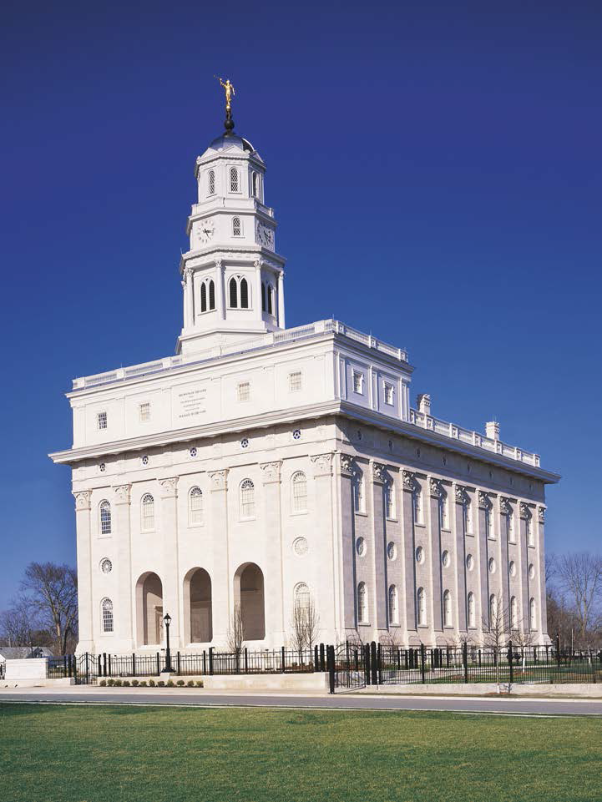
LESSON 147
The Saints work diligently to receive the blessings of the temple.
Why do you think it would have been difficult for the Saints to fulfill this commandment given through Joseph Smith?
Why do you think the Saints were willing to sacrifice so much to build the temple?

Slide 4
LESSON 147
In September 1844, Colonel Levi Williams, one of those later indicted for the murders of Joseph and Hyrum Smith, organized a major military campaign to force the Latter-day Saints out of Illinois. It was advertised as “a great wolf hunt in Hancock County” (David E. Miller and Della S. Miller, Nauvoo: The City of Joseph [1974], 186). Upon hearing of this, Governor Thomas Ford of Illinois sent General John Hardin of the state militia to the county to keep the peace. A year later, in September 1845, Colonel Williams led a mob of 300 men who raided Latter-day Saints’ settlements in outlying areas, burning many unprotected homes, farm buildings, mills, and grain stacks. In mid-September, President Brigham Young asked for volunteers to rescue those Saints. The Saints in Nauvoo prepared 134 wagons to bring the families in the outlying settlements safely to Nauvoo. (See History of the Church, 7:45–46; Church History in the Fulness of Times Student Manual, 301; David E. Miller and Della S. Miller, Nauvoo: The City of Joseph, 185–86.)
How would these attacks have made it difficult to continue working on the temple?
Why might this have been a difficult decision to make?
How do you think the decision to leave Nauvoo might have affected the Saints’efforts to complete the temple?
Why do you think the Saints continued to work on the temple even though they knew they were going to leave?

Slide 5
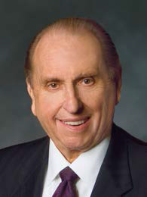
LESSON 147
What can the accounts of the Saint’s sacrifices and difficulties to build the temple teach us?
Receiving temple ordinances is worth all our righteous effort and sacrifice.
“Many years ago I read of a group of over a hundred members who left Manaus, located in the heart of the Amazon rain forest, to travel to what was then the closest temple, located in São Paulo, Brazil—nearly 2,500 miles (4,000 km) from Manaus. Those faithful Saints journeyed by boat for four days on the Amazon River and its tributaries. After completing this journey by water, they boarded buses for another three days of travel—over bumpy roads, with very little to eat, and with nowhere comfortable to sleep. After seven days and nights, they arrived at the temple in São Paulo, where ordinances eternal in nature were performed. Of course their return journey was just as difficult. However, they had received the ordinances and blessings of the temple, and although their purses were empty, they themselves were filled with the spirit of the temple and with gratitude for the blessings they had received” (“The Holy Temple—a Beacon to the World,” Ensign or Liahona, May 2011, 91).
President
Thomas S. Monson
What sacrifices did the Saints from Manaus make to receive temple ordinances?

Slide 6
LESSON 147
1. Church leaders dedicated rooms in the temple as they were completed so that ordinance work could begin as early as possible. The attic of the temple was dedicated for ordinance work on November 30, 1845. The Saints began receiving their endowments on the evening of December 10, with endowment sessions continuing until 3:00 a.m. on December 11. (See Church History in the Fulness of Times Student Manual, 303.)
2. By the end of 1845, over 1,000 members had received temple ordinances. In January 1846, President Brigham Young recorded, “Such has been the anxiety manifested by the saints to receive the ordinances [of the Temple], and such the anxiety on our part to administer to them, that I have given myself up entirely to the work of the Lord in the Temple night and day, not taking more than four hours sleep, upon an average, per day, and going home but once a week” (in History of the Church, 7:567). Many men and women contributed by washing the temple clothing each night so the work could continue the next morning without delay. (See Church History in the Fulness of Times Student Manual, 303.)
3. On February 3, 1846, President Young left the temple so he could prepare to leave Nauvoo the next day. But as he walked outside, he saw a large group of people who were still waiting to receive their endowments. Feeling compassion for his fellow Saints, he returned to the temple to serve them. He was not able to leave Nauvoo until two weeks later. Temple records show that 5,615 Saints were endowed before going west. (See Church History in the Fulness of Times Student Manual, 303–4.)
What impresses you about the Saints’ efforts to receive temple ordinances?

Slide 7
LESSON 147
What efforts and sacrifices do we have to make to receive temple ordinances?
Why do you think receiving the ordinances of the temple is worth working hard and making sacrifices?
What do you need to do so you can receive temple ordinances? (What do you need to stop or start doing?

Slide 8
LESSON 147
“The Saints leave Nauvoo"

Slide 9
LESSON 147
In September 1846 approximately 800 people, armed with six cannons, prepared to attack Nauvoo. The remaining Saints and some new citizens, numbering only about 150 fighting men, prepared to defend the city. After a few days of fighting, the Saints were forced to surrender and were told to leave the city immediately. The mob then entered the city, looted homes, and vandalized the temple. Some Saints who were not able to escape fast enough were beaten or thrown into the Mississippi River. After these remaining Saints were forced out of Nauvoo, they set up refugee camps along the Iowa side of the river. They did not have enough food, supplies, or physical strength to sustain themselves. (See Church History in the Fulness of Times Student Manual, 318.)
How do you think you might have felt if you had been called to return to Nauvoo?

Slide 10
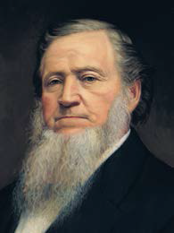
LESSON 147
“Let the fire of the covenant which you made in the House of the Lord, burn in your hearts, like flame unquenchable, till you … have searched out every man …
who [is able to leave], and impart the fire to his soul, till he shall rise up … and go straitway, and bring a load of the poor from Nauvoo. …
“… This is a day of action” (Journal History of The Church of Jesus Christ of Latter-day Saints, Sept. 28, 1846, 5–6, Church History Library, Salt Lake City).
President
Brigham Young
What does Brigham Young’s statement teach us about the covenants we make?
The Lord requires us to live by the covenants we make.
What sacrifices have you made to keep covenants?
What blessings have you experienced because you have lived according to the covenants you have made?

