Slide 1


LESSON 15
SEMINARY
Doctrine and Covenants
and Church History

Slide 2
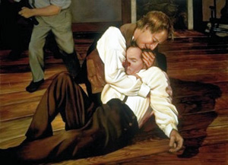
LESSON 146
“Succession in the Presidency”

Slide 3
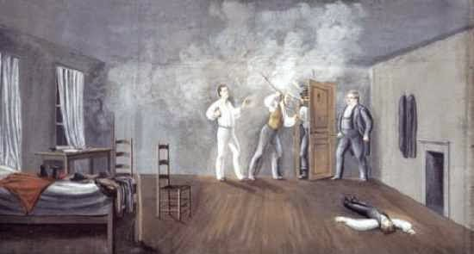
LESSON 146
“After the martyrdom of Joseph and Hyrum Smith a few people claim the right to lead the Church”

Slide 4
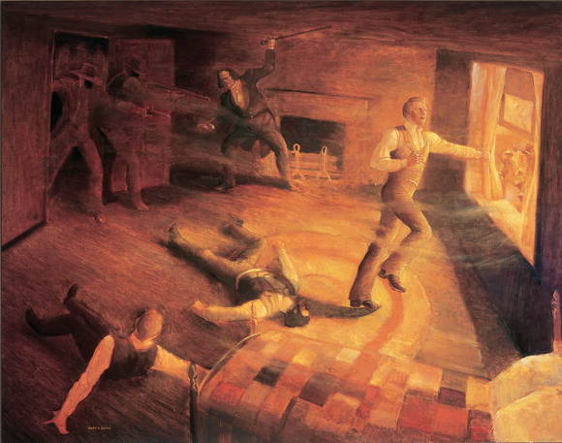
LESSON 146
When the current President of the Church dies, who will become the next President of the Church?
How will he be chosen?
How does the President of the Church receive the priesthood authority necessary to preside over the Church?
“Sidney Rigdon, First Counselor in the First Presidency, arrived [in Nauvoo] from Pittsburgh, Pennsylvania, on 3 August 1844. In the year before this time, he had begun taking a course contrary to the counsel of the Prophet Joseph Smith and had become estranged from the Church. He refused to meet with the three members of the Twelve already in Nauvoo and instead spoke to a large group of the Saints assembled for their Sunday worship service” (Our Heritage: A Brief History of The Church of Jesus Christ of Latter-day Saints [1996], 66).

Slide 5
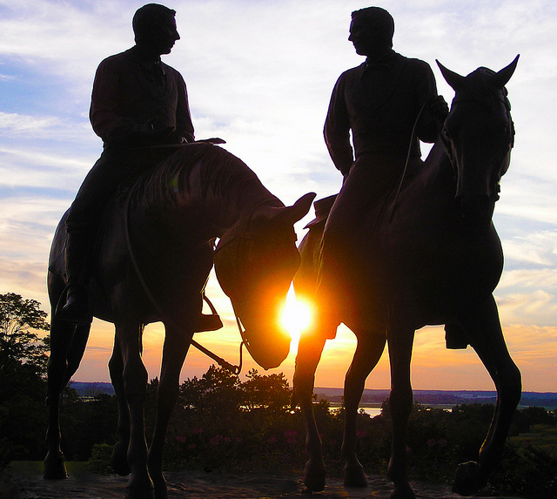
LESSON 146
If you had been in Nauvoo at the time, what might you have thought about Sidney Rigdon’s claims?
What concerns might you have had about Brother Rigdon?
James Strang, who had been baptized in February 1844, was exploring a possible location for the Saints in Wisconsin in the spring of 1844. After the martyrdom, James Strang claimed to have received a letter from Joseph Smith, stating that he had been appointed to be Joseph’s successor. James Strang’s letter, which he showed to members of the Church, appeared to have Joseph Smith’s signature. James Strang claimed to be the next prophet and announced his position at a conference of the Church in Michigan on August 5, 1844.
If you had been with the Saints in Michigan, what do you think you might have found convincing in James Strang’s claims?
What concerns might you have had about these claims?

Slide 6
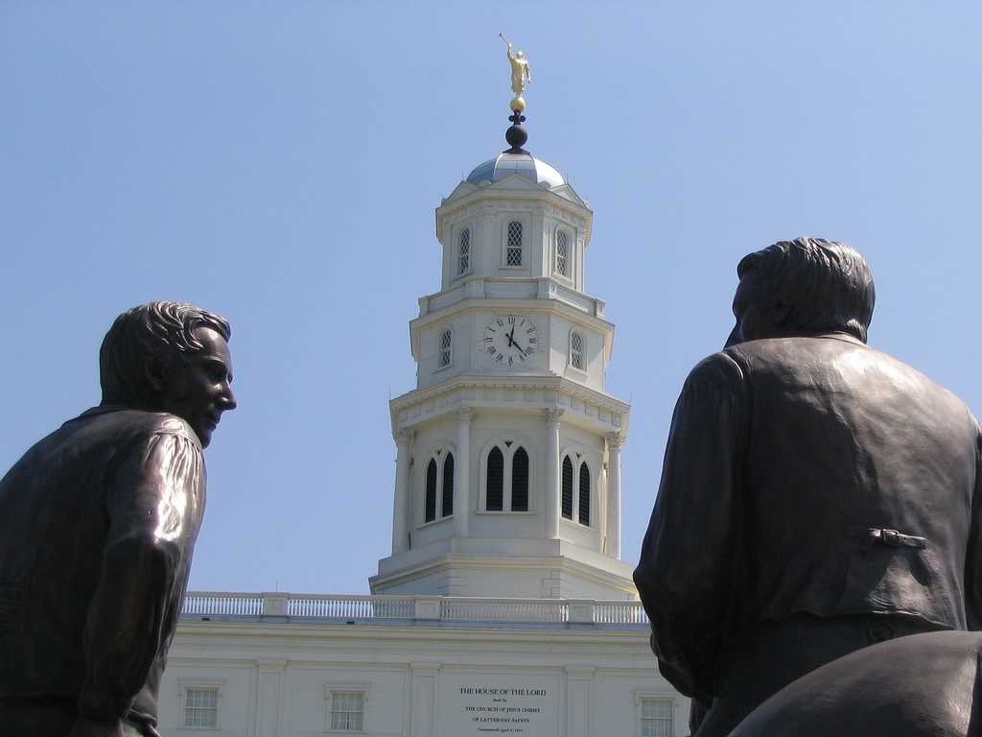
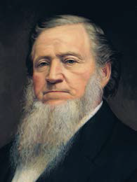
LESSON 146
Elders John Taylor, Willard Richards, and Parley P. Pratt were already in Nauvoo when Sidney Rigdon arrived. Most of the rest of the Apostles, including Brigham Young, returned to Nauvoo on the evening of August 6, 1844. The next day, August 7, the Apostles met in council at the home of John Taylor. Later that afternoon, the Twelve Apostles, the high council, and the high priests met together. President Young asked Sidney Rigdon to state his message to the Saints. Sidney Rigdon boldly declared that he had seen a vision and that no man could succeed Joseph Smith as President of the Church. He then proposed that he be appointed as the guardian of the people.
President Brigham Young Said:
“I do not care who leads the church, … but one thing I must know, and that is what God says about it. I have the keys and the means of obtaining the mind of God on the subject. …
“Joseph conferred upon our heads [referring to the Quorum of the Twelve] all the keys and powers belonging to the Apostleship which he himself held before he was taken away. …
“How often has Joseph said to the Twelve, ‘I have laid the foundation and you must build thereon, for upon your shoulders the kingdom rests’” (in History of the Church, 7:230).
Why was Brigham Young’s testimony regarding the keys of the priesthood important?
The Apostles hold all the keys of the priesthood necessary to preside over the Church.

Slide 7
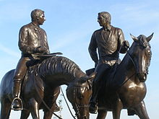
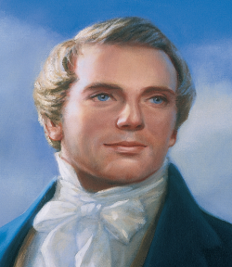
LESSON 146
“The Twelve are not subject to any other than the first Presidency, … ‘and where I am not, there is no First Presidency over the Twelve’” (in History of the Church, 2:374).
Prophet
Joseph Smith
What happens to the First Presidency when the President of the Church dies?
Who leads the Church?
When the President of the Church dies, the First Presidency is dissolved and the Quorum of the Twelve Apostles becomes the presiding quorum.

Slide 8
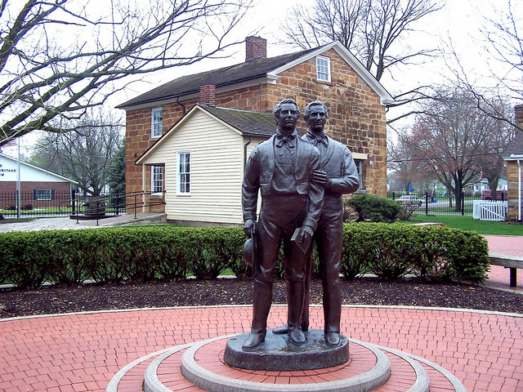
LESSON 146
Doctrine and Covenants 124:127–128.
127 I give unto you my servant Brigham Young to be a president over the Twelve traveling council;
128 Which Twelve hold the keys to open up the authority of my kingdom upon the four corners of the earth, and after that to send my word to every creature.
Why might you have been willing to follow Brigham Young after the death of the Prophet Joseph Smith?
When the President of the Church dies, the First Presidency is dissolved and the Quorum of the Twelve Apostles becomes the presiding quorum
under the
direction of the senior Apostle.

Slide 9
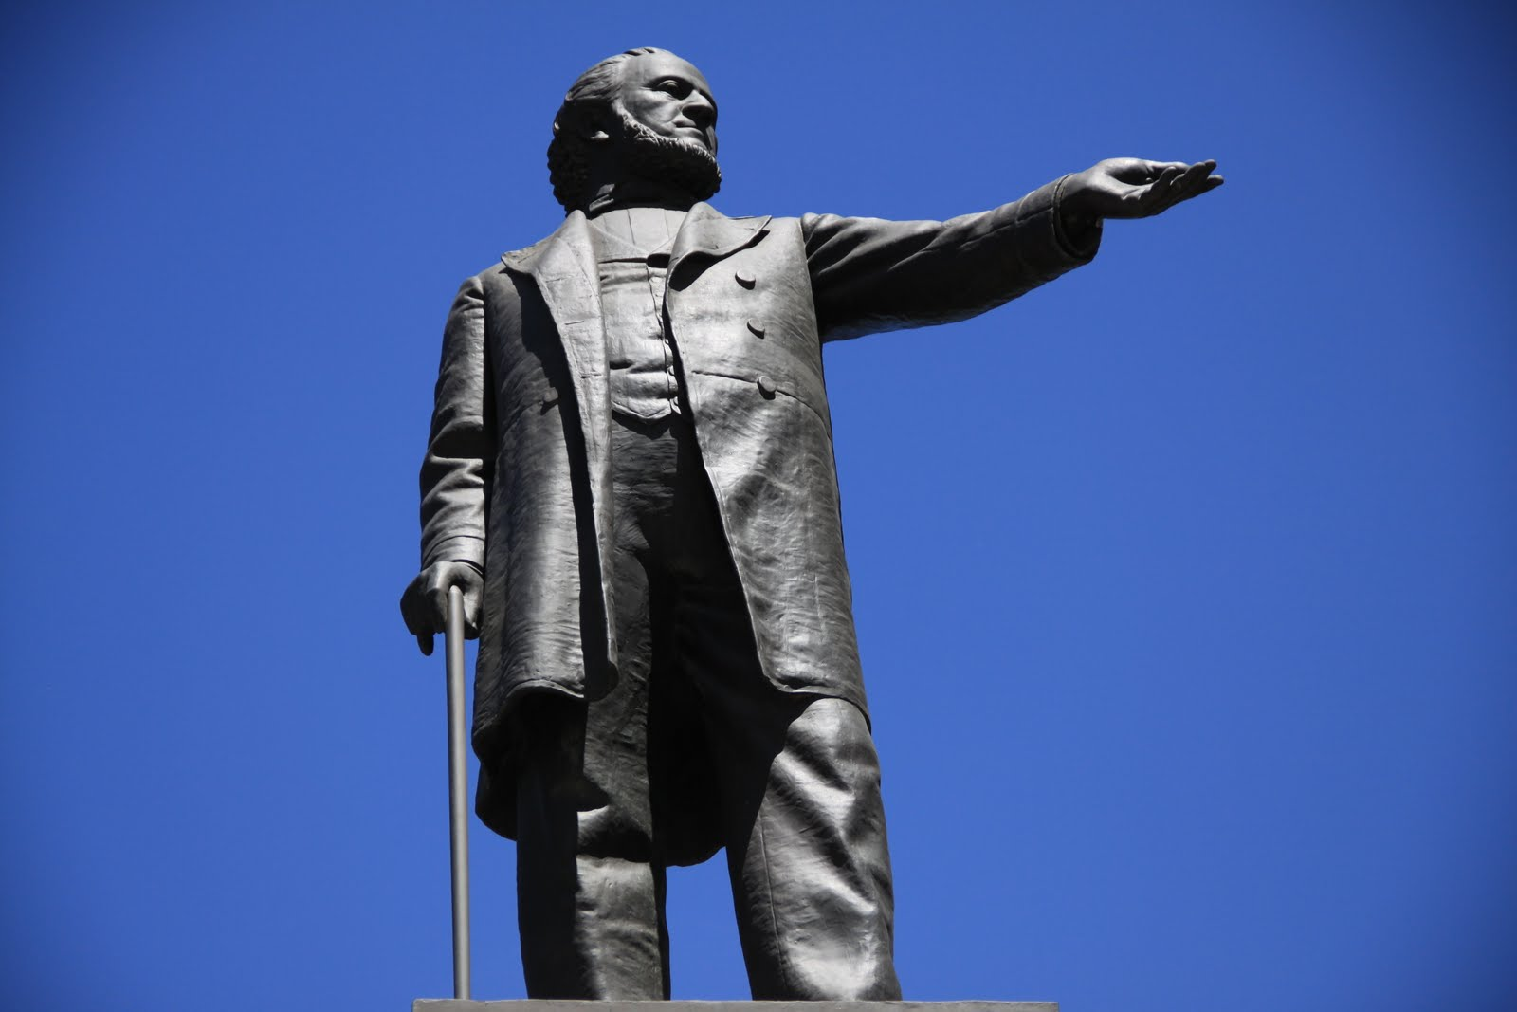
LESSON 146
“Many Saints receive a witness that Brigham Young should lead the Church”

Slide 10
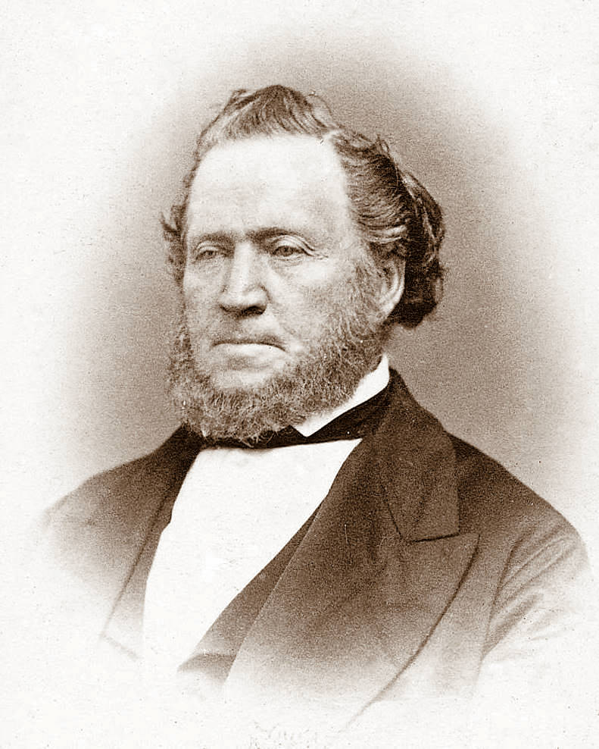
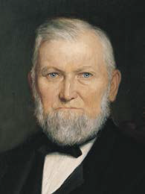
LESSON 146
Benjamin F. Johnson recalled, “As soon as he [Brigham Young] spoke I jumped upon my feet, for in every possible degree it was Joseph’s voice, and his person, in look, attitude, dress and appearance was Joseph himself, personified; and I knew in a moment the spirit and mantle of Joseph was upon him” (My Life’s Review, 104, as quoted in Church History in the Fulness of Times Student Manual, 2nd ed. [Church Educational System manual, 2003], 291). William C. Staines described Brigham Young as speaking in a “voice like the voice of the Prophet Joseph. I thought it was he, and so did thousands who heard it” (in History of the Church, 7:236).
Wilford Woodruff wrote, “If I had not seen him with my own eyes, there is no one that could have convinced me that it was not Joseph Smith, and anyone can testify to this who was acquainted with these two men” (in History of the Church, 7:236).

Slide 11
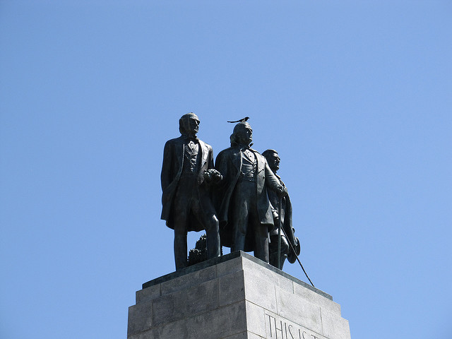
LESSON 146
How did the Lord bless the Saints to know whom He had appointed to lead the Church?
How can we know that Church leaders today are called of God?
Through the Holy Ghost, we can receive a witness that those who lead the Church have been called of God.
Why do you think it is important to receive a testimony that our Church leaders are called of God?
When have you received a witness that a leader of the Church was called of God?
What did you do to receive that witness?

Slide 12
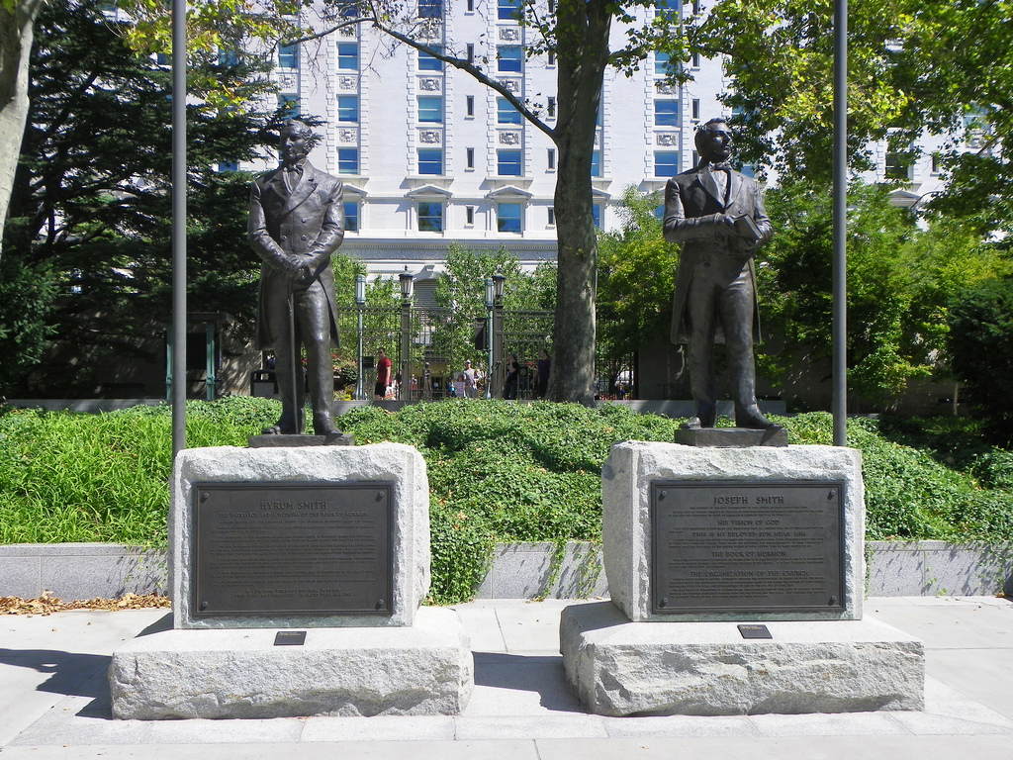
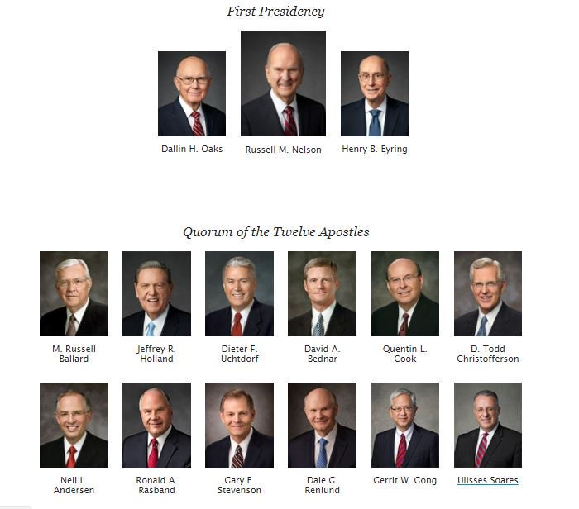
LESSON 146

