Slide 1
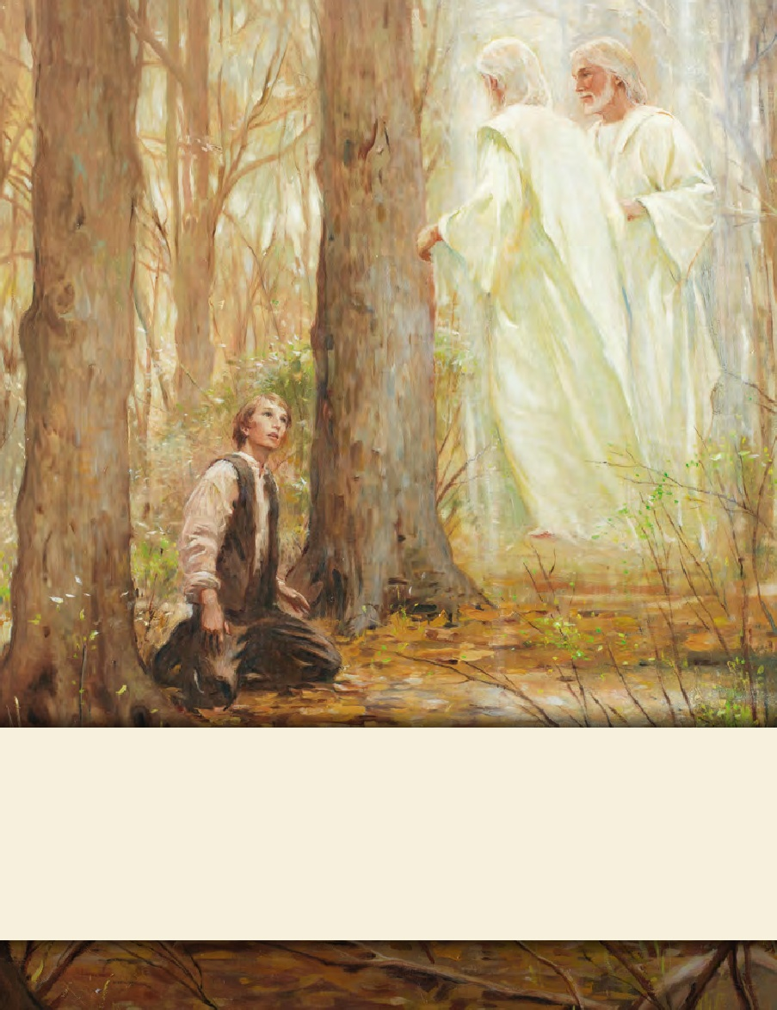
LESSON 15
SEMINARY
Doctrine and Covenants
and Church History

Slide 2
LESSON 145
Doctrine and Covenants 135, Part 2

Slide 3
LESSON 145
Doctrine and Covenants135.
“The martyrdom of Joseph and Hyrum Smith
is announced”

Slide 4
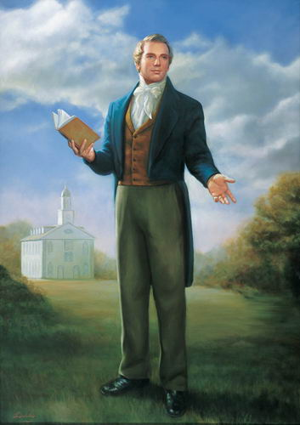
LESSON 145
Have you ever talked with someone who is not a member of the Church about the Prophet Joseph Smith?
If so, what did you talk about?

Slide 5
LESSON 145
Doctrine and Covenants135:3.
Joseph Smith, the Prophet and Seer of the Lord, has done more, save Jesus only, for the salvation of men in this world, than any other man that ever lived in it. In the short space of twenty years, he has brought forth the Book of Mormon, which he translated by the gift and power of God, and has been the means of publishing it on two continents; has sent the fulness of the everlasting gospel, which it contained, to the four quarters of the earth; has brought forth the revelations and commandments which compose this book of Doctrine and Covenants, and many other wise documents and instructions for the benefit of the children of men; gathered many thousands of the Latter-day Saints, founded a great city, and left a fame and name that cannot be slain. He lived great, and he died great in the eyes of God and his people; and like most of the Lord’s anointed in ancient times, has sealed his mission and his works with his own blood; and so has his brother Hyrum. In life they were not divided, and in death they were not separated!
Joseph Smith, the Prophet and Seer of the Lord, has done more, save Jesus only, for the salvation of men in this world, than any other man that ever lived in it. In the short space of twenty years, he has brought forth the Book of Mormon, which he translated by the gift and power of God, and has been the means of publishing it on two continents; has sent the fulness of the everlasting gospel, which it contained, to the four quarters of the earth; has brought forth the revelations and commandments which compose this book of Doctrine and Covenants, and many other wise documents and instructions for the benefit of the children of men; gathered many thousands of the Latter-day Saints, founded a great city, and left a fame and name that cannot be slain. He lived great, and he died great in the eyes of God and his people; and like most of the Lord’s anointed in ancient times, has sealed his mission and his works with his own blood; and so has his brother Hyrum. In life they were not divided, and in death they were not separated!
What is the message of this verse?
What has the Prophet Joseph Smith done for our salvation and exaltation?

Slide 6
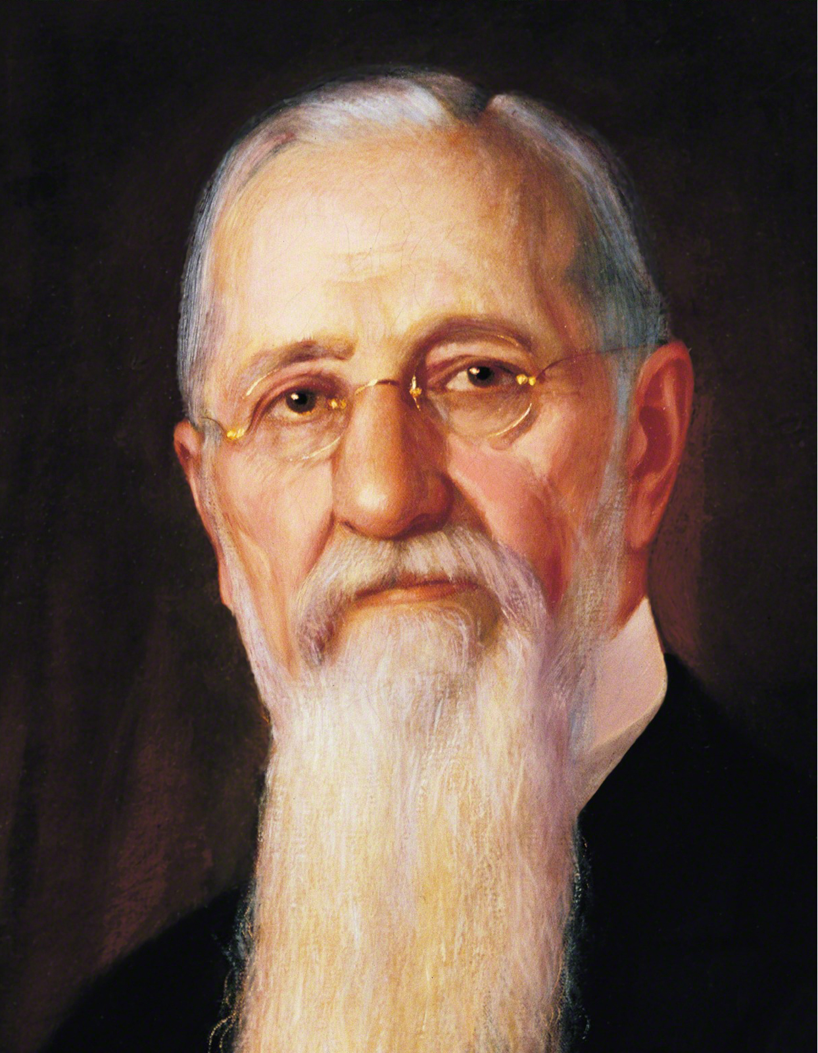
LESSON 145
“The work in which Joseph Smith was engaged was not confined to this life alone, but it pertains as well to the life to come, and to the life that has been. In other words, it relates to those who have lived upon the earth, to those who are living and to those who shall come after us. It is not something which relates to man only while he tabernacles in the flesh, but to the whole human family from eternity to eternity” (Gospel Doctrine, 5th ed. [1939],481).
President
Joseph F. Smith

Slide 7
LESSON 145
Doctrine and Covenants135:6.
Hyrum Smith was forty-four years old in February, 1844, and Joseph Smith was thirty-eight in December, 1843; and henceforward their names will be classed among the martyrs of religion; and the reader in every nation will be reminded that the Book of Mormon, and this book of Doctrine and Covenants of the church, cost the best blood of the nineteenth century to bring them forth for the salvation of a ruined world; and that if the fire can scathe a green tree for the glory of God, how easy it will burn up the dry trees to purify the vineyard of corruption. They lived for glory; they died for glory; and glory is their eternal reward. From age to age shall their names go down to posterity as gems for the sanctified.
Why were the Book of Mormon and the Doctrine and Covenants brought forth?
The Book of Mormon and the Doctrine and Covenants were brought forth for the salvation of the world.
In what ways do these books help bring about the salvation of the world?
What makes the Book of Mormon and Doctrine and Covenants among the most valuable books you might own?
What can we do to show our gratitude for the sacrifice Joseph and Hyrum Smith made to bring forth these books?

Slide 8
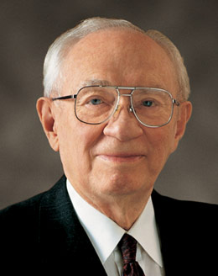
LESSON 145
“We do not worship the Prophet. We worship God our Eternal Father and the risen Lord Jesus Christ. But we acknowledge the Prophet; we proclaim him; we respect him; we reverence him as an instrument in the hands of the Almighty in restoring to the earth the ancient truths of the divine gospel, together with the priesthood through which the authority of God is exercised in the affairs of His Church and for the blessing of His people” (“Joseph Smith Jr.—Prophet of God, Mighty Servant,”Ensign, Dec. 2005,4).
President
Gordon B. Hinckley
In your own words, how would you explain Church members’ feelings about the Prophet Joseph Smith?

Slide 9
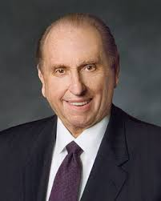
LESSON 145
In what specific ways might your life be different without the ministry of the Prophet Joseph Smith?
How has the Prophet Joseph Smith influenced your knowledge of and relationship with Heavenly Father and Jesus Christ?
“[The Prophet Joseph Smith] left behind a legacy that enables [millions of] followers today on every continent to proclaim him as a prophet of God. May we, each of us, strive to continue the Prophet Joseph’s vision for this work and to magnify his legacy through our works and testimonies to others, that they may know him as we do and that they may experience the peace and joy of the gospel he restored” (“Brother Joseph, ”Church News, Dec. 31, 2005,4).
President
Thomas S. Monson
How can we help others experience the joy of the gospel as restored through the Prophet Joseph Smith?

