Slide 1
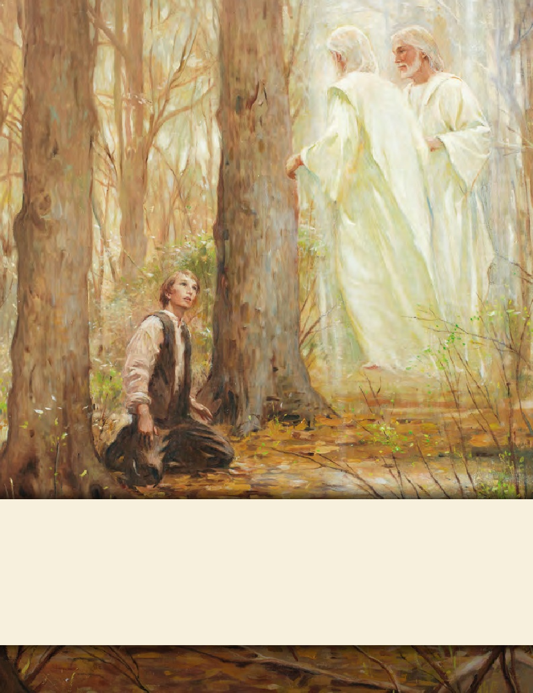
LESSON 15
SEMINARY
Doctrine and Covenants
and Church History

Slide 2
LESSON 144
Doctrine and Covenants 135, Part 1

Slide 3
LESSON 144
Doctrine and Covenants 135:1-7.
“The martyrdom of Joseph and
Hyrum Smith is announced”

Slide 4
LESSON 144
Doctrine and Covenants 135:1.
To seal the testimony of this book and the Book of Mormon, we announce the martyrdom of Joseph Smith the Prophet, and Hyrum Smith the Patriarch. They were shot in Carthage jail, on the 27th of June, 1844, about five o’clock p.m., by an armed mob—painted black—of from 150 to 200 persons. Hyrum was shot first and fell calmly, exclaiming: I am a dead man! Joseph leaped from the window, and was shot dead in the attempt, exclaiming: O Lord my God! They were both shot after they were dead, in a brutal manner, and both received four balls.
How might you have felt after hearing about this tragedy?

Slide 5
LESSON 144
Student 1.
By June 1844, animosity against the Church had greatly intensified. Some citizens in Illinois were discussing driving the Saints from the state, while others were plotting to kill the Prophet. Some of those who were conspiring against the Prophet and the Church were former members of the Church who had apostatized. On June 7, 1844, William Law, who had served as second counselor in the First Presidency, and other apostates printed the first issue of a newspaper called the Nauvoo Expositor. In an attempt to inflame the public against the Prophet and the Church, these men used this newspaper to slander Joseph Smith and other Church leaders. Joseph Smith and the majority of the Nauvoo city council recognized that the inflammatory newspaper would lead to mob violence against the city. They declared it a public nuisance and ordered that the Nauvoo Expositor press be destroyed.

Slide 6
LESSON 144
Student 2
The excitement in the area grew so intense that Governor Ford went to Carthage, the center of government for the region, to neutralize the volatile situation. He wrote to Joseph Smith, saying that only a trial of the Prophet and other leaders before a non-Mormon jury in Carthage would satisfy the people. Governor Ford also promised them complete protection and a fair trial if they came voluntarily. Joseph replied that his life would be in danger on the journey and that he would not come.
As Joseph Smith counseled with his brethren about what to do next, he felt that if he and Hyrum left Nauvoo and traveled to the West, the Saints in Nauvoo would not be harmed. Acting on this counsel, Joseph and Hyrum crossed the Mississippi River into Iowa. However, some Church members in Nauvoo doubted the Prophet’s plan. A few came to him and accused him of cowardice, saying he was abandoning the Saints and leaving them to face persecution alone. The Prophet replied, “If my life is of no value to my friends it is of none to myself” (in History of the Church,6:549). After counseling together, Joseph and Hyrum returned to Nauvoo. Early in the morning on June 24, 1844, they left for Carthage.

Slide 7
LESSON 144
Doctrine and Covenants 135:4.
When Joseph went to Carthage to deliver himself up to the pretended requirements of the law, two or three days previous to his assassination, he said: “I am going like a lamb to the slaughter; but I am calm as a summer’s morning; I have a conscience void of offense towards God, and towards all men. I shall die innocent, and it shall yet be said of me—he was murdered in cold blood.”—The same morning, after Hyrum had made ready to go—shall it be said to the slaughter? yes, for so it was—he read the following paragraph, near the close of the twelfth chapter of Ether, in the Book of Mormon, and turned down the leaf upon it:
What did Joseph say would happen to him?
What do you think it might have been like for the Prophet to leave his family, knowing he would not be coming back to them?
Why do you think Joseph was “calm as a summer’s morning” when he knew he was going “like a lamb to the slaughter”?

Slide 8
LESSON 144
Ether 12:36–38.
36 And it came to pass that I prayed unto the Lord that he would give unto the Gentiles grace, that they might have charity.
37 And it came to pass that the Lord said unto me: If they have not charity it mattereth not unto thee, thou hast been faithful; wherefore, thy garments shall be made clean. And because thou hast seen thy weakness thou shalt be made strong, even unto the sitting down in the place which I have prepared in the mansions of my Father.
38 And now I, Moroni, bid farewell unto the Gentiles, yea, and also unto my brethren whom I love, until we shall meet before the judgment-seat of Christ, where all men shall know that my garments are not spotted with your blood.
Doctrine and Covenants 135:5.
And it came to pass that I prayed unto the Lord that he would give unto the Gentiles grace, that they might have charity. And it came to pass that the Lord said unto me: If they have not charity it mattereth not unto thee, thou hast been faithful; wherefore thy garments shall be made clean. And because thou hast seen thy weakness, thou shalt be made strong, even unto the sitting down in the place which I have prepared in the mansions of my Father. And now I … bid farewell unto the Gentiles; yea, and also unto my brethren whom I love, until we shall meet before the judgment-seat of Christ, where all men shall know that my garments are not spotted with your blood. The testators are now dead, and their testament is in force.

Slide 9
LESSON 144
Why do you think these verses from the book of Ether might have been meaningful for Hyrum to read at that time?
What do you think the phrase “all men shall know that my garments are not spotted with your blood” (D&C 135:5) means?
What can we learn from Joseph and Hyrum Smith’s examples that could help us fulfill the callings we receive from God?

Slide 10
LESSON 144
Student 3
On June 25, 1844, Joseph and Hyrum Smith and other leaders posted bail at Carthage and were freed until a formal trial could be held to address the charge of inciting a riot (referring to the destruction of the Nauvoo Expositor). However, that evening Joseph and Hyrum were committed to Carthage Jail on a charge of treason, which Joseph and his lawyers protested was illegal because that charge had not been mentioned at their earlier bail hearing. No bail could be posted for treason, so they had to stay in Carthage—and remain in danger.
On June 26, 1844, Joseph met with Governor Ford in the jail. Governor Ford was contemplating going to Nauvoo, and Joseph asked to go along, feeling he was not safe in Carthage. Governor Ford promised that if he left Carthage he would take Joseph and Hyrum with him. That evening, the Prophet bore testimony to the guards of the authenticity of the Book of Mormon and the Restoration of the gospel.
On the morning of June 27, 1844, Joseph wrote in a letter to Emma: “I am very much resigned to my lot, knowing I am justified, and have done the best that could be done. Give my love to the children and all my friends” (in History of the Church,6:605). Later that day, despite knowing of plans by local citizens to storm the jail and kill the prisoners, Governor Ford left Carthage to speak to the citizens of Nauvoo. He broke his promise and did not take Joseph and Hyrum with him. Before leaving, Governor Ford placed the Carthage Greys—the most visibly hostile of the militias gathered in Carthage—in charge of guarding the jail and disbanded the other militias.

Slide 11
LESSON 144
Student 4
Shortly after 5:00 p.m. on June 27, 1844, a mob of approximately 150–200 men, with faces painted to hide their identities, surrounded the jail. The guards provided little resistance as several members of the mob rushed up the stairs to the room where the Prophet and his friends were located.
Joseph and the others pushed against the door to prevent the mob from forcing it open. Someone in the mob fired a shot through the upper panel of the door, striking Hyrum on the left side of his nose. He fell backwards, exclaiming, “I am a dead man!” (in History of the Church,6:617). John Taylor said, “I shall never forget the deep feeling of sympathy and regard manifested in the countenance of Brother Joseph as he drew nigh to Hyrum, and, leaning over him, exclaimed, ‘Oh! my poor, dear brother Hyrum!’” (in History of the Church,7:102).

Slide 12
LESSON 144
Student 5.
Earlier in the day a visitor had given Joseph a revolver. Acting in defense of everyone in the room, Joseph sprang to the door and reached around the doorframe to shoot the pistol into the hall. Only three of the six chambers fired, wounding several members of the mob. The mob then forced their guns through the half-closed door, and John Taylor tried to beat the barrels of their guns back with a walking stick.
As the conflict at the doorway increased, John Taylor tried to escape the room through a window. As he attempted to leap out of the window, he was shot in the thigh from the doorway and was also shot by someone outside. He fell to the floor, and while attempting to get under the bed next to the window, he was severely wounded by three more shots. Meanwhile, as guns came through the doorway, Willard Richards began striking them with a cane.

Slide 13
LESSON 144
Student 6.
Joseph Smith then decided to try to escape through the same window, likely to preserve his life and, some believed, to save the lives of Willard Richards and John Taylor. As Willard Richards continued to deflect the mob at the door, the Prophet leaped to the open window. As he did so, he was struck by bullets from both inside and outside the jail. He fell out of the window, exclaiming, “O Lord, my God!” and landed on the ground below. The members of the mob who were inside the jail rushed outside to assure themselves that Joseph was dead. Although there were no members of the Church on their way to Carthage, someone yelled, “The Mormons are coming!” and the entire mob fled. (See History of the Church,6:618, 620–21; see also Church History in the Fulness of Times Student Manual,283.)

Slide 14
LESSON 144
Doctrine and Covenants 135:2.
John Taylor and Willard Richards, two of the Twelve, were the only persons in the room at the time; the former was wounded in a savage manner with four balls, but has since recovered; the latter, through the providence of God, escaped, without even a hole in his robe.
What do you think the phrase “to seal the testimony of this book and the Book of Mormon” means?
What is a martyr?
A person who suffers death as a witness to the truth of his or her beliefs or cause.

Slide 15
LESSON 144
Doctrine and Covenants 135:7.
They were innocent of any crime, as they had often been proved before, and were only confined in jail by the conspiracy of traitors and wicked men; and their innocent blood on the floor of Carthage jail is a broad seal affixed to “Mormonism” that cannot be rejected by any court on earth, and their innocent blood on the escutcheon of the State of Illinois, with the broken faith of the State as pledged by the governor, is a witness to the truth of the everlasting gospel that all the world cannot impeach; and their innocent blood on the banner of liberty, and on the magna charta of the United States, is an ambassador for the religion of Jesus Christ, that will touch the hearts of honest men among all nations; and their innocent blood, with the innocent blood of all the martyrs under the altar that John saw, will cry unto the Lord of Hosts till he avenges that blood on the earth. Amen.
Through their deaths as martyrs, what did Joseph and Hyrum Smith seal their witness of?
Joseph and Hyrum Smith sealed their witness of the truthfulness of the restored gospel with their lives
How can your knowledge of Joseph and Hyrum Smith’s testimonies and their willingness to die for the truth influence your testimony?

