Slide 1
LESSON 15
SEMINARY
Doctrine and Covenants
and Church History

Slide 2
LESSON 143
Doctrine and Covenants134.

Slide 3
LESSON 143
Doctrine and Covenants134:1-4.
“The responsibilities of governments are set forth”

Slide 4
LESSON 143
What laws would you like to enact for the people in this new country to follow?
What do you think of the laws your leader has established?
How well do you plan to follow them?
What do you think is the purpose of a government?

Slide 5
LESSON 143
INTRODUCTION TO DOCTRINE AND COVENANTS 134
A declaration of belief regarding governments and laws in general, adopted by unanimous vote at a general assembly of the Church held at Kirtland, Ohio, August 17, 1835. Many Saints gathered together to consider the proposed contents of the first edition of the Doctrine and Covenants. At that time, this declaration was given the following preamble: “That our belief with regard to earthly governments and laws in general may not be misinterpreted nor misunderstood, we have thought proper to present, at the close of this volume, our opinion concerning the same.”

Slide 6
LESSON 143
Doctrine and Covenants 134:1.
We believe that governments were instituted of God for the benefit of man; and that he holds men accountable for their acts in relation to them, both in making laws and administering them, for the good and safety of society.
Governments were instituted by God for the benefit of mankind.
Government officials are accountable to God to act for the good and safety of society.
In what ways can government leaders act for the good and safety of society?

Slide 7
LESSON 143
Doctrine and Covenants 134:2.
We believe that no government can exist in peace, except such laws are framed and held inviolate as will secure to each individual the free exercise of conscience, the right and control of property, and the protection of life.
What rights should governments secure for their citizens?
“The free exercise of conscience, the right and control of property, and the protection of life.”
What do you think it means to exercise your conscience?
Why is it important to be free to exercise your conscience?

Slide 8
LESSON 143
Doctrine and Covenants 134:4.
We believe that religion is instituted of God; and that men are amenable to him, and to him only, for the exercise of it, unless their religious opinions prompt them to infringe upon the rights and liberties of others; but we do not believe that human law has a right to interfere in prescribing rules of worship to bind the consciences of men, nor dictate forms for public or private devotion; that the civil magistrate should restrain crime, but never control conscience; should punish guilt, but never suppress the freedom of the soul.
Why do you think it is important for people to be accountable to God, not governments, for the way they exercise their religion?
What do you think it means to restrain crime and punish guilt without trying to control conscience or suppress the freedom of the soul?
Doctrine and Covenants 134:3.
We believe that all governments necessarily require civil officers and magistrates to enforce the laws of the same; and that such as will administer the law in equity and justice should be sought for and upheld by the voice of the people if a republic, or the will of the sovereign.
How can the “voice of the people” seek and uphold good leaders?

Slide 9
LESSON 143
Doctrine and Covenants 134:5-6,8.
“The responsibilities of citizens are set forth”

Slide 10
LESSON 143
What do you think of this list of responsibilities?
How would you change this list?
Doctrine and Covenants 134:5-6.
4 We believe that religion is instituted of God; and that men are amenable to him, and to him only, for the exercise of it, unless their religious opinions prompt them to infringe upon the rights and liberties of others; but we do not believe that human law has a right to interfere in prescribing rules of worship to bind the consciences of men, nor dictate forms for public or private devotion; that the civil magistrate should restrain crime, but never control conscience; should punish guilt, but never suppress the freedom of the soul.
5 We believe that all men are bound to sustain and uphold the respective governments in which they reside, while protected in their inherent and inalienable rights by the laws of such governments; and that sedition and rebellion are unbecoming every citizen thus protected, and should be punished accordingly; and that all governments have a right to enact such laws as in their own judgments are best calculated to secure the public interest; at the same time, however, holding sacred the freedom of conscience.

Slide 11
LESSON 143
Let’s Learn..
Inalienable:
refers to something that cannot be taken away.
Sedition:
refers to rebellion against government leaders.
Deference:
means compliance or submission.
Supplanted:
means replaced.
Anarchy:
means lawlessness—the absence of rules and government or rebellion against
rules and government.

Slide 12
LESSON 143
What responsibility do we have toward our government?
We are to sustain and uphold the government where we live.
Which article of faith does this principle remind you of?
We believe in being subject to kings, presidents, rulers, and magistrates, in obeying, honoring, and sustaining the law.
How can we as citizens sustain and uphold the government?
How does God feel about our obedience to divine laws and human laws?
God wants us to respect and obey divine laws and human laws.

Slide 13
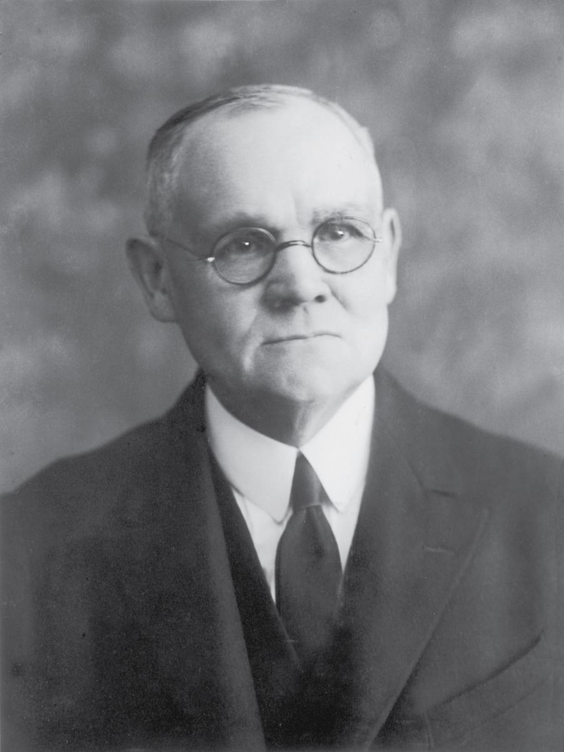
LESSON 143
“In the case of a conflict between the requirements made by the revealed word of God, and those imposed by the secular law, which of these authorities would the members of the Church be bound to obey?… “Pending the overruling by [God] in favor of religious liberty, it is the duty of the saints to submit themselves to the laws of their country. Nevertheless, they should use every proper method, as citizens or subjects of their several governments, to secure for themselves and for all men the boon of freedom in religious service. It is not required of them to suffer without protest [the] imposition by lawless persecutors, or through
Elder
James E. Talmage
the operation of unjust laws; but their protests should be offered in legal and proper order. The saints have practically demonstrated their acceptance of the doctrine that it is better to suffer evil than to do wrong by purely human opposition to unjust authority” (The Articles of Faith,12th ed. [1924], 422,423]).

Slide 14
LESSON 143
Doctrine and Covenants 134:7, 9-10,12.
“The relationship between religion and
government is described”

Slide 15
LESSON 143
Doctrine and Covenants 134:11.
“The right to appeal for help from the
government is explained”

