Slide 1
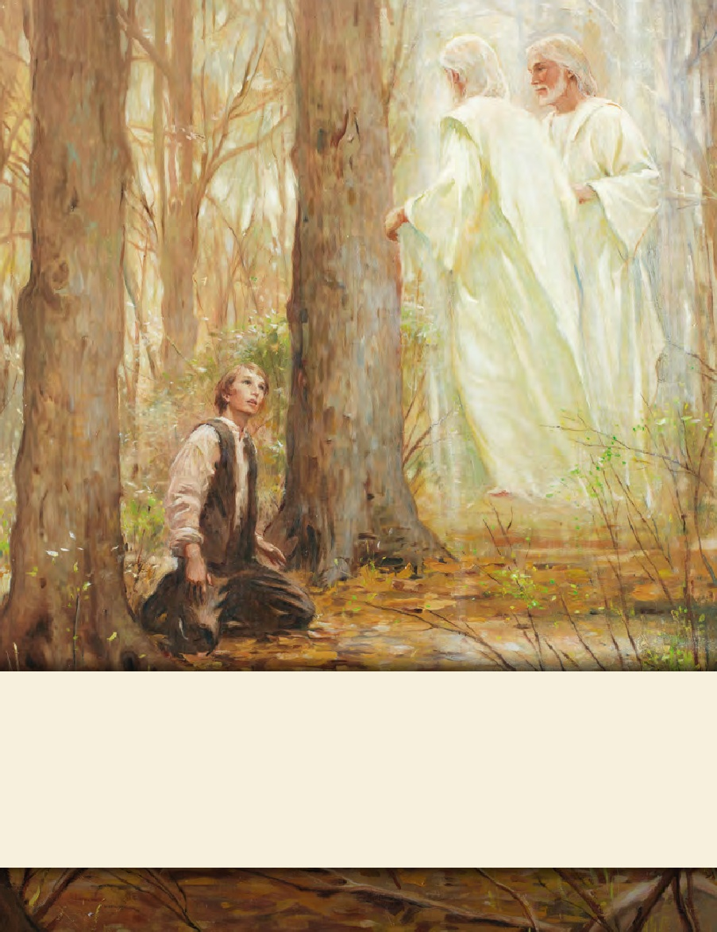
LESSON 15
SEMINARY
Doctrine and Covenants
and Church History

Slide 2
LESSON 142
Doctrine and Covenants 133:36-40.
“The Lord declares that the restored gospel shall be preached to all the world”

Slide 3
LESSON 142
When have you been very excited to see someone?
Are you excited to see the Savior at His Second Coming? Why?

Slide 4
LESSON 142
Doctrine and Covenants 133:36–39.
36 And now, verily saith the Lord, that these things might be known among you, O inhabitants of the earth, I have sent forth mine angel flying through the midst of heaven, having the everlasting gospel, who hath appeared unto some and hath committed it unto man, who shall appear unto many that dwell on the earth.
37 And this gospel shall be preached unto every nation, and kindred, and tongue, and people.
38 And the servants of God shall go forth, saying with a loud voice: Fear God and give glory to him, for the hour of his judgment is come;
39 And worship him that made heaven, and earth, and the sea, and the fountains of waters—
What evidence do you see in these verses that the Savior desires all people to be prepared for His Second Coming?
Who are the servants of God who will be preaching the message of the restored gospel?
As servants of God, we can help others prepare for the Second Coming by sharing the gospel with them.

Slide 5
LESSON 142
How are we to proclaim the gospel?
What do you think it might mean to share the gospel “with a loud voice”?
Doctrine and Covenants 133:40.
Calling upon the name of the Lord day and night, saying: O that thou wouldst rend the heavens, that thou wouldst come down, that the mountains might flow down at thy presence.
What will the servants of God do before the Second Coming?
They will pray for the Savior’s return.

Slide 6
LESSON 142
Doctrine and Covenants 133:41-56.
“Jesus Christ describes His Second Coming”

Slide 7
LESSON 142
Doctrine and Covenants 133:41-45.
41 And it shall be answered upon their heads; for the presence of the Lord shall be as the melting fire that burneth, and as the fire which causeth the waters to boil.
42 O Lord, thou shalt come down to make thy name known to thine adversaries, and all nations shall tremble at thy presence—
43 When thou doest terrible things, things they look not for;
44 Yea, when thou comest down, and the mountains flow down at thy presence, thou shalt meet him who rejoiceth and worketh righteousness, who remembereth thee in thy ways.
45 For since the beginning of the world have not men heard nor perceived by the ear, neither hath any eye seen, O God, besides thee, how great things thou hast prepared for him that waiteth for thee.
What does the Lord promise those who will wait for Him?
The Lord has prepared great blessings for those who wait for Him.
What do you think it means to wait for the Lord?

Slide 8
LESSON 142
“To any of you who are troubled about the future…
“God expects you to have enough faith and determination and enough trust in Him to keep moving, keep living, keep rejoicing. In fact, He expects you not simply to face the future (that sounds pretty grim and stoic); He expects you to embrace and shape the future—to love it and rejoice in it and delight in your opportunities.
“God is anxiously waiting for the chance to answer your prayers and fulfill your dreams, just as He always has. But He can’t if you don’t pray, and He can’t if you don’t dream. In short, He can’t if you don’t believe” (“Terror, Triumph, and a Wedding Feast” [Church Educational System devotional, Sept. 12, 2004], 3,speeches.byu.edu).
Elder
Jeffrey R. Holland
What did Elder Holland say we should do as we wait for the Savior’s Second Coming?

Slide 9
LESSON 142
Doctrine and Covenants 133:46-47.
46 And it shall be said: Who is this that cometh down from God in heaven with dyed garments; yea, from the regions which are not known, clothed in his glorious apparel, traveling in the greatness of his strength?
47 And he shall say: I am he who spake in righteousness, mighty to save.
Doctrine and Covenants 133:48-49.
48 And the Lord shall be red in his apparel, and his garments like him that treadeth in the wine-vat.
49 And so great shall be the glory of his presence that the sun shall hide his face in shame, and the moon shall withhold its light, and the stars shall be hurled from their places.
What will be distinctive about the Savior’s appearance at the time of His Second Coming?
He will be dressed in red clothing, and He will appear in great glory.

Slide 10
LESSON 142
Doctrine and Covenants 133:50-51.
50 And his voice shall be heard: I have trodden the wine-press alone, and have brought judgment upon all people; and none were with me;
51 And I have trampled them in my fury, and I did tread upon them in mine anger, and their blood have I sprinkled upon my garments, and stained all my raiment; for this was the day of vengeance which was in my heart.
How can these verses help us understand the Lord’s justice?
The red color of the Lord’s garments represents the blood of the wicked who will be destroyed when justice is poured out upon them at the Second Coming.

Slide 11
LESSON 142
Doctrine and Covenants 133:52-53.
52 And now the year of my redeemed is come; and they shall mention the loving kindness of their Lord, and all that he has bestowed upon them according to his goodness, and according to his loving kindness, forever and ever.
53 In all their afflictions he was afflicted. And the angel of his presence saved them; and in his love, and in his pity, he redeemedthem, and bore them, and carried them all the days of old;
What do these verses teach about the Lord’s mercy?

Slide 12
LESSON 142
Doctrine and Covenants 133:54-56.
54 Yea, and Enoch also, and they who were with him; the prophets who were before him; and Noah also, and they who were before him; and Moses also, and they who were before him;
55 And from Moses to Elijah, and from Elijah to John, who were with Christ in his resurrection, and the holy apostles, with Abraham, Isaac, and Jacob, shall be in the presence of the Lamb.
56 And the graves of the saints shall be opened; and they shall come forth and stand on the right hand of the Lamb, when he shall stand upon Mount Zion, and upon the holy city, the New Jerusalem; and they shall sing the song of the Lamb, day and night forever and ever.
Who will appear with the Savior at the Second Coming?
The righteous who lived before Jesus Christ and have already been resurrected will come with Him in His glory. In addition, the righteous who lived and died after Jesus Christ will be resurrected and come forth to join the Savior and those with Him.

Slide 13
LESSON 142
Doctrine and Covenants 133:57-74.
“The gospel is sent forth to prepare the earth for the
Second Coming of Jesus Christ”

Slide 14
LESSON 142
What have you learned from Doctrine and Covenants 133 about the Savior’s Second Coming? What are your feelings as you think about these events?
Doctrine and Covenants 133:57-62.
57 And for this cause, that men might be made partakers of the glories which were to be revealed, the Lord sent forth the fulness of his gospel, his everlasting covenant, reasoning in plainness and simplicity—
58 To prepare the weak for those things which are coming on the earth, and for the Lord’s errand in the day when the weak shall confound the wise, and the little one become a strong nation, and two shall put their tens of thousands to flight.
59 And by the weak things of the earth the Lord shall thresh the nations by the power of his Spirit.
60 And for this cause these commandments were given; they were commanded to be kept from the world in the day that they were given, but now are to go forth unto all flesh—
61 And this according to the mind and will of the Lord, who ruleth over all flesh.
62 And unto him that repenteth and sanctifieth himself before the Lord shall be given eternal life.

Slide 15
LESSON 142
What ultimate blessing will we receive?
Those who repent and sanctify themselves will receive eternal life.
How does the principle in verse 62 relate to the principle we identified in Doctrine and Covenants 133:45, which states that “the Lord has prepared great blessings for those who wait for Him”?

