Slide 1
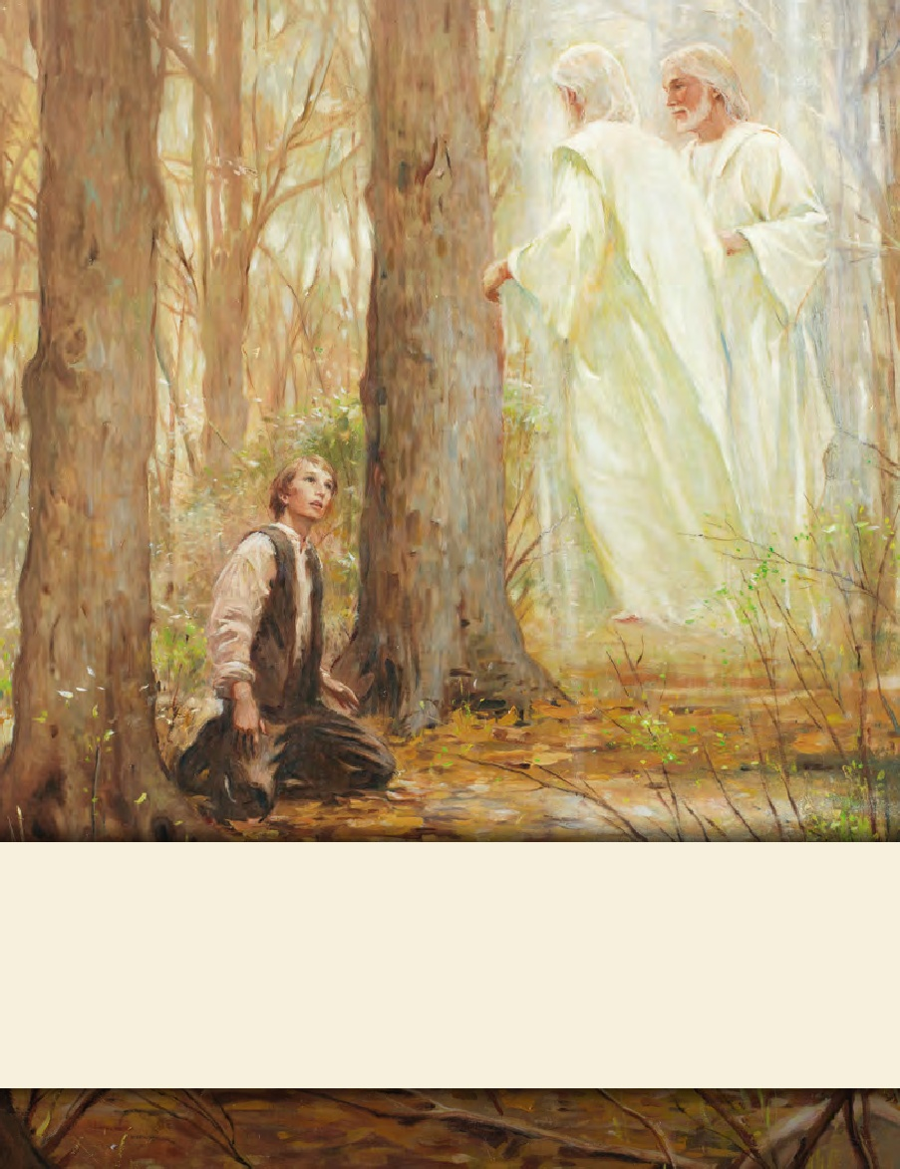
LESSON 15
SEMINARY
Doctrine and Covenants
and Church History

Slide 2
LESSON 137
Doctrine and Covenants 130:12–21

Slide 3
LESSON 137
Doctrine and Covenants 130:12–21
“Joseph Smith teaches about the Second Coming”

Slide 4
LESSON 137
Many have wondered about the exact date of the Second Coming.
Have you ever wanted to know exactly when the Second Coming of Jesus Christ will occur?
Doctrine and Covenants 130:14-17.
14 I was once praying very earnestly to know the time of the coming of the Son of Man, when I heard a voice repeat the following:
15 Joseph, my son, if thou livest until thou art eighty-five years old, thou shalt see the face of the Son of Man; therefore let this suffice, and trouble me no more on this matter.
16 I was left thus, without being able to decide whether this coming referred to the beginning of the millennium or to some previous appearing, or whether I should die and thus see his face.
17 I believe the coming of the Son of Man will not be any sooner than that time.
Did the Lord reveal to Joseph Smith the exact date of the Second Coming?
What did the Lord tell Joseph Smith to do?

Slide 5
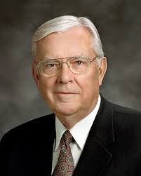
LESSON 137
“I am called as one of the Apostles to be a special witness of Christ, … and I do not know when He is going to come again. As far as I know, none of my brethren in the Quorum of the Twelve or even in the First Presidency knows. And I would humbly suggest that if we do not know, then nobody knows. … The Savior said that ‘of that day, and hour, no one knoweth; no, not the angels of God in heaven, but my Father only’ [Joseph Smith—Matthew 1:40]. “I believe that when the Lord says ‘no one’ knows, He really means that no one knows” (“When Shall These Things Be?” Ensign, Dec. 1996,56).
Elder
M. Russell Ballard
What do we learn from Doctrine and Covenants 130:14–17 and Elder Ballard’s statement?
Only God knows the exact time when the Second Coming will occur.
How can remembering this principle help you to not be misled by false claims?

Slide 6
LESSON 137
Doctrine and Covenants 130:18-19.
“Joseph Smith teaches about the importance of gaining knowledge and intelligence in this life”

Slide 7
LESSON 137
What would you pack in the suitcase?
Which of the items on the board will you be able to take with you when you die?
Doctrine and Covenants 130:18-19.
18 Whatever principle of intelligence we attain unto in this life, it will rise with us in the resurrection.
19 And if a person gains more knowledge and intelligence in this life through his diligence and obedience than another, he will have so much the advantage in the world to come.
What will be with us after we die?
The knowledge and intelligence we gain in this life will rise with us in the resurrection.

Slide 8
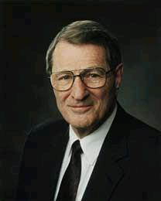
LESSON 137
“If we ponder just what it is that will rise with us in the resurrection, it seems clear that our intelligence will rise with us, meaning not simply our IQ, but also our capacity to receive and apply truth. Our talents, attributes, and skills will rise with us; certainly also our capacity to learn, our degree of self-discipline, and our capacity to work” (We Will Prove Them Herewith[1982],12).
Elder
Neal A Maxwell
What does the word intelligence mean in verses 18–19?
How can we gain greater knowledge and intelligence?
When have you gained knowledge or intelligence through your diligence and obedience?
How do you think obtaining knowledge and intelligence in this life can give us an advantage in the world to come?

Slide 9
LESSON 137
Doctrine and Covenants 130:20-21.
“Joseph Smith explains how we obtain blessings”

Slide 10
LESSON 137
What will the result be? Why?
What would you do to improve your penmanship?
Doctrine and Covenants 130:20-21.
20 There is a law, irrevocably decreed in heaven before the foundations of this world, upon which all blessings are predicated—
21 And when we obtain any blessing from God, it is by obedience to that law upon which it is predicated.
How do we obtain a blessing from God?
If we want to obtain a blessing from God, then we must obey the law upon which it is predicated.

Slide 11
LESSON 137
How do the truths in Doctrine and Covenants 130 help you appreciate Joseph Smith?

Slide 12
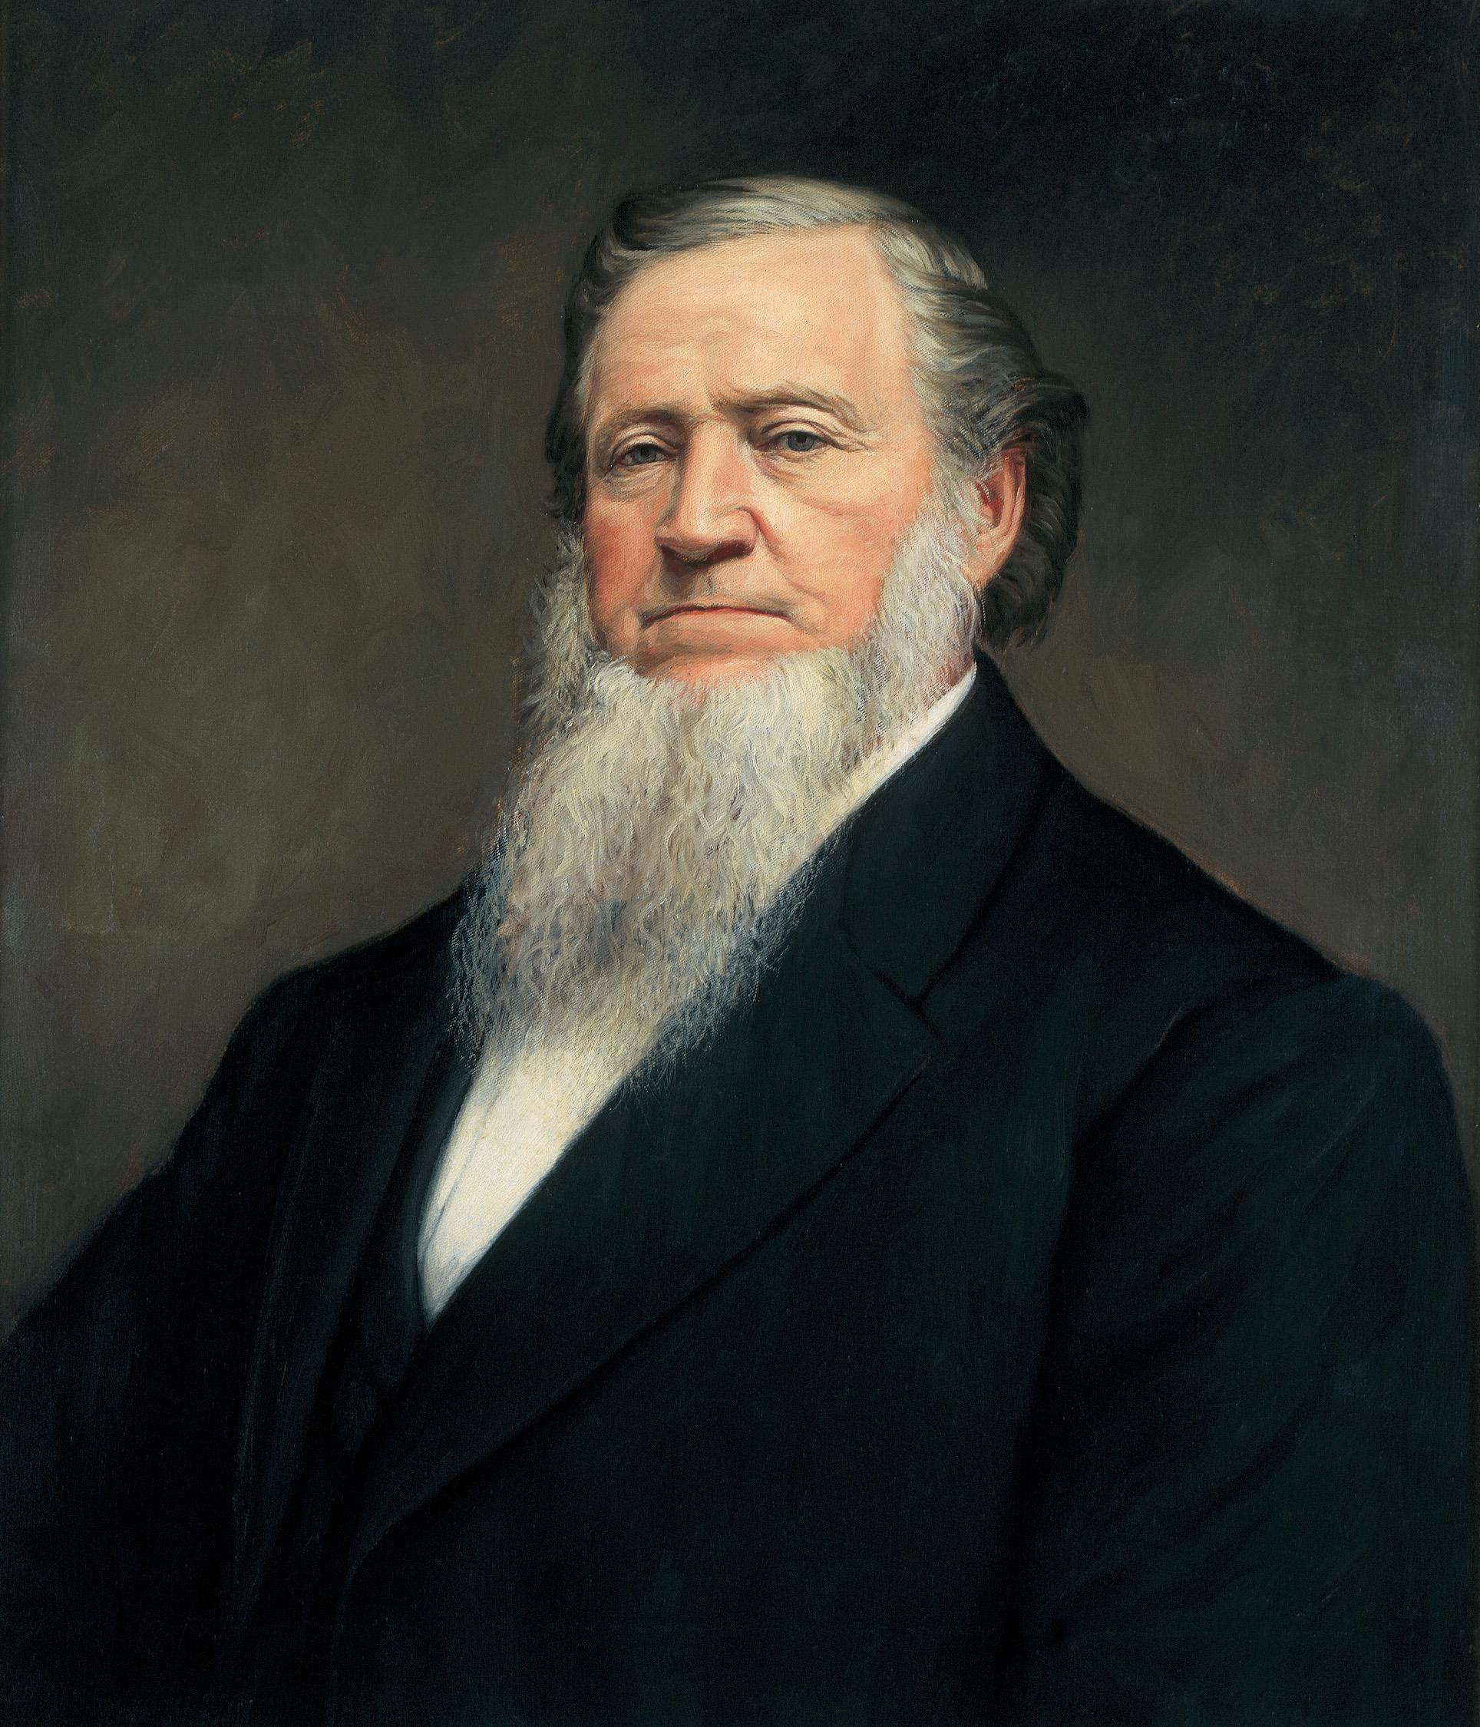
LESSON 137
“The excellency of the glory of the character of Brother Joseph Smith was that he could reduce heavenly things to the understanding of the finite. When he preached to the people—revealed the things of God, the will of God, the plan of salvation, the purposes of Jehovah, the relation in which we stand to him and all the heavenly beings, he reduced his teachings to the capacity of every man, woman, and child, making them as plain as a well-defined pathway. This should have convinced every person that ever heard him of his
President
Brigham Young
divine authority and power, for no other man was able to teach as he could, and no person can reveal the things of God, but by the revelations of Jesus Christ” (Teachings of Presidents of the Church: Brigham Young[1997],347).

