Slide 1
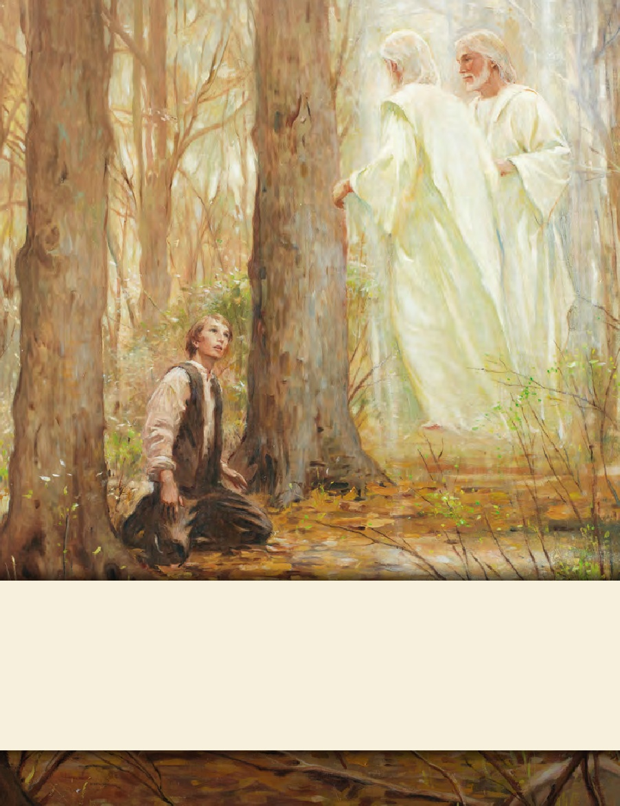
LESSON 15
SEMINARY
Doctrine and Covenants
and Church History

Slide 2
LESSON 97
Doctrine and Covenants 93:1-20.

Slide 3
LESSON 97
Doctrine and Covenants 93:1-5.
“Jesus Christ teaches how individuals can see
His face and know that He exists”

Slide 4
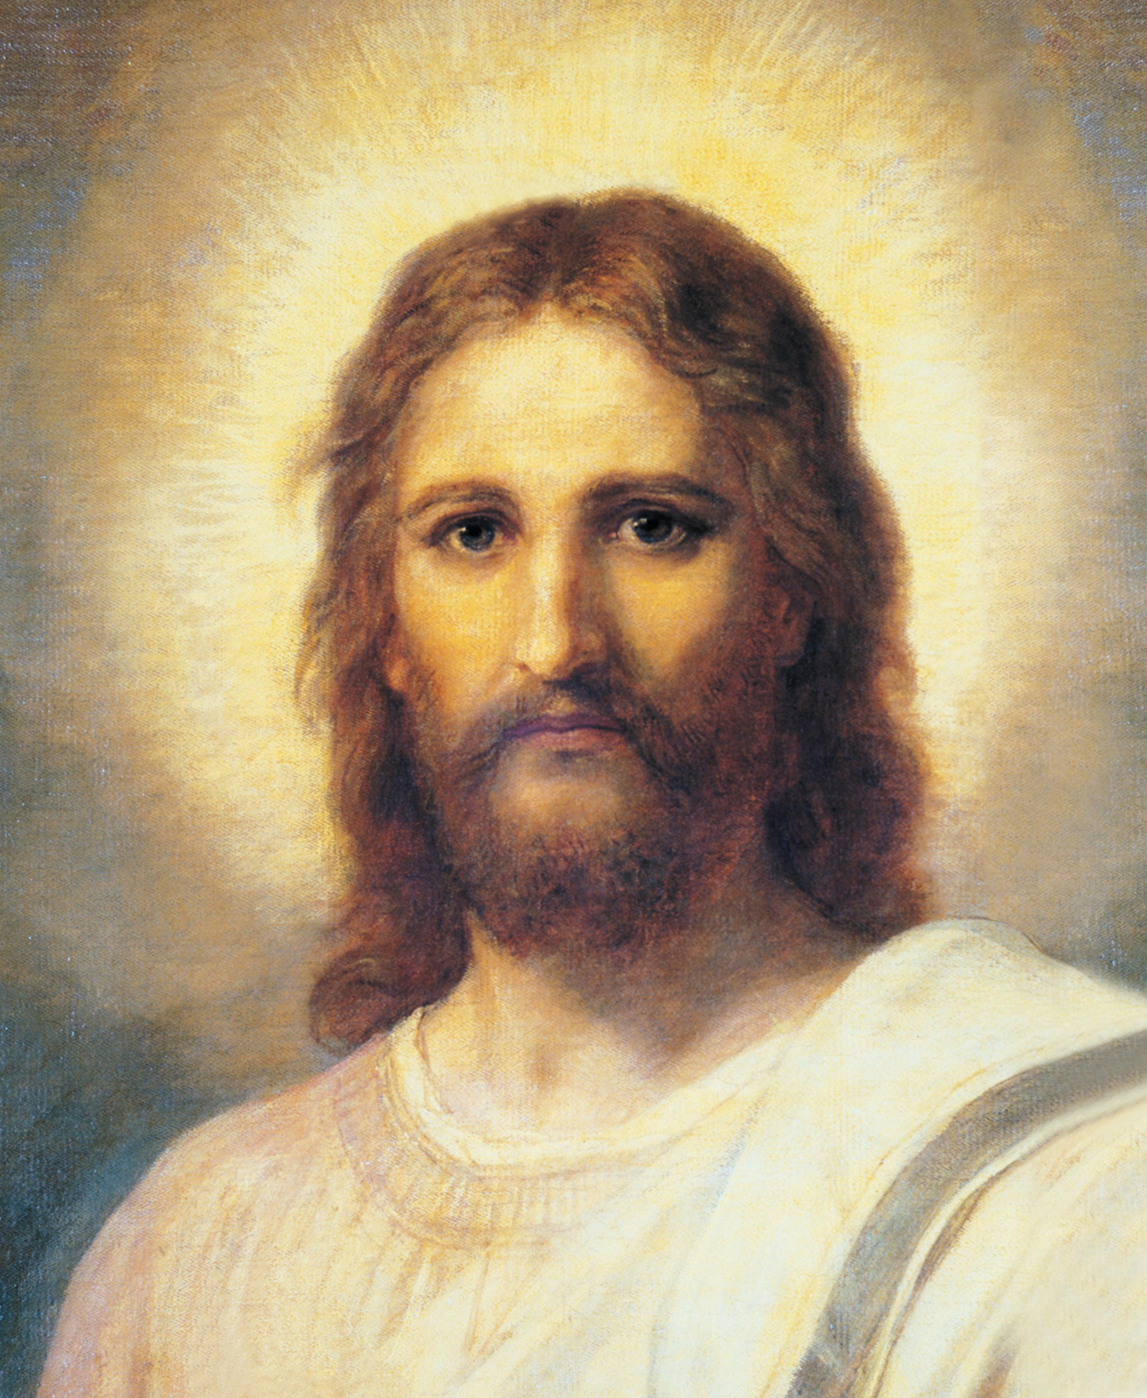
LESSON 97
Why do so many people know who this person is?
Do you think it is important to know who this person is? Why?
Why do you think it is important to know who Jesus Christ is?
What must we do to gain a testimony of Jesus Christ?
What can we know about Him if we do these things?

Slide 5
LESSON 97
Doctrine and Covenants 93:1-5.
1 Verily, thus saith the Lord: It shall come to pass that every soul who forsaketh his sins and cometh unto me, and calleth on my name, and obeyeth my voice, and keepeth my commandments, shall see my face and know that I am;
2 And that I am the true light that lighteth every man that cometh into the world;
3 And that I am in the Father, and the Father in me, and the Father and I are one—
4 The Father because he gave me of his fulness, and the Son because I was in the world and made flesh my tabernacle, and dwelt among the sons of men.
5 I was in the world and received of my Father, and the works of him were plainly manifest.
How would you state the promise in verse 1 as an “if–then” principle?
If we forsake our sins, come unto Christ, call on His name, obey His voice, and keep His commandments, then we shall see His face and know that He is.
How can each of the actions in Doctrine and Covenants 93:1 help us know Jesus Christ?
What is an important doctrine to understand about the Father and the Son?
The Father and the Son are one.
What does it mean that the Father and the Son are one?

Slide 6
LESSON 97
Doctrine and Covenants 93:17,26.
17 And he received all power, both in heaven and on earth, and the glory of the Father was with him, for he dwelt in him.
26 The Spirit of truth is of God. I am the Spirit of truth, and John bore record of me, saying: He received a fulness of truth, yea, even of all truth;
What does it mean that Jesus Christ received a fulness of the Father?
How do the truths in verses 4–5 help us further understand what it means that the Father and the Son are one?

Slide 7
LESSON 97
Doctrine and Covenants 93:6-20.
“John’s record is used to help us understand how Jesus Christ received a fulness of Heavenly Father’s glory”

Slide 8
LESSON 97
Doctrine and Covenants 93:6-11.
6 And John saw and bore record of the fulness of my glory, and the fulness of John’s record is hereafter to be revealed.
7 And he bore record, saying: I saw his glory, that he was in the beginning, before the world was;
8 Therefore, in the beginning the Word was, for he was the Word, even the messenger of salvation—
9 The light and the Redeemer of the world; the Spirit of truth, who came into the world, because the world was made by him, and in him was the life of men and the light of men.
10 The worlds were made by him; men were made by him; all things were made by him, and through him, and of him.
11 And I, John, bear record that I beheld his glory, as the glory of the Only Begotten of the Father, full of grace and truth, even the Spirit of truth, which came and dwelt in the flesh, and dwelt among us.

Slide 9
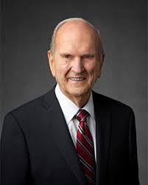
LESSON 97
How does this information help you to better know, appreciate, and follow Jesus Christ?
“The Word, even the messenger of salvation”
“In the Greek language of the New Testament, that Word was Logos, or ‘expression.’ … That terminology may seem strange, but it is appropriate. We use words to convey our expression to others. So Jesus was the Word, or expression, of His Father to the world” (“Jesus the Christ: Our Master and More,” Ensign, Apr. 2000, 4). Jesus Christ is called the messenger of salvation because He declares the Father’s words to us, and those who hear and obey His message will receive salvation (seeJohn 12:49–50).
President
Russell M. Nelson

Slide 10
LESSON 97
“The light and the Redeemer of the world”
Through the Light of Christ, Jesus Christ gives life and light to all things. He is also called the Light of the World because He provides the perfect example of how all people should live. Jesus Christ is the Redeemer of the world because through His Atonement He paid the price for the sins of all mankind and made possible the resurrection of all people.
“The Spirit of truth”
The title “the Spirit of truth” helps us understand that Jesus Christ does not lie and that He possesses a fulness of truth (see Enos 1:6;D&C 93:26). He reveals truth to mankind (seeD&C 76:7–8). This title is also used to refer to the Holy Ghost, who testifies of Jesus Christ (see John 15:26).

Slide 11
LESSON 97
“The Only Begotten of the Father”
Jesus Christ is the greatest being to be born on this earth. God is the Father of the spirits of all mankind, but Jesus Christ is the only person who was born into the world as the literal Son of God in the flesh. Because Jesus Christ was born of an immortal father, He had power over death (see John 5:26). This power allowed Him to accomplish the Atonement and Resurrection for all mankind.

Slide 12
LESSON 97
Doctrine and Covenants 93:12–17.
12 And I, John, saw that he received not of the fulness at the first, but received grace for grace;
13 And he received not of the fulness at first, but continued from grace to grace, until he received a fulness;
14 And thus he was called the Son of God, because he received not of the fulness at the first.
15 And I, John, bear record, and lo, the heavens were opened, and the Holy Ghost descended upon him in the form of a dove, and sat upon him, and there came a voice out of heaven saying: This is my beloved Son.
16 And I, John, bear record that he received a fulness of the glory of the Father;
17 And he received all power, both in heaven and on earth, and the glory of the Father was with him, for he dwelt in him.
How did Jesus Christ become like His Father?
Jesus Christ grew from grace to grace until He received a fulness of the glory of the Father.
What do you think it means that Jesus Christ continued from grace to grace until He received a fulness?

Slide 13
LESSON 97
Doctrine and Covenants 93:19-20.
19 I give unto you these sayings that you may understand and know how to worship, and know what you worship, that you may come unto the Father in my name, and in due time receive of his fulness.
20 For if you keep my commandments you shall receive of his fulness, and be glorified in me as I am in the Father; therefore, I say unto you, you shall receive grace for grace.
Why did the Savior reveal how He received the fulness of the Father?
“Perfect worship is emulation. We honor those whom we imitate” (Elder Bruce R. McConkie).
What do you think it means to worship?
How are we to worship Heavenly Father?
We are to worship Heavenly Father by following the example of Jesus Christ.
How was the Savior’s progression from grace to grace similar to the process of learning and progressing that we can experience?

Slide 14
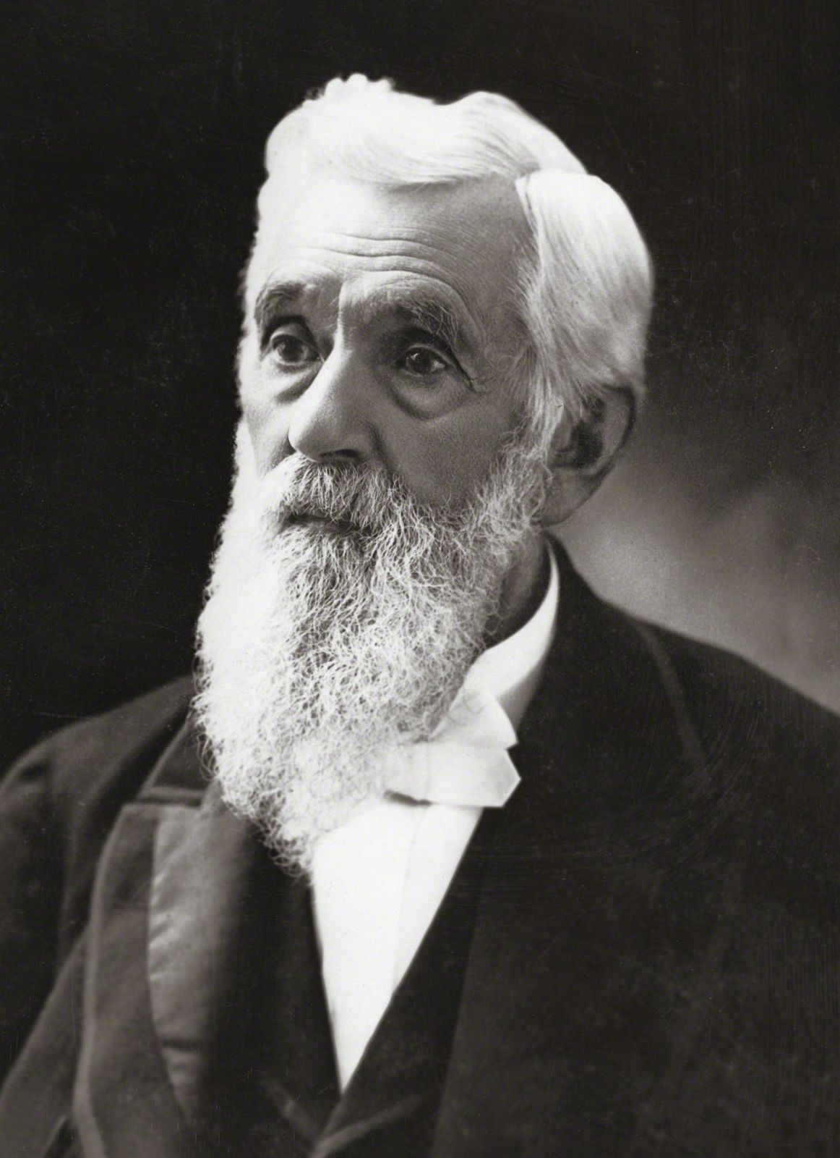
LESSON 97
What promise is given in Doctrine and Covenants 93:20 to those who follow Jesus Christ’s example and keep His commandments?
Why is it important to have a testimony of Jesus Christ’s example, teachings, and Atonement?
What can you do to continue “from grace to grace” (D&C 93:13) and be more like Him?
“Do not expect to become perfect at once. If you do, you will be disappointed. Be better today than you were yesterday, and be better tomorrow than you are today. The temptations that perhaps partially overcome us today, let them not overcome us so far tomorrow. Thus continue to be a little better day by day; and do not let your life wear away without accomplishing good to others as well as to ourselves” (Teachings of Presidents of the Church: Lorenzo Snow[2012],103).
President
Lorenzo Snow

