Slide 1
LESSON 15
SEMINARY
Doctrine and Covenants
and Church History

Slide 2
LESSON 92
Doctrine and Covenants 88:41-69.

Slide 3
LESSON 92
Doctrine and Covenants 88:41-50.
“The Savior reveals that all things
are governed by divine law”

Slide 4
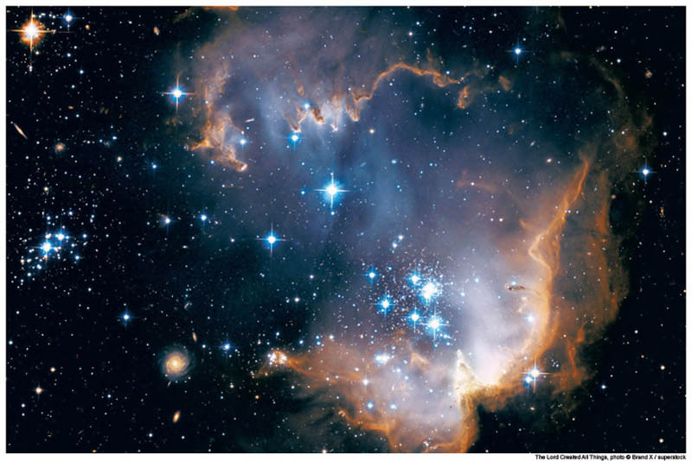
LESSON 92
Have you ever looked at the stars and thought about God and His creations?
What questions or thoughts have you pondered as you have gazed at the sky?
Doctrine and Covenants 88:41
He comprehendeth all things, and all things are before him, and all things are round about him; and he is above all things, and in all things, and is through all things, and is round about all things; and all things are by him, and of him, even God, forever and ever.
How does this verse show that God has the power to be aware of each of us and our needs?

Slide 5
LESSON 92
Doctrine and Covenants 88:42-45.
42 And again, verily I say unto you, he hath given a law unto all things, by which they move in their times and their seasons;
43 And their courses are fixed, even the courses of the heavens and the earth, which comprehend the earth and all the planets.
44 And they give light to each other in their times and in their seasons, in their minutes, in their hours, in their days, in their weeks, in their months, in their years—all these are one year with God, but not with man.
45 The earth rolls upon her wings, and the sun giveth his light by day, and the moon giveth her light by night, and the stars also give their light, as they roll upon their wings in their glory, in the midst of the power of God.
How does God govern His creations?
By His laws.

Slide 6
LESSON 92
Doctrine and Covenants 88:46-47.
46 Unto what shall I liken these kingdoms, that ye may understand?
47 Behold, all these are kingdoms, and any man who hath seen any or the least of these hath seen God moving in his majesty and power.
What are we seeing when we view even the least of God’s creations?
When we view God’s creations, we see His majesty and power.
How do the creations you see in the heavens and on the earth influence your testimony of God?
Doctrine and Covenants 88:48-50.
48 I say unto you, he hath seen him; nevertheless, he who came unto his own was not comprehended.
49 The light shineth in darkness, and the darkness comprehendeth it not; nevertheless, the day shall come when you shall comprehend even God, being quickened in him and by him.
50 Then shall ye know that ye have seen me, that I am, and that I am the true light that is in you, and that you are in me; otherwise ye could not abound.

Slide 7
LESSON 92
Doctrine and Covenants 88:51–61.
“The Lord tells a parable of men laboring in a field and being visited in turn by their master”

Slide 8
LESSON 92
Doctrine and Covenants 88:51-55.
51 Behold, I will liken these kingdoms unto a man having a field, and he sent forth his servants into the field to dig in the field.
52 And he said unto the first: Go ye and labor in the field, and in the first hour I will come unto you, and ye shall behold the joy of my countenance.
53 And he said unto the second: Go ye also into the field, and in the second hour I will visit you with the joy of my countenance.
54 And also unto the third, saying: I will visit you;
55 And unto the fourth, and so on unto the twelfth.
What did the man command his servants to do?
What did he promise his servants?
He commanded them to work in his field. He promised that he would visit them each in turn.

Slide 9
LESSON 92
Doctrine and Covenants 88:61.
Therefore, unto this parable I will liken all these kingdoms, and the inhabitants thereof—every kingdom in its hour, and in its time, and in its season, even according to the decree which God hath made.
What does this parable teach about how God interacts with the kingdoms He has created?
God will visit each of His kingdoms and their inhabitants in His time.

Slide 10
LESSON 92
Doctrine and Covenants 88:62-69.
“God promises to draw near to us as
we draw near to Him”

Slide 11
LESSON 92
How close do you feel to the Lord? Would you like to feel closer to Him?
Doctrine and Covenants 88:62–63.
62 And again, verily I say unto you, my friends, I leave these sayings with you to ponder in your hearts, with this commandment which I give unto you, that ye shall call upon me while I am near—
63 Draw near unto me and I will draw near unto you; seek me diligently and ye shall find me; ask, and ye shall receive; knock, and it shall be opened unto you.
What principle do these verses teach about drawing near to the Lord?
If we draw near to the Lord, then He will draw near to us.
What words in verse 63 teach about how we can draw near to the Lord?
Seek, ask, and knock.
What are some actions that have helped you seek, ask, and knock in order to draw nearer to the Lord?

Slide 12
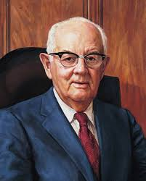
LESSON 92
“I find that when I get casual in my relationships with divinity and when it seems that no divine ear is listening and no divine voice is speaking, that I am far, far away. If I immerse myself in the scriptures the distance narrows and the spirituality returns” (Teachings of Presidents of the Church: Spencer W. Kimball [2006],67).
President
Spencer W. Kimball
Doctrine and Covenants 88:64-65.
64 Whatsoever ye ask the Father in my name it shall be given unto you, that is expedient for you;
65 And if ye ask anything that is not expedient for you, it shall turn unto your condemnation.
What does the Savior teach about how Heavenly Father answers our prayers?
Heavenly Father answers our prayers in the ways that He knows are best for us.

Slide 13
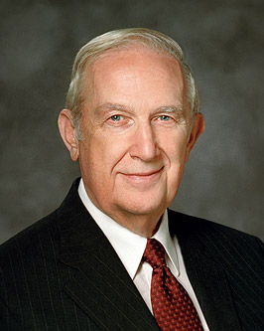
LESSON 92
“It is so hard when sincere prayer about something you desire very much is not answered the way you want. It is difficult to understand why your exercise of deep and sincere faith from an obedient life does not grant the desired result. … At times it is difficult to recognize what is best or expedient for you over time. Your life will be easier when you accept that what God does in your life is for your eternal good” (“Using the Supernal Gift of Prayer,” Ensign or Liahona, May 2007,9).
Elder
Richard G. Scott
How is the voice of God like “the voice of one crying in the wilderness”?
When have you felt that God has been near to you even though you have not seen Him?

Slide 14
LESSON 92
Doctrine and Covenants 88:67-69.
67 And if your eye be single to my glory, your whole bodies shall be filled with light, and there shall be no darkness in you; and that body which is filled with light comprehendeth all things.
68 Therefore, sanctify yourselves that your minds become single to God, and the days will come that you shall see him; for he will unveil his face unto you, and it shall be in his own time, and in his own way, and according to his own will.
69 Remember the great and last promise which I have made unto you; cast away your idle thoughts and your excess of laughter far from you.
then I will be filled with light
If my eye is single to God’s glory, ________________________.
What do you think it means for your eye to “be single to [the Lord’s] glory”?
In what ways do you see this light in them?
What do we need to do for our minds to be single to God?

Slide 15
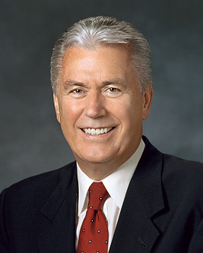
LESSON 92
“My dear brothers and sisters, … at times we may … feel insignificant, invisible, alone, or forgotten. But always remember—you matter to Him!… “God sees you not only as a mortal being on a small planet who lives for a brief season—He sees you as His child. He sees you as the being you are capable and designed to become. He wants you to know that you matter to Him” (“You Matter to Him,” Ensign or Liahona, Nov. 2011,22).
Elder
Dieter F. Uchtdorf

