Slide 1
LESSON 15
SEMINARY
Doctrine and Covenants
and Church History

Slide 2
LESSON 91
Doctrine and Covenants 88:1-40.

Slide 3
LESSON 91
Doctrine and Covenants 88:1–13.
“The Lord declares that He is the light
that is in all things”

Slide 4
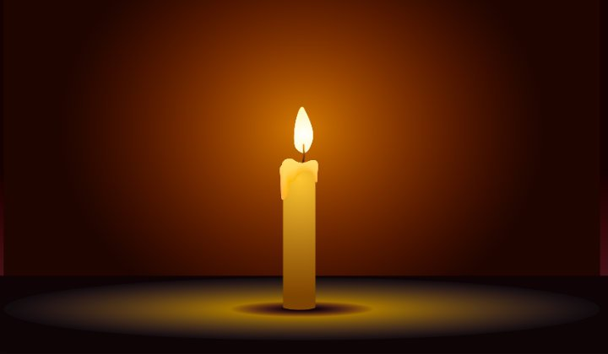
LESSON 91
How would being in complete darkness help you appreciate the blessing of light?
What does light represent in the gospel of Jesus Christ?

Slide 5
LESSON 91
Doctrine and Covenants 88:1–2.
1 Verily, thus saith the Lord unto you who have assembled yourselves together to receive his will concerning you:
2 Behold, this is pleasing unto your Lord, and the angels rejoice over you; the alms of your prayers have come up into the ears of the Lord of Sabaoth, and are recorded in the book of the names of the sanctified, even them of the celestial world.
Why do you think the Lord is pleased and the angels rejoice when we pray to know the Lord’s will?
How is knowing God’s will like a light to those who seek it?

Slide 6
LESSON 91
Doctrine and Covenants 88:6–13.
6 He that ascended up on high, as also he descended below all things, in that he comprehended all things, that he might be in all and through all things, the light of truth;
7 Which truth shineth. This is the light of Christ. As also he is in the sun, and the light of the sun, and the power thereof by which it was made.
8 As also he is in the moon, and is the light of the moon, and the power thereof by which it was made;
9 As also the light of the stars, and the power thereof by which they were made;
10 And the earth also, and the power thereof, even the earth upon which you stand.
11 And the light which shineth, which giveth you light, is through him who enlighteneth your eyes, which is the same light that quickeneth your understandings;
12 Which light proceedeth forth from the presence of God to fill the immensity of space—
13 The light which is in all things, which giveth life to all things, which is the law by which all things are governed, even the power of God who sitteth upon his throne, who is in the bosom of eternity, who is in the midst of all things.
What term is used to refer to the light of truth?
Where does all light come from?
How does God influence His creations through the Light of Christ?
Through the Light of Christ, God gives light and life to all His creations.

Slide 7
LESSON 91
Physical light Understanding Life Law
How can the truths we’ve discussed about the Light of Christ help you appreciate the Lord’s influence in your life?

Slide 8
LESSON 91
Doctrine and Covenants 88:14–40.
“The Lord explains that there are laws associated with the kingdoms of glory”

Slide 9
LESSON 91
What could the hand represent?
A spirit body.
Doctrine and Covenants 88:15.
And the spirit and the body are the soul of man.
What did the Lord call the combination of the spirit and the body?
The spirit and the body are the soul of man.
How can the things that affect our physical bodies also affect our spirits?

Slide 10
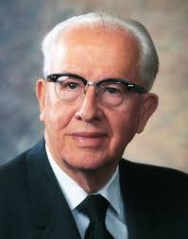
LESSON 91
“There is no question that the health of the body affects the spirit, or the Lord would never have revealed the Word of Wisdom. God has never given any temporal commandments—that which affects our bodies also affects our [spirits].…
“…Sin debilitates. It affects not only the [spirit], but the body. The scriptures are replete with examples of the physical power that can attend the righteous. On the other hand, unrepented sin can diffuse energy and lead to both mental and physical sickness” (“In His Steps,” Ensign, Sep. 1988,5).
President
Ezra Taft Benson
How can understanding the connection between your body and your spirit help you make righteous decisions?
What could this action represent?
Physical death.
What happens to the soul at death?
The spirit and the body are separated.
What could this action represent?
Resurrection.
What happens to the soul at resurrection?
The spirit and the body are reunited.

Slide 11
LESSON 91
Doctrine and Covenants 88:14, 16-17.
14 Now, verily I say unto you, that through the redemption which is made for you is brought to pass the resurrection from the dead.
16 And the resurrection from the dead is the redemption of the soul.
17 And the redemption of the soul is through him that quickeneth all things, in whose bosom it is decreed that the poor and the meek of the earth shall inherit it.
Who made it possible for our souls to be redeemed?
Jesus Christ made it possible for our souls to be redeemed.
What will the “poor and the meek” souls inherit?
The earth.
Doctrine and Covenants 88:18-20.
18 Therefore, it must needs be sanctified from all unrighteousness, that it may be prepared for the celestial glory;
19 For after it hath filled the measure of its creation, it shall be crowned with glory, even with the presence of God the Father;
20 That bodies who are of the celestial kingdom may possess it forever and ever; for, for this intent was it made and created, and for this intent are they sanctified.

Slide 12
LESSON 91
What will happen to the earth before redeemed souls can inherit it?
Whose presence will be found on the sanctified earth?
Who will qualify to live in the celestial kingdom and enjoy the presence of Heavenly Father?
Doctrine and Covenants 88:21–24.
21 And they who are not sanctified through the law which I have given unto you, even the law of Christ, must inherit another kingdom, even that of a terrestrial kingdom, or that of a telestial kingdom.
22 For he who is not able to abide the law of a celestial kingdom cannot abide a celestial glory.
23 And he who cannot abide the law of a terrestrial kingdom cannot abide a terrestrial glory.
24 And he who cannot abide the law of a telestial kingdom cannot abide a telestial glory; therefore he is not meet for a kingdom of glory. Therefore he must abide a kingdom which is not a kingdom of glory.
What determines the degree of glory a person receives in the Resurrection?
In the Resurrection we will receive glory according to the law we obey.

Slide 13
LESSON 91
Doctrine and Covenants 88:25–33.
25 And again, verily I say unto you, the earth abideth the law of a celestial kingdom, for it filleth the measure of its creation, and transgresseth not the law—
26 Wherefore, it shall be sanctified; yea, notwithstanding it shall die, it shall be quickened again, and shall abide the power by which it is quickened, and the righteous shall inherit it.
27 For notwithstanding they die, they also shall rise again, a spiritual body.
28 They who are of a celestial spirit shall receive the same body which was a natural body; even ye shall receive your bodies, and your glory shall be that glory by which your bodies are quickened.
29 Ye who are quickened by a portion of the celestial glory shall then receive of the same, even a fulness.
30 And they who are quickened by a portion of the terrestrial glory shall then receive of the same, even a fulness.
31 And also they who are quickened by a portion of the telestial glory shall then receive of the same, even a fulness.
32 And they who remain shall also be quickened; nevertheless, they shall return again to their own place, to enjoy that which they are willing to receive, because they were not willing to enjoy that which they might have received.
33 For what doth it profit a man if a gift is bestowed upon him, and he receive not the gift? Behold, he rejoices not in that which is given unto him, neither rejoices in him who is the giver of the gift.
What did you find that supports the truth that in the Resurrection we will receive glory according to the law we obey?
What do you think it means to be “of a celestial spirit”?
How does the Lord describe the resurrected bodies of those who receive celestial glory?
What type of body will he or she receive in the Resurrection?

Slide 14
LESSON 91
Discuss the following questions together: What are some benefits to obeying traffic laws? What are some consequences for disobeying traffic laws?
2. Read Doctrine and Covenants 88:34–35, and look for the consequences of living and refusing to live the laws of God. Discuss what you find.
3. Doctrine and Covenants 88:40describes qualities of people who will be drawn to the celestial kingdom. Study this verse together and identify the qualities. Then discuss what we can do to develop or strengthen these qualities in our lives.

