Slide 1
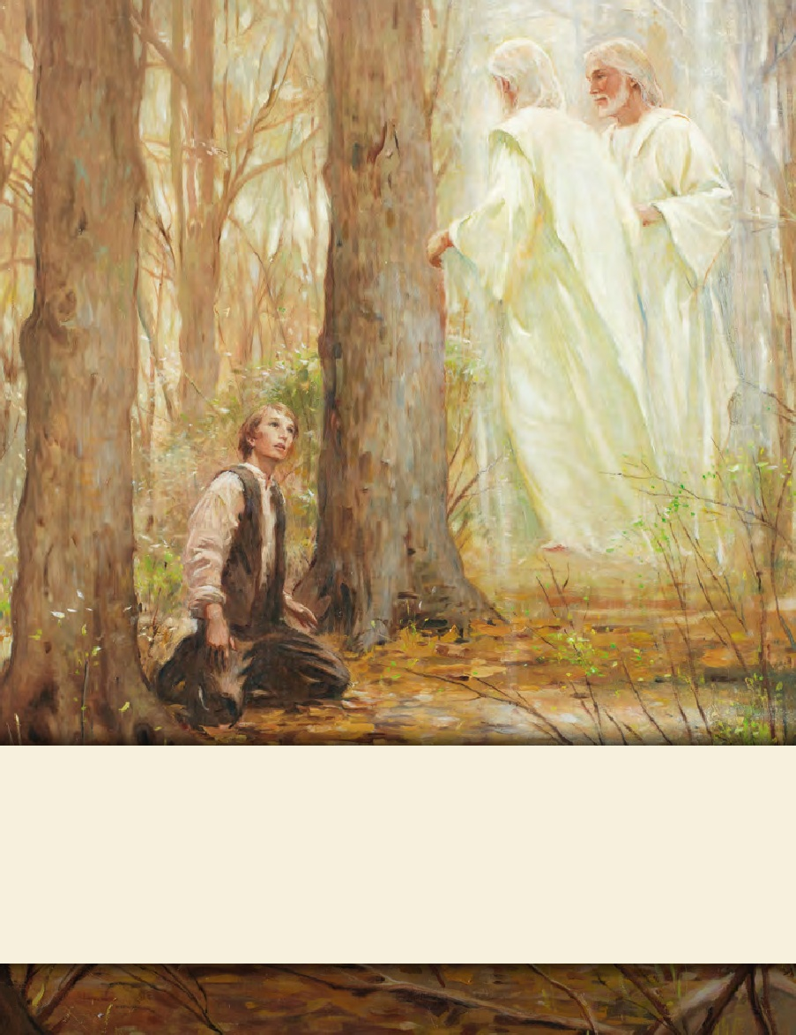
LESSON 15
SEMINARY
Doctrine and Covenants
and Church History

Slide 2
LESSON 90
Doctrine and Covenants 87.

Slide 3
LESSON 90
Doctrine and Covenants 87:1-8
“Through Joseph Smith, the Lord prophesies that
war will be poured out upon all nations”

Slide 4
LESSON 90
What is the difference between a prediction and a prophecy?
A prediction is an opinion about what might happen in the future.
A prophecy is a declaration of a future sign or event as revealed by the Holy Ghost.

Slide 5
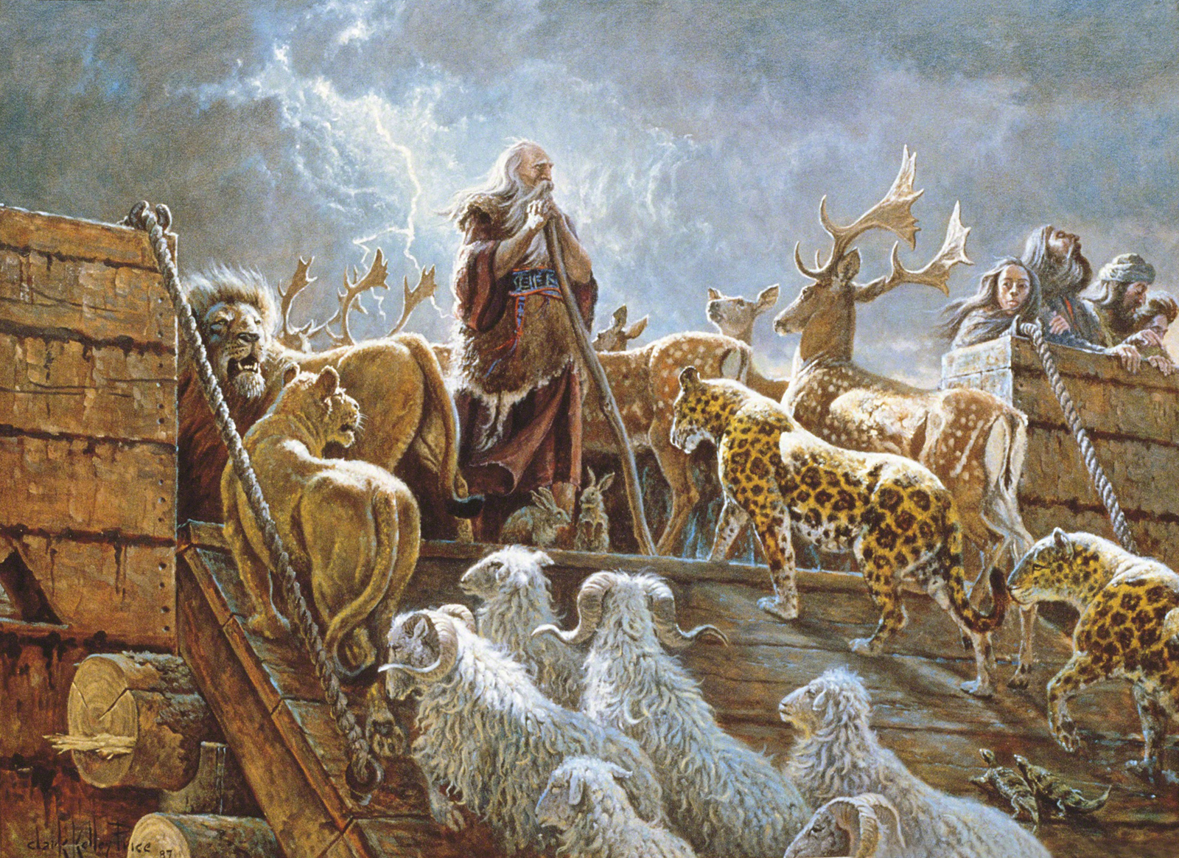
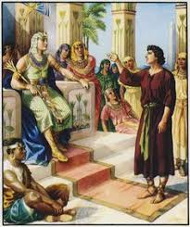
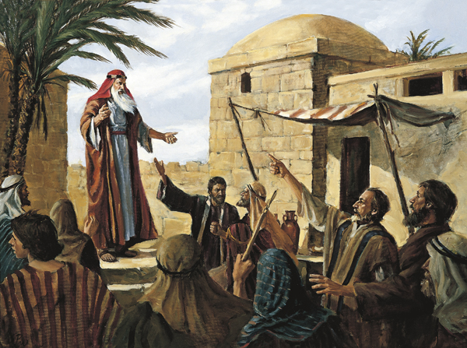
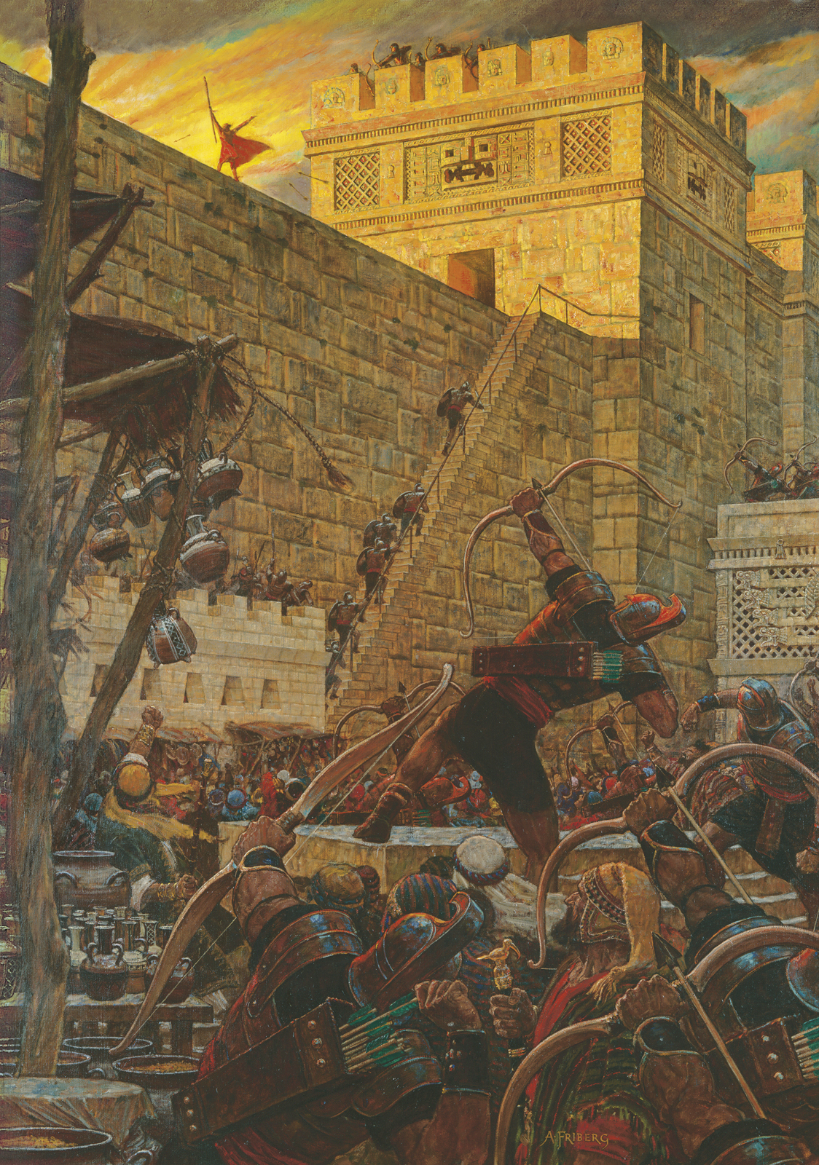
LESSON 90
Noah.
Joseph of Egypt.
Lehi.
Samuel the Lamanite.

Slide 6
LESSON 90
Joseph Smith.
Doctrine and Covenants 87:1-4.
1 Verily, thus saith the Lord concerning the wars that will shortly come to pass, beginning at the rebellion of South Carolina, which will eventually terminate in the death and misery of many souls;
2 And the time will come that war will be poured out upon all nations, beginning at this place.
3 For behold, the Southern States shall be divided against the Northern States, and the Southern States will call on other nations, even the nation of Great Britain, as it is called, and they shall also call upon other nations, in order to defend themselves against other nations; and then war shall be poured out upon all nations.
4 And it shall come to pass, after many days, slaves shall rise up against their masters, who shall be marshaled and disciplined for war.
What did the Lord say would “shortly come to pass”?
What do we learn about the Lord from verses 1–4?
The Lord can reveal the future to us through His prophets.
How can knowing that the Lord reveals the future through prophets be a blessing to the Church?
How can this be a blessing to you and your family?

Slide 7
LESSON 90
Introduction to Doctrine and Covenants 87
Revelation and prophecy on war, given through Joseph Smith the Prophet, at or near Kirtland, Ohio, December 25, 1832. At this time disputes in the United States over slavery and South Carolina’s nullification of federal tariffs were prevalent. Joseph Smith’s history states that “appearances of troubles among the nations” were becoming “more visible” to the Prophet “than they had previously been since the Church began her journey out of the wilderness.”

Slide 8
LESSON 90
Joseph Smith had learned about a political conflict between the state of South Carolina and the federal government of the United States over tariffs. (A tariff is a tax on imports.) Because residents of South Carolina relied more on imported manufactured products than did people in the northern states, they felt that federal tariffs were unfair and that they had been purposely levied at the expense of the South. Government leaders in South Carolina adopted an ordinance invalidating, or nullifying, the federal laws, and many South Carolinians began to prepare for military action against the federal government. The president of the United States asserted that he would maintain the laws of the United States by force. In December 1832, newspapers throughout the United States were reporting on this conflict. It was at this time that Joseph Smith received the revelation in Doctrine and Covenants 87 prophesying that “wars … will shortly come to pass, beginning at the rebellion of South Carolina” (D&C 87:1). In early 1833, not long after this prophecy was given, the United States government peacefully settled the issue with the state of South Carolina. Some may have believed the crisis had passed, but it had been only temporarily halted and South Carolina would still rebel.

Slide 9
LESSON 90
How would you respond if the words of a prophet were not fulfilled in the way you expected?
Doctrine and Covenants 130:12-13.
12 I prophesy, in the name of the Lord God, that the commencement of the difficulties which will cause much bloodshed previous to the coming of the Son of Man will be in South Carolina.
13 It may probably arise through the slave question. This a voice declared to me, while I was praying earnestly on the subject, December 25th, 1832.
What did Joseph Smith reaffirm in this prophecy?
That wars would begin in South Carolina.
Introduction to Doctrine and Covenants 130
Items of instruction given by Joseph Smith the Prophet, at Ramus, Illinois, April 2, 1843.
In what year did Joseph Smith reaffirm the prophecy in section 87?
1843.
What can Joseph Smith’s reaffirmation of the prophecy he had received 10 years earlier teach you about his faith?

Slide 10
LESSON 90
In 1861, Southern warships began firing on United States federal soldiers who were stationed at Fort Sumter, in Charleston Harbor, South Carolina. Other Southern states joined South Carolina in a civil war against the northern states. In time, the Southern states called on Great Britain for aid. Additionally, many who had been slaves in the South joined the army of the North and fought against their former masters. The American Civil War lasted until 1865 and resulted in the death of approximately 620,000 soldiers (some historians estimate as many as 750,000).
What can the fulfillment of the prophecies in Doctrine and Covenants 87 teach us about Joseph Smith?
Joseph Smith is a true prophet of the Lord.

Slide 11
LESSON 90
Doctrine and Covenants 87:6-7.
6 And thus, with the sword and by bloodshed the inhabitants of the earth shall mourn; and with famine, and plague, and earthquake, and the thunder of heaven, and the fierce and vivid lightning also, shall the inhabitants of the earth be made to feel the wrath, and indignation, and chastening hand of an Almighty God, until the consumption decreed hath made a full end of all nations;
7 That the cry of the saints, and of the blood of the saints, shall cease to come up into the ears of the Lord of Sabaoth, from the earth, to be avenged of their enemies.
What events did the Lord say would occur in the last days?
What are some reasons these things will occur?

Slide 12
LESSON 90
Doctrine and Covenants 87:8.
Wherefore, stand ye in holy places, and be not moved, until the day of the Lord come; for behold, it cometh quickly, saith the Lord. Amen.
What does the Lord command us to do?
We are to stand in holy places and be not moved until the Lord comes.
What are some holy places that can provide us with peace and safety?
What do you think it means to stand in holy places and “be not moved” (D&C 87:8)?
How might a person be moved from these holy places?
How have you felt blessed with peace or safety by standing in one of these holy places?
How can you strive to make your heart a holy place?
What are some ways that you can help make your home a holy place?
If the prophet were to see your room, would he view it as a holy place? Do you?

