Slide 1
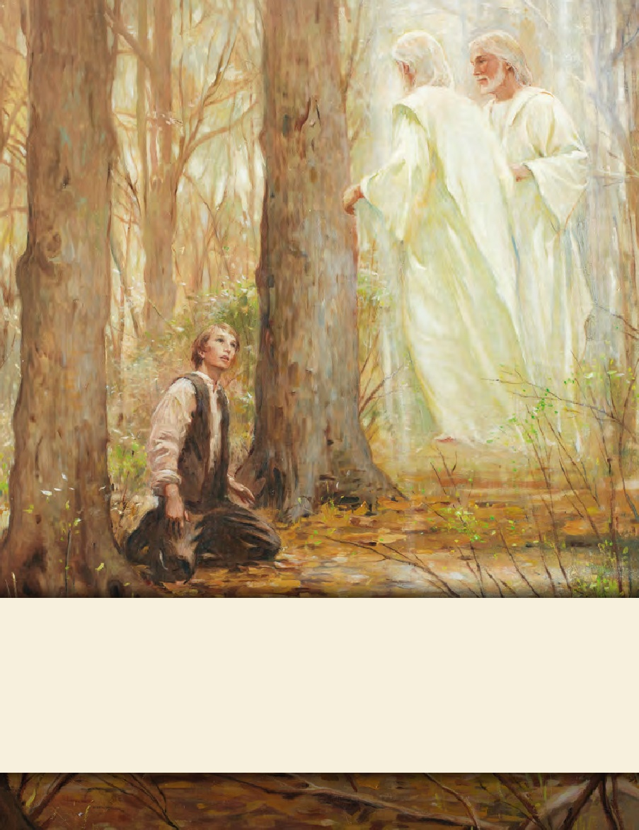
LESSON 15
SEMINARY
Doctrine and Covenants
and Church History

Slide 2
LESSON 89
Doctrine and Covenants 85-86.

Slide 3
LESSON 89
Doctrine and Covenants 85
“The Lord’s clerk is to keep a record
of the people of God”

Slide 4
LESSON 89
Why might it be difficult for this team to win?
What might need to change so this team can play better?
Introduction to Doctrine and Covenants 85
Revelation given through Joseph Smith the Prophet, at Kirtland, Ohio, November 27, 1832. This section is an extract from a letter of the Prophet to William W. Phelps, who was living in Independence, Missouri. It answers questions about those Saints who had moved to Zion but who had not followed the commandment to consecrate their properties and had thus not received their inheritances according to the established order in the Church.
Why might it have been difficult to establish the city of Zion under these circumstances?

Slide 5
LESSON 89
Doctrine and Covenants 85:1-2.
1 It is the duty of the Lord’s clerk, whom he has appointed, to keep a history, and a general church record of all things that transpire in Zion, and of all those who consecrate properties, and receive inheritances legally from the bishop;
2 And also their manner of life, their faith, and works; and also of the apostates who apostatize after receiving their inheritances.
What was the clerk instructed to record?
Doctrine and Covenants 85:3-5.
3 It is contrary to the will and commandment of God that those who receive not their inheritance by consecration, agreeable to his law, which he has given, that he may tithe his people, to prepare them against the day of vengeance and burning, should have their names enrolled with the people of God.
4 Neither is their genealogy to be kept, or to be had where it may be found on any of the records or history of the church.
5 Their names shall not be found, neither the names of the fathers, nor the names of the children written in the book of the law of God, saith the Lord of Hosts.
Which people were not to have their names written in the records of the Church?
What are some things we must do to have our names recorded as faithful members of the Church?

Slide 6
LESSON 89
If we live the laws of God, our names will be written upon the records of the Church as faithful members.
Doctrine and Covenants 85:5, 9, 11.
5 Their names shall not be found, neither the names of the fathers, nor the names of the children written in the book of the law of God, saith the Lord of Hosts.
9 And all they who are not found written in the book of remembrance shall find none inheritance in that day, but they shall be cut asunder, and their portion shall be appointed them among unbelievers, where are wailing and gnashing of teeth.
11 And they who are of the High Priesthood, whose names are not found written in the book of the law, or that are found to have apostatized, or to have been cut off from the church, as well as the lesser priesthood, or the members, in that day shall not find an inheritance among the saints of the Most High;

Slide 7
LESSON 89
Doctrine and Covenants 85:9-11.
9 And all they who are not found written in the book of remembrance shall find none inheritance in that day, but they shall be cut asunder, and their portion shall be appointed them among unbelievers, where are wailing and gnashing of teeth.
10 These things I say not of myself; therefore, as the Lord speaketh, he will also fulfil.
11 And they who are of the High Priesthood, whose names are not found written in the book of the law, or that are found to have apostatized, or to have been cut off from the church, as well as the lesser priesthood, or the members, in that day shall not find an inheritance among the saints of the Most High;
What do you think it means that those whose names are not recorded “shall find none inheritance” with the Saints?
They will not receive the blessings that will be given to the faithful.
What can cause Church members to have their names removed from the book of the law of God?
How would you summarize what you have learned about the importance of having your name recorded as a faithful member of the Church?

Slide 8
LESSON 89
Doctrine and Covenants 86
“The Lord explains the parable
of the wheat and the tares”

Slide 9
LESSON 89
Matthew 13:24–30
24 ¶ Another parable put he forth unto them, saying, The kingdom of heaven is likened unto a man which sowed good seed in his field:
25 But while men slept, his enemy came and sowed tares among the wheat, and went his way.
26 But when the blade was sprung up, and brought forth fruit, then appeared the tares also.
27 So the servants of the householder came and said unto him, Sir, didst not thou sow good seed in thy field? from whence then hath it tares?
28 He said unto them, An enemy hath done this. The servants said unto him, Wilt thou then that we go and gather them up?
29 But he said, Nay; lest while ye gather up the tares, ye root up also the wheat with them.
30 Let both grow together until the harvest: and in the time of harvest I will say to the reapers, Gather ye together first the tares, and bind them in bundles to burn them: but gather the wheat into my barn.
Wheat, tares, the field, sowers of the seed, the enemy.

Slide 10
LESSON 89
What do the wheat and the tares symbolize?
The wheat symbolizes the righteous, and the tares symbolize the wicked.
Why did the man in the parable want to wait to have the tares pulled out?

Slide 11
LESSON 89
Doctrine and Covenants 86:1–6.
1 Verily, thus saith the Lord unto you my servants, concerning the parable of the wheat and of the tares:
2 Behold, verily I say, the field was the world, and the apostles were the sowers of the seed;
3 And after they have fallen asleep the great persecutor of the church, the apostate, the whore, even Babylon, that maketh all nations to drink of her cup, in whose hearts the enemy, even Satan, sitteth to reign—behold he soweth the tares; wherefore, the tares choke the wheat and drive the church into the wilderness.
4 But behold, in the last days, even now while the Lord is beginning to bring forth the word, and the blade is springing up and is yet tender—
5 Behold, verily I say unto you, the angels are crying unto the Lord day and night, who are ready and waiting to be sent forth to reap down the fields;
6 But the Lord saith unto them, pluck not up the tares while the blade is yet tender (for verily your faith is weak), lest you destroy the wheat also.
How would you summarize the meaning of the parable?

Slide 12
LESSON 89
Doctrine and Covenants 86:7.
Therefore, let the wheat and the tares grow together until the harvest is fully ripe; then ye shall first gather out the wheat from among the tares, and after the gathering of the wheat, behold and lo, the tares are bound in bundles, and the field remaineth to be burned.
What do we learn from verse 7 about the order of gathering?
What does this teach about what will happen to the righteous and the wicked in the last days?
The Lord will gather the righteous during the last days and then destroy the wicked at His Second Coming.

Slide 13
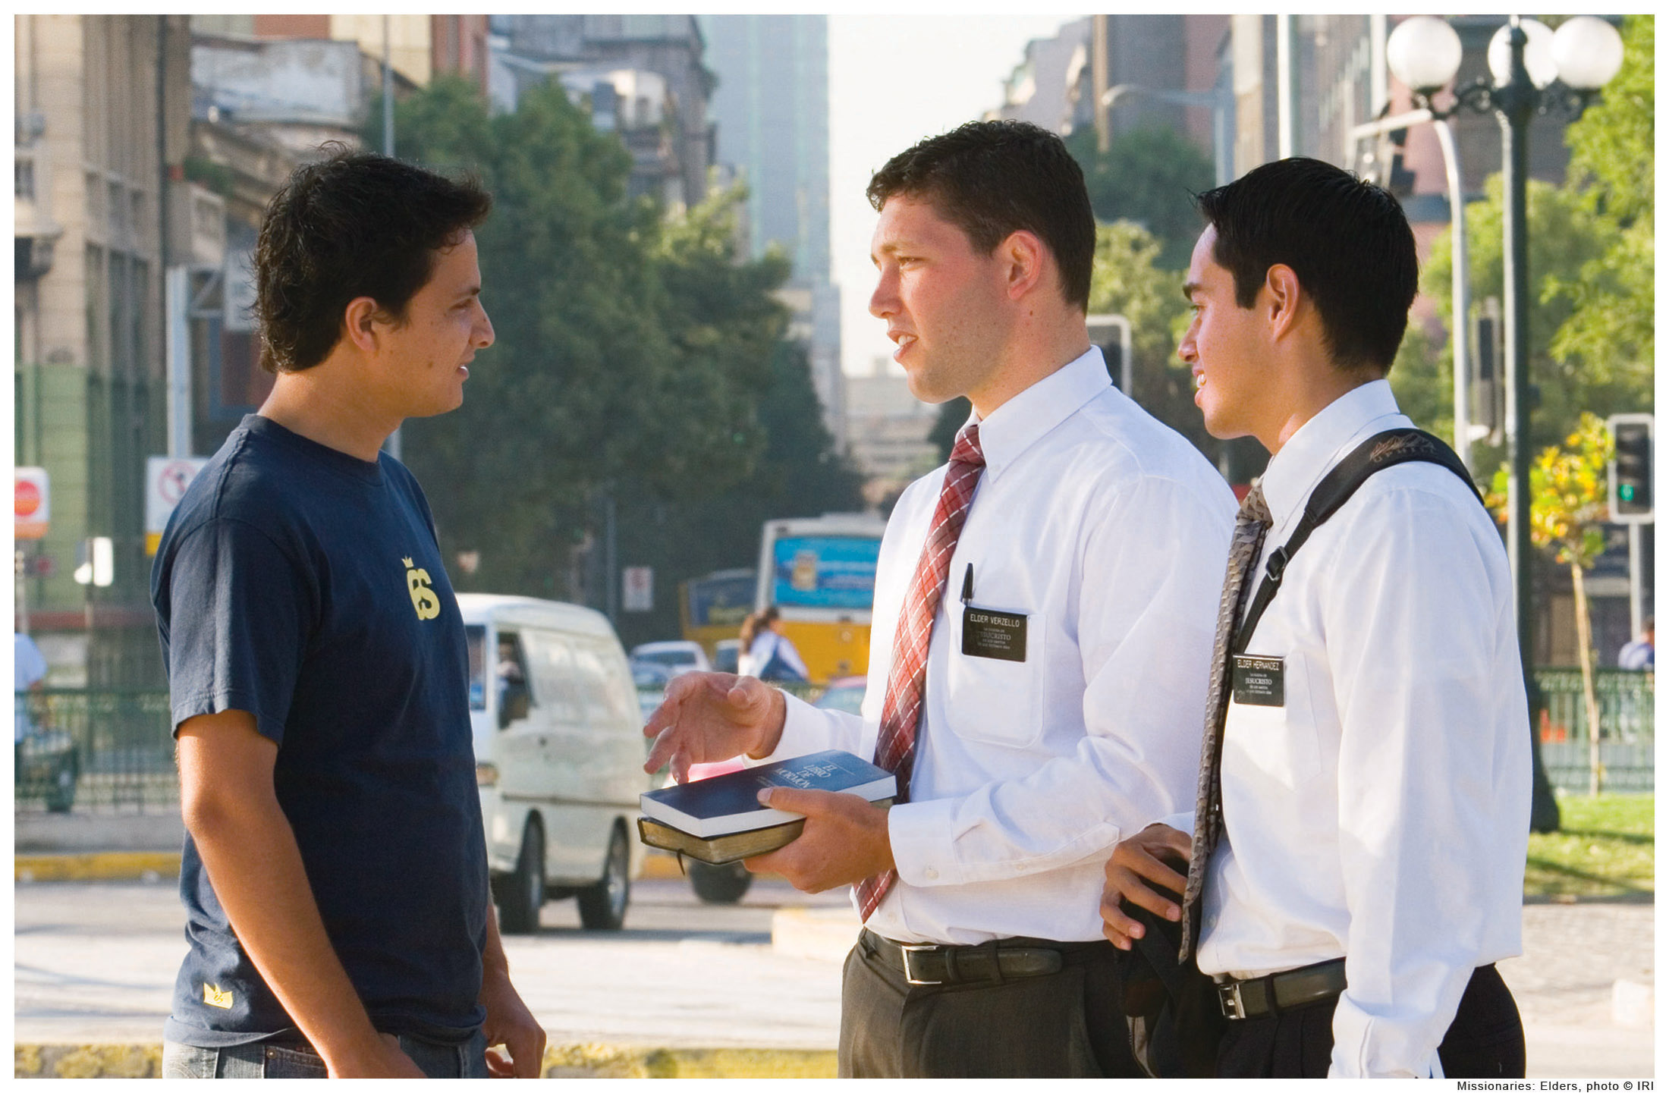
LESSON 89
Doctrine and Covenants 86:8-10.
8 Therefore, thus saith the Lord unto you, with whom the priesthood hath continued through the lineage of your fathers—
9 For ye are lawful heirs, according to the flesh, and have been hid from the world with Christ in God—
10 Therefore your life and the priesthood have remained, and must needs remain through you and your lineage until the restoration of all things spoken by the mouths of all the holy prophets since the world began.
How have you been blessed through the priesthood?
Doctrine and Covenants 86:11.
Therefore, blessed are ye if ye continue in my goodness, a light unto the Gentiles, and through this priesthood, a savior unto my people Israel. The Lord hath said it. Amen.
We can bring salvation to others by helping them receive the blessings of the priesthood.

