Slide 1
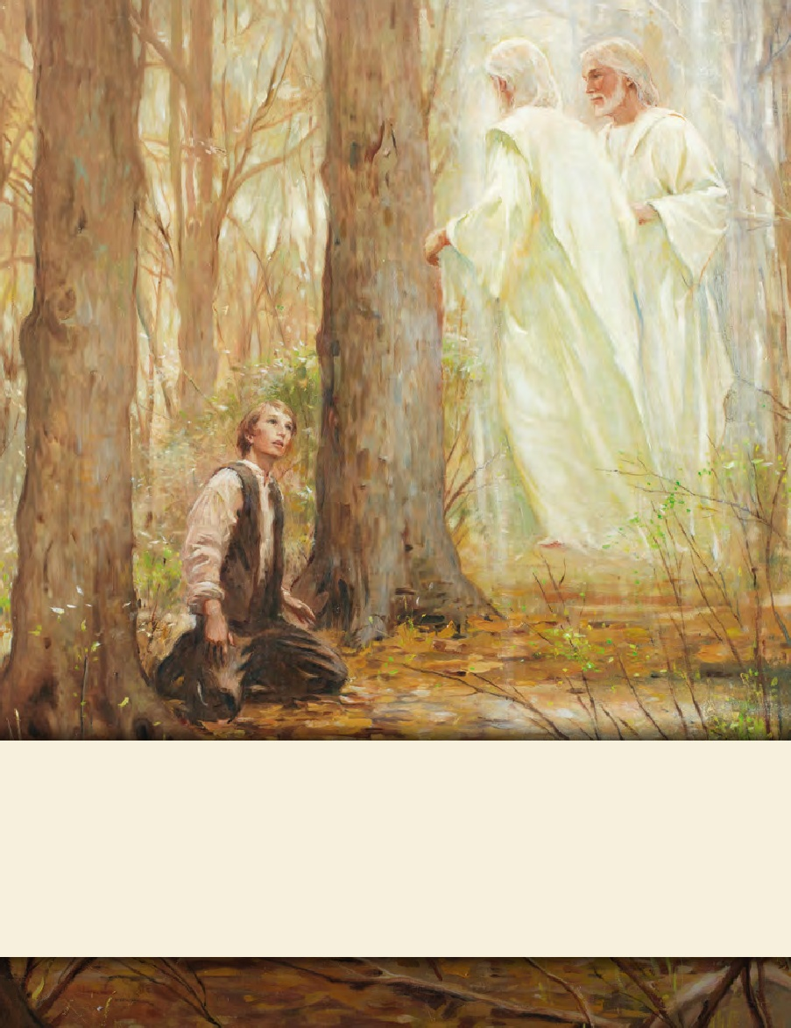
LESSON 15
SEMINARY
Doctrine and Covenants
and Church History

Slide 2
LESSON 84
Doctrine and Covenants 81.

Slide 3
LESSON 84
Doctrine and Covenants 81:1–7
“The Lord describes the role of counselors
in the First Presidency”

Slide 4
LESSON 84
Why does the Lord give us callings in His Church?
What are the blessings of faithfully fulfilling a calling?
What if someone chooses not to faithfully fulfill his or her calling?
Introduction to Doctrine and Covenants 81
Revelation given through Joseph Smith the Prophet, at Hiram, Ohio, March 15, 1832. Frederick G. Williams is called to be a high priest and a counselor in the Presidency of the High Priesthood. The historical records show that when this revelation was received in March 1832, it called Jesse Gause to the office of counselor to Joseph Smith in the Presidency. However, when he failed to continue in a manner consistent with this appointment, the call was subsequently transferred to Frederick G. Williams. The revelation (dated March 1832) should be regarded as a step toward the formal organization of the First Presidency, specifically calling for the office of counselor in that body and explaining the dignity of the appointment. Brother Gause served for a time but was excommunicated from the Church in December 1832. Brother Williams was ordained to the specified office on March 18, 1833.

Slide 5
LESSON 84
Whom did the Lord initially call to serve as a counselor to Joseph Smith in the Presidency of the High Priesthood?
Why did Jesse Gause lose his calling?
Whom did the Lord call to replace Jesse Gause?
Doctrine and Covenants 81:1–2.
1 Verily, verily, I say unto you my servant Frederick G. Williams: Listen to the voice of him who speaketh, to the word of the Lord your God, and hearken to the calling wherewith you are called, even to be a high priest in my church, and a counselor unto my servant Joseph Smith, Jun.;
2 Unto whom I have given the keys of the kingdom, which belong always unto the Presidency of the High Priesthood:
What does the Presidency hold?
The Presidency of the High Priesthood holds the keys of God’s kingdom on the earth.

Slide 6
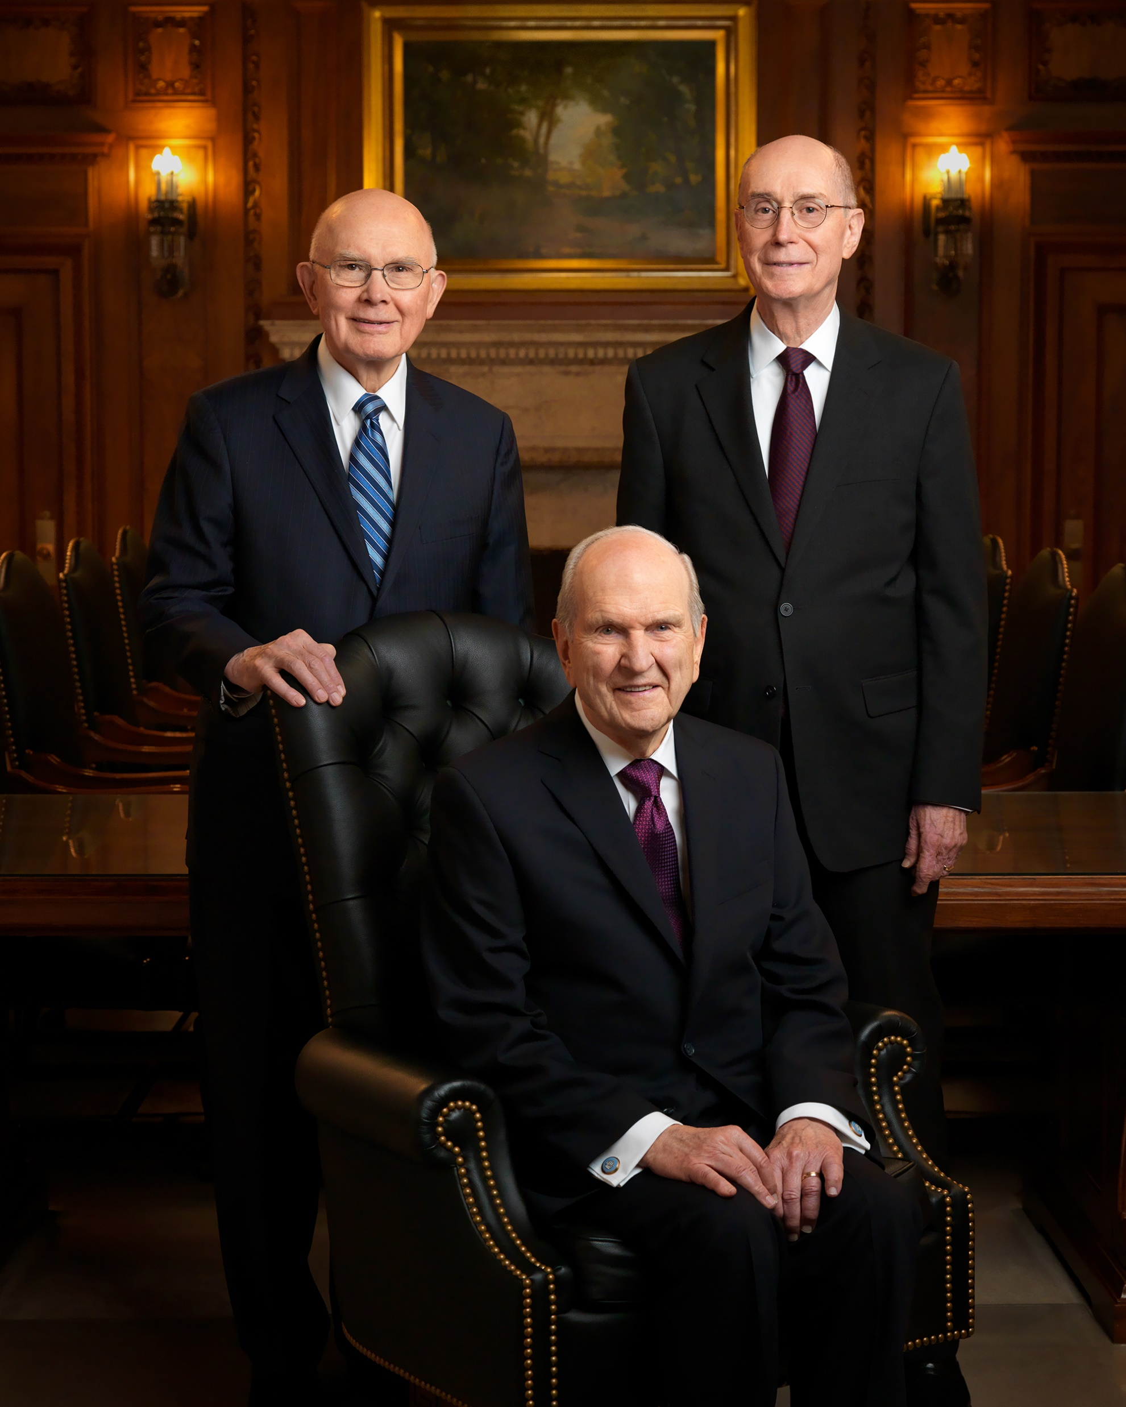
LESSON 84
What do the keys of the priesthood enable the First Presidency to do?
Direct the Lord’s work upon the earth.
A Counselor in the First Presidency.
What are the duties and responsibilities of the counselors in the First Presidency?
Doctrine and Covenants 81:3.
Therefore, verily I acknowledge him and will bless him, and also thee, inasmuch as thou art faithful in counsel, in the office which I have appointed unto you, in prayer always, vocally and in thy heart, in public and in private, also in thy ministry in proclaiming the gospel in the land of the living, and among thy brethren.
What was Frederick G. Williams supposed to do as a counselor in the First Presidency?
What do you think it means for a counselor to be “faithful in counsel” to the president?

Slide 7
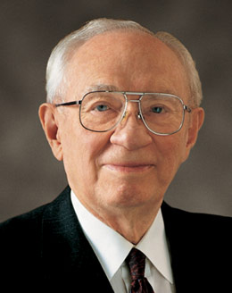
LESSON 84
“[A counselor] is an assistant to his president.…
“As an assistant, the counselor is not the president. He does not assume responsibility and move out ahead of his president.
“In presidency meetings, each counselor is free to speak his mind on all issues that come before the presidency. However, it is the prerogative of the president to make the decision, and it is the duty of the counselors to back him in that decision. His decision then becomes their decision, regardless of their previous ideas” (“In … Counsellors There Is Safety,” Ensign, Nov. 1990,49).
President
Gordon B. Hinkley
How should a counselor in a presidency counsel with the president?
How might understanding how to be faithful in counsel help someone who is serving as a counselor in any presidency in the Church?

Slide 8
LESSON 84
Doctrine and Covenants 81:4.
And in doing these things thou wilt do the greatest good unto thy fellow beings, and wilt promote the glory of him who is your Lord.
What can we do if we are faithful in our callings?
If we are faithful in our callings, we can do a great good for others and promote the glory of God.
How might serving faithfully in our Church callings help us do a great good for other people?
How might serving faithfully in our Church callings help promote the glory of God?
Doctrine and Covenants 81:5.
Wherefore, be faithful; stand in the office which I have appointed unto you; succor the weak, lift up the hands which hang down, and strengthen the feeble knees.
What can we learn about being faithful in our Church callings or being faithful members of the Church?
What do you think it means to “succor the weak, lift up the hands which hang down, and strengthen the feeble knees”?

Slide 9
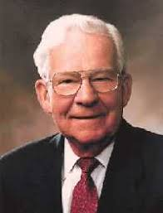
LESSON 84
“In Doctrine and Covenants 81:5, the verse might be interpreted as the Lord’s urging Frederick G. Williams to provide strength to the weak (‘succor the weak’), provide encouragement to those who are exhausted or discouraged (‘lift up the hands which hang down’), and to give courage and strength to those with feeble knees and fearful hearts” (“Strengthen the Feeble Knees,” Ensign, Nov. 1991,70).
Elder
Marvin J. Ashton
What are some ways we can “succor the weak, lift up the hands which hang down, and strengthen the feeble knees”?
When have you been lifted or strengthened by someone else?
Doctrine and Covenants 81:6–7.
6 And if thou art faithful unto the end thou shalt have a crown of immortality, and eternal life in the mansions which I have prepared in the house of my Father.
7 Behold, and lo, these are the words of Alpha and Omega, even Jesus Christ. Amen.

