Slide 1
LESSON 15
SEMINARY
Doctrine and Covenants
and Church History

Slide 2
LESSON 73
Doctrine and Covenants 67.

Slide 3
LESSON 73
Doctrine and Covenants 67:1-3.
“The Lord hears our prayers
and knows our hearts”

Slide 4
LESSON 73
When have you felt that your prayers have been heard and answered?
Doctrine and Covenants 67:1-2.
1 Behold and hearken, O ye elders of my church, who have assembled yourselves together, whose prayers I have heard, and whose hearts I know, and whose desires have come up before me.
2 Behold and lo, mine eyes are upon you, and the heavens and the earth are in mine hands, and the riches of eternity are mine to give.
What does the Lord say about His attention to our prayers?
The Lord hears our prayers and knows our hearts.
How can knowing this principle help you improve your prayers?
Doctrine and Covenants 67:3.
Ye endeavored to believe that ye should receive the blessing which was offered unto you; but behold, verily I say unto you there were fears in your hearts, and verily this is the reason that ye did not receive.

Slide 5
LESSON 73
How might fear cause someone to miss out on blessings?
If we let fear into our hearts, then we can lose blessings.
What fears do people have that may stop them from obtaining blessings?

Slide 6
LESSON 73
Doctrine and Covenants 67:4-9.
“The Lord provides a way for the elders to gain a testimony of the revelations through Joseph Smith”

Slide 7
LESSON 73
Why should we sustain our Church leaders even though we know they are imperfect?
Introduction to Doctrine and Covenants 67
Revelation given through Joseph Smith the Prophet, at Hiram, Ohio, early November 1831. The occasion was that of a special conference, and the publication of the revelations already received from the Lord through the Prophet was considered and acted upon (see the heading to section 1). William W. Phelps had recently established the Church printing press in Independence, Missouri. The conference decided to publish the revelations in the Book of Commandments and to print 10,000 copies (which because of unforeseen difficulties was later reduced to 3,000 copies). Many of the brethren bore solemn testimony that the revelations then compiled for publication were verily true, as was witnessed by the Holy Ghost shed forth upon them. Joseph Smith’s history records that after the revelation known as section 1 had been received, some conversation was had concerning the language used in the revelations. The present revelation followed.

Slide 8
LESSON 73
Doctrine and Covenants 67:5.
Your eyes have been upon my servant Joseph Smith, Jun., and his language you have known, and his imperfections you have known; and you have sought in your hearts knowledge that you might express beyond his language; this you also know.
How did the elders feel about the revelations?
Doctrine and Covenants 67:4-5.
4 And now I, the Lord, give unto you a testimony of the truth of these commandments which are lying before you.
5 Your eyes have been upon my servant Joseph Smith, Jun., and his language you have known, and his imperfections you have known; and you have sought in your hearts knowledge that you might express beyond his language; this you also know.
What did the Lord acknowledge about Joseph Smith?
Why might it be helpful to know that the Lord revealed His will to Joseph Smith even though He knew Joseph was not perfect?

Slide 9
LESSON 73
Doctrine and Covenants 67:6-9.
6 Now, seek ye out of the Book of Commandments, even the least that is among them, and appoint him that is the most wise among you;
7 Or, if there be any among you that shall make one like unto it, then ye are justified in saying that ye do not know that they are true;
8 But if ye cannot make one like unto it, ye are under condemnation if ye do not bear record that they are true.
9 For ye know that there is no unrighteousness in them, and that which is righteous cometh down from above, from the Father of lights.
What challenge did the Lord give to those who thought they could express themselves beyond the language of the revelations?

Slide 10
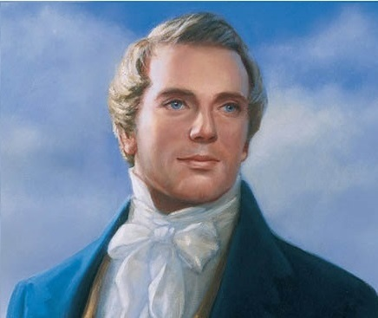
LESSON 73
“William E. M’Lellin, as the wisest man, in his own estimation, having more learning than sense, endeavored to write a commandment like unto one of the least of the Lord’s, but failed; it is an awful responsibility to write in the name of the Lord. The Elders and all present that witnessed this vain attempt of a man to imitate the language of Jesus Christ, renewed their faith in the fulness of the Gospel, and in the truth of the commandments and revelations which the Lord had given to the Church through my instrumentality; and the Elders signified a willingness to bear testimony of their truth to all the world” (in History of the Church,1:226).
Prophet
Joseph Smith
Why do you think Joseph Smith, who had limited formal schooling, could produce these revelations, but William E. McLellin, who was well educated, could not?
What can we learn from this account about judging our leaders because of their imperfections?

Slide 11
LESSON 73
Doctrine and Covenants 67:10-14.
“The Lord counsels His followers about how to prepare to abide in God’s presence”

Slide 12
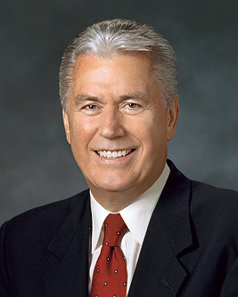
LESSON 73
What are some blessings that can come when we are patient with ourselves and others?
“In the 1960s, a professor at Stanford University began a modest experiment testing the willpower of four-year-old children. He placed before them a large marshmallow and then told them they could eat it right away or, if they waited for 15 minutes, they could have two marshmallows. “He then left the children alone and watched what happened behind a two-way mirror. Some of the children ate the marshmallow immediately; some could wait only a few minutes before giving in to temptation. Only 30 percent were able to wait” (“Continue in Patience,” Ensign or Liahona, May 2010,56).
Elder
Dieter F. Uchtdorf
How do you think this professor’s experiment and findings could relate to us?
What blessings have you received because you were patient?

Slide 13
LESSON 73
Reward
Obtain the Reward.
Doctrine and Covenants 67:10-14.
10 And again, verily I say unto you that it is your privilege, and a promise I give unto you that have been ordained unto this ministry, that inasmuch as you strip yourselves from jealousies and fears, and humble yourselves before me, for ye are not sufficiently humble, the veil shall be rent and you shall see me and know that I am—not with the carnal neither natural mind, but with the spiritual.
11 For no man has seen God at any time in the flesh, except quickened by the Spirit of God.
12 Neither can any natural man abide the presence of God, neither after the carnal mind.
13 Ye are not able to abide the presence of God now, neither the ministering of angels; wherefore, continue in patience until ye are perfected.
14 Let not your minds turn back; and when ye are worthy, in mine own due time, ye shall see and know that which was conferred upon you by the hands of my servant Joseph Smith, Jun. Amen.
What rewards did the Lord offer these elders?
What did the elders need to do in order to obtain these rewards?

Slide 14
LESSON 73
If we strip ourselves of jealousy and fear, humble ourselves, and continue in patience, we will be able to abide the presence of God.
Why do you think we need to be patient in our efforts to be worthy to abide the presence of God?
“As time went on, [the professor] kept track of the children and began to notice an interesting correlation: the children who could not wait struggled later in life and had more behavioral problems, while those who waited tended to be more positive and better motivated, have higher grades and incomes, and have healthier relationships. “…The ability to wait—to be patient—was a key character trait that might predict later success in life.… “…Without patience, we cannot please God; we cannot become perfect. Indeed, patience is a purifying process that refines understanding, deepens happiness, focuses action, and offers hope for peace” (“Continue in Patience,”56).
Elder
Dieter F. Uchtdorf
What can we learn from this experiment about blessings that come when we are patient?

