Slide 1
LESSON 15
SEMINARY
Doctrine and Covenants
and Church History

Slide 2
LESSON 71
Doctrine and Covenants 65.

Slide 3
LESSON 71
Doctrine and Covenants 65.
“The Lord declares that the gospel
will fill the whole earth”

Slide 4
LESSON 71
Introduction to Doctrine and Covenants 65
Revelation on prayer given through Joseph Smith the Prophet, at Hiram, Ohio, October 30, 1831.
Doctrine and Covenants 65: 1-2.
1 Hearken, and lo, a voice as of one sent down from on high, who is mighty and powerful, whose going forth is unto the ends of the earth, yea, whose voice is unto men—Prepare ye the way of the Lord, make his paths straight.
2 The keys of the kingdom of God are committed unto man on the earth, and from thence shall the gospel roll forth unto the ends of the earth, as the stone which is cut out of the mountain without hands shall roll forth, until it has filled the whole earth.
Where will the gospel of Jesus Christ go?
The gospel of Jesus Christ will go forth to the ends of the earth
What has the Lord “committed unto man” that enables the gospel to fill the whole earth?
The keys of the kingdom of God.

Slide 5
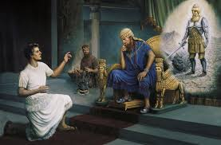
LESSON 71
31 ¶ Thou, O king, sawest, and behold a great image. This great image, whose brightness was excellent, stood before thee; and the form thereof was terrible.
32 This image’s head was of fine gold, his breast and his arms of silver, his belly and his thighs of brass,
33 His legs of iron, his feet part of iron and part of clay.
34 Thou sawest till that a stone was cut out without hands, which smote the image upon his feet that were of iron and clay, and brake them to pieces.
35 Then was the iron, the clay, the brass, the silver, and the gold, broken to pieces together, and became like the chaff of the summer threshingfloors; and the wind carried them away, that no place was found for them: and the stone that smote the image became a great mountain, and filled the whole earth.
36 ¶ This is the dream; and we will tell the interpretation thereof before the king.
37 Thou, O king, art a king of kings: for the God of heaven hath given thee a kingdom, power, and strength, and glory.
38 And wheresoever the children of men dwell, the beasts of the field and the fowls of the heaven hath he given into thine hand, and hath made thee ruler over them all. Thou art this head of gold.
39 And after thee shall arise another kingdom inferior to thee, and another third kingdom of brass, which shall bear rule over all the earth.
Daniel 2:31–39.

Slide 6
LESSON 71
40 And the fourth kingdom shall be strong as iron: forasmuch as iron breaketh in pieces and subdueth all things: and as iron that breaketh all these, shall it break in pieces and bruise.
41 And whereas thou sawest the feet and toes, part of potters’ clay, and part of iron, the kingdom shall be divided; but there shall be in it of the strength of the iron, forasmuch as thou sawest the iron mixed with miry clay.
42 And as the toes of the feet were part of iron, and part of clay, so the kingdom shall be partly strong, and partly broken.
43 And whereas thou sawest iron mixed with miry clay, they shall mingle themselves with the seed of men: but they shall not cleave one to another, even as iron is not mixed with clay.
44 And in the days of these kings shall the God of heaven set up a kingdom, which shall never be destroyed: and the kingdom shall not be left to other people, but it shall break in pieces and consume all these kingdoms, and it shall stand for ever.
45 Forasmuch as thou sawest that the stone was cut out of the mountain without hands, and that it brake in pieces the iron, the brass, the clay, the silver, and the gold; the great God hath made known to the king what shall come to pass hereafter: and the dream is certain, and the interpretation thereof sure.
Daniel 2:40-45.

Slide 7
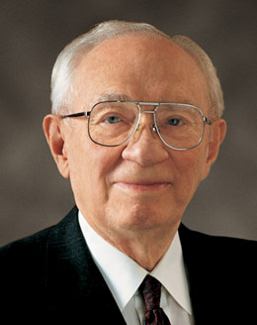
LESSON 71
What is the stone that is cut out of the mountain without hands?
The kingdom of God.
President Gordon B. Hinckley said:
“We are citizens in the greatest kingdom on earth—a kingdom not directed by the wisdom of men but led by the Lord Jesus Christ. Its presence is real. Its destiny is certain. This is the kingdom of which the prophet Daniel spoke—a stone, as it were, that should be cut out of the mountain without hands and roll forth and fill the earth. (See Dan. 2:34–35.) “No mortal man created this kingdom” (“Pillars of Truth,” Ensign, Jan. 1994,4).
What evidence do you see that Daniel’s prophecy is being fulfilled today?
How does this evidence strengthen your testimony of The Church of Jesus Christ of Latter-day Saints?
What does it mean to you to be part of the kingdom of God on the earth?

Slide 8
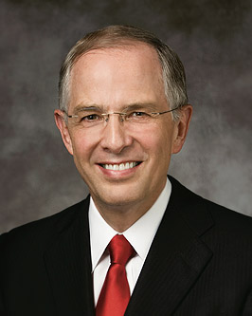
LESSON 71
“Have you ever thought about why you were sent to earth at this specific time? You were not born during the time of Adam and Eve or while pharaohs ruled Egypt or during the Ming dynasty. You have come to earth at this time, 20 centuries after the first coming of Christ. The priesthood of God has been restored to the earth, and the Lord has set His hand to prepare the world for His glorious return. These are days of great opportunity and important responsibilities. These are your days. … One of your important responsibilities is to…” (“Preparing the World for the Second Coming,” Ensignor Liahona, May 2011,49).
Elder
Neil L. Andersen
Doctrine and Covenants 65: 3.
Yea, a voice crying—Prepare ye the way of the Lord, prepare ye the supper of the Lamb, make ready for the Bridegroom.
What does it mean that we are to prepare the way of the Lord and the supper of the Lamb and make ready for the Bridegroom?
We have a responsibility to prepare ourselves and others for the Second Coming of Jesus Christ.
As you think about your responsibility to prepare yourself and others for the Second Coming, what thoughts and feelings do you have?

Slide 9
LESSON 71
Doctrine and Covenants 65: 4.
Pray unto the Lord, call upon his holy name, make known his wonderful works among the people.
In what ways can we “make known [the Lord’s] wonderful works among the people”?
Doctrine and Covenants 65:5-6.
5 Call upon the Lord, that his kingdom may go forth upon the earth, that the inhabitants thereof may receive it, and be prepared for the days to come, in the which the Son of Man shall comedown in heaven, clothed in the brightness of his glory, to meet the kingdom of God which is set up on the earth.
6 Wherefore, may the kingdom of God go forth, that the kingdom of heaven may come, that thou, O God, mayest be glorified in heaven so on earth, that thine enemies may be subdued; for thine is the honor, power and glory, forever and ever. Amen.
What should we pray for as we prepare for the Second Coming?
How might praying for these things help us prepare ourselves and others for the Second Coming?

Slide 10
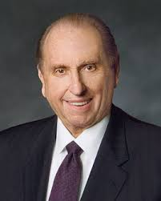
LESSON 71
“I would ask that your faith and prayers continue to be offered in behalf of those areas where our influence is limited and where we are not allowed to share the gospel freely at this time. Miracles can occur as we do so” (“Welcome to Conference,” Ensignor Liahona, Nov. 2009,6).
President
Thomas S. Monson
What should we be praying for?
How will these prayers help prepare the way for the Second Coming?
Doctrine and Covenants 65: 1-2.
1 Hearken, and lo, a voice as of one sent down from on high, who is mighty and powerful, whose going forth is unto the ends of the earth, yea, whose voice is unto men—Prepare ye the way of the Lord, make his paths straight.
2 The keys of the kingdom of God are committed unto man on the earth, and from thence shall the gospel roll forth unto the ends of the earth, as the stone which is cut out of the mountain without hands shall roll forth, until it has filled the whole earth.
In what ways do we participate in the Lord’s work to fill the earth with His gospel?

