Slide 1
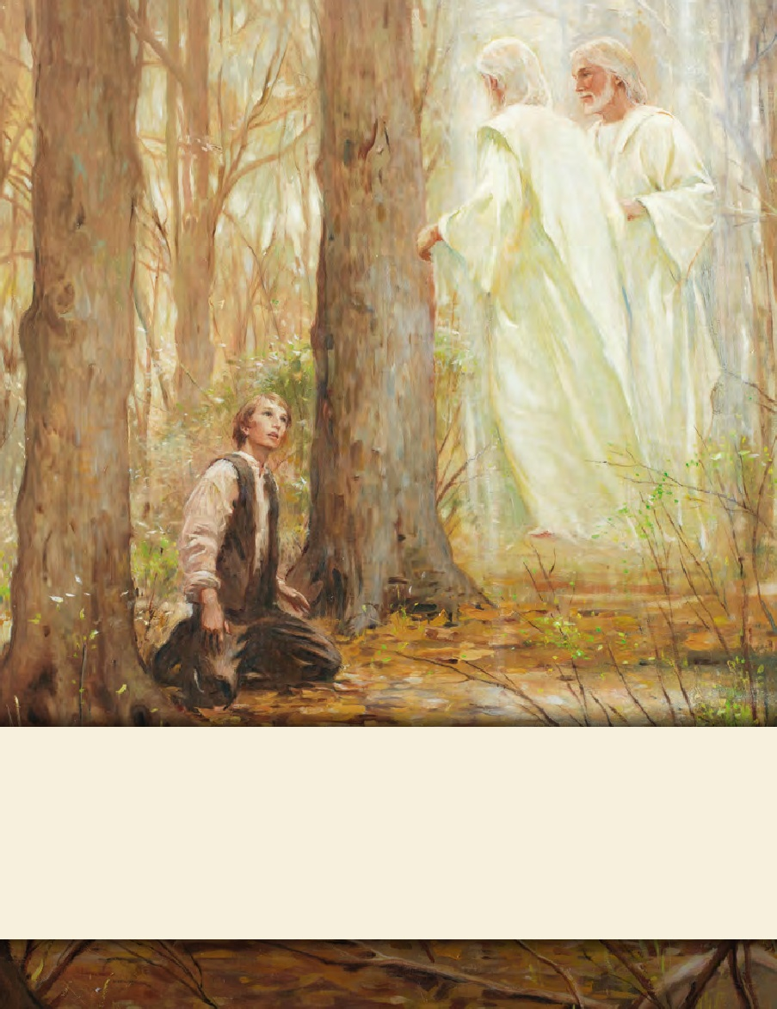
LESSON 15
SEMINARY
Doctrine and Covenants
and Church History

Slide 2
LESSON 69
Doctrine and Covenants 64:1-19.

Slide 3
LESSON 69
Doctrine and Covenants 64:1–7.
“The Lord assures the elders of
His willingness to forgive”

Slide 4
LESSON 69
When have you felt hurt because of the words or actions of another person?
How did you respond in that situation?
Doctrine and Covenants 64:1–4.
1 Behold, thus saith the Lord your God unto you, O ye elders of my church, hearken ye and hear, and receive my will concerning you.
2 For verily I say unto you, I will that ye should overcome the world; wherefore I will have compassion upon you.
3 There are those among you who have sinned; but verily I say, for this once, for mine own glory, and for the salvation of souls, I have forgiven you your sins.
4 I will be merciful unto you, for I have given unto you the kingdom.
How did the Lord say He would respond to members of the Church who had sinned?
What do these responses teach us about the Lord?
The Lord is compassionate, forgiving, and merciful.

Slide 5
LESSON 69
Why might this truth have been significant for Church members who had experienced difficulties because of disagreements and hard feelings? Why does this truth about the Savior matter to you?
Doctrine and Covenants 64:5–6.
5 And the keys of the mysteries of the kingdom shall not be taken from my servant Joseph Smith, Jun., through the means I have appointed, while he liveth, inasmuch as he obeyeth mine ordinances.
6 There are those who have sought occasion against him without cause;
What did the Lord say about Joseph Smith?

Slide 6
LESSON 69
Doctrine and Covenants 64:7.
Nevertheless, he has sinned; but verily I say unto you, I, the Lord, forgive sins unto those who confess their sins before me and ask forgiveness, who have not sinned unto death.
What can we learn from this verse about Joseph Smith?
What can we learn from this verse about what we must do to receive the Lord’s forgiveness?

Slide 7
LESSON 69
Doctrine and Covenants 64:8–19.
“The Lord commands His servants
to forgive one another”

Slide 8
LESSON 69
What emotions do you think you would feel if you were bitten by a poisonous snake?
Pursue the snake and kill it out of anger or fear,
Take immediate measures to get the poison out of his or her system.
Which of these two courses of action do you think is wiser? Why?
Doctrine and Covenants 64:8.
My disciples, in days of old, sought occasion against one another and forgave not one another in their hearts; and for this evil they were afflicted and sorely chastened.
What principle can we learn from verse 8?
When we refuse to forgive others, we bring affliction upon ourselves.
How can a person be afflicted (or hurt) by not forgiving others? How is this like the consequences of a person chasing a rattlesnake that has just bitten him?

Slide 9
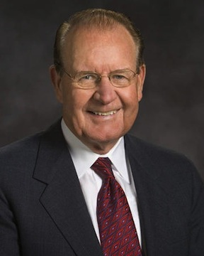
LESSON 69
Doctrine and Covenants 64:9.
Wherefore, I say unto you, that ye ought to forgive one another; for he that forgiveth not his brother his trespasses standeth condemned before the Lord; for there remaineth in him the greater sin.
What is another consequence of refusing to forgive others?
If we do not forgive others, we stand condemned before the Lord.
“It can be very difficult to forgive someone the harm they’ve done us, but when we do, we open ourselves up to a better future. No longer does someone else’s wrongdoing control our course. When we forgive others, it frees us to choose how we will live our own lives. Forgiveness means that problems of the past no longer dictate our destinies, and we can focus on the future with God’s love in our hearts” (“Forgiveness Will Change Bitterness to Love, ”Ensignor Liahona, May 2003,12).
Elder
David E. Sorensen

Slide 10
LESSON 69
1
A young woman is hurt and embarrassed after learning that some of her peers have been spreading gossip about her. Later, some of these peers apologize, but others do not. The young woman forgives those who have apologized but holds a grudge against the others.
Doctrine and Covenants 64:10-11.
10 I, the Lord, will forgive whom I will forgive, but of you it is required to forgive all men.
11 And ye ought to say in your hearts—let God judge between me and thee, and reward thee according to thy deeds.
What commandment does the Lord give in verse 10?
The Lord commands us to forgive all people.
How does this commandment relate to the young woman in the example? Why do you think it is important to forgive all people, regardless of whether they apologize for their wrongdoings?

Slide 11
LESSON 69
2
A young man disobeys a commandment. He prays for forgiveness and discusses the problem with his bishop. However, even after the bishop has assured the young man that he has fully repented, the young man continues to feel unworthy because of his past sin.
How does the commandment to forgive all people relate to the young man in this example?
Why must we forgive ourselves?

Slide 12
LESSON 69
3
A young woman is feeling sad and confused because of the actions of her father. He has abandoned his family. Before he left, he rarely showed love for the family and was often cruel. She does not understand why her father acted this way, and she carries feelings of anger toward him. She knows she should seek to forgive him but doesn’t think that she can.
How could the Lord’s counsel in verse 11 help this young woman forgive her father? How does it help us to let God be the judge of those who have hurt us?

Slide 13
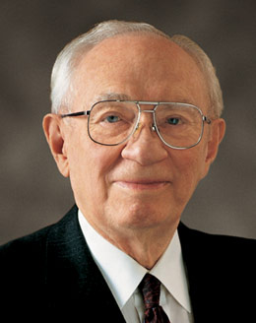
LESSON 69
I plead with you to ask the Lord for strength to forgive. … It may not be easy, and it may not come quickly. But if you will seek it with sincerity and cultivate it, it will come” (“Of You It Is Required to Forgive, ”Ensign, June 1991,5).
President
Gordon B Hinckley
What did President Hinckley counsel us to do if we are struggling to forgive someone?
How do you think praying for strength can help us to forgive?

Slide 14
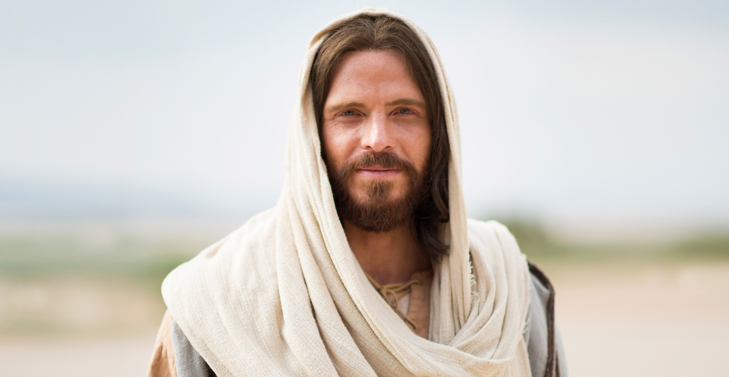
LESSON 69
The Lord is compassionate, forgiving, and merciful.

