Slide 1
LESSON 15
SEMINARY
Doctrine and Covenants
and Church History

Slide 2
LESSON 68
Doctrine and Covenants 63:22-66.

Slide 3
LESSON 68
Doctrine and Covenants 63:22–54.
“The Lord promises blessings to the
faithful in the last days”

Slide 4
LESSON 68
Why might some people feel worried about living in the last days?
____1. During the wars in the last days, wicked people will destroy one another. (SeeD&C 63:32–33.)
____2. The righteous Saints will easily escape all the destruction of the last days. (SeeD&C 63:34.)
____3. When Jesus Christ comes again, He will destroy any wicked people who are still on the earth. (SeeD&C 63:34.)
____4. Those who are faithful will eventually overcome all the challenges of this life. (SeeD&C 63:47–48.)
____5. Righteous people who die before the Second Coming will be resurrected when the Savior comes to the earth. (SeeD&C 63:49.)
____6. Righteous people who are living on the earth at the time of the Second Coming will never die. (SeeD&C 63:50–51.)

Slide 5
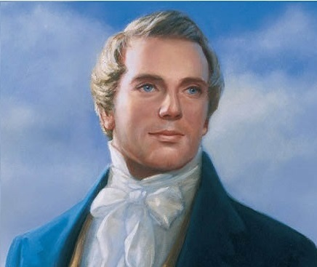
LESSON 68
“It is a false idea that the Saints will escape all the judgments, whilst the wicked suffer; for all flesh is subject to suffer, and ‘the righteous shall hardly escape;’ … many of the righteous shall fall a prey to disease, to pestilence, etc., by reason of the weakness of the flesh, and yet be saved in the Kingdom of God” (in History of the Church,4:11; see also Journals, Volume 1: 1832–1839,vol. 1 of the Journals series of The Joseph Smith Papers[2008], 352–53).
Prophet
Joseph Smith
Why do you think it is important to know that righteous people will not be spared from all the trials of the last days?

Slide 6
LESSON 68
Doctrine and Covenants 63:47–48.
47 He that is faithful and endureth shall overcome the world.
48 He that sendeth up treasures unto the land of Zion shall receive an inheritance in this world, and his works shall follow him, and also a reward in the world to come.
How would you state the Lord’s promise in this verse as an “if–then” statement?
if we are faithful and endure, then we will overcome the world.
In what ways can the Lord help us “overcome the world” in our daily lives?
In what ways can the Lord help us “overcome the world” after we die?
Doctrine and Covenants 63:49.
Yea, and blessed are the dead that die in the Lord, from henceforth, when the Lord shall come, and old things shall pass away, and all things become new, they shall rise from the dead and shall not die after, and shall receive an inheritance before the Lord, in the holy city.

Slide 7
LESSON 68
Doctrine and Covenants 63:55–56.
“The Lord expresses His displeasure
with Sidney Rigdon’s pride”

Slide 8
LESSON 68
You are invited to bear your testimony in front of many other youth at a large youth conference.
Some of the individuals in your quorum or a Young Women class complain about the activities you helped to plan.
You are a talented singer, and you have been asked to sing a song in sacrament meeting.
Doctrine and Covenants 63:55–56.
55 And now behold, verily I say unto you, I, the Lord, am not pleased with my servant Sidney Rigdon; he exalted himself in his heart, and received not counsel, but grieved the Spirit;
56 Wherefore his writing is not acceptable unto the Lord, and he shall make another; and if the Lord receive it not, behold he standeth no longer in the office to which I have appointed him.
What evidence of pride did you notice?
What was the result of Sidney’s pride?
What can we learn from verse 55?
The Spirit is grieved if we are prideful in doing the Lord’s work.

Slide 9
LESSON 68
Doctrine and Covenants 63:57–66.
“Jesus Christ instructs His servants to remember the sacredness of His name and to speak reverently of all sacred things”

Slide 10
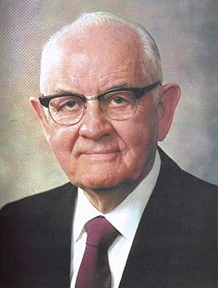
LESSON 68
“At St. Mark’s Hospital in Salt Lake City [President Spencer W. Kimball] was put under total anaesthesia and operated on, then wheeled on a table back toward his room. Still drugged, Spencer sensed his table stop by an elevator and heard the orderly, angry at something, profaning the Lord’s name. Half-conscious, he pleaded with labored sounds: ‘Please don’t say that. I love Him more than anything in this world. Please.’ An absolute silence. Then the orderly answered softly: ‘I shouldn’t have said that. I’m sorry’” (Edward L. Kimball and Andrew E. Kimball Jr., Spencer W. Kimball: Twelfth President of The Church of Jesus Christ of Latter-day Saints [1977],264).
President
Spencer W. Kimball
What about this account impresses you?
How was President Kimball’s reverence for the Lord’s name different from the way many people in the world today use the Lord’s name?

Slide 11
LESSON 68
Doctrine and Covenants 63:59–64.
59 Behold, I am from above, and my power lieth beneath. I am over all, and in all, and through all, and search all things, and the day cometh that all things shall be subject unto me.
60 Behold, I am Alpha and Omega, even Jesus Christ.
61 Wherefore, let all men beware how they take my name in their lips—
62 For behold, verily I say, that many there be who are under this condemnation, who use the name of the Lord, and use it in vain, having not authority.
63 Wherefore, let the church repent of their sins, and I, the Lord, will own them; otherwise they shall be cut off.
64 Remember that that which cometh from above is sacred, and must be spoken with care, and by constraint of the Spirit; and in this there is no condemnation, and ye receive the Spirit through prayer; wherefore, without this there remaineth condemnation.
What did you find about how we are to use the Lord’s name?
The name of Jesus Christ is sacred and must be spoken with care.

Slide 12
LESSON 68
Why do you think we are to use the Savior’s name with reverence?
How does Doctrine and Covenants 63:62 increase your understanding of what it means to take the name of the Lord in vain? How does this verse apply to priesthood ordinances?
What can we do to remember that it is sacred and must be spoken with care?
What are some other words or subjects that “come from above” and are sacred? How can we make sure we speak about them “with care”?

Slide 13
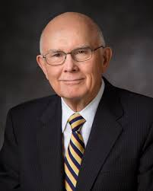
LESSON 68
“There are no more sacred or significant words in all of our language than the names of God the Father and his Son, Jesus Christ” (“Reverent and Clean,” Ensign, May 1986,50).
Elder
Dallin H. Oaks
Why are the names of God the Father and Jesus Christ sacred to you?

