Slide 1
LESSON 15
SEMINARY
Doctrine and Covenants
and Church History

Slide 2
LESSON 67
Doctrine and Covenants 63:1-21.

Slide 3
LESSON 67
Doctrine and Covenants 63:1-6
“The Lord warns the Saints about the consequences of wickedness and rebellion”

Slide 4
LESSON 67
Why do you follow your Church’s teachings instead of having fun?
Why do you think it is important that we live according to our beliefs?
Doctrine and Covenants 63:1.
Hearken, O ye people, and open your hearts and give ear from afar; and listen, you that call yourselves the people of the Lord, and hear the word of the Lord and his will concerning you.
How can calling our selves the people of the Lord be different from being the people of the Lord?
What does the Lord want us to do as His people?
As the Lord’s people, we are to open our hearts and listen to His word and His will concerning us.
What do you think it means to open our hearts?
How does opening our hearts prepare us to hear the Lord’s voice?
What do you do that helps you open your heart?

Slide 5
LESSON 67
Doctrine and Covenants 63:2, 6.
2 Yea, verily, I say, hear the word of him whose anger is kindled against the wicked and rebellious;
6 Wherefore, verily I say, let the wicked take heed, and let the rebellious fear and tremble; and let the unbelieving hold their lips, for the day of wrath shall come upon them as a whirlwind, and all flesh shall know that I am God.

Slide 6
LESSON 67
Doctrine and Covenants 63:7-21
“The Lord warns against sign
seeking and wickedness”

Slide 7
LESSON 67
Ezra Booth was a Methodist preacher in Ohio. He became interested in the Restoration in early 1831 after reading from the Book of Mormon. He traveled to Kirtland with John and Alice Johnson to meet the Prophet. Mrs. Johnson suffered from rheumatism, which had caused pain, swelling, and stiffness in her arm. When she first met Joseph Smith, she had not been able to raise her hand to her head for about two years.
“During the interview the conversation turned on the subject of supernatural gifts, such as were conferred in the days of the apostles. Some one said, ‘Here is Mrs. Johnson with a lame arm; has God given any power to man now on the earth to cure her?’ A few moments later, when the conversation had turned in another direction, [Joseph] Smith rose, and walking across the room, taking Mrs. Johnson by the hand, said in the most solemn and impressive manner: ‘Woman, in the name of the Lord Jesus Christ I command thee to be whole,’ and immediately left the room. … Mrs. Johnson at once lifted [her arm] up with ease, and on her return home the next day she was able to do her washing without difficulty or pain” (in History of the Church,1:215–16).
How do you think you might feel if you witnessed a miracle like this?

Slide 8
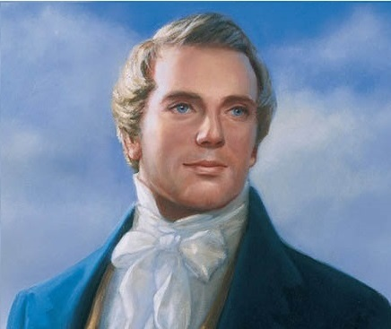
LESSON 67
Signs and Faith.
Doctrine and Covenants 63:7-9.
7 And he that seeketh signs shall see signs, but not unto salvation.
8 Verily, I say unto you, there are those among you who seek signs, and there have been such even from the beginning;
9 But, behold, faith cometh not by signs, but signs follow those that believe.
What do we learn from these verses about signs and faith?
Faith does not come by signs.
What are some examples in the scriptures of people who witnessed great signs or miracles but did not demonstrate lasting faith and righteousness?
“When he actually learned that faith, humility, patience, and tribulation go before blessing, and that God brings low before He exalts; that instead of the ‘Savior’s granting him power to smite men and make them believe’ … then he was disappointed” (in History of the Church,1:216).
Prophet
Joseph Smith

Slide 9
LESSON 67
Doctrine and Covenants 63:10-12
10 Yea, signs come by faith, not by the will of men, nor as they please, but by the will of God.
11 Yea, signs come by faith, unto mighty works, for without faith no man pleaseth God; and with whom God is angry he is not well pleased; wherefore, unto such he showeth no signs, only in wrath unto their condemnation.
12 Wherefore, I, the Lord, am not pleased with those among you who have sought after signs and wonders for faith, and not for the good of men unto my glory.
How do signs come?
Signs come by faith, according to the will of God.
Why do you think we receive signs after we have exercised faith?
What is an appropriate reason to seek signs?
“For the good of men unto [God’s] glory”—meaning to help other people and to further the Lord’s work.)
How can we exercise faith in order to receive a witness of the gospel?

Slide 10
LESSON 67
Doctrine and Covenants 63:14-19.
14 There were among you adulterers and adulteresses; some of whom have turned away from you, and others remain with you that hereafter shall be revealed.
15 Let such beware and repent speedily, lest judgment shall come upon them as a snare, and their folly shall be made manifest, and their works shall follow them in the eyes of the people.
16 And verily I say unto you, as I have said before, he that looketh on a woman to lust after her, or if any shall commit adultery in their hearts, they shall not have the Spirit, but shall deny the faith and shall fear.
17 Wherefore, I, the Lord, have said that the fearful, and the unbelieving, and all liars, and whosoever loveth and maketh a lie, and the whoremonger, and the sorcerer, shall have their part in that lake which burneth with fire and brimstone, which is the second death.
18 Verily I say, that they shall not have part in the first resurrection.
19 And now behold, I, the Lord, say unto you that ye are not justified, because these things are among you.
What does it mean to look upon others with lust?
What principle do you see in the Lord’s warning in verse 16?
If we look upon others with lust, we will not have the Spirit and we deny the faith.
Why do you think lusting after another causes a person to lose the Spirit?
What can we do to overcome temptations to lust after others?

Slide 11
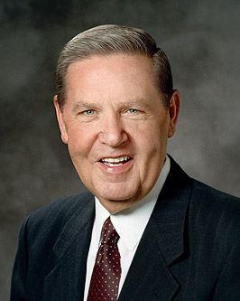
LESSON 67
“Above all, start by separating yourself from people, materials, and circumstances that will harm you.…
“…If a TV show is indecent, turn it off. If a movie is crude, walk out. If an improper relationship is developing, sever it. Many of these influences, at least initially, may not technically be evil, but they can blunt our judgment, dull our spirituality, and lead to something that could be evil.…
“…Replace lewd thoughts with hopeful images and joyful memories; picture the faces of those who love you and would be shattered if you let them down. … Whatever thoughts you have, make sure they are welcome in your heart by invitation only.…
“Cultivate and be where the Spirit of the Lord is. Make sure that includes your own home or apartment, dictating the kind of art, music, and literature you keep there” (“Place No More for the Enemy of My Soul, ”EnsignorLiahona,May 2010, 45,46).
Elder
Jeffrey R. Holland
As the Lord’s people, we are to open our hearts and listen to His word and His will concerning us.

