Slide 1
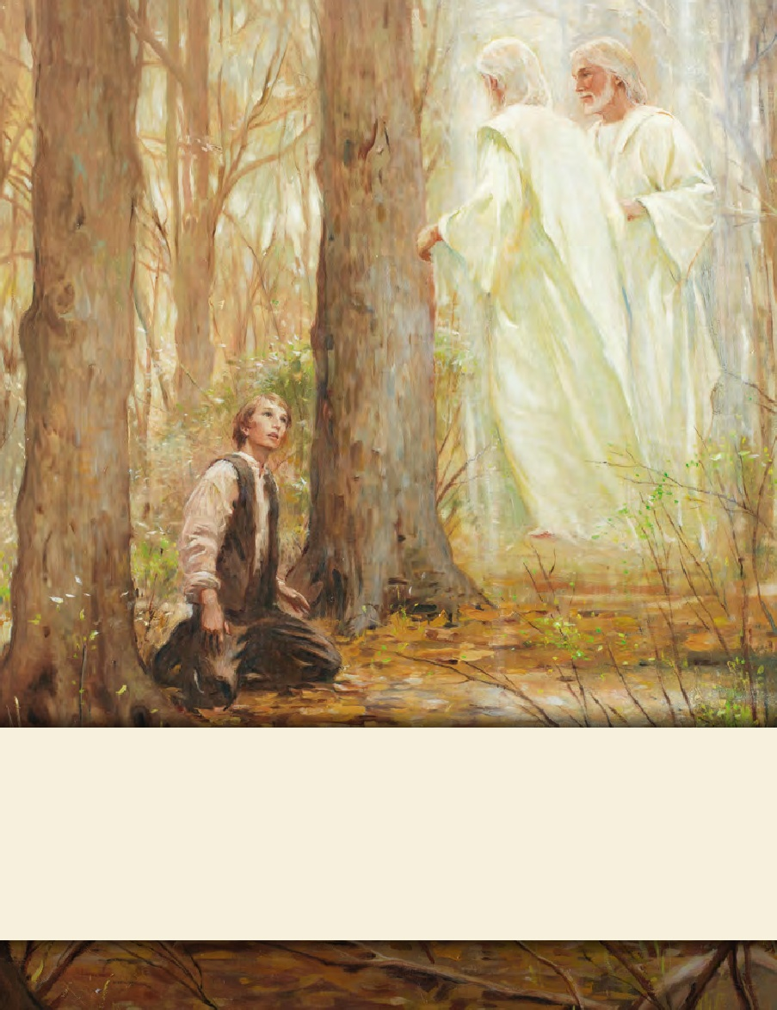
LESSON 15
SEMINARY
Doctrine and Covenants
and Church History

Slide 2
LESSON 55
Doctrine and Covenants 47-48.

Slide 3
LESSON 55
Doctrine and Covenants 47.
“The Lord appoints John Whitmer to record a history of the Church”

Slide 4
LESSON 55
Why was this experience meaningful to you?
Why do you think it is important to remember this experience?
How could a record of this experience bless your posterity?
Introduction of Doctrine and Covenants 47
Revelation given through Joseph Smith the Prophet, at Kirtland, Ohio, March 8, 1831. John Whitmer, who had already served as a clerk to the Prophet, initially hesitated when he was asked to serve as the Church historian and recorder, replacing Oliver Cowdery. He wrote, “I would rather not do it but observed that the will of the Lord be done, and if he desires it, I desire that he would manifest it through Joseph the Seer.” After Joseph Smith received this revelation, John Whitmer accepted and served in his appointed office.

Slide 5
LESSON 55
Doctrine and Covenants 47:1-3.
1 Behold, it is expedient in me that my servant John should write and keep a regular history, and assist you, my servant Joseph, in transcribing all things which shall be given you, until he is called to further duties.
2 Again, verily I say unto you that he can also lift up his voice in meetings, whenever it shall be expedient.
3 And again, I say unto you that it shall be appointed unto him to keep the church record and history continually; for Oliver Cowdery I have appointed to another office.
Why do you think it is important that the history of the Church be recorded?
What are some stories from Church history that are especially inspiring to you?

Slide 6
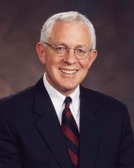
LESSON 55
“There are other great stories in our history that deserve to be known and taught at church and at home. The lessons of Kirtland, the trials of Missouri, the triumphs and eventual expulsion of the Saints from Nauvoo, and the westward trek of the pioneers are stories that inspire Latter-day Saints in every land and language. But there are equally moving stories about the rise and progress of the Church and the impact of the gospel in the lives of ordinary members in every nation touched by the restored gospel. These need recording and preserving as well.
Elder
Martin K. Jensen
“…Many of the Church’s greatest stories are contained in personal and family histories, and these are a part of our individual and family heritages” (“There Shall Be a Record Kept among You, ”Ensign, Dec. 2007,31).
Why do you think personal and family histories matter?
Which part of the experience would you emphasize? What would you want your family to feel and know as a result of reading your account?

Slide 7
LESSON 55
Doctrine and Covenants 47:1-4.
Wherefore, it shall be given him, inasmuch as he is faithful, by the Comforter, to write these things. Even so. Amen.
What did the Lord promise John Whitmer?
The Lord promised that the Comforter—the Holy Ghost—would help him in his effort to write the history of the Church.
How can we relate this to our efforts to keep personal and family histories?
If we are faithful in our efforts to keep personal and family histories, the Holy Ghost will help us.
How might the Holy Ghost help a person as he or she keeps a personal or family history?

Slide 8
LESSON 55
Doctrine and Covenants 48.
“The Lord instructs the Saints in Ohio to assist those coming from New York”

Slide 9
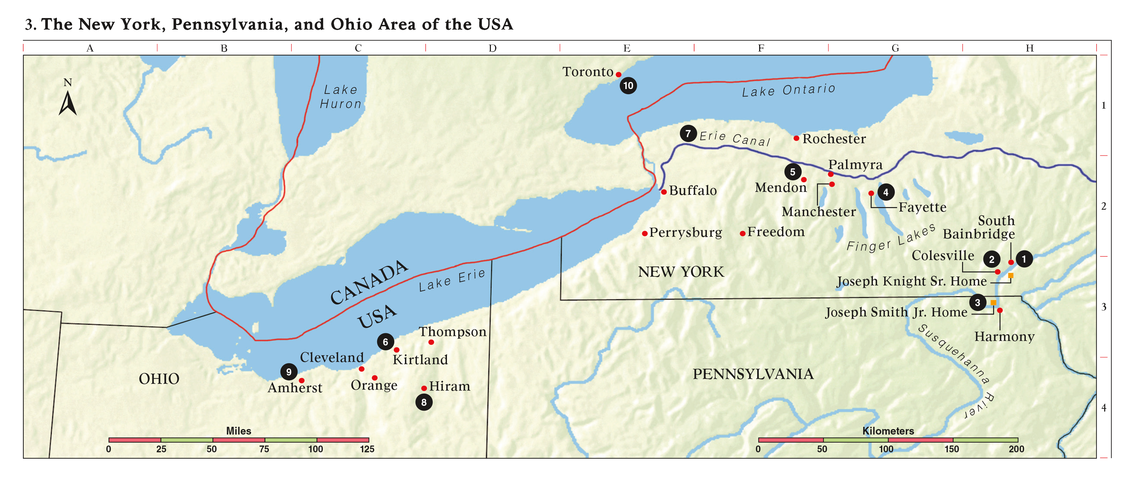
LESSON 55
What questions and concerns might you and your family have about this request?
What concerns and feelings do you think those moving into your home would have?

Slide 10
LESSON 55
Doctrine and Covenants 48:1-3.
1 It is necessary that ye should remain for the present time in your places of abode, as it shall be suitable to your circumstances.
2 And inasmuch as ye have lands, ye shall impart to the eastern brethren;
3 And inasmuch as ye have not lands, let them buy for the present time in those regions round about, as seemeth them good, for it must needs be necessary that they have places to live for the present time.
What did the Lord command the Saints in Ohio to do?
He commanded those with land to share it with the Saints who were moving to the area.
What is a principle we can learn from this commandment?
The Lord commands Latter-day Saints to share what they have with those in need.
What are some ways we can share what we have with others?

Slide 11
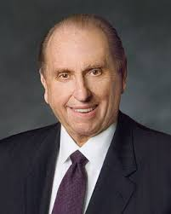
LESSON 55
“We undertook a project to save nickels and dimes for what was to be a gigantic Christmas party. Sister Gertsch kept a careful record of our progress. As boys with typical appetites we converted in our minds the monetary totals to cakes, cookies, pies, and ice cream. This was to be a glorious event. Never before had any of our teachers even suggested a social event like this was to be.
“The summer months faded into autumn. Autumn turned to winter. Our party goal had been achieved. The class had grown. A good spirit prevailed.
“None of us will forget that gray morning when our beloved teacher announced to us that the mother of one of our classmates had passed away. We thought of our own mothers and how much they meant to us. We felt sincere sorrow for Billy Devenport in his great loss.
“The lesson this Sunday was from the book of Acts, chapter 20, verse 35: ‘Remember the words of the Lord Jesus, how he said, It is more blessed to give than to receive.’ At the conclusion of the presentation of a well-prepared lesson, Lucy Gertsch commented on the economic situation of Billy’s family. These were Depression times, and money was scarce.
President
Thomas S. Monson
With a twinkle in her eyes, she asked: ‘How would you like to follow this teaching of our Lord? How would you feel about taking our party fund and, as a class, giving it to the Devenports as an expression of our love?’ The decision was unanimous. We counted so carefully each penny and placed the total sum in a large envelope. A beautiful card was purchased and inscribed with our names.
“This simple act of kindness welded us together as one” (“Your Personal Influence,” Ensign or Liahona ,May 2004,21–22).
What can we learn from this account?
How can kindness and service bless the life of the giver as well as the receiver?

