Slide 1
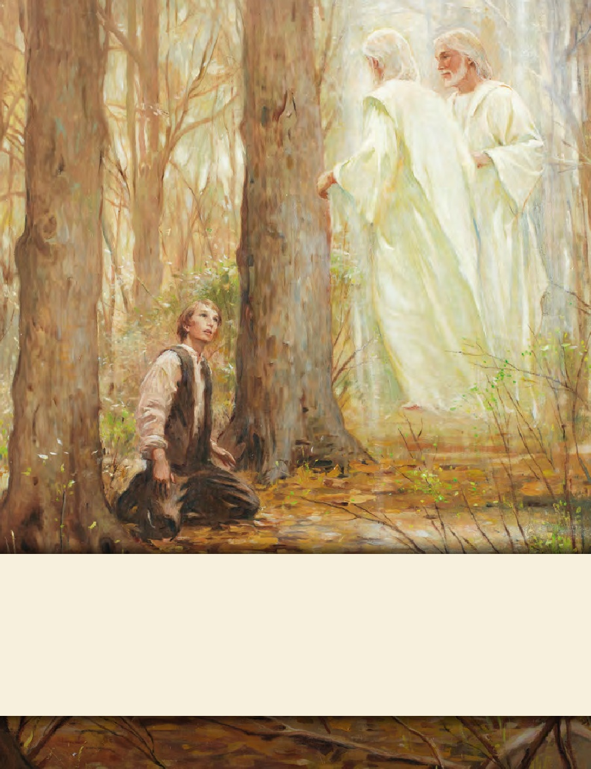
LESSON 15
SEMINARY
Doctrine and Covenants
and Church History

Slide 2
LESSON 53
Doctrine and Covenants
45:60-75.

Slide 3
LESSON 53
Doctrine and Covenants 45:60-61.
“The Lord directs Joseph Smith to begin
his translation of the New Testament”

Slide 4
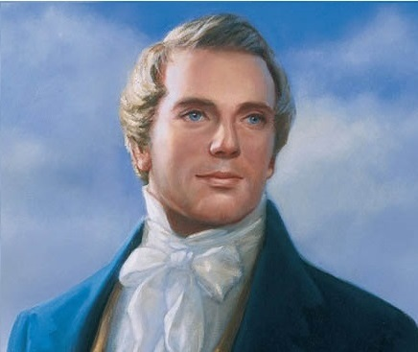
LESSON 53
What does the phrase “as far as it is translated correctly” suggest about the Bible?
“It was apparent that many important points touching the salvation of man had been taken from the Bible, or lost before it was compiled” (Teachings of Presidents of the Church: Joseph Smith[2007],217).
He also stated: “I believe the Bible as it read when it came from the pen of the original writers. Ignorant translators, careless transcribers, or designing and corrupt priests have committed many errors” (Teachings: Joseph Smith,207).
Prophet
Joseph Smith
What are at least three reasons the Bible has errors in it?

Slide 5
LESSON 53
Doctrine and Covenants 45:60-61.
60 And now, behold, I say unto you, it shall not be given unto you to know any further concerning this chapter, until the New Testament be translated, and in it all these things shall be made known;
61 Wherefore I give unto you that ye may now translate it, that ye may be prepared for the things to come.
How did the Lord say the translation of the New Testament would bless the Saints?
It would reveal more of God’s will to prepare the Saints.

Slide 6
LESSON 53
Doctrine and Covenants 45:62-65.
“The Saints are forewarned to gather into western countries”

Slide 7
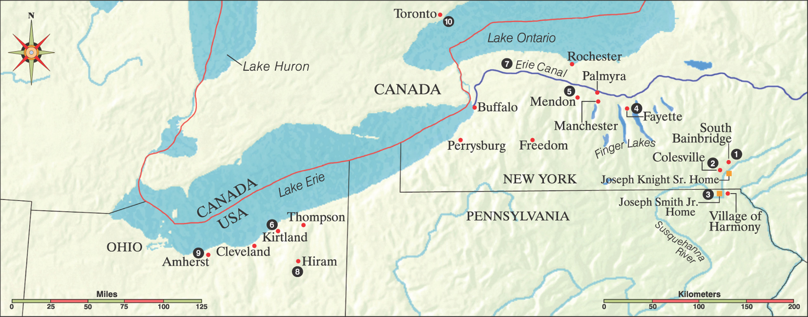
LESSON 53
Doctrine and Covenants 45:62-64.
62 For verily I say unto you, that great things await you;
63 Ye hear of wars in foreign lands; but, behold, I say unto you, they are nigh, even at your doors, and not many years hence ye shall hear of wars in your own lands.
64 Wherefore I, the Lord, have said, gather ye out from the eastern lands, assemble ye yourselves together ye elders of my church; go ye forth into the western countries, call upon the inhabitants to repent, and inasmuch as they do repent, build up churches unto me.

Slide 8
LESSON 53
What did the Lord say was “even at your doors”?
What do you think this imagery implies?
Doctrine and Covenants 45:65.
And with one heart and with one mind, gather up your riches that ye may purchase an inheritance which shall hereafter be appointed unto you.
Why were they to gather their riches?
To purchase land where the Saints could live in unity, peace, and safety.

Slide 9
LESSON 53
Doctrine and Covenants 45:66-75.
“The Lord describes
the New Jerusalem, or Zion”

Slide 10
LESSON 53
If you could choose anywhere in the world to live, where would it be? Why would you want to live there?
Doctrine and Covenants 45:66-67.
66 And it shall be called the New Jerusalem, a land of peace, a city of refuge, a place of safety for the saints of the Most High God;
67 And the glory of the Lord shall be there, and the terror of the Lord also shall be there, insomuch that the wicked will not come unto it, and it shall be called Zion.
What will the Saints’ land of inheritance be called?
The New Jerusalem, or Zion.
How did the Lord describe the New Jerusalem, or Zion?
The New Jerusalem would be a place of peace and safety, and the glory of the Lord would be there.

Slide 11
LESSON 53
Why might you want to be a part of this city?
Where have you experienced peace and safety? Why is it important to have places where you can be safe and have peace?
Doctrine and Covenants 45:68-71.
68 And it shall come to pass among the wicked, that every man that will not take his sword against his neighbor must needs flee unto Zion for safety.
69 And there shall be gathered unto it out of every nation under heaven; and it shall be the only people that shall not be at war one with another.
70 And it shall be said among the wicked: Let us not go up to battle against Zion, for the inhabitants of Zion are terrible; wherefore we cannot stand.
71 And it shall come to pass that the righteous shall be gathered out from among all nations, and shall come to Zion, singing with songs of everlasting joy.
How will the wicked feel about Zion?
Where will the righteous people of Zion come from?
Righteous people from all nations will gather to Zion.

Slide 12
LESSON 53
“Zion … is a place of righteousness, and all who build thereon are to worship the true and living God, and all believe in one doctrine, even the doctrine of our Lord and Savior Jesus Christ” (in History of the Church,2:254).
Prophet
Joseph Smith
Doctrine and Covenants 45:72-73.
72 And now I say unto you, keep these things from going abroad unto the world until it is expedient in me, that ye may accomplish this work in the eyes of the people, and in the eyes of your enemies, that they may not know your works until ye have accomplished the thing which I have commanded you;
73 That when they shall know it, that they may consider these things.

