Slide 1
LESSON 15
SEMINARY
Doctrine and Covenants
and Church History

Slide 2
LESSON 52
Doctrine and Covenants
45:16-59.

Slide 3
LESSON 52
Doctrine and Covenants 45:16–46.
“The Savior reveals signs that will
precede His Second Coming”

Slide 4
LESSON 52
How can you tell when it is about to rain?
The Signs of the Second Coming.
Doctrine and Covenants 45:16–17.
16 And I will show it plainly as I showed it unto my disciples as I stood before them in the flesh, and spake unto them, saying: As ye have asked of me concerning the signs of my coming, in the day when I shall come in my glory in the clouds of heaven, to fulfil the promises that I have made unto your fathers,
17 For as ye have looked upon the long absence of your spirits from your bodies to be a bondage, I will show unto you how the day of redemption shall come, and also the restoration of the scattered Israel.
What did the disciples ask the Lord to teach them about?
What did the Lord say He would show His disciples?

Slide 5
LESSON 52
D&C 45:18–24 D&C 45:25–27 D&C 45:28–31, 33 D&C 45:40–43
D&C 45:18–24
D&C 45:25–27
18 And now ye behold this temple which is in Jerusalem, which ye call the house of God, and your enemies say that this house shall never fall.
19 But, verily I say unto you, that desolation shall come upon this generation as a thief in the night, and this people shall be destroyed and scattered among all nations.
20 And this temple which ye now see shall be thrown down that there shall not be left one stone upon another.
21 And it shall come to pass, that this generation of Jews shall not pass away until every desolation which I have told you concerning them shall come to pass.
22 Ye say that ye know that the end of the world cometh; ye say also that ye know that the heavens and the earth shall pass away;
23 And in this ye say truly, for so it is; but these things which I have told you shall not pass away until all shall be fulfilled.
24 And this I have told you concerning Jerusalem; and when that day shall come, shall a remnant be scattered among all nations;
25 But they shall be gathered again; but they shall remain until the times of the Gentiles be fulfilled.
26 And in that day shall be heard of wars and rumors of wars, and the whole earth shall be in commotion, and men’s hearts shall fail them, and they shall say that Christ delayeth his coming until the end of the earth.
27 And the love of men shall wax cold, and iniquity shall abound.

Slide 6
LESSON 52
D&C 45:18–24 D&C 45:25–27 D&C 45:28–31, 33 D&C 45:40–43
D&C 45:28–31, 33
D&C 45:40–43
28 And when the times of the Gentiles is come in, a light shall break forth among them that sit in darkness, and it shall be the fulness of my gospel;
29 But they receive it not; for they perceive not the light, and they turn their hearts from me because of the precepts of men.
30 And in that generation shall the times of the Gentiles be fulfilled.
31 And there shall be men standing in that generation, that shall not pass until they shall see an overflowing scourge; for a desolating sickness shall cover the land.
33 And there shall be earthquakes also in divers places, and many desolations; yet men will harden their hearts against me, and they will take up the sword, one against another, and they will kill one another.
40 And they shall see signs and wonders, for they shall be shown forth in the heavens above, and in the earth beneath.
41 And they shall behold blood, and fire, and vapors of smoke.
42 And before the day of the Lord shall come, the sun shall be darkened, and the moon be turned into blood, and the stars fall from heaven.
43 And the remnant shall be gathered unto this place;

Slide 7
LESSON 52
Doctrine and Covenants 45:34.
And now, when I the Lord had spoken these words unto my disciples, they were troubled.
How do you feel when you consider the signs of the Second Coming?
Doctrine and Covenants 45:35-38.
35 And I said unto them: Be not troubled, for, when all these things shall come to pass, ye may know that the promises which have been made unto you shall be fulfilled.
36 And when the light shall begin to break forth, it shall be with them like unto a parable which I will show you—
37 Ye look and behold the fig trees, and ye see them with your eyes, and ye say when they begin to shoot forth, and their leaves are yet tender, that summer is now nigh at hand;
38 Even so it shall be in that day when they shall see all these things, then shall they know that the hour is nigh.
Why is it important to be able to recognize when “the hour is nigh,” or that the Second Coming is imminent?

Slide 8
LESSON 52
Doctrine and Covenants 45:32,39.
32 But my disciples shall stand in holy places, and shall not be moved; but among the wicked, men shall lift up their voices and curse God and die.
39 And it shall come to pass that he that feareth me shall be looking forth for the great day of the Lord to come, even for the signs of the coming of the Son of Man.
What can we do to be prepared for the Lord’s coming?
If we stand in holy places and watch for the signs, we will
be ready for the Lord’s Second Coming.
How would you complete this statement?
How do you think a follower of Jesus Christ can “stand in holy places”? Where are some places in your life that you consider “holy places”?

Slide 9
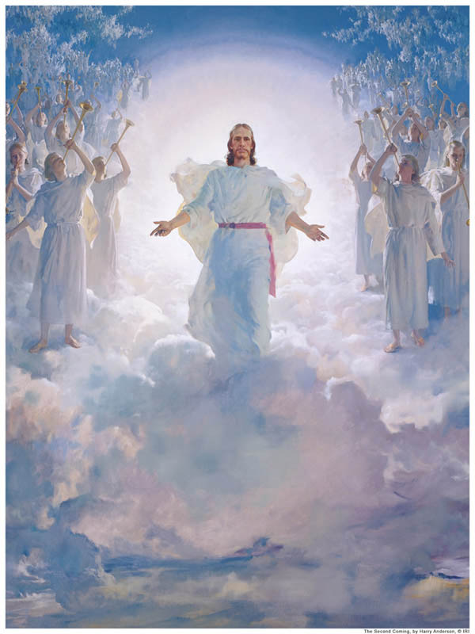
LESSON 52
“‘Holy places’ may have more to do with how one lives than where one lives. If we live worthy of the constant companionship of the Holy Ghost, then we stand in a holy place. … A holy place is any place where a person enjoys the Spirit of God” (Doctrine and Covenants Student Manual, 2nd ed. [Church Educational System manual, 2001],196).
How can we stand in holy places while we are surrounded by the wickedness of the world?

Slide 10
LESSON 52
Doctrine and Covenants 45:47–59.
“The Savior reveals signs and wonders that will attend His Second Coming”

Slide 11
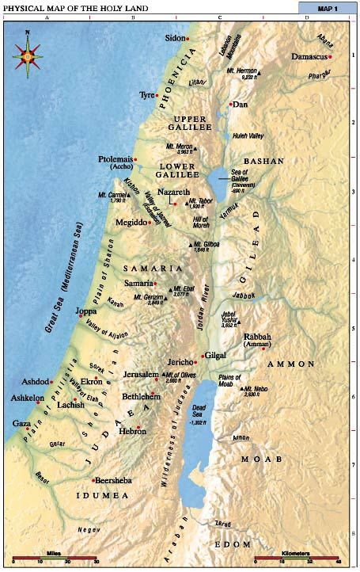
LESSON 52
Doctrine and Covenants 45:48.
And then shall the Lord set his foot upon this mount, and it shall cleave in twain, and the earth shall tremble, and reel to and fro, and the heavens also shall shake.

Slide 12
LESSON 52
Doctrine and Covenants 45:49-50.
49 And the Lord shall utter his voice, and all the ends of the earth shall hear it; and the nations of the earth shall mourn, and they that have laughed shall see their folly.
50 And calamity shall cover the mocker, and the scorner shall be consumed; and they that have watched for iniquity shall be hewn down and cast into the fire.
What will happen to the nations of the earth at the Second Coming?
Whom do you think “they that have laughed” refers to?
Doctrine and Covenants 45:51-53.
51 And then shall the Jews look upon me and say: What are these wounds in thine hands and in thy feet?
52 Then shall they know that I am the Lord; for I will say unto them: These wounds are the wounds with which I was wounded in the house of my friends. I am he who was lifted up. I am Jesus that was crucified. I am the Son of God.
53 And then shall they weep because of their iniquities; then shall they lament because they persecuted their king.
Why will the Jews weep when the Lord returns?

Slide 13
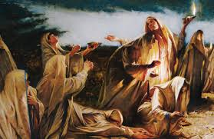
LESSON 52
Matthew 25:1–13
1 Then shall the kingdom of heaven be likened unto ten virgins, which took their lamps, and went forth to meet the bridegroom.
2 And five of them were wise, and five were foolish.
3 They that were foolish took their lamps, and took no oil with them:
4 But the wise took oil in their vessels with their lamps.
5 While the bridegroom tarried, they all slumbered and slept.
6 And at midnight there was a cry made, Behold, the bridegroom cometh; go ye out to meet him.
7 Then all those virgins arose, and trimmed their lamps.
8 And the foolish said unto the wise, Give us of your oil; for our lamps are gone out.
9 But the wise answered, saying, Not so; lest there be not enough for us and you: but go ye rather to them that sell, and buy for yourselves.
10 And while they went to buy, the bridegroom came; and they that were ready went in with him to the marriage: and the door was shut.
11 Afterward came also the other virgins, saying, Lord, Lord, open to us.
12 But he answered and said, Verily I say unto you, I know you not.
13 Watch therefore, for ye know neither the day nor the hour wherein the Son of man cometh.
In what ways were five of the virgins wise?
How does this parable relate to the Savior’s Second Coming?

Slide 14
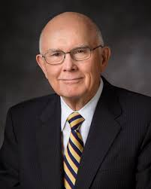
LESSON 52
Doctrine and Covenants 45:56-57.
56 And at that day, when I shall come in my glory, shall the parable be fulfilled which I spake concerning the ten virgins.
57 For they that are wise and have received the truth, and have taken the Holy Spirit for their guide, and have not been deceived—verily I say unto you, they shall not be hewn down and cast into the fire, but shall abide the day.
How will this parable be fulfilled at the Second Coming?
“The arithmetic of this parable is chilling. The ten virgins obviously represent members of Christ’s Church, for all were invited to the wedding feast and all knew what was required to be admitted when the bridegroom came. But only half were ready when he came” (“Preparation for the Second Coming,” Ensign or Liahona, May 2004,8).
Elder
Dallin H. Oaks
What must we do in order to be prepared for the Lord’s coming?

Slide 15
LESSON 52
If we receive the truth and take the Holy Spirit to be our guide, we will abide the Savior’s Second Coming.
How do you think your experiences with receiving the truth and following the Holy Spirit can help you be prepared to meet the Lord at His Second Coming?
Doctrine and Covenants 45:55:58-59.
55 And Satan shall be bound, that he shall have no place in the hearts of the children of men.
58 And the earth shall be given unto them for an inheritance; and they shall multiply and wax strong, and their children shall grow up without sin unto salvation.
59 For the Lord shall be in their midst, and his glory shall be upon them, and he will be their king and their lawgiver.

Slide 16
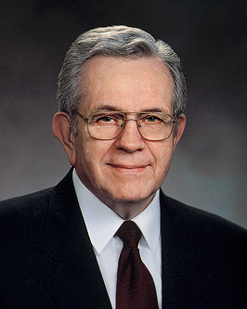
LESSON 52
“We live in troubled times—very troubled times. We hope, we pray, for better days. But that is not to be. The prophecies tell us that. We will not as a people, as families, or as individuals be exempt from the trials to come.…
“We need not live in fear of the future. We have every reason to rejoice and little reason to fear. If we follow the promptings of the Spirit, we will be safe, whatever the future holds. We will be shown what to do” (“The Cloven Tongues of Fire,” Ensign, May 2000,8).
President
Boyd K. Packer

