Slide 1
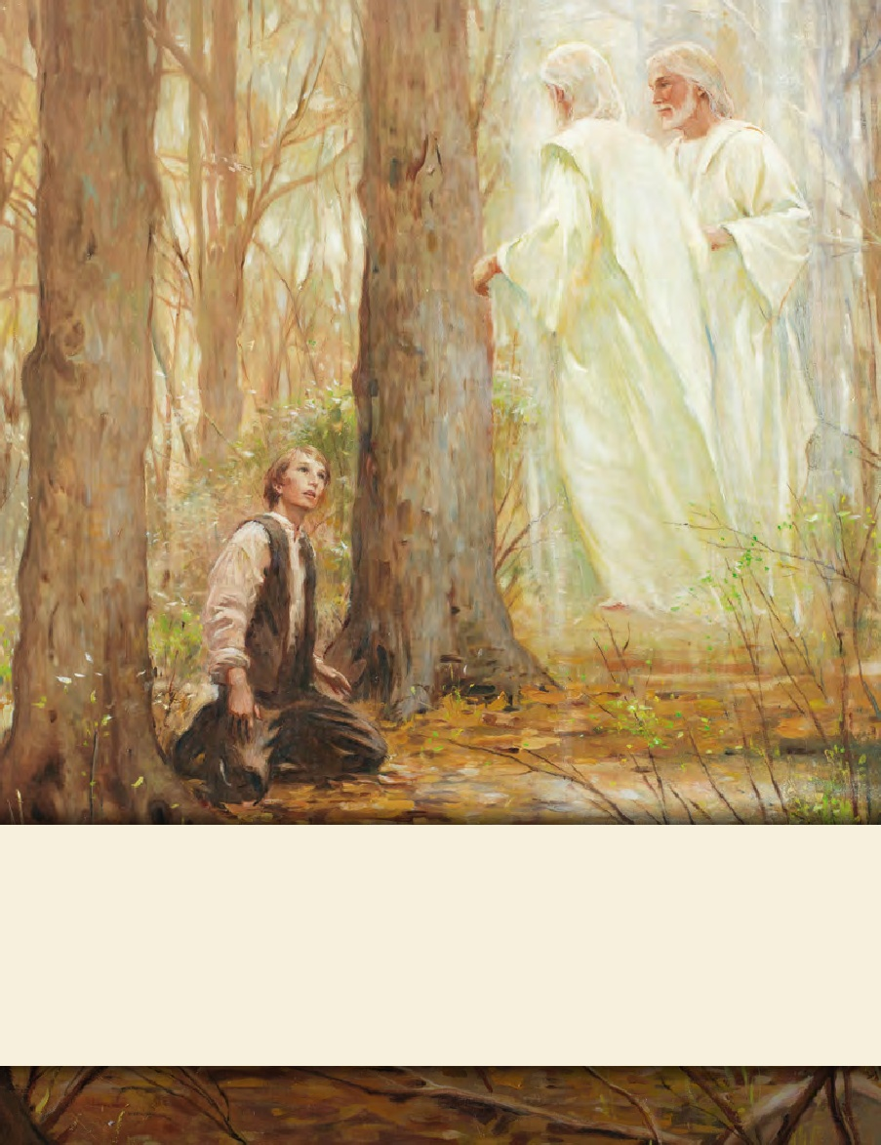
LESSON 15
SEMINARY
Doctrine and Covenants
and Church History

Slide 2
LESSON 51
Doctrine and Covenants
45:1-15.

Slide 3
LESSON 51
Doctrine and Covenants 45:1–5
“Jesus Christ emphasizes His roles as
Creator and Advocate”

Slide 4
LESSON 51
What qualities would a person need to have before you would want to listen to his or her counsel?
Introduction to Doctrine and Covenants 45
Revelation given through Joseph Smith the Prophet to the Church, at Kirtland, Ohio, March 7, 1831. Prefacing the record of this revelation, Joseph Smith’s history states that “at this age of the Church … many false reports … and foolish stories, were published … and circulated, … to prevent people from investigating the work, or embracing the faith. … But to the joy of the Saints, … I received the following.”

Slide 5
LESSON 51
Doctrine and Covenants 45:1.
Hearken, O ye people of my church, to whom the kingdom has been given; hearken ye and give ear to him who laid the foundation of the earth, who made the heavens and all the hosts thereof, and by whom all things were made which live, and move, and have a being.
Jesus Christ created the heavens and the earth.
Doctrine and Covenants 45:2.
And again I say, hearken unto my voice, lest death shall overtake you; in an hour when ye think not the summer shall be past, and the harvest ended, and your souls not saved.
Why should we hearken to the Savior?

Slide 6
LESSON 51
JUDGE
ADVOCATE
DEFENDANT
What is the role of the judge?
How might an advocate help the accused?
Doctrine and Covenants 45:3.
Listen to him who is the advocate with the Father, who is pleading your cause before him.
Who is the judge?
Who is the advocate?
Who is the defendant?
HEAVENLY FATHER
JESUS CHRIST
US

Slide 7
LESSON 51
Jesus Christ is our Advocate with Heavenly Father.
Why do we need an advocate with Heavenly Father?
We are guilty of sin. According to the justice of God, no unclean thing can dwell in His presence. Therefore, we need an advocate to plead our cause before the Father and help us be reconciled to Him.
Doctrine and Covenants 45:4-5.
4 Saying: Father, behold the sufferings and death of him who did no sin, in whom thou wast well pleased; behold the blood of thy Son which was shed, the blood of him whom thou gavest that thyself might be glorified;
5 Wherefore, Father, spare these my brethren that believe on my name, that they may come unto me and have everlasting life.
What does Jesus Christ ask Heavenly Father to consider?
The Savior tells of His sinless life and His suffering and death.
What else does the Savior ask the Father to consider?
Our faith in Jesus Christ.

Slide 8
LESSON 51
Doctrine and Covenants 45:6–10.
The Savior declares that He is the light and life of the world and that He has sent His everlasting covenant to the world.

Slide 9
LESSON 51
Doctrine and Covenants 45:6–10.
6 Hearken, O ye people of my church, and ye elders listen together, and hear my voice while it is called today, and harden not your hearts;
7 For verily I say unto you that I am Alpha and Omega, the beginning and the end, the light and the life of the world—a light that shineth in darkness and the darkness comprehendeth it not.
8 I came unto mine own, and mine own received me not; but unto as many as received me gave I power to do many miracles, and to become the sons of God; and even unto them that believed on my name gave I power to obtain eternal life.
9 And even so I have sent mine everlasting covenant into the world, to be a light to the world, and to be a standard for my people, and for the Gentiles to seek to it, and to be a messenger before my face to prepare the way before me.
10 Wherefore, come ye unto it, and with him that cometh I will reason as with men in days of old, and I will show unto you my strong reasoning.
What reasons does the Savior give for us to hearken to Him? What does it mean to you that He is “the beginning and the end”? In what ways does He bring light and life to the world?

Slide 10
LESSON 51
Jesus Christ is the beginning and the end.
Jesus Christ is the light and the life of the world.
What does the Savior promise to those who receive Him?
What do you think it means to “seek to” the gospel?
In what ways have you seen the gospel be a light to the world? In what ways is the gospel a standard for those of us who have made covenants with the Lord?

Slide 11
LESSON 51
Doctrine and Covenants 45:11–15.
“The Savior declares that He is the God of Enoch”

Slide 12
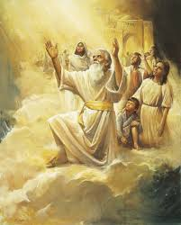
LESSON 51
Doctrine and Covenants 45:11–15.
Wherefore, hearken ye together and let me show unto you even my wisdom—the wisdom of him whom ye say is the God of Enoch, and his brethren.

Slide 13
LESSON 51
As we learn about Jesus Christ’s roles and characteristics, our desire to follow Him increases.
What have you learned about the Savior today that helps you want to hearken to Him?

