Slide 1
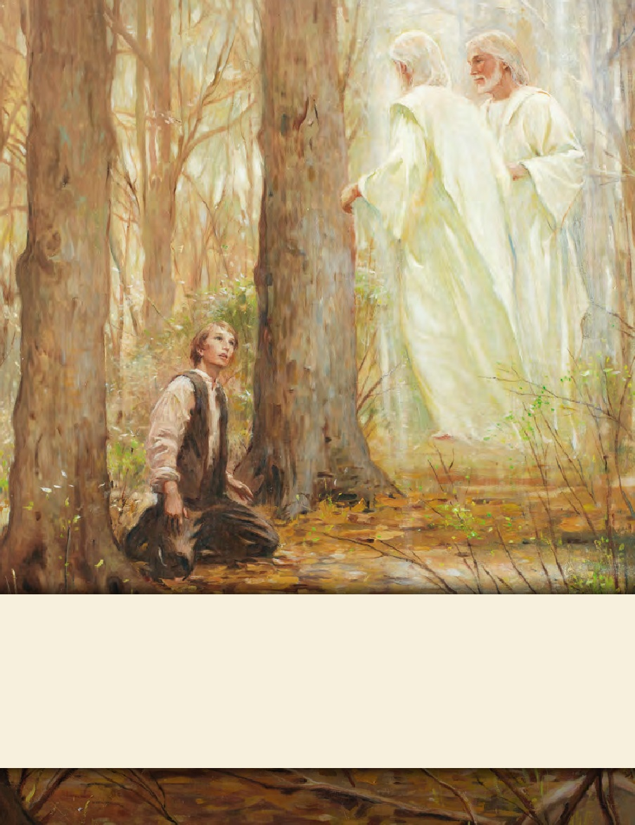
LESSON 15
SEMINARY
Doctrine and Covenants
and Church History

Slide 2
LESSON 50
Doctrine and Covenants
43-44

Slide 3
LESSON 50
Doctrine and Covenants 43:1-7.
“The Lord declares that revelations and commandments
come only through His appointed prophet”

Slide 4
LESSON 50
Why is it difficult to follow two different leaders and songs at the same time?
Doctrine and Covenants 43:1-5.
1 O hearken, ye elders of my church, and give ear to the words which I shall speak unto you.
2 For behold, verily, verily, I say unto you, that ye have received a commandment for a law unto my church, through him whom I have appointed unto you to receive commandments and revelations from my hand.
3 And this ye shall know assuredly—that there is none other appointed unto you to receive commandments and revelations until he be taken, if he abide in me.
4 But verily, verily, I say unto you, that none else shall be appointed unto this gift except it be through him; for if it be taken from him he shall not have power except to appoint another in his stead.
5 And this shall be a law unto you, that ye receive not the teachings of any that shall come before you as revelations or commandments.
Who was appointed at that time to receive commandments and revelations for the entire Church?
Joseph Smith.
Who is appointed to that position today?
The President of the Church.

Slide 5
LESSON 50
What do we learn from these verses?
Only the President of the Church can receive revelations for the entire Church.
Doctrine and Covenants 21:4-6.
Doctrine and Covenants 21:4-6.
4 Wherefore, meaning the church, thou shalt give heed unto all his words and commandments which he shall give unto you as he receiveth them, walking in all holiness before me;
5 For his word ye shall receive, as if from mine own mouth, in all patience and faith.
6 For by doing these things the gates of hell shall not prevail against you; yea, and the Lord God will disperse the powers of darkness from before you, and cause the heavens to shake for your good, and his name’s glory.
2 But, behold, verily, verily, I say unto thee, no one shall be appointed to receive commandments and revelations in this church excepting my servant Joseph Smith, Jun., for he receiveth them even as Moses.
3 And thou shalt be obedient unto the things which I shall give unto him, even as Aaron, to declare faithfully the commandments and the revelations, with power and authority unto the church.
4 And if thou art led at any time by the Comforter to speak or teach, or at all times by the way of commandment unto the church, thou mayest do it.
5 But thou shalt not write by way of commandment, but by wisdom;
6 And thou shalt not command him who is at thy head, and at the head of the church;
7 For I have given him the keys of the mysteries, and the revelations which are sealed, until I shall appoint unto them another in his stead.

Slide 6
LESSON 50
Doctrine and Covenants 43:6-7.
6 And this I give unto you that you may not be deceived, that you may know they are not of me.
7 For verily I say unto you, that he that is ordained of me shall come in at the gate and be ordained as I have told you before, to teach those revelations which you have received and shall receive through him whom I have appointed.

Slide 7
LESSON 50
Doctrine and Covenants 43:8-16.
“The elders are commanded to instruct and edify
one another and to become sanctified”

Slide 8
LESSON 50
What are some purposes of these meetings?
Doctrine and Covenants 43:8.
And now, behold, I give unto you a commandment, that when ye are assembled together ye shall instruct and edify each other, that ye may know how to act and direct my church, how to act upon the points of my law and commandments, which I have given.
What did the Lord say the elders of the Church are to do when they assemble? What does it mean to edify each other?
To build each other up and to strengthen each other.
What will we learn as we instruct and edify each other?
When we assemble together, we are to instruct and edify one another so we can learn how to act and direct the Church.

Slide 9
LESSON 50
Doctrine and Covenants 43:9,11.
9 And thus ye shall become instructed in the law of my church, and be sanctified by that which ye have received, and ye shall bind yourselves to act in all holiness before me—
11 Purge ye out the iniquity which is among you; sanctify yourselves before me.
What are we to do after we have been instructed in our Church meetings?
We are to bind ourselves to act on the knowledge we receive.
How are we blessed as we receive knowledge and act on it?
We become sanctified as we act on the truths we learn.
What do you think it means to “bind [ourselves] to act”?
How does the knowledge we receive at Church meetings help us become sanctified?

Slide 10
LESSON 50
Doctrine and Covenants 43:15-16.
15 Again I say, hearken ye elders of my church, whom I have appointed: Ye are not sent forth to be taught, but to teach the children of men the things which I have put into your hands by the power of my Spirit;
16 And ye are to be taught from on high. Sanctify yourselves and ye shall be endowed with power, that ye may give even as I have spoken.
How do you think these verses apply to the work of full-time missionaries?

Slide 11
LESSON 50
Doctrine and Covenants 43:17-35.
“God’s servants are to preach repentance in
Preparation for the Second Coming
and the Millennium”

Slide 12
LESSON 50
How do you think people feel if they are unprepared when the time comes for them to participate in such activities?
Doctrine and Covenants 43:17-18.
17 Hearken ye, for, behold, the great day of the Lord is nigh at hand.
18 For the day cometh that the Lord shall utter his voice out of heaven; the heavens shall shake and the earth shall tremble, and the trump of God shall sound both long and loud, and shall say to the sleeping nations: Ye saints arise and live; ye sinners stay and sleep until I shall call again.

Slide 13
LESSON 50
Doctrine and Covenants 43:17-22.
17 Hearken ye, for, behold, the great day of the Lord is nigh at hand.
18 For the day cometh that the Lord shall utter his voice out of heaven; the heavens shall shake and the earth shall tremble, and the trump of God shall sound both long and loud, and shall say to the sleeping nations: Ye saints arise and live; ye sinners stay and sleep until I shall call again.
19 Wherefore gird up your loins lest ye be found among the wicked.
20 Lift up your voices and spare not. Call upon the nations to repent, both old and young, both bond and free, saying: Prepare yourselves for the great day of the Lord;
21 For if I, who am a man, do lift up my voice and call upon you to repent, and ye hate me, what will ye say when the day cometh when the thunders shall utter their voices from the ends of the earth, speaking to the ears of all that live, saying—Repent, and prepare for the great day of the Lord?
22 Yea, and again, when the lightnings shall streak forth from the east unto the west, and shall utter forth their voices unto all that live, and make the ears of all tingle that hear, saying these words—Repent ye, for the great day of the Lord is come?
What did the Lord instruct the elders to teach? What truth can we learn from these verses?
To prepare ourselves for the Second Coming of Jesus Christ, we must repent.

Slide 14
LESSON 50
Doctrine and Covenants 43:25-27.
25 How oft have I called upon you by the mouth of my servants, and by the ministering of angels, and by mine own voice, and by the voice of thunderings, and by the voice of lightnings, and by the voice of tempests, and by the voice of earthquakes, and great hailstorms, and by the voice of famines and pestilences of every kind, and by the great sound of a trump, and by the voice of judgment, and by the voice of mercy all the day long, and by the voice of glory and honor and the riches of eternal life, and would have saved you with an everlasting salvation, but ye would not!
26 Behold, the day has come, when the cup of the wrath of mine indignation is full.
27 Behold, verily I say unto you, that these are the words of the Lord your God.
What “voices” did you identify? Why do you think these different voices are needed?

Slide 15
LESSON 50
Doctrine and Covenants 43:28-31.
28 Wherefore, labor ye, labor ye in my vineyard for the last time—for the last time call upon the inhabitants of the earth.
29 For in mine own due time will I come upon the earth in judgment, and my people shall be redeemed and shall reign with me on earth.
30 For the great Millennium, of which I have spoken by the mouth of my servants, shall come.
31 For Satan shall be bound, and when he is loosed again he shall only reign for a little season, and then cometh the end of the earth.
What is the great event prophesied about in these verses?
The Millennium.
What will happen during the Millennium?
During the Millennium, Satan will be bound and Jesus Christ will reign with His people on the earth.
1 Nephi 22:26
And because of the righteousness of his people, Satan has no power; wherefore, he cannot be loosed for the space of many years; for he hath no power over the hearts of the people, for they dwell in righteousness, and the Holy One of Israel reigneth.

Slide 16
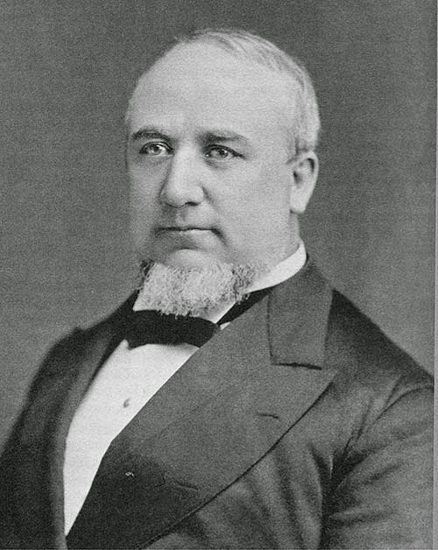
LESSON 50
“We talk about Satan being bound. Satan will be bound by the power of God; but he will be bound also by the determination of the people of God not to listen to him, not to be governed by him” (Gospel Truth: Discourses and Writings of President George Q. Cannon, comp. Jerreld L. Newquist, 2 vols. [1957–74],1:86).
President
George Q. Cannon
How can we prepare now to be counted among the righteous when the Savior comes again?

Slide 17
LESSON 50
Doctrine and Covenants 44.
“The Lord commands His servants
to assemble together”

