Slide 1
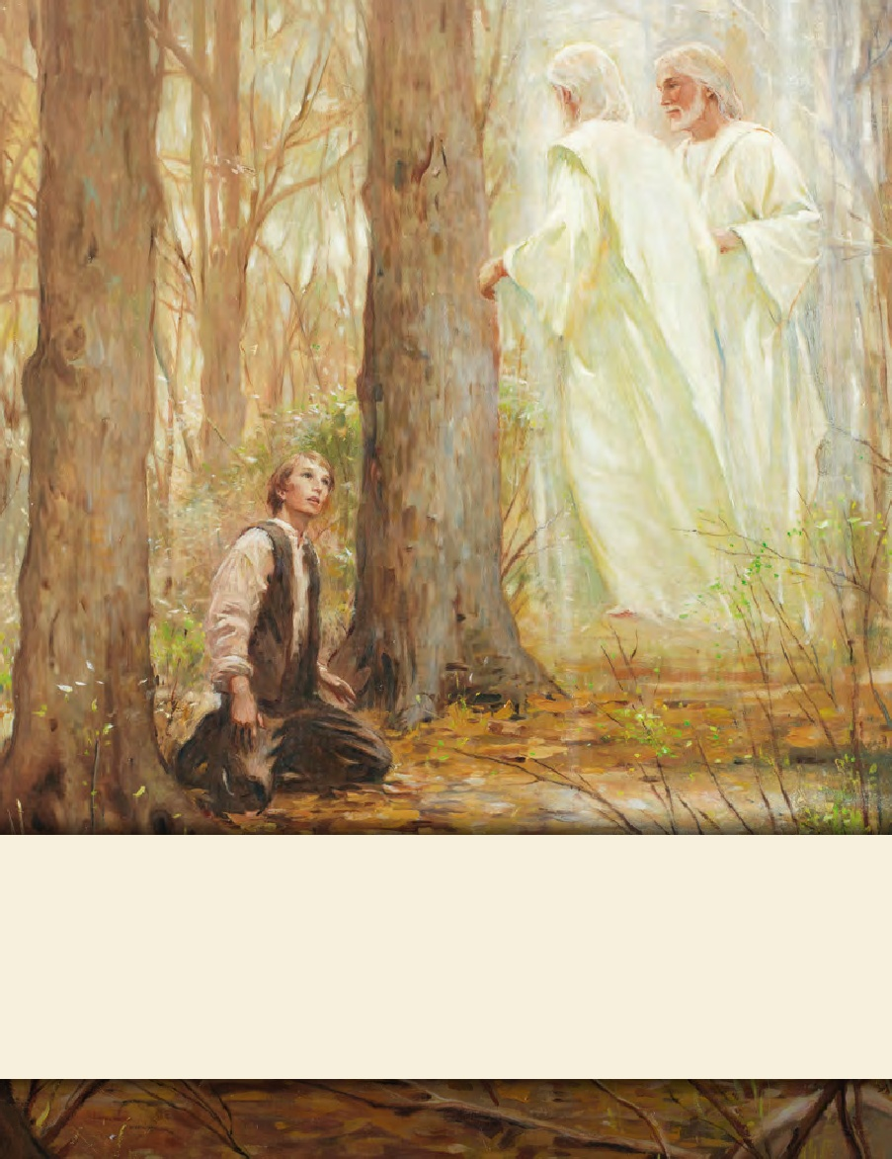
LESSON 15
SEMINARY
Doctrine and Covenants
and Church History

Slide 2
LESSON 49
Doctrine and Covenants
42:43-93

Slide 3
LESSON 49
Doctrine and Covenants 42:43-55.
“The Lord gives counsel concerning
death and healing”

Slide 4
LESSON 49
What are these items used for? Which of these should we rely on in times of illness?
Doctrine and Covenants 42:43-44.
43 And whosoever among you are sick, and have not faith to be healed, but believe, shall be nourished with all tenderness, with herbs and mild food, and that not by the hand of an enemy.
44 And the elders of the church, two or more, shall be called, and shall pray for and lay their hands upon them in my name; and if they die they shall die unto me, and if they live they shall live unto me.

Slide 5
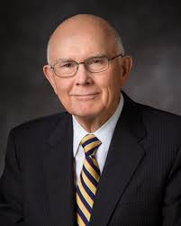
LESSON 49
“Latter-day Saints believe in applying the best available scientific knowledge and techniques. We use nutrition, exercise, and other practices to preserve health, and we enlist the help of healing practitioners, such as physicians and surgeons, to restore health.
“The use of medical science is not at odds with our prayers of faith and our reliance on priesthood blessings “Of course we don’t wait until all other methods are exhausted before we pray in faith or give priesthood blessings for healing. In emergencies, prayers and blessings come first. Most often we pursue all efforts simultaneously” (“Healing the Sick,” Ensign or Liahona, May 2010,47).
Elder Dallin H. Oaks
Why do you think it is important for us to use prayer and priesthood blessings as well as medical treatment for healing in times of illness?
Will every sick person who receives a priesthood blessing be healed?

Slide 6
LESSON 49
Doctrine and Covenants 42:48.
And again, it shall come to pass that he that hath faith in me to be healed, and is not appointed unto death, shall be healed.
What is the major factor that determines the outcome of a priesthood blessing?
Why won’t everyone who has faith in Jesus Christ be healed?
Why is it important to have faith in God’s will and timing for each of us?
If we have faith in Jesus Christ, we can be healed according to His will.

Slide 7
LESSON 49
“As children of God, knowing of His great love and His ultimate knowledge of what is best for our eternal welfare, we trust in Him. The first principle of the gospel is faith in the Lord Jesus Christ, and faith means trust. I felt that trust in a talk my cousin gave at the funeral of a teenage girl who had died of a serious illness. He spoke these words, which first astonished me and then edified me: ‘I know it was the will of the Lord that she die. She had good medical care. She was given priesthood blessings. Her name was on the prayer roll in the temple. She was the subject of hundreds of prayers for her restoration
Elder Dallin H. Oaks
to health. And I know that there is enough faith in this family that she would have been healed unless it was the will of the Lord to take her home at this time.’ I felt that same trust in the words of the father of another choice girl whose life was taken by cancer in her teen years. He declared, ‘Our family’s faith is in Jesus Christ and is not dependent on outcomes.’ Those teachings ring true to me. We do all that we can for the healing of a loved one, and then we trust in the Lord for the outcome” (“Healing the Sick,”50).
How did the individuals Elder Oaks spoke of exercise faith in Jesus Christ?
Why do you think this might be?
Why do you think it is important to exercise faith in Jesus Christ even though we may not receive the outcome we desire?

Slide 8
LESSON 49
Doctrine and Covenants 42:45-47.
45 Thou shalt live together in love, insomuch that thou shalt weep for the loss of them that die, and more especially for those that have not hope of a glorious resurrection.
46 And it shall come to pass that those that die in me shall not taste of death, for it shall be sweet unto them;
47 And they that die not in me, wo unto them, for their death is bitter.
What doctrine taught in verse 46 might bring comfort to those who mourn the loss of a loved one?
Death is sweet unto those who die in the Lord.
What do you think it means to die in the Lord?
What do you think it means that death will be “sweet” to those who die in the Lord?

Slide 9
LESSON 49
Doctrine and Covenants 42:56-73.
“The Lord promises to reveal additional scripture and
knowledge to those who ask”

Slide 10
LESSON 49
Doctrine and Covenants 42:61,68.
61 If thou shalt ask, thou shalt receive revelation upon revelation, knowledge upon knowledge, that thou mayest know the mysteries and peaceable things—that which bringeth joy, that which bringeth life eternal.
68 Therefore, he that lacketh wisdom, let him ask of me, and I will give him liberally and upbraid him not.
If we ask, the Lord will give us knowledge that will bring us peace, joy, and eternal life.
If we ask for wisdom, the Lord will give to us liberally.
What are the blessings of diligently asking the Lord for revelation?

Slide 11
LESSON 49
Doctrine and Covenants 42:74-87.
“Priesthood leaders receive instruction on dealing with members who commit serious sin”

Slide 12
LESSON 49
Doctrine and Covenants 42:88-93.
“The Lord instructs the Saints on how
to resolve personal offenses”

Slide 13
LESSON 49
When have you seen someone take offense at the words or actions of another person? Have you ever felt hurt or offended by someone else’s words or actions?
Doctrine and Covenants 42:88-89.
88 And if thy brother or sister offend thee, thou shalt take him or her between him or her and thee alone; and if he or she confess thou shalt be reconciled.
89 And if he or she confess not thou shalt deliver him or her up unto the church, not to the members, but to the elders. And it shall be done in a meeting, and that not before the world.
What are we to do with someone who has offended us?
Reconcile with him or her privately.
Why do you think this approach might be helpful?

Slide 14
LESSON 49
Offenses given in private shouldbe…
Offenses given in public shouldbe…
…resolved in public.
…resolved in private.

Slide 15
LESSON 49
Doctrine and Covenants 42:90-93.
90 And if thy brother or sister offend many, he or she shall be chastened before many.
91 And if any one offend openly, he or she shall be rebuked openly, that he or she may be ashamed. And if he or she confess not, he or she shall be delivered up unto the law of God.
92 If any shall offend in secret, he or she shall be rebuked in secret, that he or she may have opportunity to confess in secret to him or her whom he or she has offended, and to God, that the church may not speak reproachfully of him or her.
93 And thus shall ye conduct in all things.
Offenses given in private should be resolved in private. Offenses given in public should be resolved in public.
Why might it be inappropriate for private offenses to be resolved publicly?
Why might it at times be wise to resolve public offenses publicly?
How do you think resolving offenses appropriately might bless a family? A ward or branch? A group of classmates?

