Slide 1
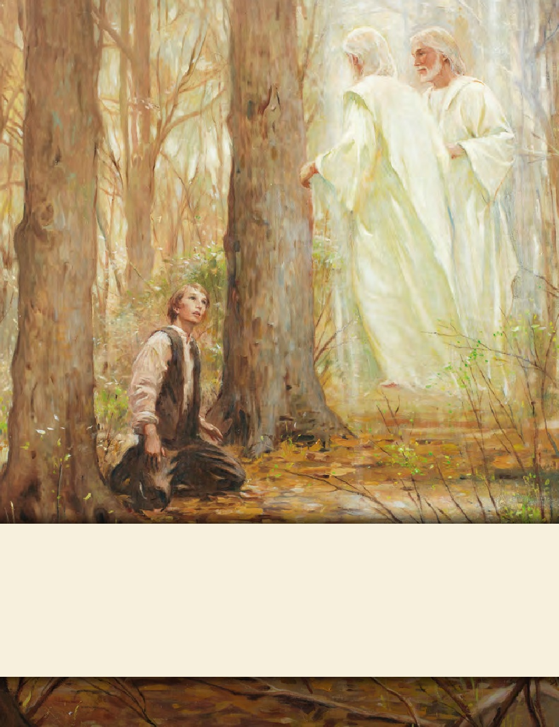
LESSON 15
SEMINARY
Doctrine and Covenants
and Church History

Slide 2
LESSON 45
“At the Ohio”

Slide 3
LESSON 45
Mini-lesson 1—The Law of the Church.
Why are laws important?
Why might laws be important in the Church?
Doctrine and Covenants 38:32.
Wherefore, for this cause I gave unto you the commandment that ye should go to the Ohio; and there I will give unto you my law; and there you shall be endowed with power from on high;
Consecrate, Law of Consecration
To dedicate, to make holy, or to become righteous. The law of consecration is a divine principle whereby men and women voluntarily dedicate their time, talents, and material wealth to the establishment and building up of God’s kingdom.
United Order
An organization through which the Saints in the early days of the restored Church sought to live the law of consecration. Individuals shared property, goods, and profits, receiving these things according to their wants and needs

Slide 4
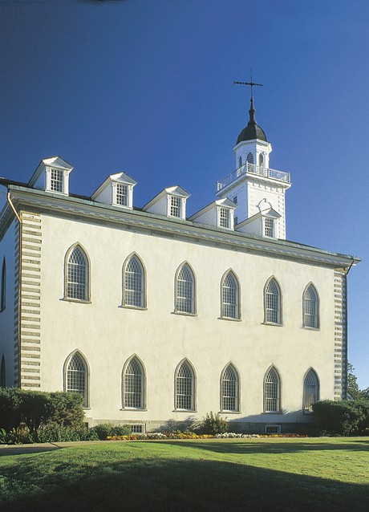
LESSON 45
Mini-lesson 2—The Kirtland Temple.
Doctrine and Covenants 88:119.
Organize yourselves; prepare every needful thing; and establish a house, even a house of prayer, a house of fasting, a house of faith, a house of learning, a house of glory, a house of order, a house of God;
Doctrine and Covenants 110:07.
For behold, I have accepted this house, and my name shall be here; and I will manifest myself to my people in mercy in this house.
Doctrine and Covenants 110:11.
After this vision closed, the heavens were again opened unto us; and Moses appeared before us, and committed unto us the keys of the gathering of Israel from the four parts of the earth, and the leading of the ten tribes from the land of the north

Slide 5
LESSON 45
Mini-lesson 3—Missionary Work.
Doctrine and Covenants 42:6-7.
6 And ye shall go forth in the power of my Spirit, preaching my gospel, two by two, in my name, lifting up your voices as with the sound of a trump, declaring my word like unto angels of God.
7 And ye shall go forth baptizing with water, saying: Repent ye, repent ye, for the kingdom of heaven is at hand.
What commandment did the Lord give the Saints?
How were these missionaries to preach the gospel?
How is this similar to how full-time missionaries preach the gospel today?

Slide 6
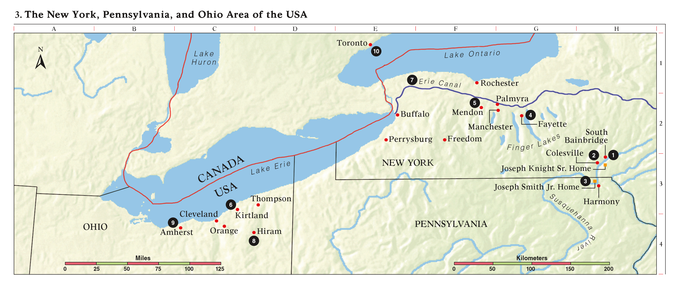
LESSON 45
Doctrine and Covenants 38:33.
And from thence, whosoever I will shall go forth among all nations, and it shall be told them what they shall do; for I have a great work laid up in store, for Israel shall be saved, and I will lead them whithersoever I will, and no power shall stay my hand.

Slide 7
LESSON 45
Mini-lesson 4—Other Significant Revelations and Events.
Doctrine and Covenants 42:61.
If thou shalt ask, thou shalt receive revelation upon revelation, knowledge upon knowledge, that thou mayest know the mysteries and peaceable things—that which bringeth joy, that which bringeth life eternal.
The section introduction 76
The section introduction 89
A vision given to Joseph Smith the Prophet and Sidney Rigdon, at Hiram, Ohio, February 16, 1832. Prefacing the record of this vision, Joseph Smith’s history states: “Upon my return from Amherst conference, I resumed the translation of the Scriptures. From sundry revelations which had been received, it was apparent that many important points touching the salvation of man had been taken from the Bible, or lost before it was compiled. It appeared self-evident from what truths were left, that if God rewarded every one according to the deeds done in the body the term ‘Heaven,’ as intended for the Saints’ eternal home, must include more kingdoms than one. Accordingly, … while translating St. John’s Gospel, myself and Elder Rigdon saw the following vision.” At the time this vision was given, the Prophet was translating John 5:29.
Revelation given through Joseph Smith the Prophet, at Kirtland, Ohio, February 27, 1833. As a consequence of the early brethren using tobacco in their meetings, the Prophet was led to ponder upon the matter; consequently, he inquired of the Lord concerning it. This revelation, known as the Word of Wisdom, was the result.

Slide 8
LESSON 45
The section introduction 107
The section introduction 137
Revelation on the priesthood, given through Joseph Smith the Prophet, at Kirtland, Ohio, about April 1835. Although this section was recorded in 1835, the historical records affirm that most of verses 60 through 100 incorporate a revelation given through Joseph Smith on November 11, 1831. This section was associated with the organization of the Quorum of the Twelve in February and March 1835. The Prophet likely delivered it in the presence of those who were preparing to depart May 3, 1835, on their first quorum mission.
A vision given to Joseph Smith the Prophet, in the temple at Kirtland, Ohio, January 21, 1836. The occasion was the administration of ordinances in preparation for the dedication of the temple.
What do you think it was like for the Saints in Ohio to hear some of these truths for the first time?

Slide 9
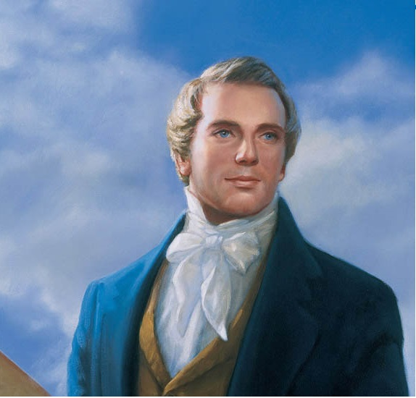
LESSON 45
Opposition and apostasy plague the faithful in Ohio.
“Many false reports, lies, and foolish stories, were published in the newspapers, and circulated in every direction, to prevent people from investigating the work, or embracing the faith” (in History of the Church,1:158).
Joseph Smith

