Slide 1
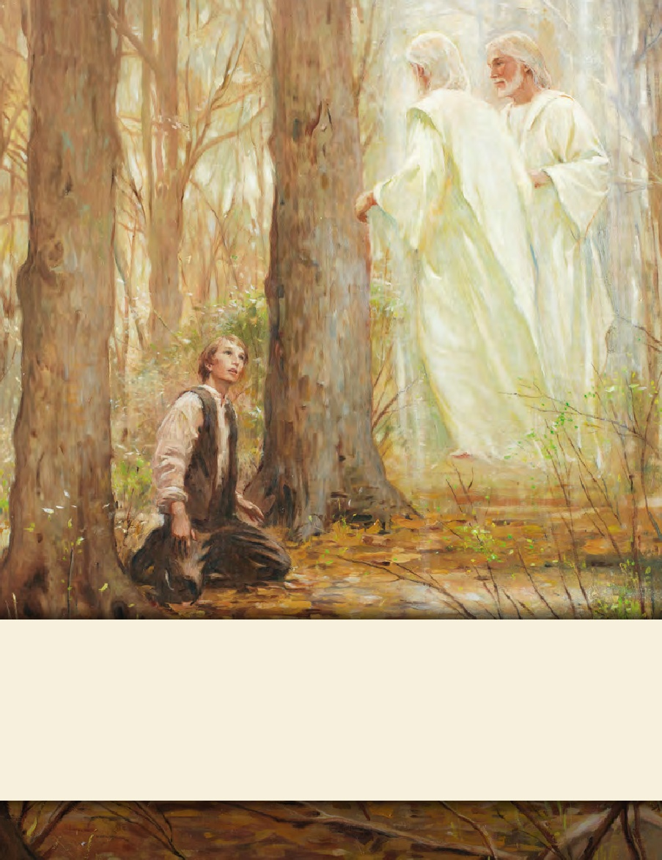
LESSON 15
SEMINARY
Doctrine and Covenants
and Church History

Slide 2
LESSON 40
Doctrine and Covenants 35.

Slide 3
LESSON 40
Doctrine and Covenants 35:1-12.
“The Lord says that He has prepared Sidney Rigdon for a greater work”

Slide 4
LESSON 40
What have you experienced that helps you know that the Lord knows you and has a plan for your life?
Introduction Lesson
Within six months of the Church’s organization, Oliver Cowdery and Peter Whitmer Jr. were called to preach the gospel to the American Indians (see D&C 28:8;30:5). Ziba Peterson and Parley P. Pratt were called soon thereafter to accompany them (see D&C 32). On their way to the western borders of Missouri, they stopped in Mentor, Ohio, and Kirtland, Ohio, where they shared the message of the restored gospel with Elder Pratt’s friend and former minister, Sidney Rigdon. In a short time more than 100 people, including Sidney Rigdon and many members of his
congregation, were baptized. This more than doubled the Church’s total membership. After the elders left the Kirtland area to continue their journey, Sidney Rigdon and a friend named Edward Partridge traveled to Fayette, New York, to meet the Prophet Joseph Smith. Soon after their arrival, Joseph received the revelation recorded in Doctrine and Covenants 35. In it, the Lord gave Sidney specific responsibilities within the newly restored Church.

Slide 5
LESSON 40
Doctrine and Covenants 35:1-3.
1 Listen to the voice of the Lord your God, even Alpha and Omega, the beginning and the end, whose course is one eternal round, the same today as yesterday, and forever.
2 I am Jesus Christ, the Son of God, who was crucified for the sins of the world, even as many as will believe on my name, that they may become the sons of God, even one in me as I am one in the Father, as the Father is one in me, that we may be one.
3 Behold, verily, verily, I say unto my servant Sidney, I have looked upon thee and thy works. I have heard thy prayers, and prepared thee for a greater work.
What evidence did you find that the Lord was aware of Sidney Rigdon?
What do these verses suggest about the Lord’s relationship with us?
The Lord knows us and has a work for each of us to do.
Why does this truth matter to you?

Slide 6
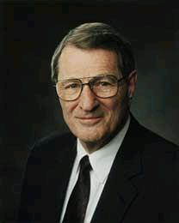
LESSON 40
“I testify to you that God has known you individually … for a long, long time (see D&C 93:23). He has loved you for a long, long time. … He knows your names and all your heartaches and your joys!” (“Remember How Merciful the Lord Hath Been,” Ensign or Liahona, May 2004,46).
Neal A. Maxwell

Slide 7
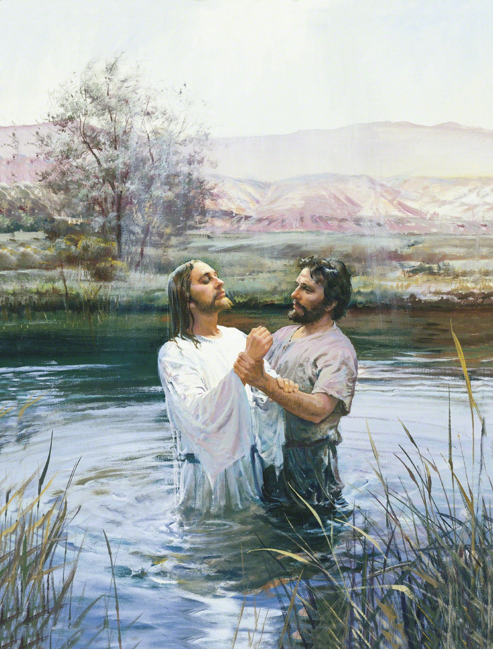
LESSON 40
Doctrine and Covenants 35:4-6.
4 Thou art blessed, for thou shalt do great things. Behold thou wast sent forth, even as John, to prepare the way before me, and before Elijah which should come, and thou knewest it not.
5 Thou didst baptize by water unto repentance, but they received not the Holy Ghost;
6 But now I give unto thee a commandment, that thou shalt baptize by water, and they shall receive the Holy Ghost by the laying on of the hands, even as the apostles of old.
4 Thou art blessed, for thou shalt do great things. Behold thou wast sent forth, even as John, to prepare the way before me, and before Elijah which should come, and thou knewest it not.
5 Thou didst baptize by water unto repentance, but they received not the Holy Ghost;
6 But now I give unto thee a commandment, that thou shalt baptize by water, and they shall receive the Holy Ghost by the laying on of the hands, even as the apostles of old.
How was Sidney like John the Baptist?
He had prepared others to receive the fulness of the gospel.
What was part of this “greater work”?
He would help others receive baptism and the gift of the Holy Ghost through the proper authority.

Slide 8
LESSON 40
Doctrine and Covenants 35:7-11.
7 And it shall come to pass that there shall be a great work in the land, even among the Gentiles, for their folly and their abominations shall be made manifest in the eyes of all people.
8 For I am God, and mine arm is not shortened; and I will show miracles, signs, and wonders, unto all those who believe on my name.
9 And whoso shall ask it in my name in faith, they shall cast out devils; they shall heal the sick; they shall cause the blind to receive their sight, and the deaf to hear, and the dumb to speak, and the lame to walk.
10 And the time speedily cometh that great things are to be shown forth unto the children of men;
11 But without faith shall not anything be shown forth except desolations upon Babylon, the same which has made all nations drink of the wine of the wrath of her fornication
What did the Lord promise those who follow Him in faith?
The Lord will work miracles, signs, and wonders according to the faith of those who believe on His name.
Why do you think miracles, signs, and wonders are so closely linked to faith?

Slide 9
LESSON 40
Doctrine and Covenants 35:13-19.
“The Lord promises to help those
He calls to do His work”

Slide 10
LESSON 40
Doctrine and Covenants 35:13.
Wherefore, I call upon the weak things of the world, those who are unlearned and despised, to thresh the nations by the power of my Spirit;
Which phrases in this verse describe those whom the Lord calls to assist in His work?
In what ways could those whom the Lord calls to assist in His work be considered “the weak things of the world”?
Why might those whom the world considers weak be good candidates to help the Lord accomplish His work?
What do you think is the meaning of the phrase “thresh the nations by the power of my Spirit”?
What truth can we learn from verse 13?
God calls upon those who are weak to accomplish His work through the power of His Spirit.
How could this truth help someone who feels nervous about serving a mission? How could it help someone who has been asked to teach at church but feels inadequate? How could it help someone who feels prompted to share the gospel but isn’t sure what to say or do?

Slide 11
LESSON 40
Doctrine and Covenants 35:14-15.
14 And their arm shall be my arm, and I will be their shield and their buckler; and I will gird up their loins, and they shall fight manfully for me; and their enemies shall be under their feet; and I will let fall the sword in their behalf, and by the fire of mine indignation will I preserve them.
15 And the poor and the meek shall have the gospel preached unto them, and they shall be looking forth for the time of my coming, for it is nigh at hand.
What are some phrases in these verses that describe how the Lord will bless us as we assist in His work?
Doctrine and Covenants 35:17-19,22.
17 And I have sent forth the fulness of my gospel by the hand of my servant Joseph; and in weakness have I blessed him;
18 And I have given unto him the keys of the mystery of those things which have been sealed, even things which were from the foundation of the world, and the things which shall come from this time until the time of my coming, if he abide in me, and if not, another will I plant in his stead.
19 Wherefore, watch over him that his faith fail not, and it shall be given by the Comforter, the Holy Ghost, that knoweth all things.
What counsel did the Lord give to Sidney Rigdon regarding the Prophet Joseph Smith?
How can we apply this counsel in regard to our Church leaders today?

Slide 12
LESSON 40
Doctrine and Covenants 35:20-27.
“The Lord commands Sidney Rigdon to write for Joseph Smith, preach the gospel, and keep the covenants he had made”

Slide 13
LESSON 40
Doctrine and Covenants 35:20-23.
20 And a commandment I give unto thee—that thou shalt write for him; and the scriptures shall be given, even as they are in mine own bosom, to the salvation of mine own elect;
21 For they will hear my voice, and shall see me, and shall not be asleep, and shall abide the day of my coming; for they shall be purified, even as I am pure.
22 And now I say unto you, tarry with him, and he shall journey with you; forsake him not, and surely these things shall be fulfilled.
23 And inasmuch as ye do not write, behold, it shall be given unto him to prophesy; and thou shalt preach my gospel and call on the holy prophets to prove his words, as they shall be given him.
What are some of the duties the Lord called Sidney Rigdon to perform?
Doctrine and Covenants 35:24-25.
24 Keep all the commandments and covenants by which ye are bound; and I will cause the heavens to shake for your good, and Satan shall tremble and Zion shall rejoice upon the hills and flourish;
25 And Israel shall be saved in mine own due time; and by the keys which I have given shall they be led, and no more be confounded at all.
What do you think it means that the Lord would cause the heavens to shake for your good?

Slide 14
LESSON 40
As we keep the commandments and honor our covenants, the Lord will help us accomplish His work.
The Lord knows us and has a work for each of us to do.
God calls upon those who are weak to accomplish His work through the power of His Spirit.
As we keep the commandments and honor our covenants, the Lord will help us accomplish His work.
The Lord knows us and has a work for each of us to do.
God calls upon those who are weak to accomplish His work through the power of His Spirit.
As we keep the commandments and honor our covenants, the Lord will help us accomplish His work.
How do the three truths on the board relate to each other?
When have you (or someone you know) received the Lord’s help while seeking to accomplish His work?
Doctrine and Covenants 35:26-27.
26 Lift up your hearts and be glad, your redemption draweth nigh.
27 Fear not, little flock, the kingdom is yours until I come. Behold, I come quickly. Even so. Amen.
What reasons do you think Sidney Rigdon and Joseph Smith had to lift up their hearts and be glad?

