Slide 1
LESSON 15
SEMINARY
Doctrine and Covenants
and Church History

Slide 2
LESSON 39
Doctrine and Covenants 33-34.

Slide 3
LESSON 39
Doctrine and Covenants 33:1-6
“The Lord calls Ezra Thayre and Northrop Sweet to proclaim the gospel”

Slide 4
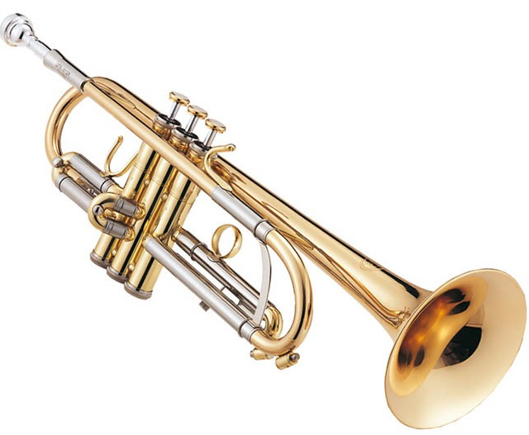
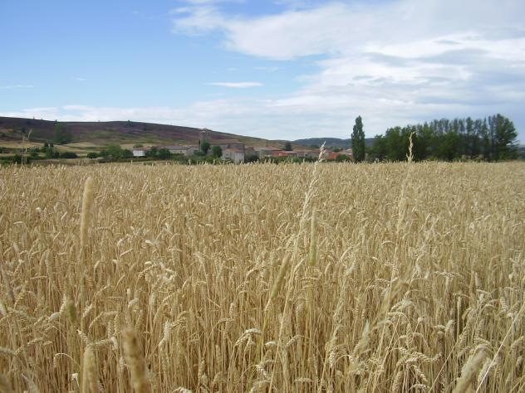
LESSON 39
How could these things relate to missionary work?

Slide 5
LESSON 39
Doctrine and Covenants 33:1-2
1 Behold, I say unto you, my servants Ezra and Northrop, open ye your ears and hearken to the voice of the Lord your God, whose word is quick and powerful, sharper than a two-edged sword, to the dividing asunder of the joints and marrow, soul and spirit; and is a discerner of the thoughts and intents of the heart.
2 For verily, verily, I say unto you that ye are called to lift up your voices as with the sound of a trump, to declare my gospel unto a crooked and perverse generation.
What do you think it means to “open … your ears and hearken to the voice of … God”? How can we show the Lord that our ears are open to hearing His voice?
What do you think it means to declare the gospel “as with the sound of a trump”?

Slide 6
LESSON 39
Doctrine and Covenants 33:3
For behold, the field is white already to harvest; and it is the eleventh hour, and the last time that I shall call laborers into my vineyard.
What do you think the Lord’s vineyard represents?
(The world).
Who might the laborers in the Lord’s vineyard represent?
(Members of the Lord’s Church).
What do you think the phrase “it is the eleventh hour” means?
(This is the final dispensation of the gospel and the last time the Lord will set up His kingdom on earth before His Second Coming).

Slide 7
LESSON 39
Doctrine and Covenants 33:4
And my vineyard has become corrupted every whit; and there is none which doeth good save it be a few; and they err in many instances because of priestcrafts, all having corrupt minds
Which phrases in this verse stand out to you? Why? What can we do to strengthen ourselves against the corrupt influences of the world?
The Lord has____________________and is_________________________.

Slide 8
LESSON 39
Doctrine and Covenants 33:5-6.
5 And verily, verily, I say unto you, that this church have I established and called forth out of the wilderness.
6 And even so will I gather mine elect from the four quarters of the earth, even as many as will believe in me, and hearken unto my voice.
What is something God has done and something He is now doing that can help strengthen us against the corruption of the world?
The Lord has established His Church and is gathering His elect in the last days.
According toverse6, who are the elect?
Considering the corruptness of the world, why would it be important for the Lord’s elect to gather together?
How has your membership in The Church of Jesus Christ of Latter-day Saints strengthened you against the corruption in the world?

Slide 9
LESSON 39
Doctrine and Covenants 33:7-18.
“The Lord gives Ezra Thayre and Northrop Sweet
instructions for teaching the gospel”

Slide 10
LESSON 39
Doctrine and Covenants 33:7-10.
7 Yea, verily, verily, I say unto you, that the field is white already to harvest; wherefore, thrust in your sickles, and reap with all your might, mind, and strength.
8 Open your mouths and they shall be filled, and you shall become even as Nephi of old, who journeyed from Jerusalem in the wilderness.
9 Yea, open your mouths and spare not, and you shall be laden with sheaves upon your backs, for lo, I am with you.
10 Yea, open your mouths and they shall be filled, saying: Repent, repent, and prepare ye the way of the Lord, and make his paths straight; for the kingdom of heaven is at hand;
If we open our mouths to declare the gospel…
the Lord will inspire us with what to say.
What are some situations in which we might be reluctant to open our mouths about the gospel?
When have you decided to open your mouth to speak about the gospel and felt inspired to know what to say? When have you seen someone else share the gospel and felt that they were inspired in what they said?

Slide 11
LESSON 39
Doctrine and Covenants 33:16-18.
16 And the Book of Mormon and the holy scriptures are given of me for your instruction; and the power of my Spirit quickeneth all things.
17 Wherefore, be faithful, praying always, having your lamps trimmed and burning, and oil with you, that you may be ready at the coming of the Bridegroom—
18 For behold, verily, verily, I say unto you, that I come quickly. Even so. Amen.
What counsel did the Lord give Ezra and Northrop that could help them know what to say as missionaries?
What do you think is the meaning of the Lord’s counsel to have “your lamps trimmed and burning, and oil with you”?
How can the Lord’s counsel in these verses help us be ready to open our mouths to share the gospel at any moment and in any situation?

Slide 12
LESSON 39
Doctrine and Covenants 34.
“The Lord commends Orson Pratt for his faith and commands him to preach the gospel”

Slide 13
LESSON 39
Doctrine and Covenants 34
Introduction
Revelation given through Joseph Smith the Prophet to Orson Pratt, at Fayette, New York, November 4, 1830. Brother Pratt was nineteen years old at the time. He had been converted and baptized when he first heard the preaching of the restored gospel by his older brother, Parley P. Pratt, six weeks before. This revelation was received in the Peter Whitmer Sr. home.
Who was blessed in this example? How old was Orson Pratt when he was baptized? How did he learn about the gospel?
Doctrine and Covenants 34:1.
My son Orson, hearken and hear and behold what I, the Lord God, shall say unto you, even Jesus Christ your Redeemer.

Slide 14
LESSON 39
Doctrine and Covenants 34:2-3.
2 The light and the life of the world, a light which shineth in darkness and the darkness comprehendeth it not;
3 Who so loved the world that he gave his own life, that as many as would believe might become the sons of God. Wherefore you are my son.
Why did the Lord call Orson His son?
Because of Orson’s belief in the Lord.
What did the Lord do for “as many as” believe in Him?

Slide 15
LESSON 39
Doctrine and Covenants 34:4-6.
4 And blessed are you because you have believed;
5 And more blessed are you because you are called of me to preach my gospel—
6 To lift up your voice as with the sound of a trump, both long and loud, and cry repentance unto a crooked and perverse generation, preparing the way of the Lord for his second coming.
Why do you think we are “more blessed” when we teach the gospel to others?

Slide 16
LESSON 39
Doctrine and Covenants 34:10-11.
10 Wherefore, lift up your voice and spare not, for the Lord God hath spoken; therefore prophesy, and it shall be given by the power of the Holy Ghost.
11 And if you are faithful, behold, I am with you until I come—
What blessings are given to those who diligently teach the gospel?
Those who diligently teach the gospel will do so by the power of the Holy Ghost.
What blessing is promised to those who are faithful?
If we are faithful, the Lord will be with us.
How might the truth in Doctrine and Covenants 34:11 help you in a time of discouragement?

