Slide 1
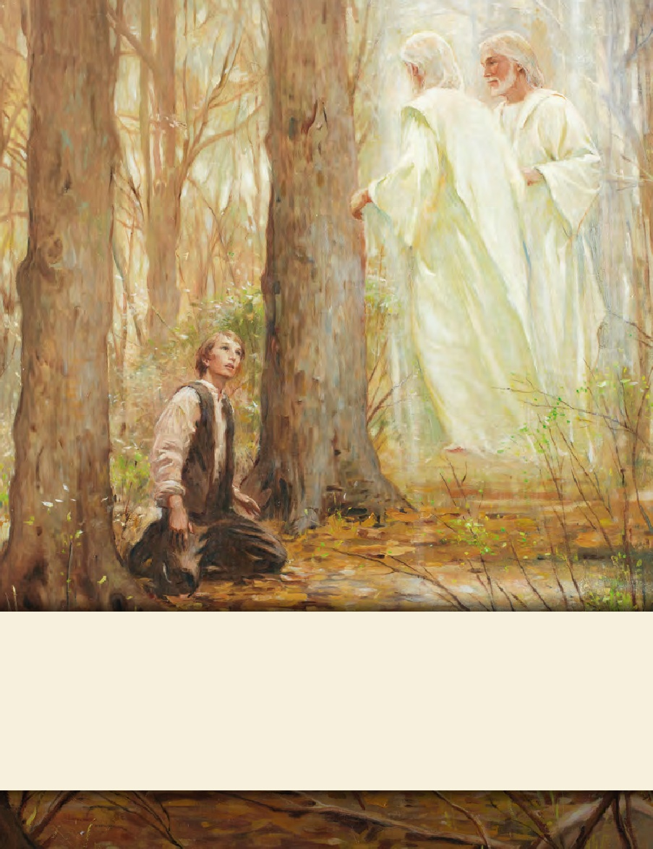
LESSON 15
SEMINARY
Doctrine and Covenants
and Church History

Slide 2
LESSON 38
Doctrine and Covenants 31-32.

Slide 3
LESSON 38
Doctrine and Covenants 31:1-8
“The Lord calls Thomas B. Marsh to preach the gospel and help establish the Church”

Slide 4
LESSON 38
While living in Boston, Massachusetts, in 1829, Thomas B. Marsh concluded that none of the churches he knew of were consistent with the teachings of the Bible. He wrote, “I believed the Spirit of God dictated me to make a journey west.” He departed from his wife, Elizabeth, and their young family to search for the truth. After a three-month journey, Thomas was traveling home when he “heard of [a] Golden Book found by a youth named Joseph Smith.” He made his way to Palmyra, New York, where he met Martin Harris. The printer gave Thomas a proof sheet containing the first sixteen pages of the Book of Mormon. Thomas later wrote, “After arriving home … I showed my wife the sixteen pages of the Book of Mormon … with which she was well pleased, believing it to be the work of God.”
About a year later, after learning about the organization of the Church, Thomas and his family moved to Palmyra. While living in the area he was baptized near Fayette and ordained an elder by Oliver Cowdery in September 1830 (see Thomas B. Marsh, “History of Thomas Baldwin Marsh,” Millennial Star, June 11, 1864,375).

Slide 5
LESSON 38
What impresses you about Thomas B. Marsh’s search for the truth?
Doctrine and Covenants 31:1-2
Thomas, my son, blessed are you because of your faith in my work.
2 Behold, you have had many afflictions because of your family; nevertheless, I will bless you and your family, yea, your little ones; and the day cometh that they will believe and know the truth and be one with you in my church.
What encouragement did the Lord give to Thomas in these verses?
What promise did the Lord give Thomas concerning his family?
What principle can we learn from Doctrine and Covenants 31:1–2 that can help us if we have family members who are not members of the Church or are not faithfully living according to their covenants?
Through our faithfulness, our family members may be blessed to believe and know the truth.
What are some ways individuals may be blessed through the faithfulness of family members? What examples of this have you seen?

Slide 6
LESSON 38
Doctrine and Covenants 31:3-4.
3 Lift up your heart and rejoice, for the hour of your mission is come; and your tongue shall be loosed, and you shall declare glad tidings of great joy unto this generation.
4 You shall declare the things which have been revealed to my servant, Joseph Smith, Jun. You shall begin to preach from this time forth, yea, to reap in the field which is white already to be burned.

Slide 7
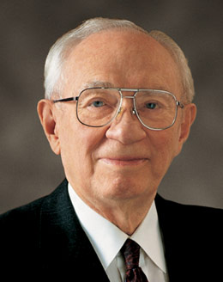
LESSON 38
“You will bless the lives of those you teach, and their posterity after them. You will bless your own life. You will bless the lives of your family, who will sustain you and pray for you” (“Of Missions, Temples, and Stewardship,” Ensign, Nov. 1995,52).
Gordon B. Hinckley
Who is blessed through missionary service?
Doctrine and Covenants 31:5-8.
5 Therefore, thrust in your sickle with all your soul, and your sins are forgiven you, and you shall be laden with sheaves upon your back, for the laborer is worthy of his hire. Wherefore, your family shall live.
6 Behold, verily I say unto you, go from them only for a little time, and declare my word, and I will prepare a place for them.
7 Yea, I will open the hearts of the people, and they will receive you. And I will establish a church by your hand;
8 And you shall strengthen them and prepare them against the time when they shall be gathered.

Slide 8
LESSON 38
What blessings would come to those whom Thomas would teach?
How would Thomas be blessed for his missionary service?
How would his family be blessed?
How has another person’s missionary service blessed your life or the life of someone you know?

Slide 9
LESSON 38
Doctrine and Covenants 31:9-13.
Jesus Christ gives personal
counsel to Thomas B. Marsh

Slide 10
LESSON 38
Which item of counsel did you choose? Why do you think this counsel is important for us today?
2. What is one way we can apply this counsel in our lives?
3. How can we benefit from following this counsel?
Doctrine and Covenants 31:9-12.
9 Be patient in afflictions, revile not against those that revile. Govern your house in meekness, and be steadfast.
10 Behold, I say unto you that you shall be a physician unto the church, but not unto the world, for they will not receive you.
11 Go your way whithersoever I will, and it shall be given you by the Comforter what you shall do and whither you shall go.
12 Pray always, lest you enter into temptation and lose your reward.

Slide 11
LESSON 38
Doctrine and Covenants 31:13.
Be faithful unto the end, and lo, I am with you. These words are not of man nor of men, but of me, even Jesus Christ, your Redeemer, by the will of the Father. Amen.
If we are faithful to the end, then the Lord will be with us.
When have you felt that the Lord was with you as you sought to be faithful to Him?

Slide 12
LESSON 38
Doctrine and Covenants 32.
“The Lord calls Parley P. Pratt and Ziba Peterson to join the mission to the Lamanites”

Slide 13
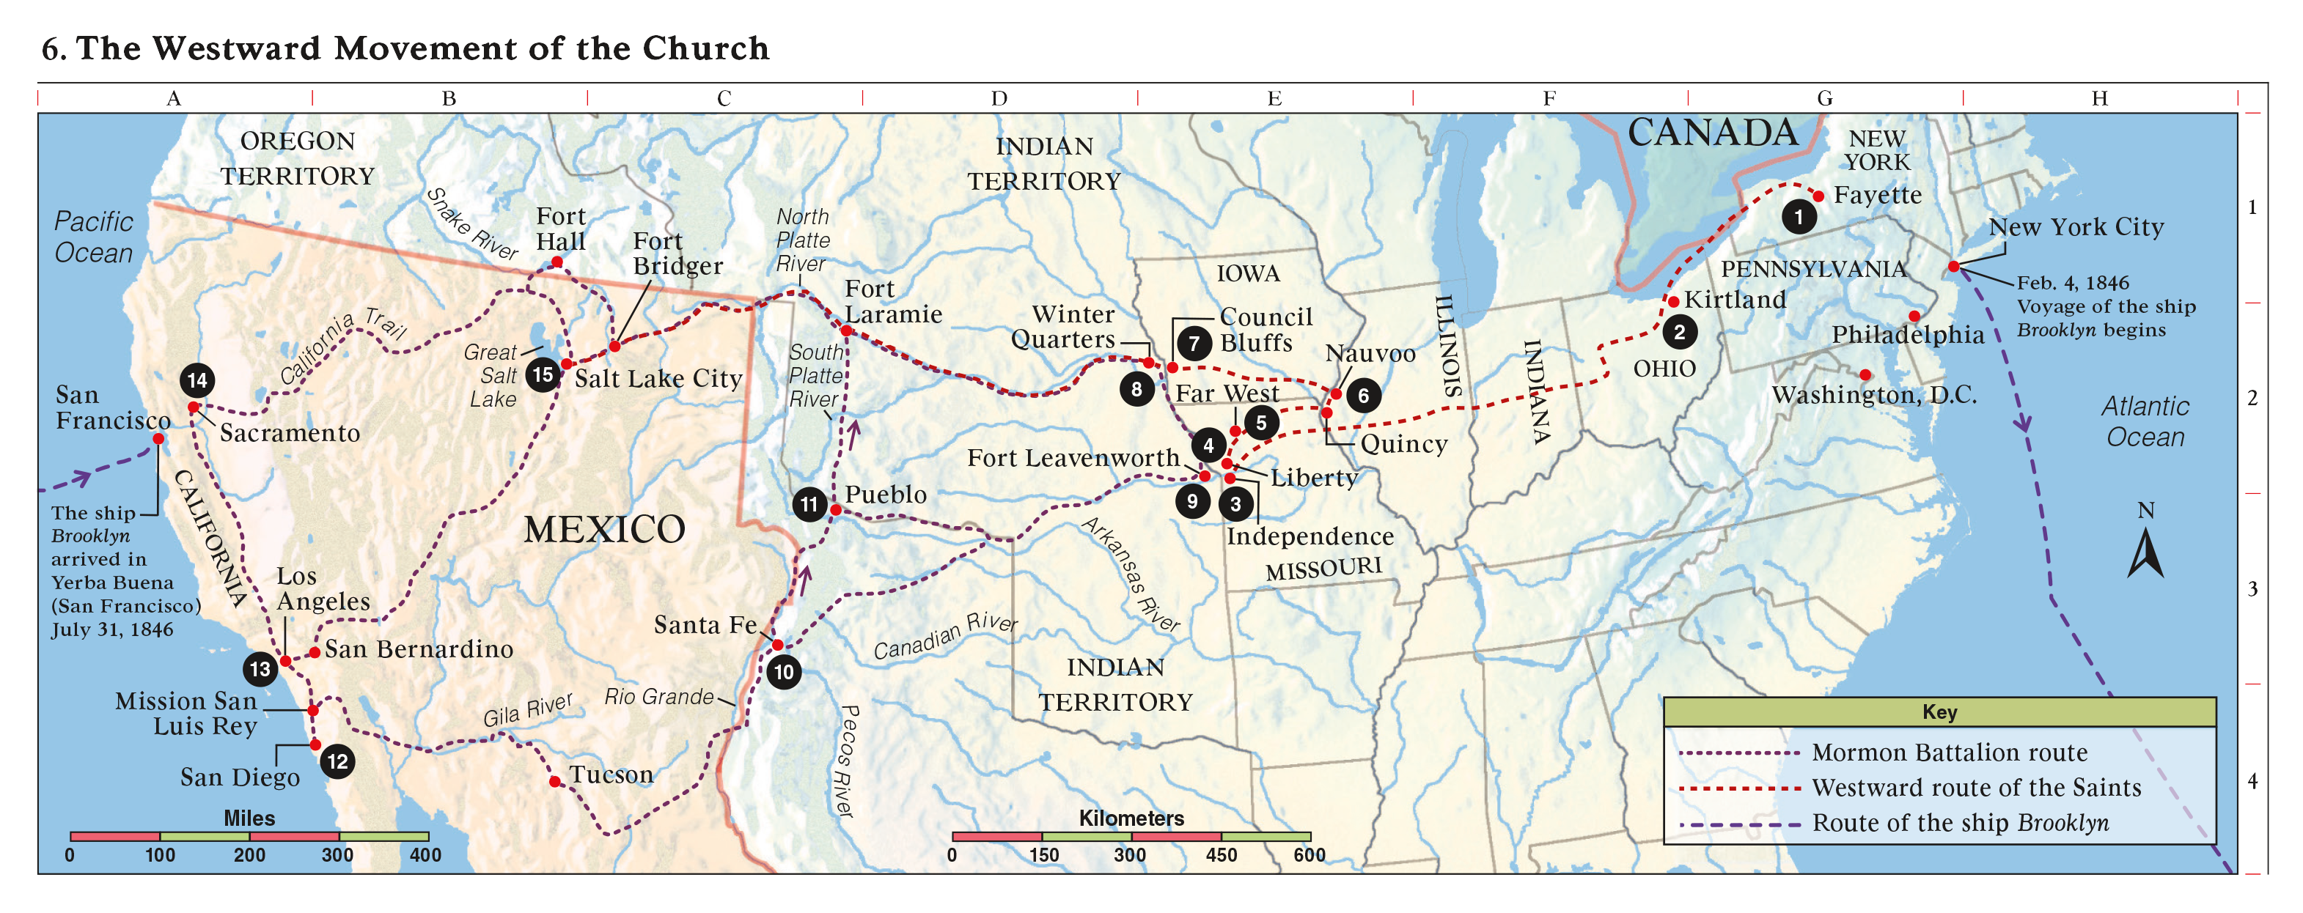
LESSON 38
Where were Oliver Cowdery and Peter Whitmer Jr. called to preach the gospel?

Slide 14
LESSON 38
Doctrine and Covenants 32
Introduction.
Revelation given through Joseph Smith the Prophet to Parley P. Pratt and Ziba Peterson, in Manchester, New York, early October 1830. Great interest and desires were felt by the elders respecting the Lamanites, of whose predicted blessings the Church had learned from the Book of Mormon. In consequence, supplication was made that the Lord would indicate His will as to whether elders should be sent at that time to the Indian tribes in the West. The revelation followed.
What question did some elders of the Church have concerning the mission to the Lamanites?
They wanted to know if additional missionaries might be called to teach the Lamanites.

Slide 15
LESSON 38
Doctrine and Covenants 32:1-3.
1 And now concerning my servant Parley P. Pratt, behold, I say unto him that as I live I will that he shall declare my gospel and learn of me, and be meek and lowly of heart.
2 And that which I have appointed unto him is that he shall go with my servants, Oliver Cowdery and Peter Whitmer, Jun., into the wilderness among the Lamanites.
3 And Ziba Peterson also shall go with them; and I myself will go with them and be in their midst; and I am their advocate with the Father, and nothing shall prevail against them.
What were Parley and Ziba called to do?
What did the Lord promise them?
If we are faithful to the end, then the Lord will be with us.

