Slide 1
LESSON 15
SEMINARY
Doctrine and Covenants
and Church History

Slide 2
LESSON 36
Doctrine and Covenants 29:30-50.

Slide 3
LESSON 36
Doctrine and Covenants 29:30-45.
“The Savior declares that He has redeemed us from the Fall and that He offers salvation from our sins”

Slide 4
LESSON 36
Doctrine and Covenants 29:31-32.
31 For by the power of my Spirit created I them; yea, all things both spiritual and temporal—
32 First spiritual, secondly temporal, which is the beginning of my work; and again, first temporal, and secondly spiritual, which is the last of my work.

Slide 5
LESSON 36
Doctrine and Covenants 29:34-35.
34 Wherefore, verily I say unto you that all things unto me are spiritual, and not at any time have I given unto you a law which was temporal; neither any man, nor the children of men; neither Adam, your father, whom I created.
35 Behold, I gave unto him that he should be an agent unto himself; and I gave unto him commandment, but no temporal commandment gave I unto him, for my commandments are spiritual; they are not natural nor temporal, neither carnal nor sensual.
How did the Lord describe His commandments?
All God’s commandments are spiritual.
All God’s commandments are spiritual.
How would you explain the Lord’s declaration that all His commandments are spiritual?
What are some examples of spiritual blessings that come when we keep the commandments?
How might the doctrine written on the board help your friend in the scenario discussed at the beginning of the lesson?

Slide 6
LESSON 36
Doctrine and Covenants 29:39.
And it must needs be that the devil should tempt the children of men, or they could not be agents unto themselves; for if they never should have bitter they could not know the sweet.
Why does the Lord allow the devil to tempt us? Why is it important for us to have choices between good and evil?
Moses 3:16-17
16 And I, the Lord God, commanded the man, saying: Of every tree of the garden thou mayest freely eat,
17 But of the tree of the knowledge of good and evil, thou shalt not eat of it, nevertheless, thou mayest choose for thyself, for it is given unto thee; but, remember that I forbid it, for in the day thou eatest thereof thou shalt surely die.
What commandment did the Lord give Adam?
The Lord commanded Adam not to eat the fruit of the tree of the knowledge of good and evil.
What did the Lord say would happen if Adam transgressed this commandment?
Adam would die. From the day of his transgression Adam was subject to physical and spiritual death.

Slide 7
LESSON 36
Doctrine and Covenants 29:40-41.
40 Wherefore, it came to pass that the devil tempted Adam, and he partook of the forbidden fruit and transgressed the commandment, wherein he became subject to the will of the devil, because he yielded unto temptation.
41 Wherefore, I, the Lord God, caused that he should be cast out from the Garden of Eden, from my presence, because of his transgression, wherein he became spiritually dead, which is the first death, even that same death which is the last death, which is spiritual, which shall be pronounced upon the wicked when I shall say: Depart, ye cursed.
What is spiritual death?
Spiritual death is being removed from God’s presence.

Slide 8
LESSON 36
Doctrine and Covenants 29:42.
But, behold, I say unto you that I, the Lord God, gave unto Adam and unto his seed, that they should not die as to the temporal death, until I, the Lord God, should send forth angels to declare unto them repentance and redemption, through faith on the name of mine Only Begotten Son.
What other kind of death came because of Adam’s transgression?
Temporal death; in other words, the death of the physical body. This death is the separation of the spirit from the body.
Helaman 14:16.
Yea, behold, this death bringeth to pass the resurrection, and redeemeth all mankind from the first death—that spiritual death; for all mankind, by the fall of Adam being cut off from the presence of the Lord, are considered as dead, both as to things temporal and to things spiritual.
Who experiences the consequences of Adam’s transgression?

Slide 9
LESSON 36
Helaman 14:17.
But behold, the resurrection of Christ redeemeth mankind, yea, even all mankind, and bringeth them back into the presence of the Lord.
How will the consequences of Adam’s transgression be overcome? Who will receive these blessings?
Alma 33:22
Alma 42:23
If so, wo shall come upon you; but if not so, then cast about your eyes and begin to believe in the Son of God, that he will come to redeem his people, and that he shall suffer and die to atone for their sins; and that he shall rise again from the dead, which shall bring to pass the resurrection, that all men shall stand before him, to be judged at the last and judgment day, according to their works.
But God ceaseth not to be God, and mercy claimeth the penitent, and mercy cometh because of the atonement; and the atonement bringeth to pass the resurrection of the dead; and the resurrection of the dead bringeth back men into the presence of God; and thus they are restored into his presence, to be judged according to their works, according to the law and justice.

Slide 10
LESSON 36
Doctrine and Covenants 29:43-44.
43 And thus did I, the Lord God, appoint unto man the days of his probation—that by his natural death he might be raised in immortality unto eternal life, even as many as would believe;
44 And they that believe not unto eternal damnation; for they cannot be redeemed from their spiritual fall, because they repent not.
Doctrine and Covenants 29:42-43.
42 But, behold, I say unto you that I, the Lord God, gave unto Adam and unto his seed, that they should not die as to the temporal death, until I, the Lord God, should send forth angels to declare unto them repentance and redemption, through faith on the name of mine Only Begotten Son.
43 And thus did I, the Lord God, appoint unto man the days of his probation—that by his natural death he might be raised in immortality unto eternal life, even as many as would believe.
What do we need to do to be saved from the consequences of our own sins?
Through His Atonement, Jesus Christ offers forgiveness and eternal life to all those who exercise faith in Him and repent of their sins.

Slide 11
LESSON 36
“Immortality is to live forever as a resurrected being. Through the Atonement of Jesus Christ, everyone will receive this gift. Eternal life, or exaltation, is to inherit a place in the highest degree of the celestial kingdom, where we will live in God’s presence and continue as families (see D&C 131:1–4). Like immortality, this gift is made possible through the Atonement of Jesus Christ. However, it requires our ‘obedience to the laws and ordinances of the Gospel’ (Articles of Faith 1:3)” (True to the Faith: A Gospel Reference[2004],52).

Slide 12
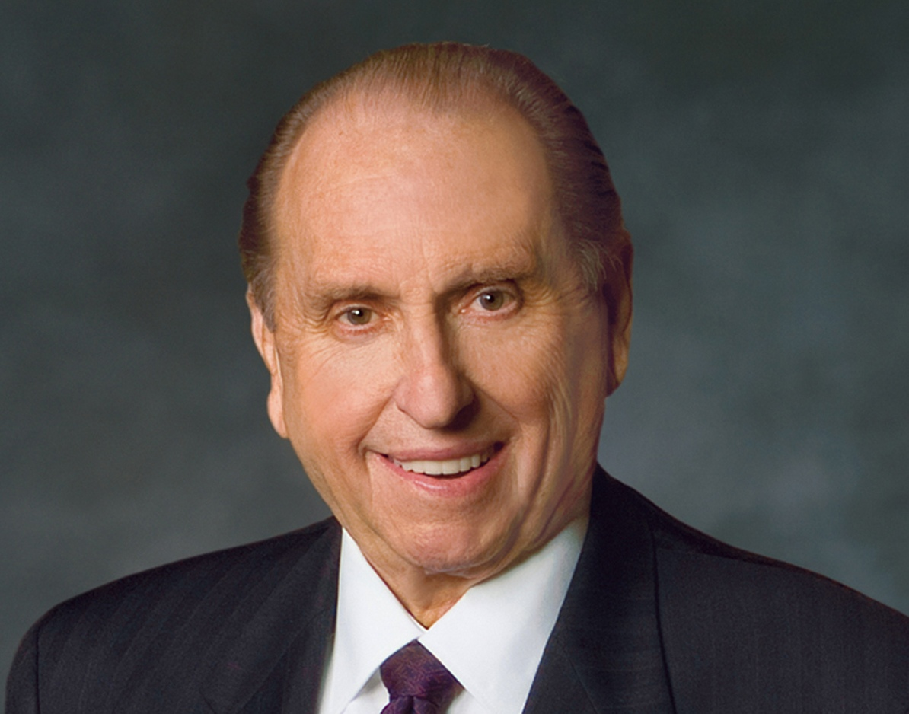
LESSON 36
“Don’t put your eternal life at risk. If you have sinned, the sooner you begin to make your way back, the sooner you will find the sweet peace and joy that come with the miracle of forgiveness.
“…You are of a noble birthright. Eternal life in the kingdom of our Father is your goal. Such a goal is not achieved in one glorious attempt but rather is the result of a lifetime of righteousness, an accumulation of wise choices, even a constancy of purpose. As with anything really
Thomas S. Monson
worthwhile, the reward of eternal life requires effort.
“…May we be filled with gratitude for the right of choice, accept the responsibility of choice, and ever be conscious of the results of choice” (“The Three Rs of Choice, ”Ensign or Liahona, Nov. 2010,69–70).

Slide 13
LESSON 36
Doctrine and Covenants 29:46-50.
“The Savior declares that little children and those without understanding are redeemed through His Atonement”

Slide 14
LESSON 36
Doctrine and Covenants 29:46-47.
46 But behold, I say unto you, that little children are redeemed from the foundation of the world through mine Only Begotten;
47 Wherefore, they cannot sin, for power is not given unto Satan to tempt little children, until they begin to become accountable before me.

Slide 15
LESSON 36
What does this mean for little children who die before they reach the age of eight?
They are saved in the celestial kingdom.
Doctrine and Covenants 137:10.
Joseph Smith Translation,
Genesis 17:11.
And I also beheld that all children who die before they arrive at the years of accountability are saved in the celestial kingdom of heaven.
And I will establish a covenant of circumcision with thee, and it shall be my covenant between me and thee, and thy seed after thee, in their generations; that thou mayest know forever that children are not accountable before me until they are eight years old.
How does this passage enhance your understanding of the Atonement of Jesus Christ?

Slide 16
LESSON 36
Doctrine and Covenants 29:49.
And, again, I say unto you, that whoso having knowledge, have I not commanded to repent?

