Slide 1
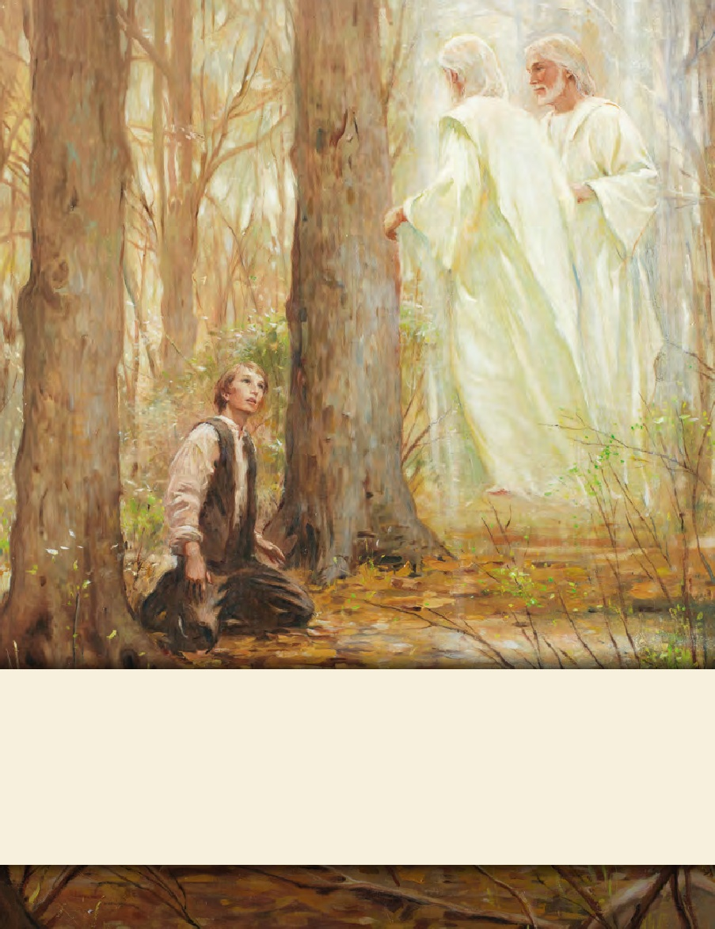
LESSON 15
SEMINARY
Doctrine and Covenants
and Church History

Slide 2
LESSON 135
Doctrine and Covenants 128:12–25

Slide 3
LESSON 135
Doctrine and Covenants 128:12–18.
“Joseph Smith teaches about the salvation of the living and the dead”

Slide 4
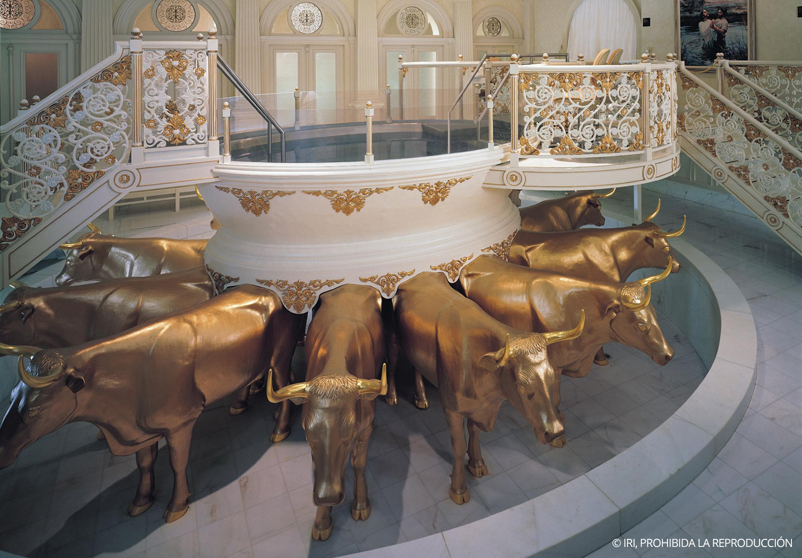
LESSON 135
Doctrine and Covenants 128:12–13.
12 Herein is glory and honor, and immortality and eternal life—The ordinance of baptism by water, to be immersed therein in order to answer to the likeness of the dead, that one principle might accord with the other; to be immersed in the water and come forth out of the water is in the likeness of the resurrection of the dead in coming forth out of their graves; hence, this ordinance was instituted to form a relationship with the ordinance of baptism for the dead, being in likeness of the dead.
13 Consequently, the baptismal font was instituted as a similitude of the grave, and was commanded to be in a place underneath where the living are wont to assemble, to show forth the living and the dead, and that all things may have their likeness, and that they may accord one with another—that which is earthly conforming to that which is heavenly, as Paul hath declared, 1 Corinthians 15:46, 47, and 48:
How could you use the teachings in verses 12–13 to help someone understand why baptism is done by immersion?

Slide 5
LESSON 135
Doctrine and Covenants 128:15.
And now, my dearly beloved brethren and sisters, let me assure you that these are principles in relation to the dead and the living that cannot be lightly passed over, as pertaining to our salvation. For their salvation is necessary and essential to our salvation, as Paul says concerning the fathers—that they without us cannot be made perfect—neither can we without our dead be made perfect.
Why do our ancestors need us to perform baptisms for the dead?
Our ancestors who die without the gospel cannot progress toward perfection until the saving ordinances of the gospel are performed for them.

Slide 6
LESSON 135
“Your deceased ancestors live in a place called the spirit world. There they have the opportunity to hear and accept the gospel of Jesus Christ. However, they cannot receive the ordinances of the gospel for themselves, and they cannot progress until others provide these ordinances for them. “Your privilege and responsibility is to give your ancestors this gift by identifying them and ensuring that ordinances are performed in their behalf in the temple. They may then choose whether to accept the work that has been done” (Member’s Guide to Temple and Family History Work[2009],2).
How do you think your ancestors might feel toward you when you do this work for them?
What is another reason we perform baptisms for the dead?
The salvation of our deceased ancestors is necessary and essential to our salvation.
Why do you think “their salvation is necessary and essential to our salvation”?

Slide 7
LESSON 135
Doctrine and Covenants 128:16-17.
16 And now, in relation to the baptism for the dead, I will give you another quotation of Paul, 1 Corinthians 15:29: Else what shall they do which are baptized for the dead, if the dead rise not at all? Why are they then baptized for the dead?
17 And again, in connection with this quotation I will give you a quotation from one of the prophets, who had his eye fixed on the restoration of the priesthood, the glories to be revealed in the last days, and in an especial manner this most glorious of all subjects belonging to the everlasting gospel, namely, the baptism for the dead; for Malachi says, last chapter, verses 5th and 6th: Behold, I will send you Elijah the prophet before the coming of the great and dreadful day of the Lord: And he shall turn the heart of the fathers to the children, and the heart of the children to their fathers, lest I come and smite the earth with a curse.
How might these Bible passages be helpful to a friend who is not a member of the Church?

Slide 8
LESSON 135
Doctrine and Covenants 128:18.
I might have rendered a plainer translation to this, but it is sufficiently plain to suit my purpose as it stands. It is sufficient to know, in this case, that the earth will be smitten with a curse unless there is a welding link of some kind or other between the fathers and the children, upon some subject or other—and behold what is that subject? It is the baptism for the dead. For we without them cannot be made perfect; neither can they without us be made perfect. Neither can they nor we be made perfect without those who have died in the gospel also; for it is necessary in the ushering in of the dispensation of the fulness of times, which dispensation is now beginning to usher in, that a whole and complete and perfect union, and welding together of dispensations, and keys, and powers, and glories should take place, and be revealed from the days of Adam even to the present time. And not only this, but those things which never have been revealed from the foundation of the world, but have been kept hid from the wise and prudent, shall be revealed unto babes and sucklings in this, the dispensation of the fulness of times.
How do the links of a chain relate to Joseph Smith’s teachings about baptism for the dead?
Baptism for the dead helps to link us eternally to our ancestors.

Slide 9
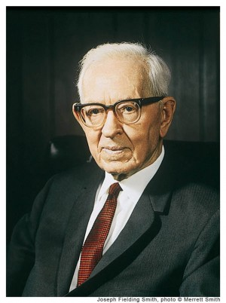
LESSON 135
“There must be a family organization, a family unit, and each generation must be linked to the chain that goes before in order to bring perfection in family organization. Thus eventually we will be one large family with Adam at the head, Michael, the archangel, presiding over his posterity” (Doctrines of Salvation, comp. Bruce R. McConkie, 3vols. [1954–56],2:175).
President
Joseph Fielding Smith
“If there is not a welding link between the fathers and the children—which is the work for the dead—then we will all stand rejected; the whole work of God will fail and be utterly wasted” (Doctrines of Salvation,2:122).
President
Joseph Fielding Smith

Slide 10
LESSON 135
Doctrine and Covenants 128:19-25.
“Joseph Smith expresses joy in the Restoration of the gospel and encourages the Saints to be faithful as they work for the salvation of the dead”

Slide 11
LESSON 135
Doctrine and Covenants 128:19.
Now, what do we hear in the gospel which we have received? A voice of gladness! A voice of mercy from heaven; and a voice of truth out of the earth; glad tidings for the dead; a voice of gladness for the living and the dead; glad tidings of great joy. How beautiful upon the mountains are the feet of those that bring glad tidings of good things, and that say unto Zion: Behold, thy God reigneth! As the dews of Carmel, so shall the knowledge of God descend upon them!
What “glad tidings” have we received?
The gospel of Jesus Christ.
How is the gospel of Jesus Christ a voice of gladness for the living and the dead?

Slide 12
LESSON 135
Doctrine and Covenants 128:20-21.
20 And again, what do we hear? Glad tidings from Cumorah! Moroni, an angel from heaven, declaring the fulfilment of the prophets—the book to be revealed. A voice of the Lord in the wilderness of Fayette, Seneca county, declaring the three witnesses to bear record of the book! The voice of Michael on the banks of the Susquehanna, detecting the devil when he appeared as an angel of light! The voice of Peter, James, and John in the wilderness between Harmony, Susquehanna county, and Colesville, Broome county, on the Susquehanna river, declaring themselves as possessing the keys of the kingdom, and of the dispensation of the fulness of times!
21 And again, the voice of God in the chamber of old Father Whitmer, in Fayette, Seneca county, and at sundry times, and in divers places through all the travels and tribulations of this Church of Jesus Christ of Latter-day Saints! And the voice of Michael, the archangel; the voice of Gabriel, and of Raphael, and of divers angels, from Michael or Adam down to the present time, all declaring their dispensation, their rights, their keys, their honors, their majesty and glory, and the power of their priesthood; giving line upon line, precept upon precept; here a little, and there a little; giving us consolation by holding forth that which is to come, confirming our hope!
The keys, powers, and authority of the past dispensations have been restored in the dispensation of the fulness of times.

Slide 13
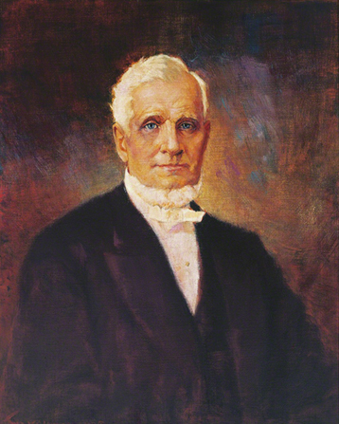
LESSON 135
“The principles which [Joseph Smith] had placed him in communication with the Lord, and not only with the Lord, but with the ancient apostles and prophets; such men, for instance, as Abraham, Isaac, Jacob, Noah, Adam, Seth, Enoch, and Jesus, and the Father, and the apostles that lived on this continent, as well as those who lived on the Asiatic continent. He seemed to be as familiar with these people as we are with one another. Why? Because he had to introduce a dispensation which was called the dispensation of the fulness of times, and it was known as such by the ancient servants of God” (The Gospel Kingdom[1987],353.)
President
John Taylor
What difference does it make in your life to know that the gospel was restored to the earth through heavenly messengers?

Slide 14
LESSON 135
Doctrine and Covenants 128:22-23
, 24.
22 Brethren, shall we not go on in so great a cause? Go forward and not backward. Courage, brethren; and on, on to the victory! Let your hearts rejoice, and be exceedingly glad. Let the earth break forth into singing. Let the dead speak forth anthems of eternal praise to the King Immanuel, who hath ordained, before the world was, that which would enable us to redeem them out of their prison; for the prisoners shall go free.
23 Let the mountains shout for joy, and all ye valleys cry aloud; and all ye seas and dry lands tell the wonders of your Eternal King! And ye rivers, and brooks, and rills, flow down with gladness. Let the woods and all the trees of the field praise the Lord; and ye solid rocks weep for joy! And let the sun, moon, and the morning stars sing together, and let all the sons of God shout for joy! And let the eternal creations declare his name forever and ever! And again I say, how glorious is the voice we hear from heaven, proclaiming in our ears, glory, and salvation, and honor, and immortality, and eternal life; kingdoms, principalities, and powers!
24 Behold, the great day of the Lord is at hand; and who can abide the day of his coming, and who can stand when he appeareth? For he is like a refiner’s fire, and like fuller’s soap; and he shall sit as a refiner and purifier of silver, and he shall purify the sons of Levi, and purge them as gold and silver, that they may offer unto the Lord an offering in righteousness. Let us, therefore, as a church and a people, and as Latter-day Saints, offer unto the Lord an offering in righteousness; and let us present in his holy temple, when it is finished, a book containing the records of our dead, which shall be worthy of all acceptation.
What righteous offering are we to make to the Lord?
A book containing the records of our dead.

Slide 15
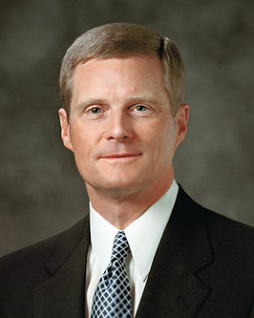
LESSON 135
What can we do to contribute to this “book”?
What does verse 24 teach about our participation in family history work and temple work?
When we do family history work and receive temple ordinances for our ancestors, we make a righteous offering to the Lord.
“Many of you may think family history work is to be performed primarily by older people. But I know of no age limit described in the scriptures or guidelines announced by Church leaders restricting this important service.…
“It is no coincidence that … tools have come forth at a time when young people are so familiar with a wide range of information and communication technologies. … The skills and aptitude evident among many young people today are a preparation to contribute to the work of salvation.
“…I encourage you to study, to search out your ancestors, and to prepare yourselves to perform proxy baptisms in the house of the Lord for your kindred dead. … And I urge you to help other people identify their family histories” (“The Hearts of the Children Shall Turn,” Ensign or Liahona, Nov. 2011,26).
Elder
David A. Bednar
In what ways can you participate in family history work and temple work?
When have you made offerings through family history work and temple work?
In what ways were you blessed as you made these offerings?

