Slide 1
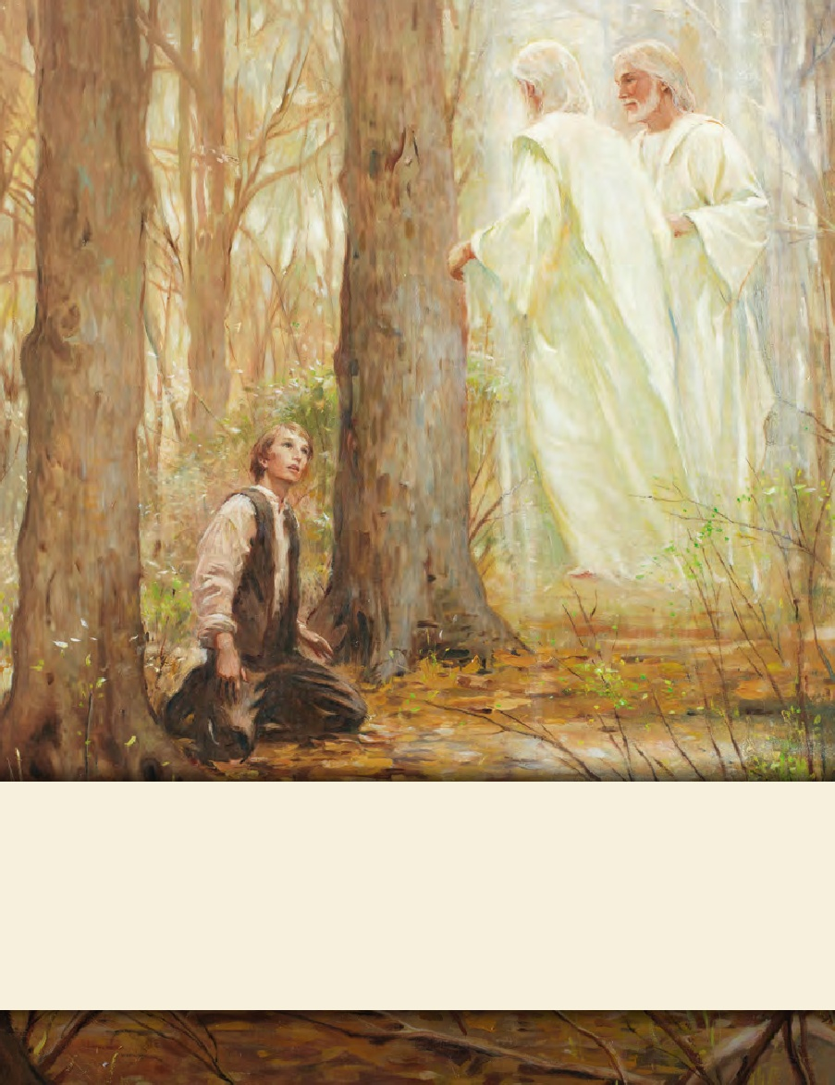
LESSON 15
SEMINARY
Doctrine and Covenants
and Church History

Slide 2
LESSON 133
Doctrine and Covenants 124:84–145;125–126

Slide 3
LESSON 133
Doctrine and Covenants 124:84–122.
“The Lord gives counsel to specific individuals”

Slide 4
LESSON 133
How important might it be for you to obtain the instructions in the envelope?
How closely would you follow them once you had them?
William Law (D&C89–90) | Hyrum Smith (D&C94–96) | Amos Davies (D&C111–114) | Robert Foster (D&C115–118)
What similarity did you notice in the instruction given to these men?
Each passage contains instruction to follow the counsel of the Prophet Joseph Smith.
How would you summarize the promises the Lord made to these men if they hearkened to the Prophet?
How do each of the promised blessings listed on the board relate to the phrase “it will be well with us”?
When have you been blessed by hearkening to the counsel of the prophets?

Slide 5
LESSON 133
Doctrine and Covenants 124:84.
And with my servant Almon Babbitt, there are many things with which I am not pleased; behold, he aspireth to establish his counsel instead of the counsel which I have ordained, even that of the Presidency of my Church; and he setteth up a golden calf for the worship of my people.
What did Almon Babbitt do instead of following the counsel of the First Presidency?
He aspired to establish his own counsel.
What are some examples of how people might establish their own counsel in our day?

Slide 6
LESSON 133
Doctrine and Covenants 124:123-145.
“The Lord names those who are to serve in various priesthood leadership positions”

Slide 7
LESSON 133
Doctrine and Covenants 124:143.
First, I give unto you Hyrum Smith to be a patriarch unto you, to hold the sealing blessings of my church, even the Holy Spirit of promise, whereby ye are sealed up unto the day of redemption, that ye may not fall notwithstanding the hour of temptation that may come upon you.
Why does the Lord call priesthood leaders and give priesthood keys?
The Lord calls priesthood leaders to govern the work of the ministry and help perfect the Saints.

Slide 8
LESSON 133
Doctrine and Covenants 125.
“The Lord directs the Saints to gather to
the places He appoints”

Slide 9
LESSON 133
Doctrine and Covenants 126.
“Brigham Young is no longer required to leave his family to serve additional missions”

Slide 10
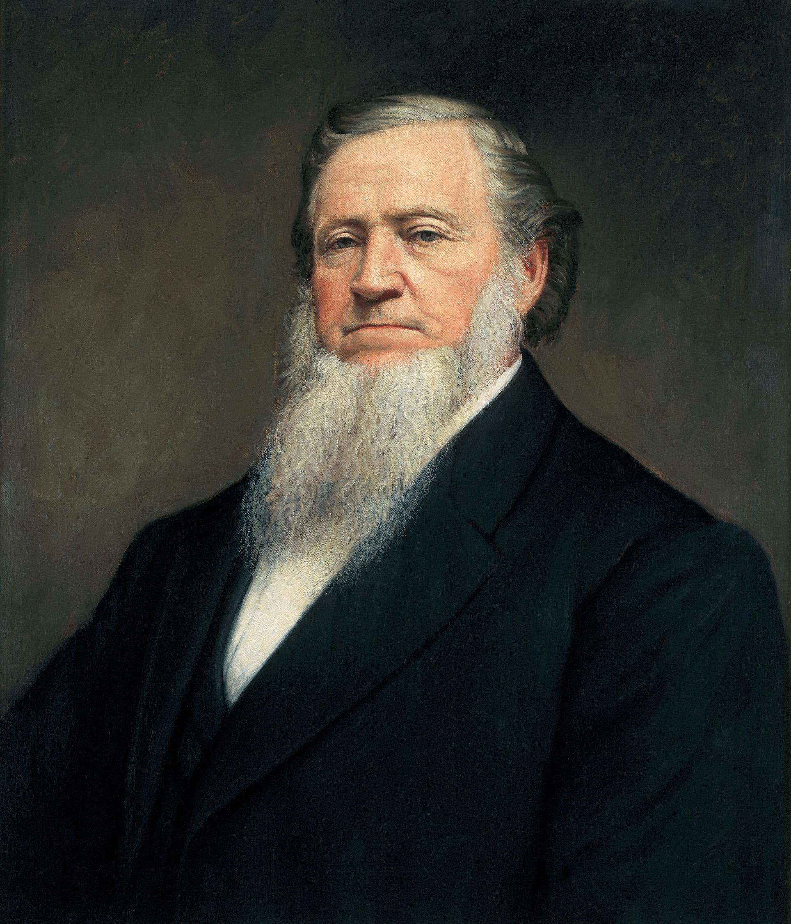
LESSON 133
How would you feel about leaving your family so many times?
How would you feel about it if you were responsible for providing for your family’s needs?
President Brigham Young Said:
“I was determined to go to England or to die trying. My firm resolve was that I would do what I was required to do in the Gospel of life and salvation, or I would die trying to do it” (Teachings of Presidents of the Church: Brigham Young [1997],5).

Slide 11
LESSON 133
Doctrine and Covenants 126:1-3.
1 Dear and well-beloved brother, Brigham Young, verily thus saith the Lord unto you: My servant Brigham, it is no more required at your hand to leave your family as in times past, for your offering is acceptable to me.
2 I have seen your labor and toil in journeyings for my name.
3 I therefore command you to send my word abroad, and take especial care of your family from this time, henceforth and forever. Amen.
If we labor diligently for the Lord, then He will accept our righteous offering.
When have you felt that the Lord was pleased with your service?

