Slide 1
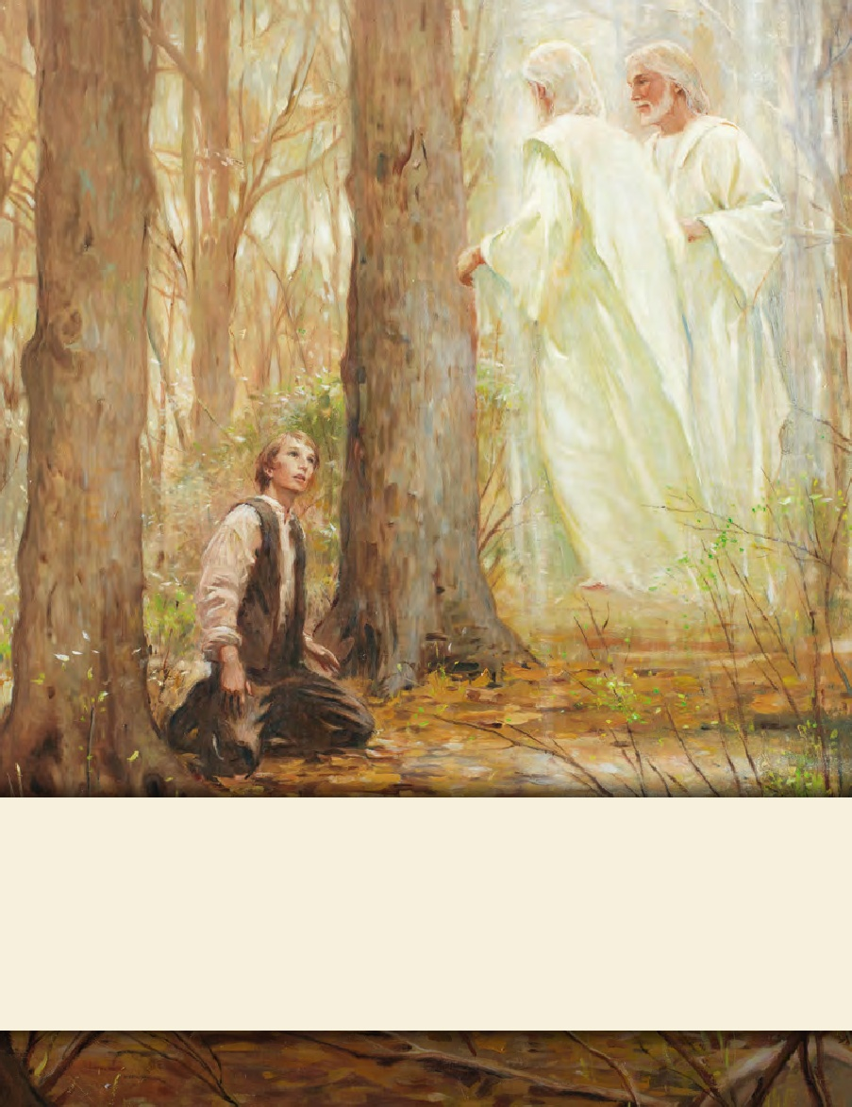
LESSON 15
SEMINARY
Doctrine and Covenants
and Church History

Slide 2
LESSON 132
Doctrine and Covenants 124:22–83

Slide 3
LESSON 132
Doctrine and Covenants 124:22–41,56–83.
“The Lord commands the Saints to build a temple and a house for visitors in Nauvoo”

Slide 4
LESSON 132
What is something you have accomplished that required a significant amount of time, effort, or sacrifice on your part?
Why was your accomplishment worth the time, effort, or sacrifice it required?
Doctrine and Covenants 124:25-27.
25 And again, verily I say unto you, let all my saints come from afar.
26 And send ye swift messengers, yea, chosen messengers, and say unto them: Come ye, with all your gold, and your silver, and your precious stones, and with all your antiquities; and with all who have knowledge of antiquities, that will come, may come, and bring the box tree, and the fir tree, and the pine tree, together with all the precious trees of the earth;
27 And with iron, with copper, and with brass, and with zinc, and with all your precious things of the earth; and build a house to my name, for the Most High to dwell therein.
What did the Lord command the Saints to do?
What did the Lord want the Saints to use to build the temple?

Slide 5
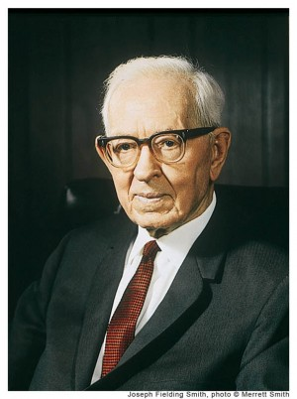
LESSON 132
Doctrine and Covenants 124:28.
For there is not a place found on earth that he may come to and restore again that which was lost unto you, or which he hath taken away, even the fulness of the priesthood.
Why did the Saints need to build a temple?
To provide a place where the Lord could come and restore the fulness of the priesthood.
“Every man who is faithful and will receive these ordinances and blessings obtains a fulness of the priesthood, and the Lord has said that ‘he makes them equal in power, and in might, and in dominion’ [D&C 76:95; see also D&C 88:107].… The Lord has made it possible for every man in this Church, through his obedience, to receive the fulness of the priesthood through the ordinances of the temple of the Lord. This cannot be received anywhere else” (in Doctrines of Salvation, comp. Bruce R. McConkie, 3vols. [1954–56], 3:132–33).
Prophet
Joseph Fielding Smith
What is an ordinance?
A sacred, formal act performed by the authority of the priesthood.

Slide 6
LESSON 132
Doctrine and Covenants 124:29
-34.
29 For a baptismal font there is not upon the earth, that they, my saints, may be baptized for those who are dead—
30 For this ordinance belongeth to my house, and cannot be acceptable to me, only in the days of your poverty, wherein ye are not able to build a house unto me.
31 But I command you, all ye my saints, to build a house unto me; and I grant unto you a sufficient time to build a house unto me; and during this time your baptisms shall be acceptable unto me.
32 But behold, at the end of this appointment your baptisms for your dead shall not be acceptable unto me; and if you do not these things at the end of the appointment ye shall be rejected as a church, with your dead, saith the Lord your God.
33 For verily I say unto you, that after you have had sufficient time to build a house to me, wherein the ordinance of baptizing for the dead belongeth, and for which the same was instituted from before the foundation of the world, your baptisms for your dead cannot be acceptable unto me;
34 For therein are the keys of the holy priesthood ordained, that you may receive honor and glory.
Where did the Lord say that the ordinance of baptism for the dead needed to take place in order to be acceptable to Him?
Why did the Lord allow the Saints to perform baptisms outside of the temple temporarily?

Slide 7
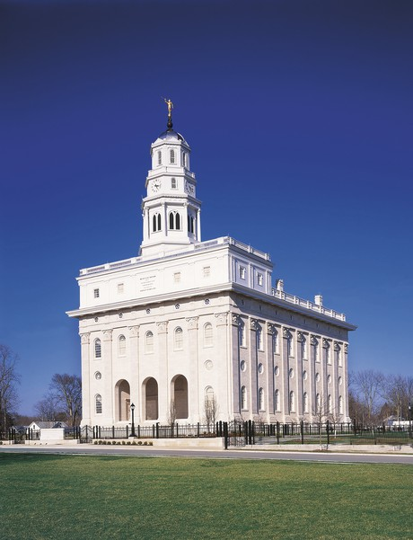
LESSON 132

Slide 8
LESSON 132
Where is the only place in which the fulness of the priesthood ordinances can be obtained for the redemption of both the living and the dead?
The temple is the only place where we can obtain the fulness of the priesthood ordinances for the redemption of the living and the dead.
How might this doctrine have motivated the Saints to make the necessary sacrifices to build a temple in Nauvoo?

Slide 9
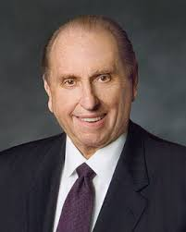
LESSON 132
“Those who understand the eternal blessings which come from the temple know that no sacrifice is too great, no price too heavy, no struggle too difficult in order to receive those blessings. There are never too many miles to travel, too many obstacles to overcome, or too much discomfort to endure. They understand that the saving ordinances received in the temple that permit us to someday return to our Heavenly Father in an eternal family relationship and to be endowed with blessings and power from on high are worth every sacrifice and every effort” (“The Holy Temple—a Beacon to the World, ”Ensign or Liahona, May 2011,92).
President
Thomas S. Monson
What sacrifices might you have to make in order to be worthy and prepared to receive the ordinances of the temple?

Slide 10
LESSON 132
Doctrine and Covenants 124:38-41.
38 For, for this cause I commanded Moses that he should build a tabernacle, that they should bear it with them in the wilderness, and to build a house in the land of promise, that those ordinances might be revealed which had been hid from before the world was.
39 Therefore, verily I say unto you, that your anointings, and your washings, and your baptisms for the dead, and your solemn assemblies, and your memorials for your sacrifices by the sons of Levi, and for your oracles in your most holy places wherein you receive conversations, and your statutes and judgments, for the beginning of the revelations and foundation of Zion, and for the glory, honor, and endowment of all her municipals, are ordained by the ordinance of my holy house, which my people are always commanded to build unto my holy name.
40 And verily I say unto you, let this house be built unto my name, that I may reveal mine ordinances therein unto my people;
41 For I deign to reveal unto my church things which have been kept hid from before the foundation of the world, things that pertain to the dispensation of the fulness of times.
Why did the Lord command the ancient Israelites to build a tabernacle and temples?
Why is the temple important to you? Why does the Church build temples?

Slide 11
LESSON 132
Doctrine and Covenants 124:42-55.
“The Lord explains what will happen if the Saints obey the commandment to build a temple”

Slide 12
LESSON 132
Doctrine and Covenants 124:42-45.
42 And I will show unto my servant Joseph all things pertaining to this house, and the priesthood thereof, and the place whereon it shall be built.
43 And ye shall build it on the place where you have contemplated building it, for that is the spot which I have chosen for you to build it.
44 If ye labor with all your might, I will consecrate that spot that it shall be made holy.
45 And if my people will hearken unto my voice, and unto the voice of my servants whom I have appointed to lead my people, behold, verily I say unto you, they shall not be moved out of their place.
Doctrine and Covenants 124:55.
And again, verily I say unto you, I command you again to build a house to my name, even in this place, that you may prove yourselves unto me that ye are faithful in all things whatsoever I command you, that I may bless you, and crown you with honor, immortality, and eternal life.
What do we prove to the Lord when we obey His commandments?
By obeying the Lord’s commandments, we prove our faithfulness

Slide 13
LESSON 132
How could the opportunity to prove your faithfulness to God motivate you to obey His commandments?
What additional blessings did the Lord promise the Saints if they would build a temple in Nauvoo?
Why is it important to understand that the blessings we receive for our faithfulness to the Lord may not be immediate?

