Slide 1
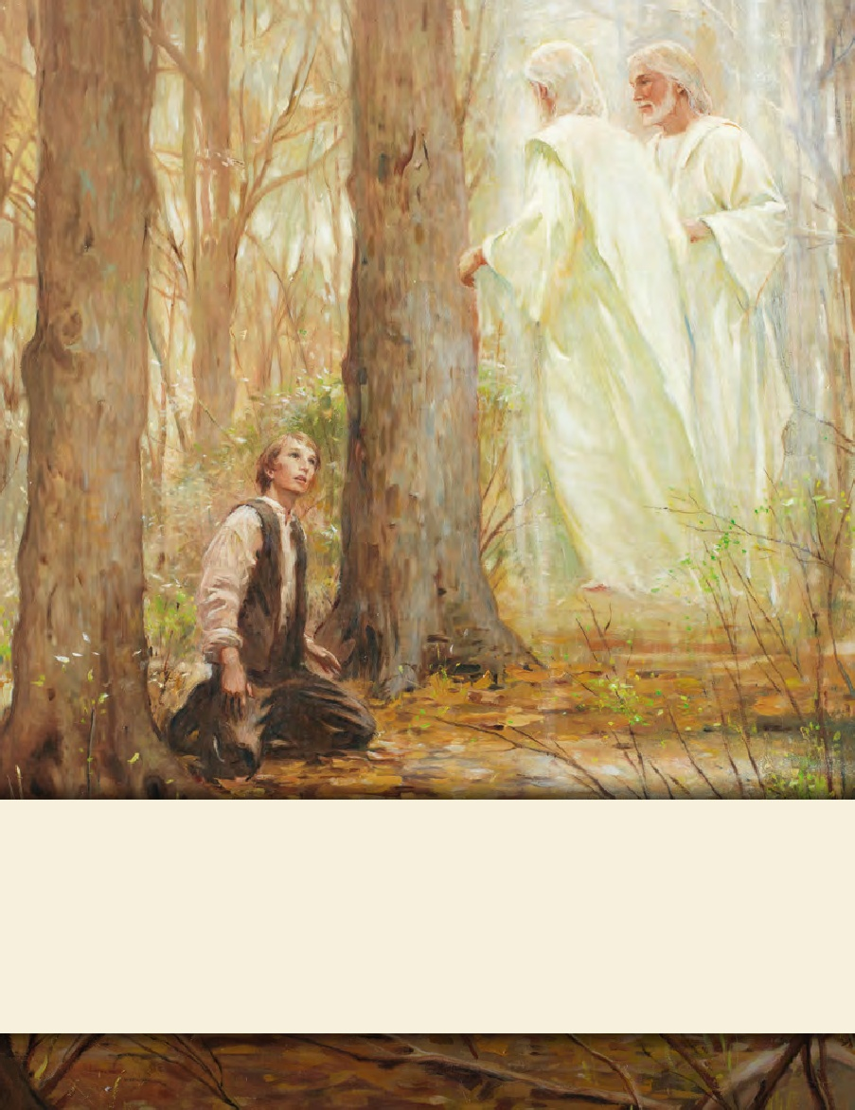
LESSON 15
SEMINARY
Doctrine and Covenants
and Church History

Slide 2
LESSON 131
Doctrine and Covenants 124:1-14.
“The Lord commands that a proclamation of the gospel be sent to the rulers of the earth”

Slide 3
LESSON 131
Strong
Weak
In what ways does the world try to make a young man or young woman feel weak according to its standards?
Doctrine and Covenants 124:1.
Verily, thus saith the Lord unto you, my servant Joseph Smith, I am well pleased with your offering and acknowledgments, which you have made; for unto this end have I raised you up, that I might show forth my wisdom through the weak things of the earth.
In what ways might Joseph Smith have been weak when he was called to restore the gospel?
Why would the Lord call the weak to do His work?
The Lord shows forth His wisdom through the weak things of the earth.
In what ways did the Lord show forth His wisdom through the Prophet Joseph Smith?
How did the Lord magnify Joseph Smith’s abilities?

Slide 4
LESSON 131
How could remembering this truth help us as we receive various calls and assignments to serve in the Church?
How have you been blessed by those who have faithfully served the Lord even though they may have been seen as weak in the eyes of the world?
Doctrine and Covenants 124:2-3.
2 Your prayers are acceptable before me; and in answer to them I say unto you, that you are now called immediately to make a solemn proclamation of my gospel, and of this stake which I have planted to be a cornerstone of Zion, which shall be polished with the refinement which is after the similitude of a palace.
3 This proclamation shall be made to all the kings of the world, to the four corners thereof, to the honorable president-elect, and the high-minded governors of the nation in which you live, and to all the nations of the earth scattered abroad.
What did the Lord call Joseph Smith to do?
Make a proclamation of the gospel to the rulers of the earth.
What have been some of the most effective ways in which you have shared the gospel with others?

Slide 5
LESSON 131
How?
Why?
Doctrine and Covenants 124:4-8.
4 Let it be written in the spirit of meekness and by the power of the Holy Ghost, which shall be in you at the time of the writing of the same;
5 For it shall be given you by the Holy Ghost to know my will concerning those kings and authorities, even what shall befall them in a time to come.
6 For, behold, I am about to call upon them to give heed to the light and glory of Zion, for the set time has come to favor her.
7 Call ye, therefore, upon them with loud proclamation, and with your testimony, fearing them not, for they are as grass, and all their glory as the flower thereof which soon falleth, that they may be left also without excuse—
8 And that I may visit them in the day of visitation, when I shall unveil the face of my covering, to appoint the portion of the oppressor among hypocrites, where there is gnashing of teeth, if they reject my servants and my testimony which I have revealed unto them.
We are to proclaim the gospel in meekness and by the power of the Holy Ghost.
What do you think it means to proclaim the gospel in meekness?
What do you think it means to proclaim the gospel by the power of the Holy Ghost?
How can we share the gospel in meekness and by the power of the Holy Ghost using these methods?

Slide 6
LESSON 131
Doctrine and Covenants 124:9.
And again, I will visit and soften their hearts, many of them for your good, that ye may find grace in their eyes, that they may come to the light of truth, and the Gentiles to the exaltation or lifting up of Zion.
The Lord can soften the hearts of those who hear the gospel.
How can this doctrine relate to the truth about how we should proclaim the gospel in meekness and by the power of the Holy Ghost?

Slide 7
LESSON 131
Doctrine and Covenants 124:15-21.
“The Lord gives instructions to
Church leaders in Nauvoo”

Slide 8
LESSON 131
Doctrine and Covenants 124:15-20.
15 And again, verily I say unto you, blessed is my servant Hyrum Smith; for I, the Lord, love him because of the integrity of his heart, and because he loveth that which is right before me, saith the Lord.
16 Again, let my servant John C. Bennett help you in your labor in sending my word to the kings and people of the earth, and stand by you, even you my servant Joseph Smith, in the hour of affliction; and his reward shall not fail if he receive counsel.
17 And for his love he shall be great, for he shall be mine if he do this, saith the Lord. I have seen the work which he hath done, which I accept if he continue, and will crown him with blessings and great glory.
18 And again, I say unto you that it is my will that my servant Lyman Wight should continue in preaching for Zion, in the spirit of meekness, confessing me before the world; and I will bear him up as on eagles’ wings; and he shall beget glory and honor to himself and unto my name.
19 That when he shall finish his work I may receive him unto myself, even as I did my servant David Patten, who is with me at this time, and also my servant Edward Partridge, and also my aged servant Joseph Smith, Sen., who sitteth with Abraham at his right hand, and blessed and holy is he, for he is mine.
20 And again, verily I say unto you, my servant George Miller is without guile; he may be trusted because of the integrity of his heart; and for the love which he has to my testimony I, the Lord, love him.
15 And again, verily I say unto you, blessed is my servant Hyrum Smith; for I, the Lord, love him because of the integrity of his heart, and because he loveth that which is right before me, saith the Lord.
16 Again, let my servant John C. Bennett help you in your labor in sending my word to the kings and people of the earth, and stand by you, even you my servant Joseph Smith, in the hour of affliction; and his reward shall not fail if he receive counsel.
17 And for his love he shall be great, for he shall be mine if he do this, saith the Lord. I have seen the work which he hath done, which I accept if he continue, and will crown him with blessings and great glory.
18 And again, I say unto you that it is my will that my servant Lyman Wight should continue in preaching for Zion, in the spirit of meekness, confessing me before the world; and I will bear him up as on eagles’ wings; and he shall beget glory and honor to himself and unto my name.
19 That when he shall finish his work I may receive him unto myself, even as I did my servant David Patten, who is with me at this time, and also my servant Edward Partridge, and also my aged servant Joseph Smith, Sen., who sitteth with Abraham at his right hand, and blessed and holy is he, for he is mine.
20 And again, verily I say unto you, my servant George Miller is without guile; he may be trusted because of the integrity of his heart; and for the love which he has to my testimony I, the Lord, love him.
How does the Lord feel about those who have integrity?
The Lord loves and trusts those who have integrity of heart.
How would you define integrity of heart?

Slide 9
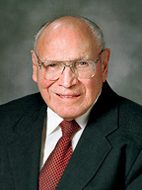
LESSON 131
“To me, integrity means always doing what is right and good, regardless of the immediate consequences. It means being righteous from the very depth of our soul, not only in our actions but, more importantly, in our thoughts and in our hearts. Personal integrity implies such trustworthiness and incorruptibility that we are incapable of being false to a trust or covenant” (“Personal Integrity, ”Ensign, May 1990,30).
Elder
Joseph B. Wirthlin
Why do you think the Lord loves those who have integrity of heart?

