Slide 1
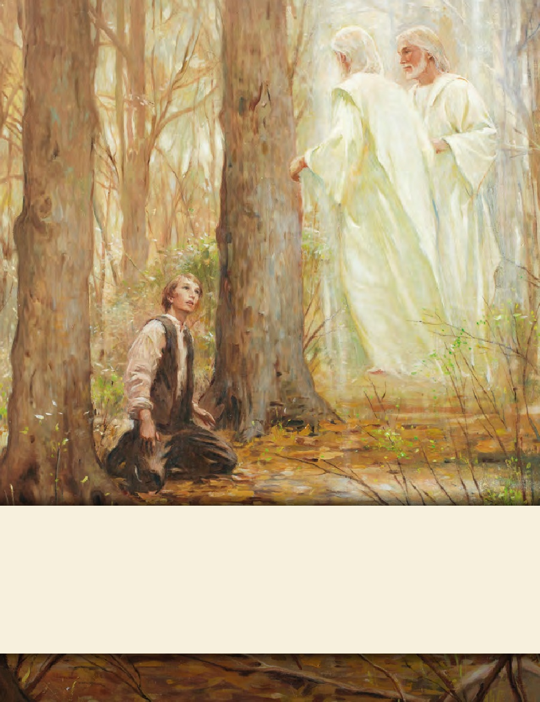
LESSON 15
SEMINARY
Doctrine and Covenants
and Church History

Slide 2
LESSON 130
“The Establishment of Nauvoo”

Slide 3
LESSON 130
The Saints establish the city of Nauvoo
How do you think the Saints might have felt when they were expelled from Missouri?

Slide 4
LESSON 130
Student Teacher 1: The Saints transform Commerce, Illinois, into Nauvoo—a place of beauty.
What are some circumstances in your life right now that are difficult or unpleasant?
When the Saints arrived at the place they would call Nauvoo, much of the land was a swamp infested with mosquitos. The mosquitos carried a disease called malaria, which caused severe fevers and chills and could result in death. Many of the Saints were infected and became ill. Some of the afflicted were so sick that they could only crawl around as they tried to help each other, and some died. (See Church History in the Fulness of Times Student Manual,2nd ed. [Church Educational System manual, 2003], 217–18.)
Would you have called this a beautiful place?
Why do you think the Prophet Joseph Smith chose to call this swampland a beautiful place?

Slide 5
LESSON 130
Joseph Smith also contracted malaria, but after several days of sickness, he arose on July 22, 1839, and was filled with the Spirit of God. He blessed many of the sick near his home. In one instance, Joseph approached a tent belonging to a Church member named Henry G. Sherwood, who was near death. When the Prophet commanded him to rise and come out of the tent, Brother Sherwood obeyed and was healed.
Joseph crossed to the Iowa side of the river and continued to bless the sick. As Joseph was preparing to return to the Illinois side, a man who was not a member of the Church asked the Prophet if he would come bless his twin babies about two miles away. “Joseph said he could not go, but he gave Wilford Woodruff a red silk handkerchief and told him to administer to them, promising that when he wiped their faces with it they would be healed” (Church History in the Fulness of Times,219). Wilford followed this instruction, and the children were healed. Wilford called that day “a day of God’s power” (Wilford Woodruff Journals, July 22, 1839, quoted in Church History in the Fulness of Times,218).
Despite the faith and power of that day, sickness continued among the Saints for the next several months. However, they continued to care for one another and worked to build their new home. They dug ditches to drain water from the swamps to the river, which made the land more usable and reduced the mosquito problem. Eventually they built many homes and other structures, including the Nauvoo Temple, which was considered by some to be one of the finest buildings in the country.
How does the “day of God’s power” on July 22, 1839, help you have greater faith in the Lord?
How did the Saints make Nauvoo a beautiful place?
What can we learn from their example?
What can happen when we seek to improve the circumstances around us?
As we seek to improve the circumstances around us, we also improve ourselves.

Slide 6
LESSON 130
Student Teacher 2: The Relief Society is founded
What can we learn about the Relief Society from Eliza R. Snow’s statement?
Relief Society is an inspired part of the Restoration of the Church of Jesus Christ.
Why do you think it is important for us to understand this truth?
“Relief Society was established to help prepare daughters of God for the blessings of eternal life. The purposes of Relief Society are to increase faith and personal righteousness, strengthen families and homes, and provide relief by seeking out and helping those in need” (Daughters in My Kingdom,xi).

Slide 7
LESSON 130
“Missionary work spreads across the earth”

Slide 8
LESSON 130
What are some items that can extinguish afire?
What are some items that cause a fire to grow?
Joseph Smith compared the work of God to a fire. Do you think the persecutions the Saints experienced in Missouri were like water that began to extinguish the work of God or like fuel that caused it to grow? Why?
“Persecution has not stopped the progress of truth, but has only added fuel to the flame.…
“…The Standard of Truth has been erected; no unhallowed hand can stop the work from progressing; persecutions may rage, mobs may combine, armies may assemble, calumny may defame, but the truth of God will go forth boldly, nobly, and independent, till it has penetrated every continent, visited every clime, swept every country, and sounded in every ear, till the purposes of God shall be accomplished, and the Great Jehovah shall say the work is done” (in History of the Church,4:540).
Prophet
Joseph Smith
What do we learn from this statement?
Nothing will stop the progress of God’s work throughout the earth.

Slide 9
LESSON 130
How does Elder Woodruff’s experience illustrate the principle that nothing will stop the progress of God’s work?
How is Joseph Smith’s prophecy concerning the progress of God’s work being fulfilled today?
How do you feel about participating in this work?
What can you do to help God’s work spread among all people?

