Slide 1
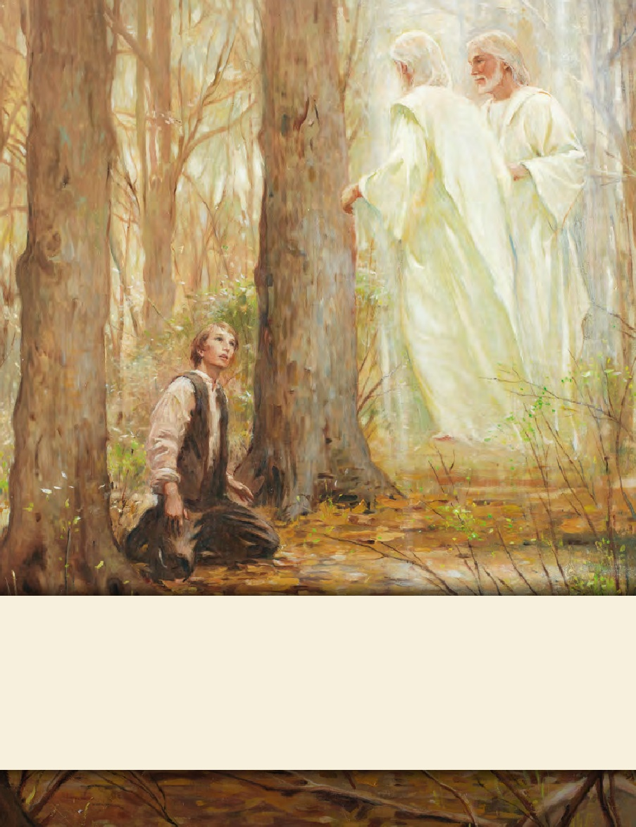
LESSON 15
SEMINARY
Doctrine and Covenants
and Church History

Slide 2
LESSON 127
Doctrine and Covenants 121:11-33.

Slide 3
LESSON 127
Doctrine and Covenants 121:11–25.
“The Savior describes the judgments that would come upon those who persecute the Saints”

Slide 4
LESSON 127
“The Mormons must be treated as enemies and must be exterminated.”
Would you be afraid to leave your home?
Where would you turn for help?
How would you feel if you found out the declaration was influenced by some of your former friends?

Slide 5
LESSON 127
Doctrine and Covenants 121:11–17.
11 And they who do charge thee with transgression, their hope shall be blasted, and their prospects shall melt away as the hoar frost melteth before the burning rays of the rising sun;
12 And also that God hath set his hand and seal to change the times and seasons, and to blind their minds, that they may not understand his marvelous workings; that he may prove them also and take them in their own craftiness;
13 Also because their hearts are corrupted, and the things which they are willing to bring upon others, and love to have others suffer, may come upon themselves to the very uttermost;
14 That they may be disappointed also, and their hopes may be cut off;
15 And not many years hence, that they and their posterity shall be swept from under heaven, saith God, that not one of them is left to stand by the wall.
16 Cursed are all those that shall lift up the heel against mine anointed, saith the Lord, and cry they have sinned when they have not sinned before me, saith the Lord, but have done that which was meet in mine eyes, and which I commanded them.
17 But those who cry transgression do it because they are the servants of sin, and are the children of disobedience themselves.
What do you think the phrase “their hope shall be blasted, and their prospects shall melt away” means?
Those who fight against the Lord’s servants ultimately will not succeed in their designs.
What reasons did the Lord give for why some had accused the Lord’s servants of sin?
The accusers’ “hearts [were] corrupted,” and they were “servants of sin” and “children of disobedience.

Slide 6
LESSON 127
Doctrine and Covenants 121:18–22.
18 And those who swear falsely against my servants, that they might bring them into bondage and death—
19 Wo unto them; because they have offended my little ones they shall be severed from the ordinances of mine house.
20 Their basket shall not be full, their houses and their barns shall perish, and they themselves shall be despised by those that flattered them.
21 They shall not have right to the priesthood, nor their posterity after them from generation to generation.
22 It had been better for them that a millstone had been hanged about their necks, and they drowned in the depth of the sea.

Slide 7
LESSON 127
On October 30, 1838, just three days after the extermination order was issued, approximately 240 men approached a Mormon settlement at a place called Haun’s Mill. The women and children fled into the woods, while the men sought protection in the blacksmith shop. One of the Saints’ leaders, David Evans, swung his hat and cried for peace. The sound of a hundred rifles answered him, most of them aimed at the blacksmith shop. The mobbers shot mercilessly at everyone in sight, including women, elderly men, and children. Amanda Smith seized her two little girls and ran with Mary Stedwell across the millpond on a walkway. Amanda recalled, “Yet though we were women, with tender children, in flight for our lives, the demons poured volley after volley to kill us” (in Andrew Jenson, The Historical Record, July 1886,84).
Members of the mob entered the blacksmith shop and found and killed 10-year-old Sardius Smith, son of Amanda Smith, hiding under the blacksmith’s bellows. The man later explained, “Nits [young lice] will make lice, and if he had lived he would have become a Mormon” (in Jenson, The Historical Record, Dec. 1888, 673; see also James B. Allen and Glen M. Leonard, The Story of the Latter-day Saints[1976], 127–28). Alma Smith, Sardius’s seven-year-old brother, witnessed the murder of his father and brother and was himself shot in the hip. He was not discovered by the mob and was later miraculously healed through prayer and faith. Although a few men along with women and children escaped across the river into the hills, at least 17 people were killed, and about 13 were wounded. (See Church History in the Fulness of Times Student Manual[Church Educational System manual, 2003], 201, 203–4; see also History of the Church3:183–87.) No one in the violent mob was brought to justice for their crimes in the courts of Missouri or by federal authorities.
What feelings might you have had if you had experienced these cruelties?
How might you have felt when you learned that your attackers would not be held accountable for their actions?

Slide 8
LESSON 127
Doctrine and Covenants 121:23–25.
23 Wo unto all those that discomfort my people, and drive, and murder, and testify against them, saith the Lord of Hosts; a generation of vipers shall not escape the damnation of hell.
24 Behold, mine eyes see and know all their works, and I have in reserve a swift judgment in the season thereof, for them all;
25 For there is a time appointed for every man, according as his works shall be.
What principles do we learn from verses 23–25?
The Lord sees and knows all our works. Those who fight against the Lord and His people will receive God’s judgment at His appointed time
How might the principles we identified in verses 23–25 relate to situations today when people appear to escape the consequences for their wrongdoing?

Slide 9
LESSON 127
Doctrine and Covenants 121:26-33.
“God promises to reveal eternal truths
through the Holy Ghost”

Slide 10
LESSON 127
What were some of the hardships Joseph Smith and his companions endured in Liberty Jail?
Doctrine and Covenants 121:26.
God shall give unto you knowledge by his Holy Spirit, yea, by the unspeakable gift of the Holy Ghost, that has not been revealed since the world was until now;

Slide 11
LESSON 127
What truth did Joseph Smith record in verse 26?
God will give us knowledge through the Holy Ghost.
“You can have sacred, revelatory, profoundly instructive experiences with the Lord in the most miserable experiences of your life—in the worst settings, while enduring the most painful injustices, when facing the most insurmountable odds and opposition you have ever faced” (“Lessons from Liberty Jail,” Ensign, Sept. 2009,28).
Elder
Jeffrey R. Holland

Slide 12
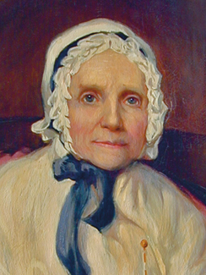
LESSON 127
How can receiving knowledge through the Holy Ghost help us when we experience difficulties?
When have you received knowledge or guidance through the Holy Ghost that has helped you through a difficult time?
“In the midst of my grief, I found consolation that surpassed all earthly comfort. I was filled with the Spirit of God, and received the following by the gift of prophecy: ‘Let your heart be comforted concerning your children, they shall not be harmed by their enemies.…’ This relieved my mind, and I was prepared to comfort my children. I told them what had been revealed to me, which greatly consoled them” (History of Joseph Smith by His Mother, ed. Preston Nibley [1958],291).
Lucy Mack
Smith
How might the Lord’s promise of revelation through the Holy Ghost have been comforting to Joseph Smith and the Saints during this time of persecution?

Slide 13
LESSON 127
Doctrine and Covenants 121:33
How long can rolling waters remain impure? What power shall stay the heavens? As well might man stretch forth his puny arm to stop the Missouri river in its decreed course, or to turn it up stream, as to hinder the Almighty from pouring down knowledge from heaven upon the heads of the Latter-day Saints.
What principle can we learn from this verse?
Nothing can stop the Lord’s work from going forward.
How does it make you feel to know that the Lord’s work will continue regardless of opposition?

