Slide 1
LESSON 15
SEMINARY
Doctrine and Covenants
and Church History

Slide 2
LESSON 126
Doctrine and Covenants 121:1-10; 122.

Slide 3
LESSON 126
Doctrine and Covenants 121:1-6.
“Joseph Smith prays for the suffering Saints”

Slide 4
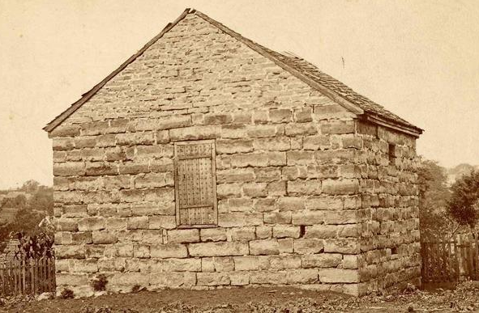
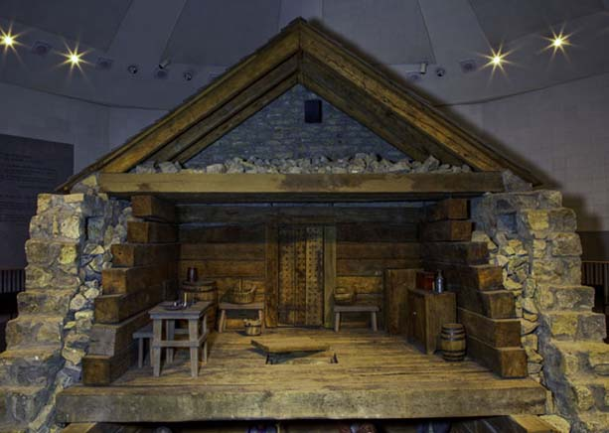
LESSON 126
What would you tell your friend?
What would you do if you were the one experiencing these afflictions?
What feelings and thoughts might you have had if you had been in Joseph’s place?

Slide 5
LESSON 126
Doctrine and Covenants 121:1–6.
1 O God, where art thou? And where is the pavilion that covereth thy hiding place?
2 How long shall thy hand be stayed, and thine eye, yea thy pure eye, behold from the eternal heavens the wrongs of thy people and of thy servants, and thine ear be penetrated with their cries?
3 Yea, O Lord, how long shall they suffer these wrongs and unlawful oppressions, before thine heart shall be softened toward them, and thy bowels be moved with compassion toward them?
4 O Lord God Almighty, maker of heaven, earth, and seas, and of all things that in them are, and who controllest and subjectest the devil, and the dark and benighted dominion of Sheol—stretch forth thy hand; let thine eye pierce; let thy pavilion be taken up; let thy hiding place no longer be covered; let thine ear be inclined; let thine heart be softened, and thy bowels moved with compassion toward us.
5 Let thine anger be kindled against our enemies; and, in the fury of thine heart, with thy sword avenge us of our wrongs.
6 Remember thy suffering saints, O our God; and thy servants will rejoice in thy name forever.
What questions and pleas did you find?
What else impressed you about these verses?

Slide 6
LESSON 126
Doctrine and Covenants 121:7–10;122.
“The Lord comforts Joseph Smith”

Slide 7
LESSON 126
Doctrine and Covenants 121:7–10.
7 My son, peace be unto thy soul; thine adversity and thine afflictions shall be but a small moment;
8 And then, if thou endure it well, God shall exalt thee on high; thou shalt triumph over all thy foes.
9 Thy friends do stand by thee, and they shall hail thee again with warm hearts and friendly hands.
10 Thou art not yet as Job; thy friends do not contend against thee, neither charge thee with transgression, as they did Job.
When we call upon the Lord during times of adversity and affliction, we can receive His peace.
If we endure trials well in mortality, God will bless us now and in the eternities.
In times of trial, we can find comfort in the support of true friends.

Slide 8
LESSON 126
What is the difference between enduring a trial and enduring a trial well?
Whom do you know who is an example of enduring a trial well?
What do you think this means? How can this perspective help us endure our trials well?
Who shall seek counsel and blessings through the Prophet Joseph Smith?

Slide 9
LESSON 126
Doctrine and Covenants 122:1-4.
1 The ends of the earth shall inquire after thy name, and fools shall have thee in derision, and hell shall rage against thee;
2 While the pure in heart, and the wise, and the noble, and the virtuous, shall seek counsel, and authority, and blessings constantly from under thy hand.
3 And thy people shall never be turned against thee by the testimony of traitors.
4 And although their influence shall cast thee into trouble, and into bars and walls, thou shalt be had in honor; and but for a small moment and thy voice shall be more terrible in the midst of thine enemies than the fierce lion, because of thy righteousness; and thy God shall stand by thee forever and ever.
In what ways do we continue to receive counsel from Joseph Smith?
In what ways do we receive authority and blessings because of him?
What promises did the Lord extend to Joseph Smith?

Slide 10
LESSON 126
Doctrine and Covenants 122:5-7.
5 If thou art called to pass through tribulation; if thou art in perils among false brethren; if thou art in perils among robbers; if thou art in perils by land or by sea;
6 If thou art accused with all manner of false accusations; if thine enemies fall upon thee; if they tear thee from the society of thy father and mother and brethren and sisters; and if with a drawn sword thine enemies tear thee from the bosom of thy wife, and of thine offspring, and thine elder son, although but six years of age, shall cling to thy garments, and shall say, My father, my father, why can’t you stay with us? O, my father, what are the men going to do with you? and if then he shall be thrust from thee by the sword, and thou be dragged to prison, and thine enemies prowl around thee like wolves for the blood of the lamb;
7 And if thou shouldst be cast into the pit, or into the hands of murderers, and the sentence of death passed upon thee; if thou be cast into the deep; if the billowing surge conspire against thee; if fierce winds become thine enemy; if the heavens gather blackness, and all the elements combine to hedge up the way; and above all, if the very jaws of hell shall gape open the mouth wide after thee, know thou, my son, that all these things shall give thee experience, and shall be for thy good.
What positive results can come from adversity and afflictions?
Afflictions can give us experience and be for our good.

Slide 11
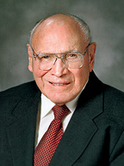
LESSON 126
“You may feel singled out when adversity enters your life. You shake your head and wonder, ‘Why me?’ “But the dial on the wheel of sorrow eventually points to each of us. At one time or another, everyone must experience sorrow. No one is exempt.… “Learning to endure times of disappointment, suffering, and sorrow is part of our on-the-job training. These experiences, while often difficult to bear at the time, are precisely the kinds of experiences that stretch our understanding, build our character, and increase our compassion for others” (“Come What May, and Love It, ”EnsignorLiahona,Nov. 2008,27).
Elder
Joseph B. Wirthlin
What did Elder Wirthlin say our difficult experiences can do for us?

Slide 12
LESSON 126
Doctrine and Covenants 122:8
The Son of Man hath descended below them all. Art thou greater than he?
What do you think it means that the Savior “descended below them all”?
2 Nephi 9:20–21.
Alma 7:11.
Doctrine and Covenants 88:5–6.
20 O how great the holiness of our God! For he knoweth all things, and there is not anything save he knows it.
21 And he cometh into the world that he may save all men if they will hearken unto his voice; for behold, he suffereth the pains of all men, yea, the pains of every living creature, both men, women, and children, who belong to the family of Adam.
And he shall go forth, suffering pains and
afflictions and temptations of every kind; and this that the word might be fulfilled which saith he will take upon him the pains and the sicknesses of his people.
5 Which glory is that of the church of the Firstborn, even of God, the holiest of all, through Jesus Christ his Son—
6 He that ascended up on high, as also he descended below all things, in that he comprehended all things, that he might be in all and through all things, the light of truth;
The Savior suffered the pains and afflictions of all people.

Slide 13
LESSON 126
“Because Jesus Christ suffered greatly, He understands our suffering. He understands our grief. We experience hard things so that we too may have increased compassion and understanding for others.
“Remember the sublime words of the Savior to the Prophet Joseph Smith when he suffered with his companions in the smothering darkness of Liberty Jail.…
“…Joseph took comfort from these words, and so can we” (“Come What May, and Love It,”27).
Elder
Joseph B. Wirthlin
In what ways have your experiences with “hard things” increased your compassion and understanding for others?

Slide 14
LESSON 126
Doctrine and Covenants 122:9.
As also the light of the stars, and the power thereof by which they were made;
How do you feel Doctrine and Covenants 122:9 relates to you?
How can this verse strengthen you during difficult experiences?

