Slide 1
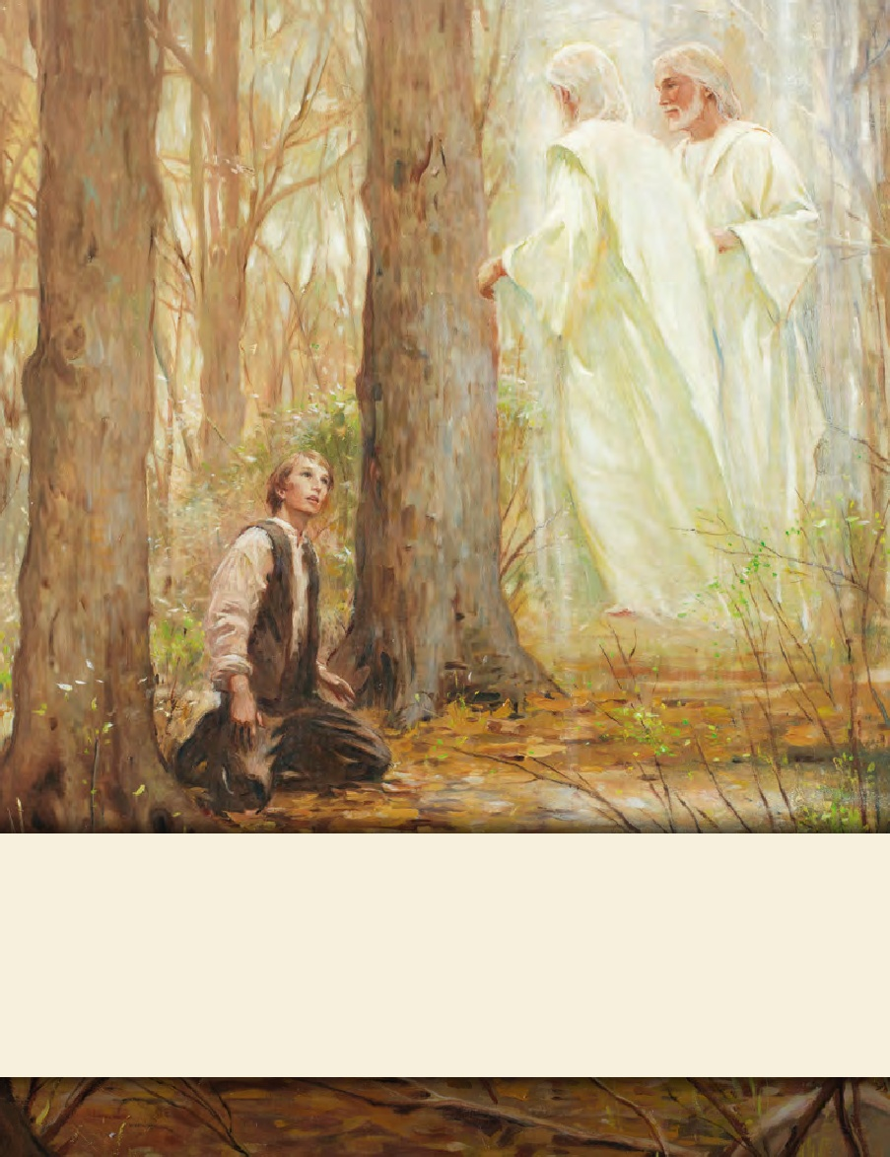
LESSON 15
SEMINARY
Doctrine and Covenants
and Church History

Slide 2
LESSON 125
Doctrine and Covenants 119-120

Slide 3
LESSON 125
Doctrine and Covenants 119:1-4.
“The Lord reveals the law of tithing”

Slide 4
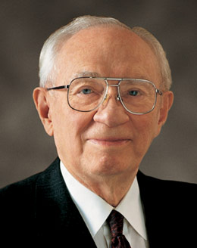
LESSON 125
“A woman in São Paulo, Brazil … worked while going to school to provide for her family. I use her own words in telling this story. She says:
“‘The university in which I studied had a regulation that prohibited the students that were in debt from taking tests.’…
“‘I remember a time when I … faced serious financial difficulties. … When I figured the monthly budget, I noticed that there wouldn’t be enough to pay [both] my tithing and my university. I would have to choose between them. The bimonthly tests would start the following week, and if I didn’t take them I could lose the school year. I felt great agony. … I had a painful decision before me, and I didn’t know what to decide’” (“We Walk by Faith, ”Ensign, May 2002,73).
President
Gordon B. Hinckley
What would you say to someone in a similar dilemma?

Slide 5
LESSON 125
“‘This feeling consumed my soul and remained with me [for days]. It was then that I remembered that when I was baptized I had agreed to live the law of tithing. I had taken upon myself an obligation, not with the missionaries, but with my Heavenly Father. At that moment, the anguish started to disappear, giving place to a pleasant sensation of tranquility and determination.…
“‘That night when I prayed, I asked the Lord to forgive me for my indecision. On Sunday, … with great pleasure I paid my tithing and offerings. That was a special day. I felt happy and peaceful within myself and with Heavenly Father’” (“We Walk by Faith,”73).
President
Gordon B. Hinckley

Slide 6
LESSON 125
Introduction to Doctrine and Covenants 119
Revelation given through Joseph Smith the Prophet, at Far West, Missouri, July 8, 1838, in answer to his supplication: “O Lord! Show unto thy servants how much thou requirest of the properties of thy people for a tithing.” The law of tithing, as understood today, had not been given to the Church previous to this revelation. The term tithing in the prayer just quoted and in previous revelations (64:23; 85:3; 97:11) had meant not just one-tenth, but all free-will offerings, or contributions, to the Church funds. The Lord had previously given to the Church the law of consecration and stewardship of property, which members (chiefly the leading elders) entered into by a covenant that was to be everlasting. Because of failure on the part of many to abide by this covenant, the Lord withdrew it for a time and gave instead the law of tithing to the whole Church. The Prophet asked the Lord how much of their property He required for sacred purposes. The answer was this revelation.
What did Joseph Smith ask the Lord?

Slide 7
LESSON 125
Doctrine and Covenants 119:1-4.
1 Verily, thus saith the Lord, I require all their surplus property to be put into the hands of the bishop of my church in Zion,
2 For the building of mine house, and for the laying of the foundation of Zion and for the priesthood, and for the debts of the Presidency of my Church.
3 And this shall be the beginning of the tithing of my people.
4 And after that, those who have thus been tithed shall pay one-tenth of all their interest annually; and this shall be a standing law unto them forever, for my holy priesthood, saith the Lord.
What is tithing?
The Lord commands us to pay one-tenth of our increase to Him as tithing.

Slide 8
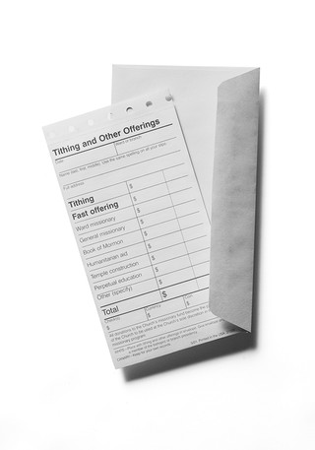
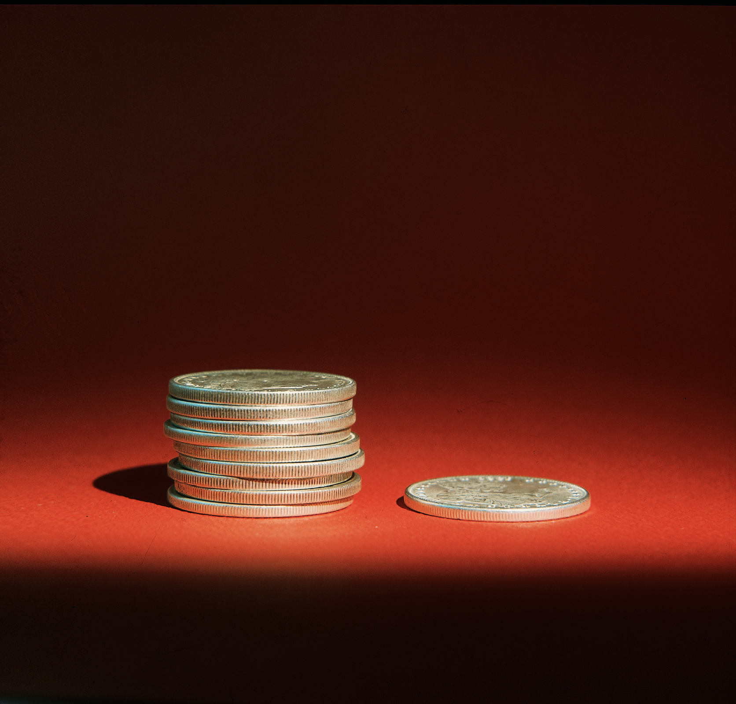
LESSON 125
“The law is simply stated as ‘one-tenth of all their interest.’ Interest means profit, compensation, increase. It is the wage of one employed, the profit from the operation of a business, the increase of one who grows or produces, or the income to a person from any other source. The Lord said it is a standing law ‘forever’ as it has been in the past” (in Conference Report, Apr. 1964,35).
President
Howard W. Hunter
What do you learn from the Lord commanding the Saints to pay tithing at a time when it was difficult for them to do so?
In what ways is paying tithing an act of faith?

Slide 9
LESSON 125
How much tithing should be paid on that amount of money?
Have we paid a full tithe?
Doctrine and Covenants 119:1-2.
1 Verily, thus saith the Lord, I require all their surplus property to be put into the hands of the bishop of my church in Zion,
2 For the building of mine house, and for the laying of the foundation of Zion and for the priesthood, and for the debts of the Presidency of my Church.
What are tithing funds used for?
Tithing funds are used to build temples and to accomplish the work of the Lord.

Slide 10
LESSON 125
Doctrine and Covenants 119:5–7.
“The Lord explains the law of tithing”

Slide 11
LESSON 125
Doctrine and Covenants 119:6–7.
6 And I say unto you, if my people observe not this law, to keep it holy, and by this law sanctify the land of Zion unto me, that my statutes and my judgments may be kept thereon, that it may be most holy, behold, verily I say unto you, it shall not be a land of Zion unto you.
7 And this shall be an ensample unto all the stakes of Zion. Even so. Amen.
What is accomplished by obedience to the law of tithing?
Sanctifying the land of Zion to the Lord.
Paying tithing sanctifies us as individuals and as a Church.
How has paying tithing helped sanctify you?
In what ways do you think paying tithing would help someone be sanctified?

Slide 12
LESSON 125
Doctrine and Covenants 120.
“The Lord organizes a council for the
disposition of the tithes”

Slide 13
LESSON 125
Introduction to Doctrine and Covenants 120
Revelation given through Joseph Smith the Prophet, at Far West, Missouri, July 8, 1838, making known the disposition of the properties tithed as named in the preceding revelation, section 119.
Doctrine and Covenants 120:1.
Verily, thus saith the Lord, the time is now come, that it shall be disposed of by a council, composed of the First Presidency of my Church, and of the bishop and his council, and by my high council; and by mine own voice unto them, saith the Lord. Even so. Amen.
Who determines how tithing funds are used?
The Council on the Disposition of the Tithes and is composed of the First Presidency, the Quorum of the Twelve Apostles, and the Presiding Bishopric.

Slide 14
LESSON 125
How are the members of this council to decide how to use tithing funds?
The Lord directs the use of tithing funds through His chosen servants.
“I keep on the credenza behind my desk a widow’s mite that was given me in Jerusalem many years ago as a reminder, a constant reminder, of the sanctity of the funds with which we have to deal. They come from the widow, they are her offering as well as the tithe of the rich man, and they are to be used with care and discretion for the purposes of the Lord. We treat them carefully and safeguard them and try in every way that we can to see that they are used as we feel the Lord would have them used for the upbuilding of His work and the betterment of people” (“This Thing Was Not Done in a Corner, ”Ensign,Nov. 1996,50).
President
Gordon B. Hinckley

