Slide 1
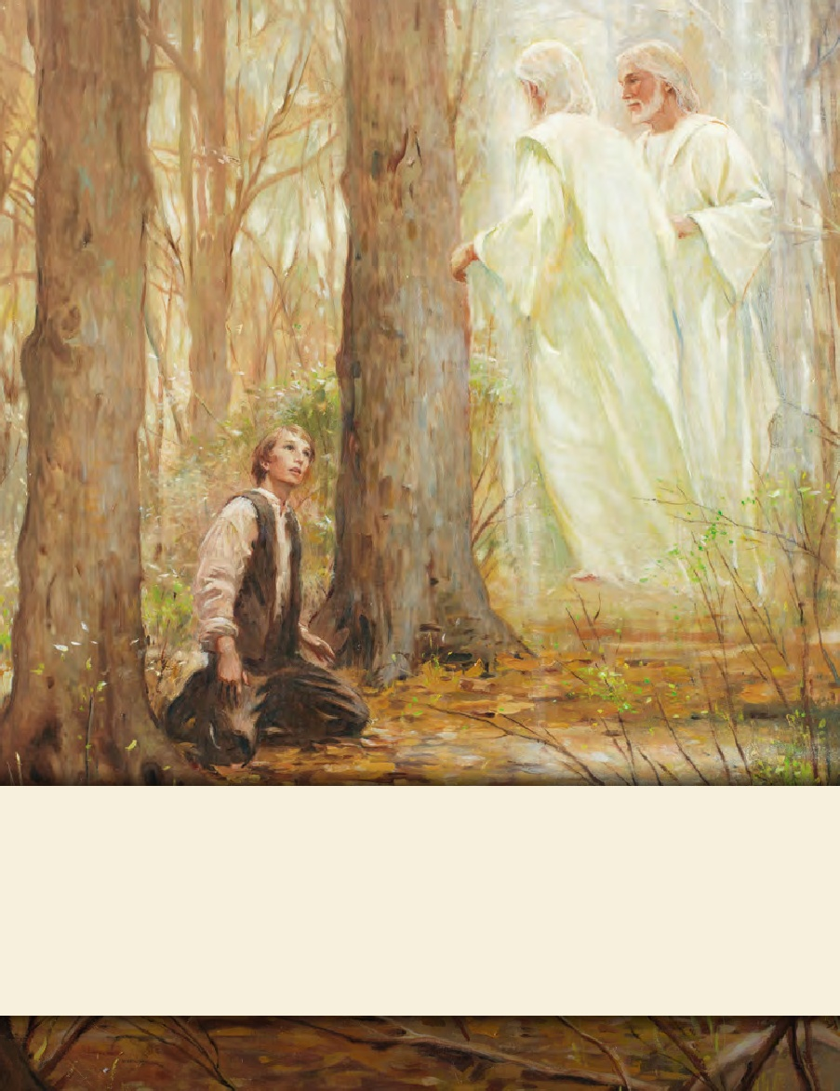
LESSON 15
SEMINARY
Doctrine and Covenants
and Church History

Slide 2
LESSON 123
Doctrine and Covenants 115-116

Slide 3
LESSON 123
Doctrine and Covenants 115:1–6.
"The Lord commands the members of His Church to “arise and shine forth”

Slide 4
LESSON 123
1. What does the name of the organization communicate?
2. Who leads the organization?
3. What does the organization do?

Slide 5
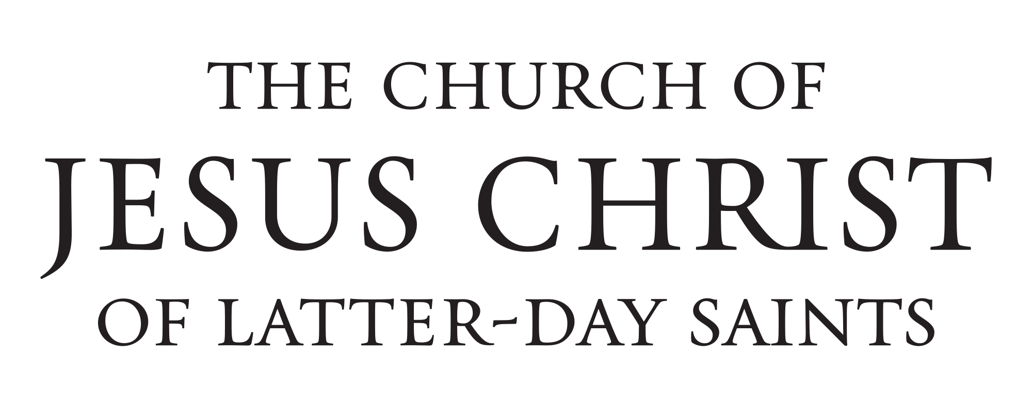
LESSON 123
Doctrine and Covenants 115:4.
For thus shall my church be called in the last days, even The Church of Jesus Christ of Latter-day Saints.

Slide 6
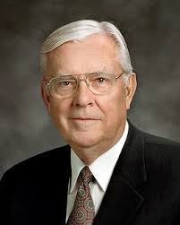
LESSON 123
“The word The indicates the unique position of the restored Church among the religions of the world. “The words Church of Jesus Christ declare that it is His Church.… “Of Latter-day explains that it is the same Church as the Church that Jesus Christ established during His mortal ministry but restored in these latter days.… “Saints… simply refers to those who seek to make their lives holy by covenanting to follow Christ” (“The Importance of a Name, ”Ensign or Liahona, Nov. 2011,80).
Elder
M. Russell Ballard
What are some important truths communicated by the name of the Church?
Doctrine and Covenants 115:5.
Verily I say unto you all: Arise and shine forth, that thy lightmay be a standard for the nations;
What does the Lord expect of us as members of His Church?
What do you think it means to “arise and shine forth” as members of The Church of Jesus Christ of Latter-day Saints?

Slide 7
LESSON 123
What blessing will come as members of the Church follow the Lord’s counsel to arise and shine forth?
If we arise and shine forth, our light will be a standard for the nations.
What do you think it means that our light, or example, can be a “standard for the nations”?
How can following the Savior’s commandment to arise and shine forth attract others to The Church of Jesus Christ of Latter-day Saints?

Slide 8
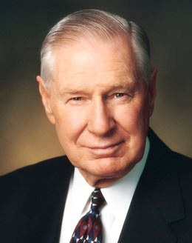
LESSON 123
“Some years ago, Constance, a student nurse, was assigned to try and help a woman who had injured her leg in an accident. The woman refused medical help because she had had a negative experience with someone at the hospital. She was afraid and had become something of a recluse. The first time Constance dropped by, the injured woman ordered her out. On the second try, she did let Constance in. By now the woman’s leg was covered with large ulcers, and some of the flesh was rotting. But still she didn’t want to be treated.
“Constance made it a matter of prayer, and in a day or two the answer came. She took some foaming hydrogen peroxide with her for the next visit. As this was painless, the old woman let her use it on her leg. Then they talked about more serious treatment at the hospital. Constance assured her the hospital would make her stay as pleasant as possible. In a day or
President
James E. Faust
two the woman did get the courage to enter the hospital. When Constance visited her, the woman smiled as she said, ‘You convinced me.’ Then, quite unexpectedly, she asked Constance, ‘What church do you belong to?’ Constance told her she was a member of The Church of Jesus Christ of Latter-day Saints. The woman said: ‘I knew it. I knew you were sent to me from the first day that I saw you. There was a light in your face that I had noticed in others of your faith. I had to put my trust in you.’
“In three months’ time that festering leg was completely healed. Members of the ward where the old woman lived remodeled her house and fixed up her yard. The missionaries met with her, and she was baptized soon after [see Constance Polve, “A Battle Won, ”New Era, Apr. 1980, 44–45]. All of this because she noticed the light in that young student nurse’s face” (“The Light in Their Eyes,” Ensign or Liahona, Nov. 2005,22).
What did Constance do to “arise and shine forth”?
How was the light in Constance’s face a standard for the injured woman?

Slide 9
LESSON 123
Doctrine and Covenants 115:6.
And that the gathering together upon the land of Zion, and upon her stakes, may be for a defense, and for a refuge from the storm, and from wrath when it shall be poured out without mixture upon the whole earth.
What blessings are promised to those who gather to the stakes of Zion?
We gather to the stakes of Zion for defense and for refuge.
What do we need to defend ourselves against?
What do we need refuge from?
In what ways have you seen that gathering together as Saints helps us defend ourselves and find refuge?

Slide 10
LESSON 123
Doctrine and Covenants 115:7–19.
“The Lord commands the Saints to establish the city of Far West and to build a temple”

Slide 11
LESSON 123
Doctrine and Covenants 115:17-19.
17 And again, verily I say unto you, it is my will that the city of Far West should be built up speedily by the gathering of my saints;
18 And also that other places should be appointed for stakes in the regions round about, as they shall be manifested unto my servant Joseph, from time to time.
19 For behold, I will be with him, and I will sanctify him before the people; for unto him have I given the keys of this kingdom and ministry. Even so. Amen.
What did the Lord want the Saints to do in Far West?
What were they to do under Joseph Smith’s direction in the regions surrounding Far West?
What qualifies the President of the Church today to direct the Lord’s work on the earth?
The President of the Church holds the keys to direct the Lord’s work upon the earth.

Slide 12
LESSON 123
Doctrine and Covenants 116:1.
“The Lord identifies Adam-ondi-Ahman as the location of a future meeting between the Lord and His people”

Slide 13
LESSON 123
Introduction for Doctrine and Covenants 116.
Revelation given to Joseph Smith the Prophet, near Wight’s Ferry, at a place called Spring Hill, Daviess County, Missouri, May 19, 1838.
Doctrine and Covenants 116:1.
Spring Hill is named by the Lord Adam-ondi-Ahman, because, said he, it is the place where Adam shall come to visit his people, or the Ancient of Days shall sit, as spoken of by Daniel the prophet.

Slide 14
LESSON 123

