Slide 1
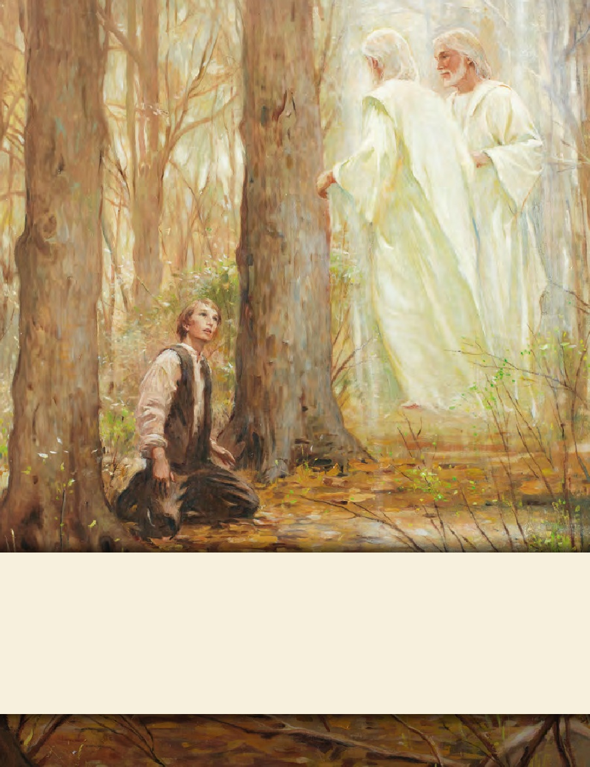
LESSON 15
SEMINARY
Doctrine and Covenants
and Church History

Slide 2
LESSON 121
The Church Moves to Northern Missouri

Slide 3
LESSON 121
Apostasy and the city of Far West.
“During a period of apostasy and persecution, faithful Saints move to northern Missouri”

Slide 4
LESSON 121
Do difficulties and trials help strengthen our faith or cause us to lose faith?

Slide 5
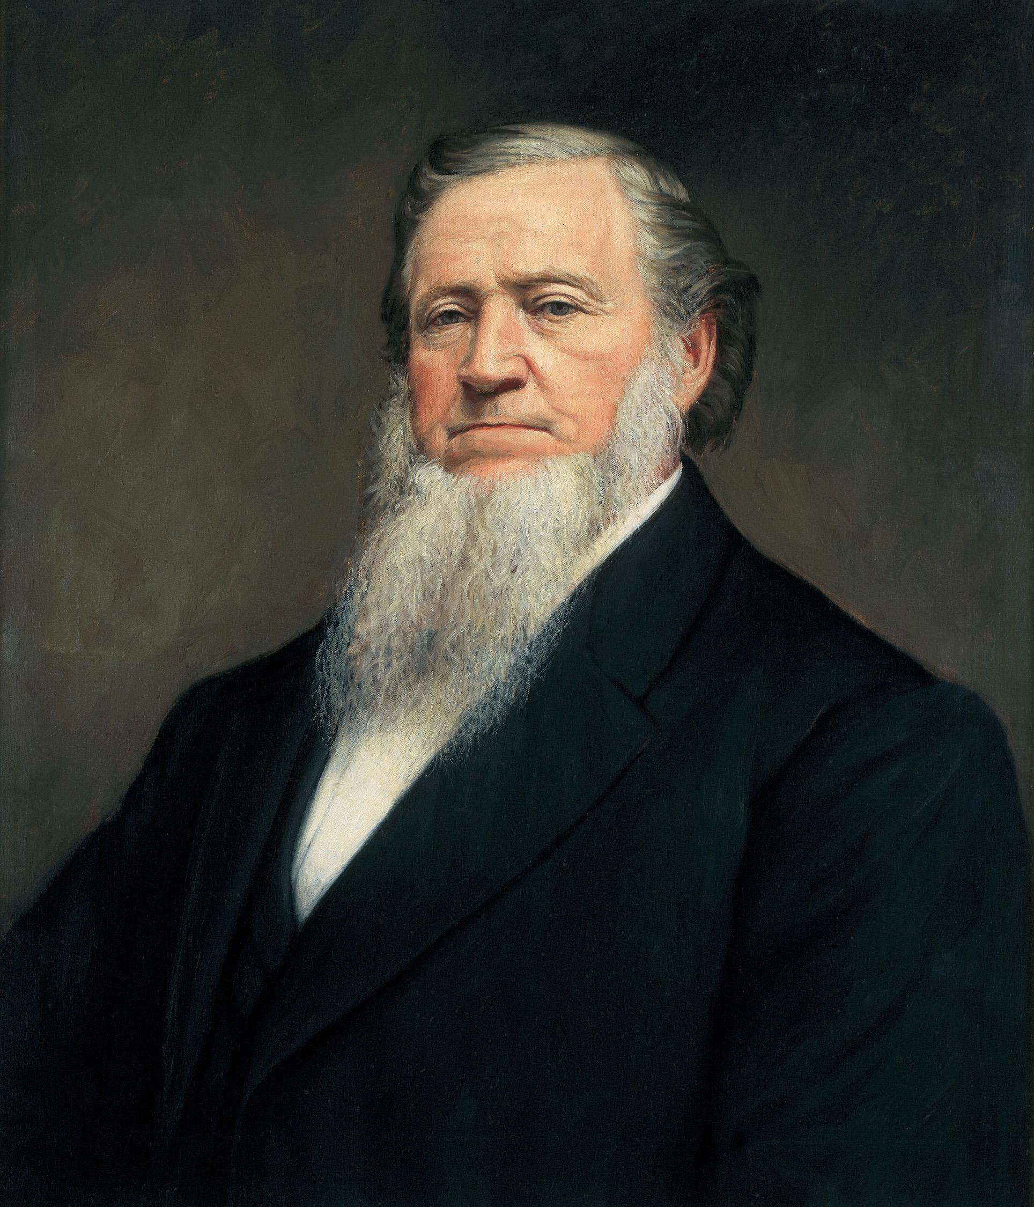
LESSON 121
Historical Summary 1—Apostasy in Kirtland
In 1837, the Saints in Kirtland, Ohio, experienced some financial problems. To help the Saints be more self-sufficient in their finances, Joseph Smith and other Church leaders established a company similar to a bank and called it the Kirtland Safety Society. Because of a widespread economic depression during this time, many banks failed throughout the nation. The Kirtland Safety Society also failed in the fall of 1837. Two hundred investors in the bank lost almost everything, with Joseph Smith sustaining the greatest losses. Even though the Kirtland Safety Society was not funded by the Church, some of the Saints considered it a Church bank or the Prophet’s bank and blamed Joseph Smith for their financial problems. Some even began calling him a fallen prophet. But despite the bank’s failure, many others who lost money continued in the faith and stayed true to the Prophet. (See Church History in the Fulness of Times Student Manual[Church Educational System manual, 2003], 171–73.)
A spirit of apostasy and faultfinding spread among many of the Saints. Brigham Young described an occasion when some of the Church leaders and Saints met to renounce Joseph Smith and appoint a new prophet:
“Several of the Twelve, the witnesses to the Book of Mormon, and others of the Authorities of the Church, held a council in the upper room of the Temple. The question before them was to ascertain how the Prophet Joseph could be deposed, and David Whitmer appointed President of the Church. … I rose up, and in a plain and forcible manner told them that Joseph was a Prophet, and I knew it, and that they might rail and slander him as much as they pleased, they could not destroy the appointment of the Prophet of God, they could only destroy their own authority, cut the thread that bound them to the Prophet and to God and sink themselves to hell” (Manuscript History of Brigham Young 1801–1844,ed. Elden Jay Watson [1968],15–16).
President
Brigham Young

Slide 6
LESSON 121
By June 1838, approximately 200 or 300 apostates had left the Church, including four Apostles, the Three Witnesses of the Book of Mormon, and a member of the First Presidency (see Church History in the Fulness of Times,177). However, most of the Saints responded to this period of testing with faith, much like Brigham Young did. They were strengthened by the Lord, and they remained true to their testimonies. Several of those who left the Church during this period of apostasy later returned and requested that they be reunited again with the Lord’s Church. Among them were Oliver Cowdery, Martin Harris, Luke Johnson, and Frederick G. Williams.
In the midst of these struggles in Kirtland, a few apostates sought to kill Joseph Smith. Warned by the Spirit, he and Sidney Rigdon left during the night on January 12, 1838. Their enemies pursued them for days, but the Lord protected them. They arrived with their families in Far West, Missouri, on March 14,1838.
Discuss the following questions as a group:
What principles can we learn from these historical events?
What would you have done to remain faithful to the Prophet during this time of faultfinding?
When has enduring a trial with faith strengthened your faith in the Savior?
In what ways has following the prophet been a spiritual protection for you?

Slide 7
LESSON 121
Historical Summary 2—Northern Missouri Leadership
In the summer of 1836, when citizens of Clay County, Missouri, were pressuring the Saints to find a more permanent home, John Whitmer and William W. Phelps, the two counselors in the Missouri stake presidency, used Church money to purchase land in a place known as Far West in northern Missouri. However, when they offered parcels of land to incoming Saints, they sold the land for a small profit, which they kept for themselves. Upset by this and other offenses, the high council in Missouri removed the stake presidency from office.
Joseph Smith upheld the council’s action, and William W. Phelps was offended. In November 1838, Brother Phelps signed an affidavit against the Prophet. This affidavit contributed to Joseph Smith and others being arrested and thrown into Liberty Jail for the winter. Brother Phelps was excommunicated from the Church shortly thereafter.
In jail, Joseph Smith and those with him suffered immensely, not only from the brutal conditions of their imprisonment but also from reports of the Saints being driven from their homes and abused in many ways. The Missouri mobs, unchecked by the governor, destroyed property and lives, including the massacre of 17 people at a mill owned by a man named Jacob Haun.
William W. Phelps suffered spiritually for his actions, and he wrote Joseph Smith a letter asking for forgiveness a year later. The Prophet wrote back:

Slide 8
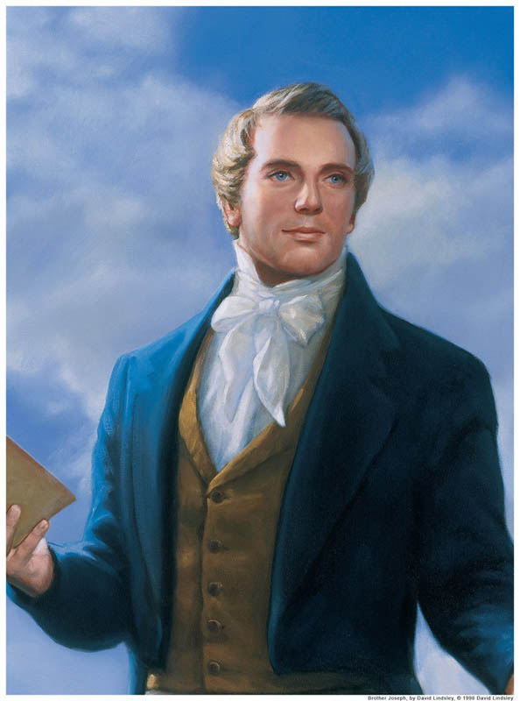
LESSON 121
“It is true, that we have suffered much in consequence of your behavior.…
“However, the cup has been drunk, the will of our Father has been done, and we are yet alive, for which we thank the Lord.…
“Believing your confession to be real, and your repentance genuine, I shall be happy once again to give you the right hand of fellowship, and rejoice over the returning prodigal.…
“‘Come on dear brother, since the war is past,
“‘For friends at first, are friends again at last’” (in History of the Church,4:163,164).
Prophet
Joseph Smith
Discuss the following questions as a group:
Why is it difficult to forgive a friend who has betrayed you and caused you to suffer?
What principles can we learn from Joseph Smith’s example?
What other lessons can we learn from this experience?

Slide 9
LESSON 121
Historical summary 1
As we choose to respond to trials with faith rather than doubt, our testimonies can be strengthened; as we support the prophet and follow his counsel, we receive spiritual security that binds us to God.
Historical summary2
As we forgive others, the Lord can heal our relationships
Why is this principle important for us to remember?
How would you explain this truth to a friend?
When have you experienced or seen an example of this principle?
What will I do differently because of the principle or principles I learned today?

Slide 10
LESSON 121
“Events leading to the Saints’ expulsion from
northern Missouri”

Slide 11
LESSON 121
Why is it important for us to think about how our actions or words reflect on the Church?
What did a few of the Saints say or do that caused negative reactions to the Church?

Slide 12
LESSON 121
In 1837 and 1838, some disaffected and excommunicated members of the Church living among the Saints in Far West began to bring lawsuits against the Church and its leaders and to harass the Church. Some of the Saints began to grow impatient with these dissenters. In June 1838, Sidney Rigdon spoke heatedly in what has become known as the “Salt Sermon.” He referenced Matthew 5:13and said that if the salt loses its savor, it is good for nothing and should be cast out, implying that those who had left the Church should be cast out from among the Saints. Additionally, 84 Church members signed a document ordering the apostates to leave the county. Two weeks later, on July 4, Sidney Rigdon gave a speech in which he promised that the Saints would defend themselves even if it came to a “war of extermination.” Though both of these speeches seemed to contradict the Lord’s instruction to “sue for peace” (D&C 105:38), both speeches were published and caused great alarm among non–Latter-day Saints. (See Church History in the Fulness of Times,191–92.)
On August 6, 1838, as a group of Saints tried to vote in Gallatin, Missouri, they were pushed aside by a group of Missourians, and one local man hit one of the Saints. The Saints fought back, and a number of men were injured on both sides. This incident led to additional conflicts and threats and increased the misunderstanding between the Latter-day Saints and their neighbors in Missouri.
During this time, a convert named Sampson Avard administered secret oaths to those who would join him in forming a band of marauders called the Danites. Avard instructed them to rob and plunder the Missourians, saying that this would help build up the kingdom of God. Avard convinced his followers that his directions were coming from the First Presidency. The truth was later discovered, and Avard was excommunicated. Avard’s actions caused significant damage to the image of the Church and helped lead to the Prophet’s imprisonment in Liberty Jail.
In October 1838, a battle between some members of the Church and Missouri militiamen left a few men dead on each side. Exaggerated reports of the battle reached Governor Lilburn W. Boggs, governor of the state of Missouri, who then issued what has become known as the extermination order: “The Mormons must be treated as enemies and must be exterminated or driven from the state, if necessary for the public good” (quoted in History of the Church,3:175). Soon, the city of Far West was surrounded by a militia that outnumbered the Saints’ forces five to one. Joseph Smith and other Church leaders were imprisoned in Liberty Jail, where they remained all winter. The rest of the Saints were forced to leave the state.

Slide 13
LESSON 121
Why might it be important for us to recognize that some of the persecution the Saints suffered resulted from Church members’ actions?
What can we learn from these events about how our own actions and words can influence others?
Our actions and words can influence how others view the Church of Jesus Christ.

