Slide 1
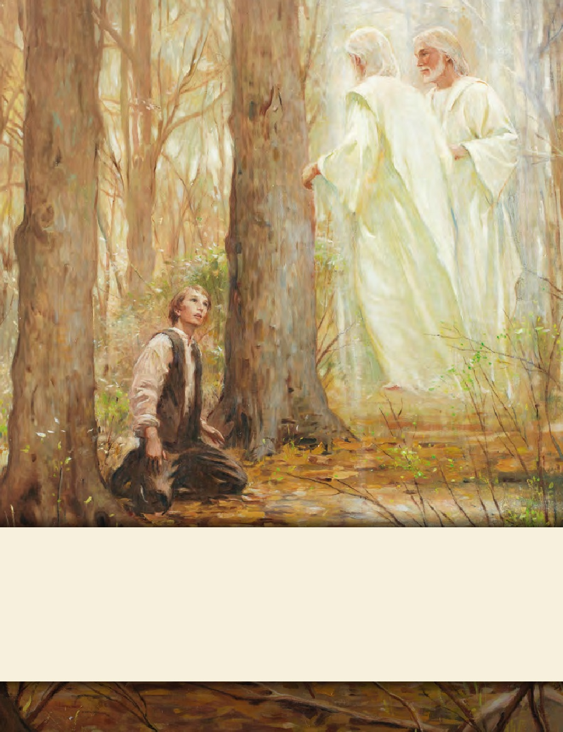
LESSON 15
SEMINARY
Doctrine and Covenants
and Church History

Slide 2
LESSON 119
Doctrine and Covenants 111.

Slide 3
LESSON 119
Doctrine and Covenants 111.
“The Lord provides reassurance and instruction for Joseph Smith and other Church leaders”

Slide 4
LESSON 119
What are some things that bring stress or anxiety into your life?
Doctrine and Covenants 104:80.
And inasmuch as you are diligent and humble, and exercise the prayer of faith, behold, I will soften the hearts of those to whom you are in debt, until I shall send means unto you for your deliverance.

Slide 5
LESSON 119
How do you think you would have felt after traveling to Salem in hopes of finding the means to help pay the Church’s debt and not finding what you expected?
What would you have done?
Doctrine and Covenants 111:1.
I, the Lord your God, am not displeased with your coming this journey, notwithstanding your follies.
What about the trip to Salem might have been considered a folly?
Doctrine and Covenants 111:2.
I have much treasure in this city for you, for the benefit of Zion, and many people in this city, whom I will gather out in due time for the benefit of Zion, through your instrumentality.
What did the Lord say He had in Salem?
Much treasure and many people.
When did the Lord say He would gather out the people He had in Salem?
In due time.

Slide 6
LESSON 119
What can we learn from Joseph Smith’s experience in Salem and the Lord’s teachings in Doctrine and Covenants 111:1–2?
The Lord can bring forth good from our sincere efforts.
In what ways can the Lord bring forth good from our efforts, even if they are originally misguided?
How does it influence you to know that the Lord can bring forth good from your sincere efforts?
Doctrine and Covenants 111:5–8.
5 Concern not yourselves about your debts, for I will give you power to pay them.
6 Concern not yourselves about Zion, for I will deal mercifully with her.
7 Tarry in this place, and in the regions round about;
8 And the place where it is my will that you should tarry, for the main, shall be signalized unto you by the peace and power of my Spirit, that shall flow unto you.
How did the Lord comfort Joseph Smith and his companions with regard to the Church’s debts and the status of Zion?
How would Joseph Smith and the other Church leaders know where to stay during the rest of their visit in Salem?
What truth can we learn from the Lord’s instruction in verse 8?
We can receive the Lord’s direction through the peace and power of His Spirit.
How can this principle help you face concerns and challenges?

Slide 7
LESSON 119
Doctrine and Covenants 111:9-10
-11.
9 This place you may obtain by hire. And inquire diligently concerning the more ancient inhabitants and founders of this city;
10 For there are more treasures than one for you in this city.
11 Therefore, be ye as wise as serpents and yet without sin; and I will order all things for your good, as fast as ye are able to receive them. Amen.
How would you restate the Lord’s counsel in verse 11?
If we are wise and avoid sin, then the Lord will arrange all things for our good.
What are some wise choices we can make?
What do you think it means that the Lord “will order all things for [our]good”?
When have you seen an example of this principle?

