Slide 1
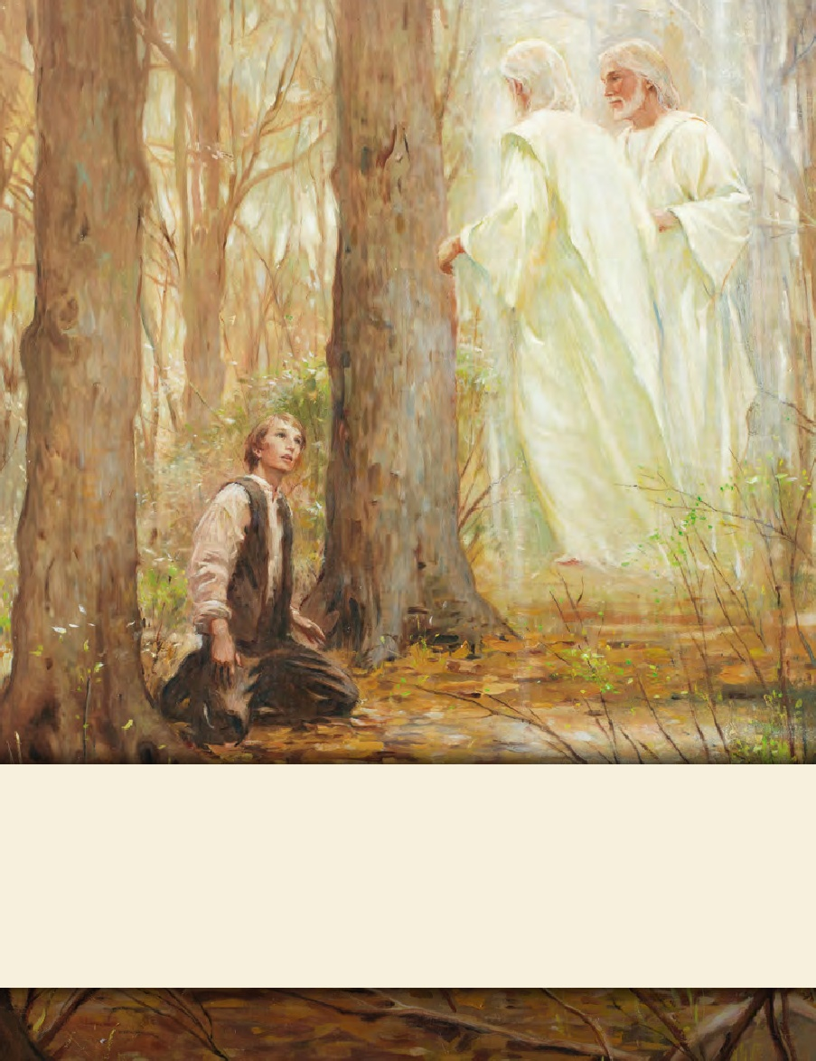
LESSON 15
SEMINARY
Doctrine and Covenants
and Church History

Slide 2
LESSON 118
Doctrine and Covenants 110

Slide 3
LESSON 118
Doctrine and Covenants 110:1–10.
“The Lord appears and accepts
the Kirtland Temple”

Slide 4
LESSON 118
What does the phrase “the House of the Lord” mean to you?
Introduction to Doctrine and Covenants 110.
Visions manifested to Joseph Smith the Prophet and Oliver Cowdery in the temple at Kirtland, Ohio, April 3, 1836. The occasion was that of a Sabbath day meeting. Joseph Smith’s history states: “In the afternoon, I assisted the other Presidents in distributing the Lord’s Supper to the Church, receiving it from the Twelve, whose privilege it was to officiate at the sacred desk this day. After having performed this service to my brethren, I retired to the pulpit, the veils being dropped, and bowed myself, with Oliver Cowdery, in solemn and silent prayer. After rising from prayer, the following vision was opened to both of us.”
Who was present during this vision?
What had they been doing before this vision occurred?

Slide 5
LESSON 118
Doctrine and Covenants 110:1-3
-5.
1 The veil was taken from our minds, and the eyes of our understanding were opened.
2 We saw the Lord standing upon the breastwork of the pulpit, before us; and under his feet was a paved work of pure gold, in color like amber.
3 His eyes were as a flame of fire; the hair of his head was white like the pure snow; his countenance shone above the brightness of the sun; and his voice was as the sound of the rushing of great waters, even the voice of Jehovah, saying:
4 I am the first and the last; I am he who liveth, I am he who was slain; I am your advocate with the Father.
5 Behold, your sins are forgiven you; you are clean before me; therefore, lift up your heads and rejoice.
What in these verses is meaningful to you? Why?

Slide 6
LESSON 118
Doctrine and Covenants 110:6-10.
6 Let the hearts of your brethren rejoice, and let the hearts of all my people rejoice, who have, with their might, built this house to my name.
7 For behold, I have accepted this house, and my name shall be here; and I will manifest myself to my people in mercy in this house.
8 Yea, I will appear unto my servants, and speak unto them with mine own voice, if my people will keep my commandments, and do not pollute this holy house.
9 Yea the hearts of thousands and tens of thousands shall greatly rejoice in consequence of the blessings which shall be poured out, and the endowment with which my servants have been endowed in this house.
10 And the fame of this house shall spread to foreign lands; and this is the beginning of the blessing which shall be poured out upon the heads of my people. Even so. Amen.
Why did the Saints have great reason to rejoice?
The Lord accepted the temple and promised to manifest Himself to them in it.
How can the Lord manifest Himself to people in the temple?

Slide 7
LESSON 118
If we obey the Lord’s commandments and keep His house pure, He will manifest Himself to us in His temples.
How can we keep the Lord’s house pure and unpolluted?
Why do you think the Lord requires us to be obedient and clean before He will manifest Himself to us in His house?
Doctrine and Covenants 110:9-10.
9 Yea the hearts of thousands and tens of thousands shall greatly rejoice in consequence of the blessings which shall be poured out, and the endowment with which my servants have been endowed in this house.
10 And the fame of this house shall spread to foreign lands; and this is the beginning of the blessing which shall be poured out upon the heads of my people. Even so. Amen.
Who will be blessed because of the restoration of temple blessings?
How is the world blessed because of temples and the work of salvation for the living and the dead?
How is the temple a blessing in your life?

Slide 8
LESSON 118
Doctrine and Covenants 110:11–16.
“Moses, Elias, and Elijah appear, and priesthood keys are restored to Joseph Smith and Oliver Cowdery”

Slide 9
LESSON 118
 | Moses D&C 110:11 | Elias D&C 110:12 | Elijah D&C 110:13–16
Priesthood keys restored
What these keys direct

Slide 10
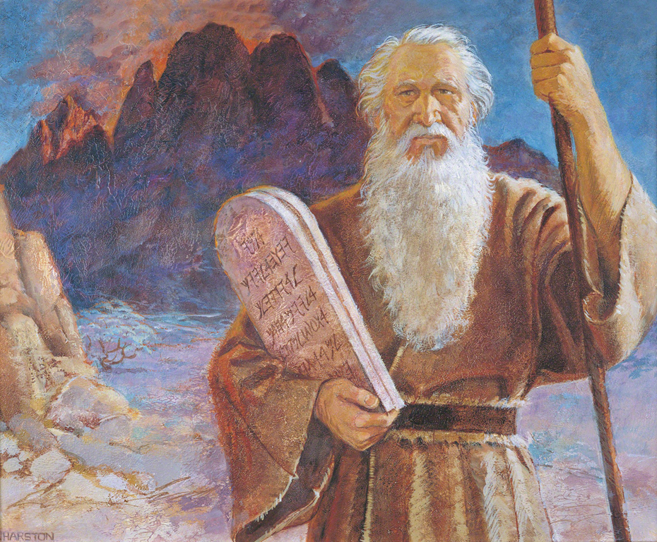
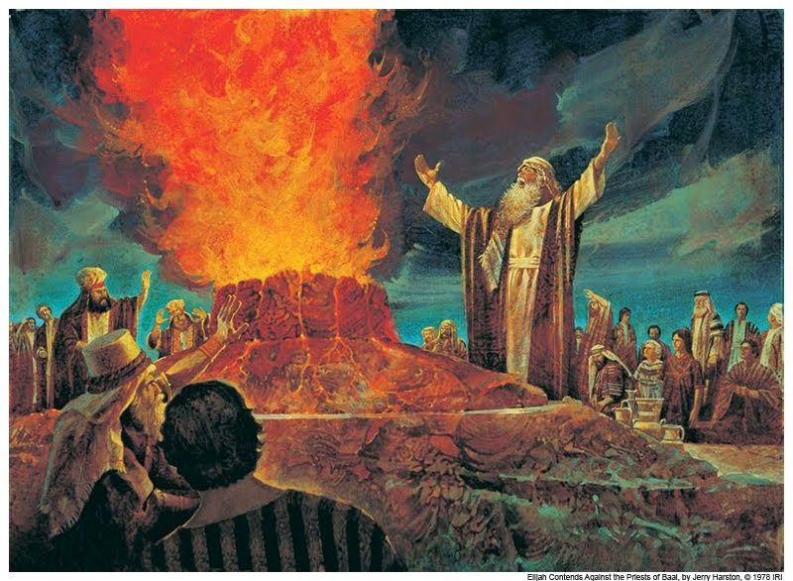
LESSON 118

Slide 11
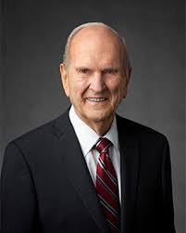
LESSON 118
 | Moses D&C 110:11 | Elias D&C 110:12 | Elijah D&C 110:13–16
Priesthood keys restored
What these keys direct
The keys of the gathering of Israel.
The dispensation of the gospel of Abraham.
The keys of this dispensation.
Missionary work.
In our day, how does the Lord gather His children into His kingdom?
“Missionary work is crucial to the gathering of Israel. … In many nations our missionaries have searched for those of scattered Israel” (“The Gathering of Scattered Israel, ”EnsignorLiahona,Nov. 2006,81).
President
Russell M. Nelson
How has your life been influenced by Moses restoring the keys governing missionary work?

Slide 12
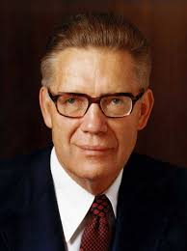
LESSON 118
“Elias brings back ‘the gospel of Abraham,’ the great Abrahamic covenant whereby the faithful receive promises of eternal increase, promises that through celestial marriage their eternal posterity shall be as numerous as the sands upon the seashore or as the stars in heaven for multitude. Elias gives the promise—received of old by Abraham, Isaac, and Jacob—that in modern men and in their seed all generations shall be blessed. And we are now offering the blessings of Abraham, Isaac, and Jacob to all who will receive them” (“The Keys of the Kingdom,” Ensign, May 1983,22).
Elder
Bruce R. McConkie
What promises were given to Abraham?
 | Moses D&C 110:11 | Elias D&C 110:12 | Elijah D&C 110:13–16
Priesthood keys restored
What these keys direct
The keys of the gathering of Israel.
The dispensation of the gospel of Abraham.
The keys of this dispensation.
Missionary work.
Celestial marriage and eternal posterity.
What do the blessings of celestial marriage and eternal posterity mean to you?
Why are they important to you?

Slide 13
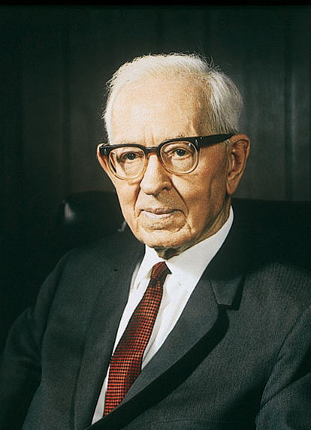
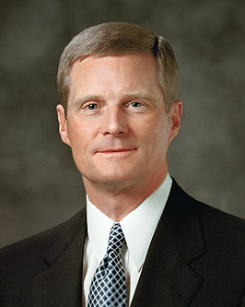
LESSON 118
President Joseph Fielding Smith taught: “This sealing power bestowed upon Elijah, is the power which binds husbands and wives, and children to parents for time and eternity. It is the binding power existing in every Gospel ordinance. … It is by this power that all the ordinances pertaining to salvation are bound, or sealed, and it was the mission of Elijah to come, and restore it” (Elijah the Prophet and His Mission[1957],5).
Elder David A. Bednar of the Quorum of the Twelve Apostles explained: “As members of Christ’s restored Church, we have the covenant responsibility to search out our ancestors and provide for them the saving ordinances of the gospel. … For these reasons we do family history research, build temples, and perform vicarious ordinances. For these reasons Elijah was sent to restore the sealing authority that binds on earth and in heaven” (“The Hearts of the Children Shall Turn, ”EnsignorLiahona,Nov. 2011,25–26).
What power or authority did Elijah restore?

Slide 14
LESSON 118
 | Moses D&C 110:11 | Elias D&C 110:12 | Elijah D&C 110:13–16
Priesthood keys restored
What these keys direct
The keys of the gathering of Israel.
The dispensation of the gospel of Abraham.
The keys of this dispensation.
Celestial marriage and eternal posterity.
Sealing power, including temple and family history work.
Missionary work.
How have you been blessed by the restoration of the sealing power?
The keys of missionary work, eternal families, and temple work help us to…

Slide 15
LESSON 118
Doctrine and Covenants 110:11–16.
11 After this vision closed, the heavens were again opened unto us; and Moses appeared before us, and committed unto us the keys of the gathering of Israel from the four parts of the earth, and the leading of the ten tribes from the land of the north.
12 After this, Elias appeared, and committed the dispensation of the gospel of Abraham, saying that in us and our seed all generations after us should be blessed.
13 After this vision had closed, another great and glorious vision burst upon us; for Elijah the prophet, who was taken to heaven without tasting death, stood before us, and said:
14 Behold, the time has fully come, which was spoken of by the mouth of Malachi—testifying that he [Elijah] should be sent, before the great and dreadful day of the Lord come—
15 To turn the hearts of the fathers to the children, and the children to the fathers, lest the whole earth be smitten with a curse—
16 Therefore, the keys of this dispensation are committed into your hands; and by this ye may know that the great and dreadful day of the Lord is near, even at the doors.
Why are missionary work, eternal families, and temple work necessary?
The keys of missionary work, eternal families, and temple work help us to prepare for the Lord’s Second Coming.

Slide 16
LESSON 118
How have you been blessed because of the priesthood keys that have been restored?
What can you do to help someone else be blessed through one of these restored keys?

