Slide 1
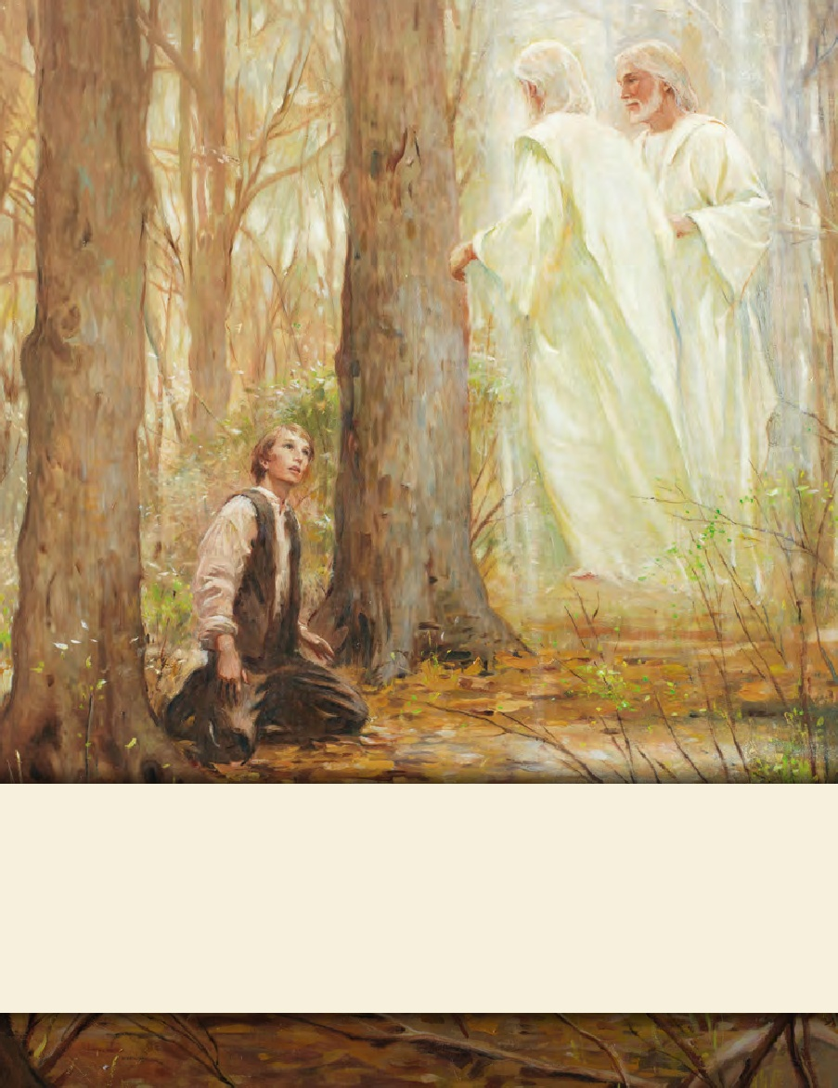
LESSON 15
SEMINARY
Doctrine and Covenants
and Church History

Slide 2
LESSON 116
Doctrine and Covenants 109:1-46.

Slide 3
LESSON 116
Doctrine and Covenants 109:1–23.
“Joseph Smith asks the Lord to accept the Kirtland Temple and to bless those who worship there”

Slide 4
LESSON 116
Why do we build temples?

Slide 5
LESSON 116
Doctrine and Covenants 109:1–4.
1 Thanks be to thy name, O Lord God of Israel, who keepest covenant and showest mercy unto thy servants who walk uprightly before thee, with all their hearts—
2 Thou who hast commanded thy servants to build a house to thy name in this place [Kirtland].
3 And now thou beholdest, O Lord, that thy servants have done according to thy commandment.
4 And now we ask thee, Holy Father, in the name of Jesus Christ, the Son of thy bosom, in whose name alone salvation can be administered to the children of men, we ask thee, O Lord, to accept of this house, the workmanship of the hands of us, thy servants, which thou didst command us to build.
What was the first reason the Saints built the Kirtland Temple?
The Lord commands us to build temples.

Slide 6
LESSON 116
Doctrine and Covenants 109:5.
For thou knowest that we have done this work through great tribulation; and out of our poverty we have given of our substance to build a house to thy name, that the Son of Man might have a place to manifest himself to his people.
What phrases did you notice?
Between June 1833 and March 1836, Church members sacrificed time, money, and possessions to help build a house for the Lord. The men volunteered their labor on the construction. The women made clothing and provided lodging. When many of the men were away with Zion’s Camp, some women continued the work on the temple. Some Latter-day Saints, like John Tanner and Vienna Jacques, gave much of their wealth for the building of the temple. Others contributed skilled labor. For example, Brigham Young baptized a man named Artemus Millet in Canada. Brother Millet gave up his job as a stone mason for the Canadian government so he and his family could move to Kirtland, where he served as the superintendent of the construction of the temple. In all, the temple cost approximately 60,000 United States dollars—an incredible sum for that time, especially considering the poverty of the Saints. By comparison, that amount would be worth well over 1,000,000 United States dollars today.

Slide 7
LESSON 116
What impresses you about the sacrifices the Saints made to build the temple?
What truth did you find about why the Saints wanted to build the temple?
II the temple, the Lord can manifest Himself to us.
-13.
Doctrine and Covenants 109:10-11
10 And now, Holy Father, we ask thee to assist us, thy people, with thy grace, in calling our solemn assembly, that it may be done to thine honor and to thy divine acceptance;
11 And in a manner that we may be found worthy, in thy sight, to secure a fulfilment of the promises which thou hast made unto us, thy people, in the revelations given unto us;
12 That thy glory may rest down upon thy people, and upon this thy house, which we now dedicate to thee, that it may be sanctified and consecrated to be holy, and that thy holy presence may be continually in this house;
13 And that all people who shall enter upon the threshold of the Lord’s house may feel thy power, and feel constrained to acknowledge that thou hast sanctified it, and that it is thy house, a place of thy holiness.
What did Joseph Smith ask the Lord to do so the people could receive the blessings of the temple?
As we seek to be worthy to enter the temple, why do we need the Lord’s grace?

Slide 8
LESSON 116
What phrases did you find that help you understand how the Lord manifests Himself to us in the temple?
How does feeling close to the Lord in the temple influence your life when you are outside the temple?
Doctrine and Covenants 109:14-23.
14 And do thou grant, Holy Father, that all those who shall worship in this house may be taught words of wisdom out of the best books, and that they may seek learning even by study, and also by faith, as thou hast said;
15 And that they may grow up in thee, and receive a fulness of the Holy Ghost, and be organized according to thy laws, and be prepared to obtain every needful thing;
16 And that this house may be a house of prayer, a house of fasting, a house of faith, a house of glory and of God, even thy house;
17 That all the incomings of thy people, into this house, may be in the name of the Lord;
18 That all their outgoings from this house may be in the name of the Lord;
19 And that all their salutations may be in the name of the Lord, with holy hands, uplifted to the Most High;
20 And that no unclean thing shall be permitted to come into thy house to pollute it;
21 And when thy people transgress, any of them, they may speedily repent and return unto thee, and find favor in thy sight, and be restored to the blessings which thou hast ordained to be poured out upon those who shall reverence thee in thy house.
22 And we ask thee, Holy Father, that thy servants may go forth from this house armed with thy power, and that thy name may be upon them, and thy glory be round about them, and thine angels have charge over them;
23 And from this place they may bear exceedingly great and glorious tidings, in truth, unto the ends of the earth, that they may know that this is thy work, and that thou hast put forth thy hand, to fulfil that which thou hast spoken by the mouths of the prophets, concerning the last days.

Slide 9
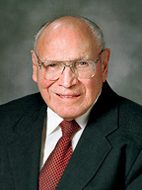
LESSON 116
What additional blessings has the Lord promised to those who worship in the temple?
What are some results of worshipping in the temple?
Receiving temple blessings arms us with power and with the Lord’s help as we serve Him.
What do you think it means to be “armed with [the Lord’s]power”?
“In the house of the Lord, faithful Church members can be endowed ‘with power from on high’ [D&C 95:8], power that will enable us to resist temptation, honor covenants, obey the Lord’s commandments, and bear fervent, fearless testimony of the gospel to family, friends, and neighbors” (“Cultivating Divine Attributes,” Ensign,Nov. 1998,27).
Elder
Joseph B. Wirthlin
How would this kind of power be a blessing to you and your family?
How would this kind of power be a blessing for full-time missionaries?

Slide 10
LESSON 116
Doctrine and Covenants 109:24–46.
“Joseph Smith asks the Lord to protect and bless those who worship in the temple and those who preach the gospel”

Slide 11
LESSON 116
Doctrine and Covenants 109:24–28.
24 We ask thee, Holy Father, to establish the people that shall worship, and honorably hold a name and standing in this thy house, to all generations and for eternity;
25 That no weapon formed against them shall prosper; that he who diggeth a pit for them shall fall into the same himself;
26 That no combination of wickedness shall have power to rise up and prevail over thy people upon whom thy name shall be put in this house;
27 And if any people shall rise against this people, that thine anger be kindled against them;
28 And if they shall smite this people thou wilt smite them; thou wilt fight for thy people as thou didst in the day of battle, that they may be delivered from the hands of all their enemies.

Slide 12
LESSON 116
What kind of protection did Joseph pray for?
What can we do to receive this kind of protection?
What can we learn from these verses about receiving protection from evil?
If the Lord’s people are worthy and worship Him in the temple, then wickedness will not prevail over them.
President Howard W. Hunter Said:
“Truly, the Lord desires that His people be a temple-motivated people. It would be the deepest desire of my heart to have every member of the Church be temple worthy. … Let us be a temple-attending and a temple-loving people. Let us hasten to the temple as frequently as time and means and personal circumstances allow” (“The Great Symbol of Our Membership,”Ensign,Oct. 1994,5).

