Slide 1
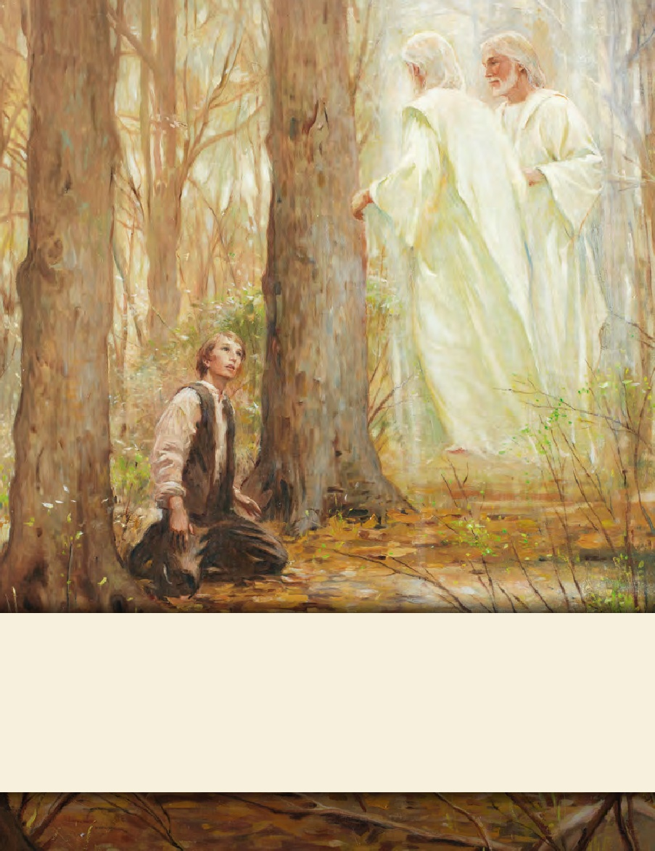
LESSON 15
SEMINARY
Doctrine and Covenants
and Church History

Slide 2
LESSON 115
Doctrine and Covenants 137.

Slide 3
LESSON 115
Doctrine and Covenants 137:1–6.
“Joseph Smith sees a vision of
the celestial kingdom”

Slide 4
LESSON 115
Who are some of the most important people in your life?
Why are they especially significant to you?
Why would it be important to you to know that the people you love will have the opportunity to live in the celestial kingdom?
Introduction to Doctrine and Covenants 137.
A vision given to Joseph Smith the Prophet, in the temple at Kirtland, Ohio, January 21, 1836. The occasion was the administration of ordinances in preparation for the dedication of the temple.

Slide 5
LESSON 115
Doctrine and Covenants 137:1–4
-6.
1 The heavens were opened upon us, and I beheld the celestial kingdom of God, and the glory thereof, whether in the body or out I cannot tell.
2 I saw the transcendent beauty of the gate through which the heirs of that kingdom will enter, which was like unto circling flames of fire;
3 Also the blazing throne of God, whereon was seated the Father and the Son.
4 I saw the beautiful streets of that kingdom, which had the appearance of being paved with gold.
6 And marveled how it was that he had obtained an inheritance in that kingdom, seeing that he had departed this life before the Lord had set his hand to gather Israel the second time, and had not been baptized for the remission of sins.
Who did Joseph Smith see in the celestial kingdom?
Heavenly Father, Jesus Christ, Adam, Abraham, Joseph’s mother and father, and Joseph’s brother Alvin.

Slide 6
LESSON 115
Why did Joseph marvel when he saw that his brother Alvin would be in the celestial kingdom?
Joseph Smith loved and admired his eldest brother, Alvin. Alvin loved Joseph too, and he supported Joseph in his preparation to receive the gold plates from the angel Moroni. In November 1823, when Alvin was 25 years old and Joseph was 17, Alvin suddenly became gravely ill. As his condition worsened and it became apparent that he would soon die, he counseled Joseph: “I want you to be a good boy and do everything that lies in your power to obtain the records. Be faithful in receiving instruction and keeping every commandment that is given you” (quoted in Teachings of Presidents of the Church: Joseph Smith[2007],401; see also Church History in the Fulness of Times Student Manual,2nd ed. [Church Educational System manual, 2003],41–42).
Alvin’s death brought great sorrow to the Smith family. A Presbyterian minister in Palmyra, New York, officiated at Alvin’s funeral. “As Alvin had not been a member of the minister’s congregation, the clergyman asserted in his sermon that Alvin could not be saved. William Smith, Joseph’s younger brother, recalled: ‘[The minister] … intimated very strongly that [Alvin] had gone to hell, for Alvin was not a church member, but he was a good boy and my father did not like it’” (quoted in Teachings of Presidents of the Church: Joseph Smith,401, 403)

Slide 7
LESSON 115
Doctrine and Covenants 137:7–10.
“The Lord reveals how He will judge people who die without a knowledge of the gospel”

Slide 8
LESSON 115
Why would Alvin be able to enter the celestial kingdom even though he had not been baptized during his lifetime?
Doctrine and Covenants 137:7-8.
7 Thus came the voice of the Lord unto me, saying: All who have died without a knowledge of this gospel, who would have received it if they had been permitted to tarry, shall be heirs of the celestial kingdom of God;
8 Also all that shall die henceforth without a knowledge of it, who would have received it with all their hearts, shall be heirs of that kingdom;
What truth did the Lord reveal to Joseph Smith that answers the question on the board?
All people who die without a knowledge of the gospel, who would have received it, will inherit the celestial kingdom.
How might this truth comfort those who have loved ones who have died without a knowledge of the gospel?

Slide 9
LESSON 115
Doctrine and Covenants 137:9.
For I, the Lord, will judge all men according to their works, according to the desire of their hearts.
How will the Lord judge us?
The Lord will judge us by our works and the desires of our hearts.
Why do you think our desires and our works are both important?
How does this example illustrate the importance of our desires as well as our works?

Slide 10
LESSON 115
How does this example illustrate the importance of our desires as well as our works?
A member of the Church has a righteous desire to be married in the temple. After a lifetime of faithful service in the Church, this member dies without having an opportunity to be sealed to a spouse in the temple.
2. A young man valiantly keeps his baptismal covenants and performs his Aaronic Priesthood duties. He has a great desire to serve a full-time mission but is unable to do so because of a physical disability.
3. A young woman holds a grudge against another young woman. She pretends to be friendly but secretly hopes that bad things will happen to the other young woman.
4. A young man thinks lustful thoughts, and he does not seek the Lord’s help to change his inappropriate thoughts and feelings.

Slide 11
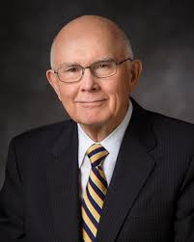
LESSON 115
“Are we sure to be guiltless under the law of God if we merely refrain from evil acts? What if we entertain evil thoughts and desires?
“Will hateful feelings go unnoticed in the day of judgment? Will envy? Will covetousness?…
“Our answers to such questions illustrate what we might call the bad news, that we can sin without overt acts, merely by our feelings and the desires of
Our hearts.
“There is also good news. Under the law of God, we
President
Dallin H. Oaks
can be rewarded for righteousness even where we are unable to perform the acts that are usually associated with such blessings.
“When someone wanted to do something for my father-in-law but was prevented by circumstances, he would say, ‘Thank you. I will take the good will for the deed.’ Similarly, I believe that our Father in Heaven will receive the true desires of our hearts as a substitute for actions that are genuinely impossible” (“The Desires of Our Hearts,” Ensign, June 1986,66).
How does it influence you to know that you will be judged by your works and the desires of your heart?

Slide 12
LESSON 115
Doctrine and Covenants 137:10.
And I also beheld that all children who die before they arrive at the years of accountability are saved in the celestial kingdom of heaven.
Who will be saved in the celestial kingdom?
All children who die before they become accountable will be saved in the celestial kingdom.

Slide 13
LESSON 115
What have you learned from Doctrine and Covenants137about the Lord’s efforts to give all people the opportunity to live in the celestial kingdom?

