Slide 1
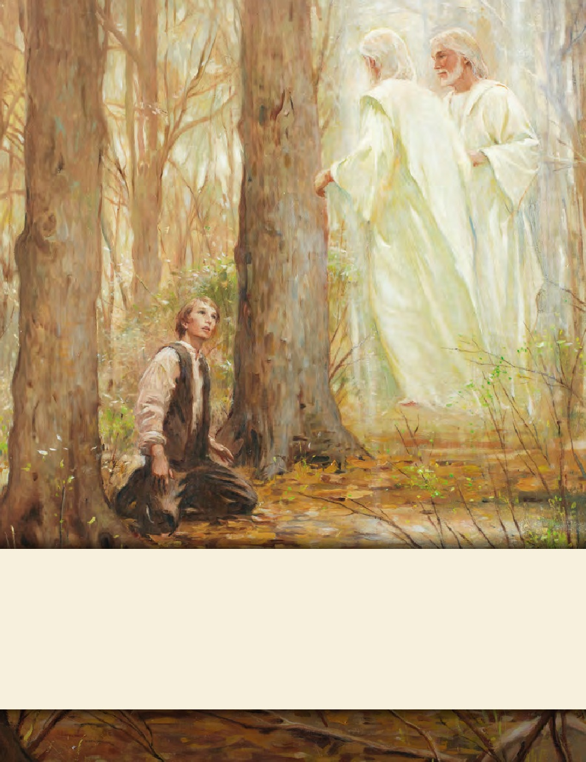
LESSON 15
SEMINARY
Doctrine and Covenants
and Church History

Slide 2
LESSON 114
Doctrine and Covenants 108.

Slide 3
LESSON 114
Doctrine and Covenants 108:1–3.
“The Lord forgives Lyman Sherman
for his sins”

Slide 4
LESSON 114
Have you ever been prompted by the Spirit to do something?
What blessings did you receive when you obeyed the Spirit’s promptings?
Introduction to Doctrine and Covenants 108.
Revelation given through Joseph Smith the Prophet, at Kirtland, Ohio, December 26, 1835. This section was received at the request of Lyman Sherman, who had previously been ordained a seventy and who had come to the Prophet with a request for a revelation to make known his duty.

Slide 5
LESSON 114
Lyman Sherman was a faithful member of the Church who had served in Zion’s Camp and had been called as one of the seven Presidents of the Quorum of the Seventy. The Prophet Joseph Smith recorded in his journal that on December 26, 1835, “Brother Lyman Sherman came in, and requested to have the word of the Lord through me; ‘for,’ said he, ‘I have been wrought upon to make known to you my feelings and desires, and was promised that I should have a revelation which should make known my duty’” (inHistory of the Church,2:345; see alsoJournals, Volume1: 1832–1839,vol.1 of the Journals series ofThe Joseph Smith Papers [2008],137).
What do you think Lyman meant when he said he had been “wrought upon” to talk to Joseph Smith?

Slide 6
LESSON 114
Doctrine and Covenants 108:1.
Verily thus saith the Lord unto you, my servant Lyman: Your sins are forgiven you, because you have obeyed my voice in coming up hither this morning to receive counsel of him whom I have appointed.
What blessing do we invite into our lives as we willingly obey the voice of the Lord?
As we obey the Lord’s voice, we invite His forgiveness.
Why do you think obeying promptings from the Lord invites forgiveness?
Doctrine and Covenants 108:2.
Therefore, let your soul be at rest concerning your spiritual standing, and resist no more my voice.
What do you think it means to “let your soul be at rest concerning your spiritual standing”?
How do you think the counsel to “resist no more [the Lord’s] voice” could help someone let their soul be at rest?
The Lord’s forgiveness brings rest to our souls.

Slide 7
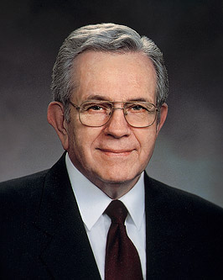
LESSON 114
“[The] great morning of forgiveness may not come at once. Do not give up if at first you fail. Often the most difficult part of repentance is to forgive yourself. Discouragement is part of that test. Do not give up. That brilliant morning will come. “Then ‘the peace of God, which passeth … understanding’ comes into your life once again. [Philip. 4:7.] Then you, like Him, will remember your sins no more. How will you know? You will know! [See Mosiah 4:1–3.]” (“The Brilliant Morning of Forgiveness, ”Ensign,Nov. 1995,20).
President
Boyd K. Packer
How would you describe what it feels like to let your soul be at rest?
Doctrine and Covenants 108:3.
And arise up and be more careful henceforth in observing your vows, which you have made and do make, and you shall be blessed with exceeding great blessings.
What counsel did the Lord give Brother Sherman?
To “arise up and be more careful henceforth in observing [his] vows.”
What are some vows we make?

Slide 8
LESSON 114
Doctrine and Covenants 108:4–8.
“The Lord gives Lyman Sherman additional counsel and promises”

Slide 9
LESSON 114
A solemn assembly is a special gathering for “the dedication of temples, special instruction to priesthood leaders, and sustaining a new President of the Church”.
Doctrine and Covenants 108:4-6.
4 Wait patiently until the solemn assembly shall be called of my servants, then you shall be remembered with the first of mine elders, and receive right by ordination with the rest of mine elders whom I have chosen.
5 Behold, this is the promise of the Father unto you if you continue faithful.
6 And it shall be fulfilled upon you in that day that you shall have right to preach my gospel wheresoever I shall send you, from henceforth from that time.
What did the Lord tell Lyman Sherman he would receive?

Slide 10
LESSON 114
Doctrine and Covenants 108:7-8.
7 Therefore, strengthen your brethren in all your conversation, in all your prayers, in all your exhortations, and in all your doings.
8 And behold, and lo, I am with you to bless you and deliver you forever. Amen.
In what ways did the Lord want Lyman Sherman to strengthen his brethren?
We are to strengthen others in all our conversations and actions.
How can you strengthen those around you in your conversations?
How can you strengthen those around you by your actions?

