Slide 1
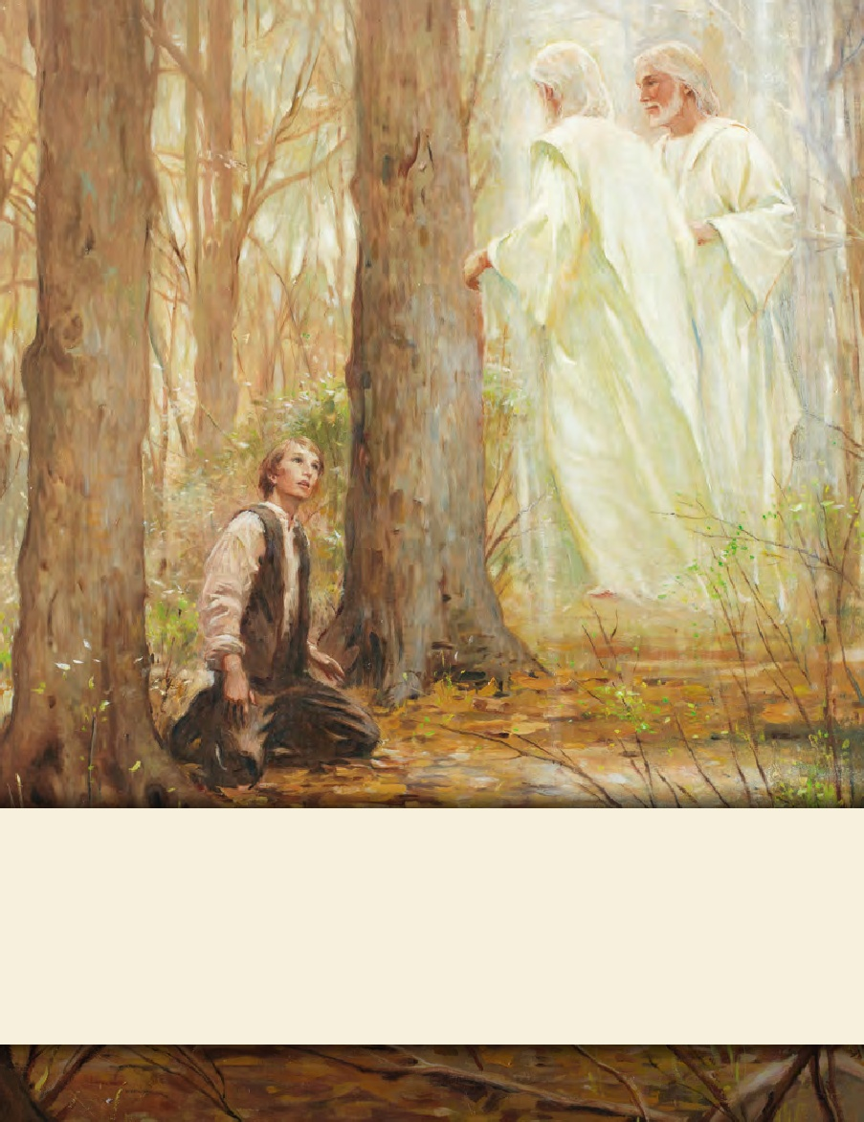
LESSON 15
SEMINARY
Doctrine and Covenants
and Church History

Slide 2
LESSON 111
Doctrine and Covenants 106:1-107:20.

Slide 3
LESSON 111
Doctrine and Covenants 106.
“The Lord calls Warren Cowdery as the presiding high priest in Freedom, New York”

Slide 4
LESSON 111
How do you think that person felt as he was sustained?
Doctrine and Covenants 106:1-3.
1 It is my will that my servant Warren A. Cowdery should be appointed and ordained a presiding high priest over my church, in the land of Freedom and the regions round about;
2 And should preach my everlasting gospel, and lift up his voice and warn the people, not only in his own place, but in the adjoining counties;
3 And devote his whole time to this high and holy calling, which I now give unto him, seeking diligently the kingdom of heaven and its righteousness, and all things necessary shall be added thereunto; for the laborer is worthy of his hire.
What did the Lord instruct Warren Cowdery to do?
Doctrine and Covenants 106:6.
And again, verily I say unto you, there was joy in heaven when my servant Warren bowed to my scepter, and separated himself from the crafts of men;
What do you think the phrase “bowed to my scepter” means?

Slide 5
LESSON 111
What do you think the phrase “separated himself from the crafts of men” means?
we humble ourselves before the Lord
He will have mercy on us, lift us up, and
If_____ __ _____________, then____ _ _____
______ __ .
give us grace and assurance
Doctrine and Covenants 106:7-8.
7 Therefore, blessed is my servant Warren, for I will have mercy on him; and, notwithstanding the vanity of his heart, I will lift him up inasmuch as he will humble himself before me.
8 And I will give him grace and assurance wherewith he may stand; and if he continue to be a faithful witness and a light unto the church I have prepared a crown for him in the mansions of my Father. Even so. Amen.
In what ways does the Lord lift up those who humble themselves before Him?

Slide 6
LESSON 111
Doctrine and Covenants 107:1–20.
“The Lord teaches about the Melchizedek and Aaronic Priesthoods”

Slide 7
LESSON 111
This prophet “was a man of faith, who wrought righteousness; and when a child he feared God, and stopped the mouths of lions, and quenched the violence of fire” (Joseph Smith Translation, Genesis 14:26[in the Bible appendix]). As king of Salem, he “did establish peace in the land in his days; therefore he was called the prince of peace” (Alma 13:18). The prophet Abraham paid tithes to him (see Alma 13:15).
“Melchizedek”
Doctrine and Covenants 107:1-4.
1 There are, in the church, two priesthoods, namely, the Melchizedek and Aaronic, including the Levitical Priesthood.
2 Why the first is called the Melchizedek Priesthood is because Melchizedek was such a great high priest.
3 Before his day it was called the Holy Priesthood, after the Order of the Son of God.
4 But out of respect or reverence to the name of the Supreme Being, to avoid the too frequent repetition of his name, they, the church, in ancient days, called that priesthood after Melchizedek, or the Melchizedek Priesthood.

Slide 8
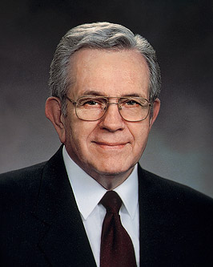
LESSON 111
What was the Melchizedek Priesthood called before Melchizedek’s day?
Why is it now called the Melchizedek Priesthood?
The Melchizedek Priesthood is after the order of the Son of God.
What does this principle suggest about how priesthood holders should fulfill their responsibilities?
President Boyd K Packer said:
“When priesthood authority is exercised properly, priesthood bearers do what He [Jesus Christ] would do if He were present” (“The Power of the Priesthood,” Ensign, May 2010,7).

Slide 9
LESSON 111
Relief Society, Sunday School, Young Men, Young Women, and Primary.
What is an appendage?
A part of a body, such as an arm or leg.
What right and authority does the Melchizedek Priesthood hold?
The Melchizedek Priesthood holds the right of presidency, power, and authority over all the offices in the Church, and the authority to administer in spiritual things.
Doctrine and Covenants 107:10.
High priests after the order of the Melchizedek Priesthood have a right to officiate in their own standing, under the direction of the presidency, in administering spiritual things, and also in the office of an elder, priest (of the Levitical order), teacher, deacon, and member.

Slide 10
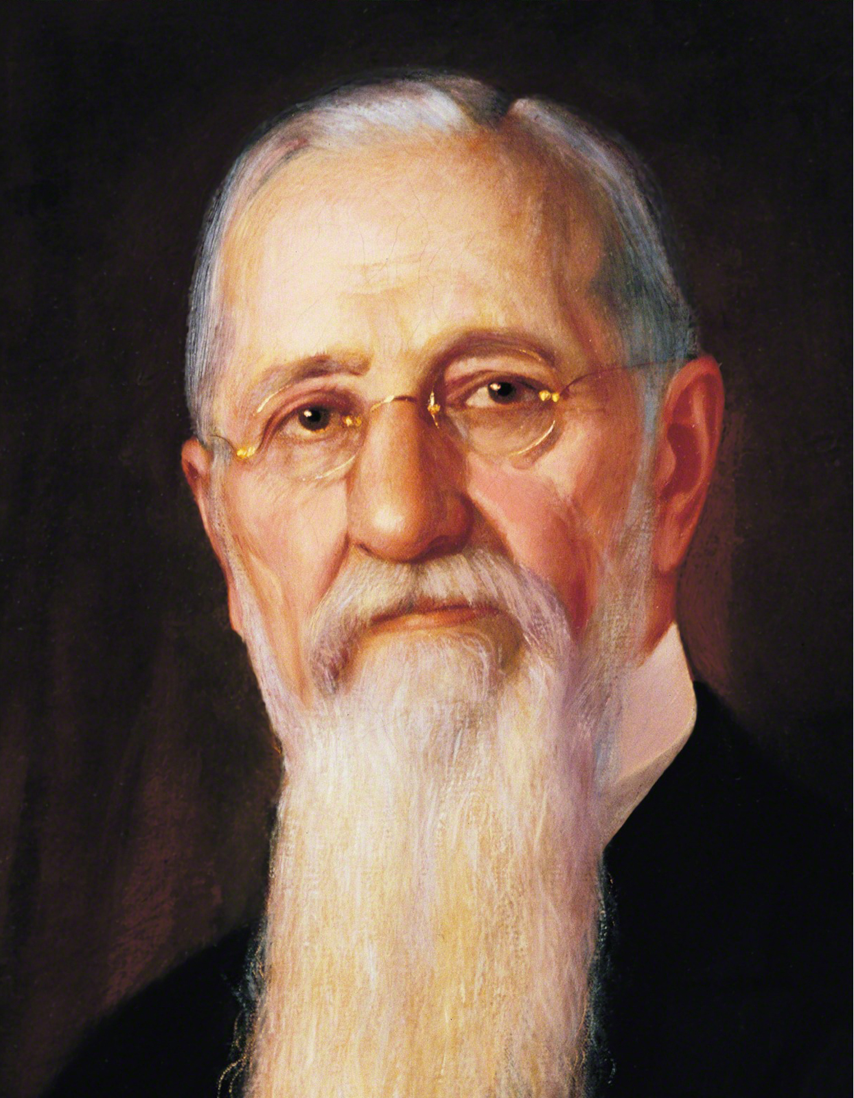
LESSON 111
“There is no government in the Church of Jesus Christ separate and apart, above, or outside of the holy Priesthood or its authority. … [Auxiliary organizations] are not outside of, nor above it, nor beyond its reach. They acknowledge the principle of the Priesthood. Wherever they are they always exist with the view of accomplishing some good; some soul’s salvation, temporal or spiritual” (Teachings of Presidents of the Church: Joseph F. Smith[1998],341–42).
President
Joseph F. Smith

Slide 11
LESSON 111
Doctrine and Covenants 107:18-19.
18 The power and authority of the higher, or Melchizedek Priesthood, is to hold the keys of all the spiritual blessings of the church—
19 To have the privilege of receiving the mysteries of the kingdom of heaven, to have the heavens opened unto them, to commune with the general assembly and church of the Firstborn, and to enjoy the communion and presence of God the Father, and Jesus the mediator of the new covenant.
What authority does the Melchizedek Priesthood hold?
Melchizedek Priesthood holds the keys of all the spiritual blessings of the Church.

Slide 12
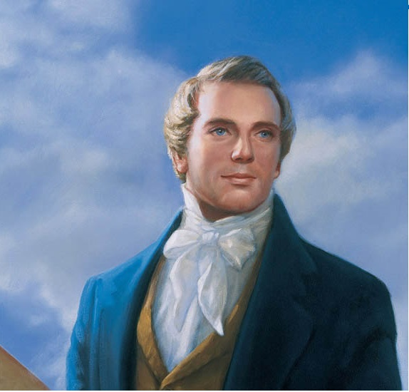
LESSON 111
Prophet Joseph Smith Said:
“[The Melchizedek Priesthood] is the channel through which all knowledge, doctrine, the plan of salvation, and every important matter is revealed from heaven” (in History of the Church,4:207).
Which spiritual blessings described in verse 19 stand out to you? Why?
What are some blessings you have received through the Melchizedek Priesthood?

Slide 13
LESSON 111
Doctrine and Covenants 107:13-14, 20.
13 The second priesthood is called the Priesthood of Aaron, because it was conferred upon Aaron and his seed, throughout all their generations.
14 Why it is called the lesser priesthood is because it is an appendage to the greater, or the Melchizedek Priesthood, and has power in administering outward ordinances.
20 The power and authority of the lesser, or Aaronic Priesthood, is to hold the keys of the ministering of angels, and to administer in outward ordinances, the letter of the gospel, the baptism of repentance for the remission of sins, agreeable to the covenants and commandments.
What authority does the Aaronic Priesthood hold?
The Aaronic Priesthood holds the keys of the ministering of angels and administering in outward ordinances.
What ordinance is mentioned in verse 20?
What other outward ordinance is administered by the authority of the Aaronic Priesthood?
The sacrament.
What are some blessings you have received through the Aaronic Priesthood?

Slide 14
LESSON 111
Melchizedek Priesthood offices
Aaronic Priesthood offices
Elder.
Deacon.
High priest.
Teacher.
Patriarch.
Priest.
Seventy.
Bishop.
Apostle.
Doctrine and Covenants 107:13,15.
13 The second priesthood is called the Priesthood of Aaron, because it was conferred upon Aaron and his seed, throughout all their generations.
15 The bishopric is the presidency of this priesthood, and holds the keys or authority of the same.

