Slide 1
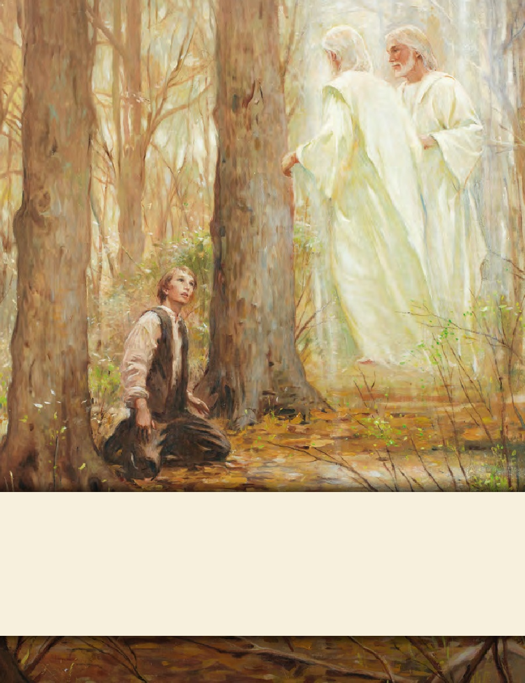
LESSON 15
SEMINARY
Doctrine and Covenants
and Church History

Slide 2
LESSON 110
Doctrine and Covenants 105.

Slide 3
LESSON 110
Doctrine and Covenants 105:1–19.
“The Lord instructs the Saints to wait for the redemption of Zion”

Slide 4
LESSON 110
What role did unity play in accomplishing this task?
The response to the Prophet Joseph Smith and others’ efforts to recruit volunteers and resources for Zion’s Camp was not as successful as hoped for. By the time the camp, or army, began its march in the beginning of May 1834, only 122 people had volunteered to go. Zion’s Camp recruited additional volunteers along the way to Missouri. When the group that Hyrum Smith and Lyman Wight had recruited from Michigan Territory met up with Joseph Smith’s company in early June 1834, Zion’s Camp consisted of just over 200 men, 12 women, and 9 children (see Alexander L. Baugh, “Joseph Smith and Zion’s Camp,” Ensign, June 2005,45).

Slide 5
LESSON 110
Doctrine and Covenants 105:7-8.
7 I speak not concerning those who are appointed to lead my people, who are the first elders of my church, for they are not all under this condemnation;
8 But I speak concerning my churches abroad—there are many who will say: Where is their God? Behold, he will deliver them in time of trouble, otherwise we will not go up unto Zion, and will keep our moneys.
Doctrine and Covenants 105:1-6.
1 Verily I say unto you who have assembled yourselves together that you may learn my will concerning the redemption of mine afflicted people—
2 Behold, I say unto you, were it not for the transgressions of my people, speaking concerning the church and not individuals, they might have been redeemed even now.
3 But behold, they have not learned to be obedient to the things which I required at their hands, but are full of all manner of evil, and do not impart of their substance, as becometh saints, to the poor and afflicted among them;
4 And are not united according to the union required by the law of the celestial kingdom;
5 And Zion cannot be built up unless it is by the principles of the law of the celestial kingdom; otherwise I cannot receive her unto myself.
6 And my people must needs be chastened until they learn obedience, if it must needs be, by the things which they suffer.

Slide 6
LESSON 110
In what ways had Church members failed to be united and obedient?
What must we do to help build up Zion?
To help build up Zion, we must be united and obedient to all that God asks.
Why do you think unity and obedience are required for Zion to be built up?
What experiences have helped you understand the importance of Church members being united?

Slide 7
LESSON 110
Zion’s Camp marched about 900 miles (1,450 kilometers) through 4 states, traveling between 20 and 40 miles (about 30–60 kilometers) a day for 45 days. Camp members experienced blistered feet, hot and humid weather conditions food shortages, and unhealthy food. On occasion, intense thirst moved some camp members to drink swamp water from which mosquito larvae had been strained out (sometimes using their teeth as strainers) or to drink water out of horse tracks after a rainstorm. Throughout the expedition, Zion’s Camp was also often threatened with violence from others. (See Church History in the Fulness of Times Student Manual,2nd ed. [Church Educational System manual, 2003], 143–45.)
How do you think you would have responded to these challenges?

Slide 8
LESSON 110
Doctrine and Covenants 105:9-14.
9 Therefore, in consequence of the transgressions of my people, it is expedient in me that mine elders should wait for a little season for the redemption of Zion—
10 That they themselves may be prepared, and that my people may be taught more perfectly, and have experience, and know more perfectly concerning their duty, and the things which I require at their hands.
11 And this cannot be brought to pass until mine elders are endowed with power from on high.
12 For behold, I have prepared a great endowment and blessing to be poured out upon them, inasmuch as they are faithful and continue in humility before me.
13 Therefore it is expedient in me that mine elders should wait for a little season, for the redemption of Zion.
14 For behold, I do not require at their hands to fight the battles of Zion; for, as I said in a former commandment, even so will I fulfil—I will fight your battles.
What did the Lord instruct the camp to do regarding the redemption of Zion?
How might you have felt hearing this revelation just before arriving at your destination?
What reasons did the Lord give for why Zion would not be redeemed at that time?

Slide 9
LESSON 110
Doctrine and Covenants 105:18-19.
18 But inasmuch as there are those who have hearkened unto my words, I have prepared a blessing and an endowment for them, if they continue faithful.
19 I have heard their prayers, and will accept their offering; and it is expedient in me that they should be brought thus far for a trial of their faith.
Why did the Lord command Zion’s Camp to travel all the way to Missouri and then reveal that Zion would not yet be redeemed?
In what ways was the faith of the members of Zion’s Camp tried during their experience?
What can we learn from these verses?
God has prepared great blessings for those who are faithful through their trials.
When have you or someone you know experienced a trial of faith?
How have trials of your faith prepared you for greater blessings?

Slide 10
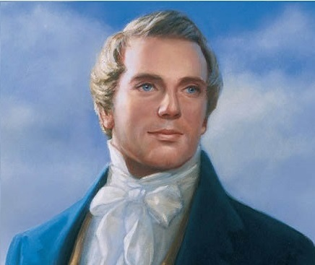
LESSON 110
“God did not want you to fight. He could not organize His kingdom with twelve men to open the Gospel door to the nations of the earth, and with seventy men under their direction to follow in their tracks, unless He took them from a body of men who had offered their lives, and who had made as great a sacrifice as did Abraham” (in History of the Church,2:182; see also Church History in the Fulness of Times,151).

Slide 11
LESSON 110
Doctrine and Covenants 105:20–41.
“The Lord teaches the Saints what they are to do before Zion is redeemed”

Slide 12
LESSON 110
What are some ways we should respond to persecution?
Doctrine and Covenants 105:38-41.
38 And again I say unto you, sue for peace, not only to the people that have smitten you, but also to all people;
39 And lift up an ensign of peace, and make a proclamation of peace unto the ends of the earth;
40 And make proposals for peace unto those who have smitten you, according to the voice of the Spirit which is in you, and all things shall work together for your good.
41 Therefore, be faithful; and behold, and lo, I am with you even unto the end. Even so. Amen.
What blessing would come to the Saints in Missouri if they sought to establish peace with others?
If we seek to establish peace with others, then all things will work together for our good.
What can we do to help establish peace with others?
How have you been blessed as you have sought to establish peace, including with those who might persecute you?

