Slide 1
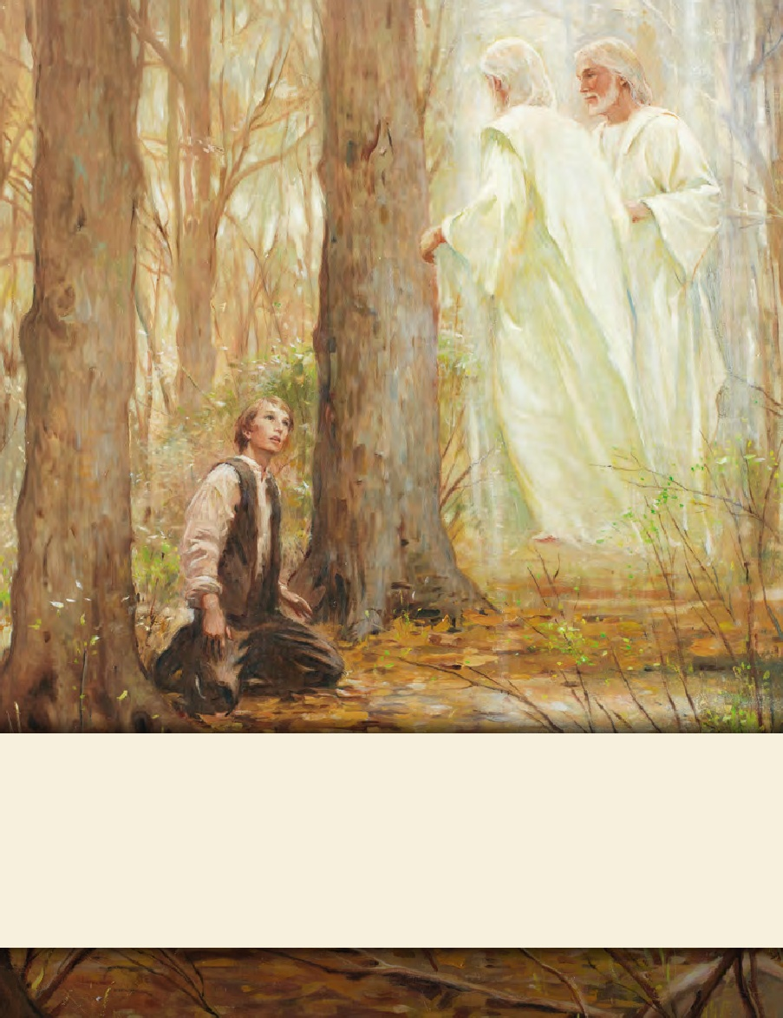
LESSON 15
SEMINARY
Doctrine and Covenants
and Church History

Slide 2
LESSON 109
Doctrine and Covenants 104.

Slide 3
LESSON 109
Doctrine and Covenants 104:1–18.
“The Lord gives instructions
concerning the United Order”

Slide 4
LESSON 109
What was necessary to lift the heavy object?
Introduction to Doctrine and Covenants 104.
Revelation given to Joseph Smith the Prophet, at or near Kirtland, Ohio, April 23, 1834, concerning the United Firm (see the headings to sections 78 and 82). The occasion was likely that of a council meeting of members of the United Firm, which discussed the pressing temporal needs of the Church. An earlier meeting of the firm on April 10 had resolved that the organization be dissolved. This revelation directs that the firm instead be reorganized; its properties were to be divided among members of the firm as their stewardships. Under Joseph Smith’s direction, the phrase “United Firm” was later replaced with “United Order” in the revelation.

Slide 5
LESSON 109
Doctrine and Covenants 104:1–4.
1 Verily I say unto you, my friends, I give unto you counsel, and a commandment, concerning all the properties which belong to the order which I commanded to be organized and established, to be a united order, and an everlasting order for the benefit of my church, and for the salvation of men until I come—
2 With promise immutable and unchangeable, that inasmuch as those whom I commanded were faithful they should be blessed with a multiplicity of blessings;
3 But inasmuch as they were not faithful they were nigh unto cursing.
4 Therefore, inasmuch as some of my servants have not kept the commandment, but have broken the covenant through covetousness, and with feigned words, I have cursed them with a very sore and grievous curse.
What did some of the brethren break because of covetousness?

Slide 6
LESSON 109
Doctrine and Covenants 104:11-13.
11 It is wisdom in me; therefore, a commandment I give unto you, that ye shall organize yourselves and appoint every man his stewardship;
12 That every man may give an account unto me of the stewardship which is appointed unto him.
13 For it is expedient that I, the Lord, should make every man accountable, as a steward over earthly blessings, which I have made and prepared for my creatures.
Why did the Lord appoint a stewardship to each member of the United Order?
Doctrine and Covenants 104:14.
I, the Lord, stretched out the heavens, and built the earth, my very handiwork; and all things therein are mine.
Who owned the property that was to be given to members of the United Order?
The Lord created the earth, and all things in it are His.
How might this truth influence the way you view and use your possessions?

Slide 7
LESSON 109
Doctrine and Covenants 104:15-18.
15 And it is my purpose to provide for my saints, for all things are mine.
16 But it must needs be done in mine own way; and behold this is the way that I, the Lord, have decreed to provide for my saints, that the poor shall be exalted, in that the rich are made low.
17 For the earth is full, and there is enough and to spare; yea, I prepared all things, and have given unto the children of men to be agents unto themselves.
18 Therefore, if any man shall take of the abundance which I have made, and impart not his portion, according to the law of my gospel, unto the poor and the needy, he shall, with the wicked, lift up his eyes in hell, being in torment.
How does the Lord want His Saints to be provided for?
What do you think it means that “the poor are exalted in that the rich are made low”?

Slide 8
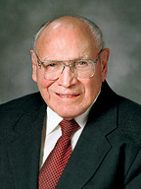
LESSON 109
“The Lord’s way consists of helping people help themselves. The poor are exalted because they work for the temporary assistance they receive, they are taught correct principles, and they are able to lift themselves from poverty to self-reliance. The rich are made low because they humble themselves to give generously of their means to those in need” (“Inspired Church Welfare,” Ensign, May 1999,77).
Elder
Joseph B. Wirthlin
What principles do verses 17–18t each about our responsibility to help others?
We are accountable to use what the Lord has given us to help others.
Why do you think it is important that we impart of our abundance to those in need?
How can we help others in the Lord’s way?

Slide 9
LESSON 109
Doctrine and Covenants 104:19–77.
“The Lord gives instructions concerning the United Order, stewardships, and the treasury”

Slide 10
LESSON 109
Doctrine and Covenants 104:23, 25, 31, 33, 35, 38, 42, 46.
23 And I will multiply blessings upon him, inasmuch as he will be humble before me.
25 And inasmuch as he is faithful, I will multiply blessings upon him and his seed after him.
31 And inasmuch as they are faithful, behold I will bless, and multiply blessings upon them.
33 And, inasmuch as they are faithful, I will multiply blessings upon them and their seed after them, even a multiplicity of blessings.
35 And inasmuch as he is faithful, I will multiply blessings upon him.
38 And inasmuch as he is faithful, I will multiply a multiplicity of blessings upon him.
42 And inasmuch as he is faithful in keeping my commandments, which I have given unto him, I will multiply blessings upon him and his seed after him, even a multiplicity of blessings. 46 And I will multiply blessings upon the house of my servant Joseph Smith, Jun., inasmuch as he is faithful, even a multiplicity of blessings.
What can this phrase teach us about how our obedience affects the blessings we receive?
Inasmuch as we are humble and faithful, the Lord will
multiply our blessings.
When have you seen someone blessed for being faithful in their responsibilities to the Lord?

Slide 11
LESSON 109
Doctrine and Covenants 104:78–86.
“The Lord instructs Church leaders regarding the United Order’s debts”

Slide 12
LESSON 109
Doctrine and Covenants 104:78.
And again, verily I say unto you, concerning your debts—behold it is my will that you shall pay all your debts.
What did the Lord instruct the members of the United Order to do?
Doctrine and Covenants 104:80-82.
80 And inasmuch as you are diligent and humble, and exercise the prayer of faith, behold, I will soften the hearts of those to whom you are in debt, until I shall send means unto you for your deliverance.
81 Therefore write speedily to New York and write according to that which shall be dictated by my Spirit; and I will soften the hearts of those to whom you are in debt, that it shall be taken away out of their minds to bring affliction upon you.
82 And inasmuch as ye are humble and faithful and call upon my name, behold, I will give you the victory.

Slide 13
LESSON 109
What principle can we learn from Doctrine and Covenants 104:80–82?
If we are humble and faithful and call upon the Lord’s name, then He will help us accomplish what He has asked us to do.
What does the Lord ask Church members to do today that might be considered challenging? What role do you think humility, faithfulness, and prayer have in accomplishing the things the Lord has asked you to do?
Who from the scriptures is an example of the principle we identified in verses 80–82? Who do you know today who is an example of this principle?

