Slide 1
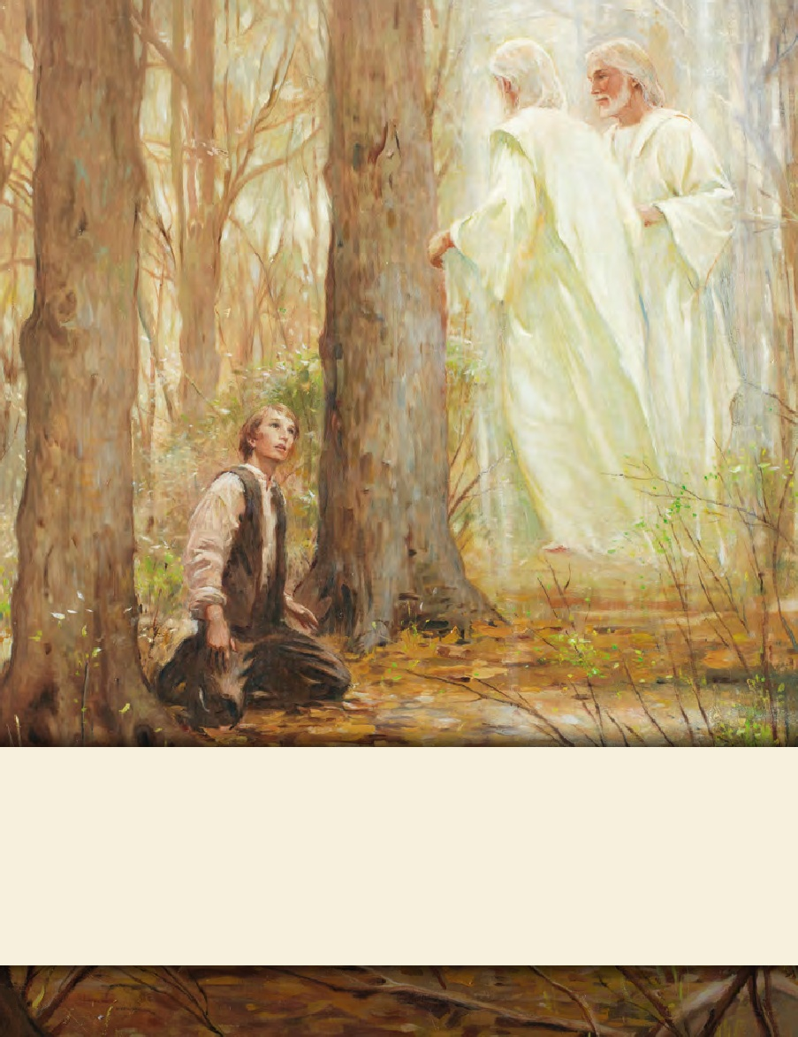
LESSON 15
SEMINARY
Doctrine and Covenants
and Church History

Slide 2
LESSON 108
Doctrine and Covenants 103

Slide 3
LESSON 108
Doctrine and Covenants 103:1-20.
“The Lord promises that Zion
will be redeemed”

Slide 4
LESSON 108
What enemies do the righteous have today?
Why do you think the enemies of the Lord are able to hinder the spiritual progress of some of the Lord’s people?
Introduction to Doctrine and Covenants 103
Revelation given through Joseph Smith the Prophet, at Kirtland, Ohio, February 24, 1834. This revelation was received after the arrival in Kirtland, Ohio, of Parley P. Pratt and Lyman Wight, who had come from Missouri to counsel with the Prophet as to the relief and restoration of the Saints to their lands in Jackson County.
Why had Brother Pratt and Brother Wight come to Kirtland?

Slide 5
LESSON 108
Doctrine and Covenants 103:1-4.
1 Verily I say unto you, my friends, behold, I will give unto you a revelation and commandment, that you may know how to act in the discharge of your duties concerning the salvation and redemption of your brethren, who have been scattered on the land of Zion;
2 Being driven and smitten by the hands of mine enemies, on whom I will pour out my wrath without measure in mine own time.
3 For I have suffered them thus far, that they might fill up the measure of their iniquities, that their cup might be full;
4 And that those who call themselves after my name might be chastened for a little season with a sore and grievous chastisement, because they did not hearken altogether unto the precepts and commandments which I gave unto them.
What are two reasons the Lord allowed His enemies to persecute the Saints?
One reason was to allow the persecutors to “fill up the measure of their iniquities, that their cup might be full”—in other words, to justify His judgments on the wicked. Another reason was to chasten the disobedient Saints.
Why did the Saints need to be chastened?
What do you think is the meaning of the phrase “they did not hearken altogether”?
They were not completely obedient to the Lord.

Slide 6
LESSON 108
Doctrine and Covenants 103:5-7.
5 But verily I say unto you, that I have decreed a decree which my people shall realize, inasmuch as they hearken from this very hour unto the counsel which I, the Lord their God, shall give unto them.
6 Behold they shall, for I have decreed it, begin to prevail against mine enemies from this very hour.
7 And by hearkening to observe all the words which I, the Lord their God, shall speak unto them, they shall never cease to prevail until the kingdoms of the world are subdued under my feet, and the earth is given unto the saints, to possess it forever and ever.
What blessing would they receive?
They would prevail against the Lord’s enemies “from [that] very hour.
What do these verses teach about how we can prevail against the influences of the world?
When we begin to follow the Lord’s counsel, we receive strength to begin to prevail against the world.

Slide 7
LESSON 108
Doctrine and Covenants 103:8-10.
8 But inasmuch as they keep not my commandments, and hearken not to observe all my words, the kingdoms of the world shall prevail against them.
9 For they were set to be a light unto the world, and to be the saviors of men;
10 And inasmuch as they are not the saviors of men, they are as salt that has lost its savor, and is thenceforth good for nothing but to be cast out and trodden under foot of men.
What are some results of choosing not to obey all the Lord’s words?
If we disobey the Lord’s commandments, the world will prevail against us. If we do not observe all the Lord’s words, we lose the ability to be a light to others.
Why do you think someone who is disobedient or only partially obedient to the Lord might not be able to prevail against the enemies of the Lord?
What are some examples of how people can gain victory over an enemy of the Lord by striving to obey the Lord’s words?

Slide 8
LESSON 108
Doctrine and Covenants 103:21–40
“The Lord reveals how the land of
Zion is to be redeemed”

Slide 9
LESSON 108
Volunteers needed! Fellow Saints in Jackson County, Missouri, have been forcibly driven from their lands by ruthless mobs. Join in bringing relief to these Saints and helping protect them as they regain and maintain their lands in Zion. Depart from Kirtland, Ohio, on May 1,1834
Doctrine and Covenants 103:21–23.
21 Verily, verily I say unto you, that my servant Joseph Smith, Jun., is the man to whom I likened the servant to whom the Lord of the vineyard spake in the parable which I have given unto you.
22 Therefore let my servant Joseph Smith, Jun., say unto the strength of my house, my young men and the middle aged—Gather yourselves together unto the land of Zion, upon the land which I have bought with money that has been consecrated unto me.
23 And let all the churches send up wise men with their moneys, and purchase lands even as I have commanded them.

Slide 10
LESSON 108
Do you think you would have been willing to go to Jackson County to help the Saints? Why or why not?
What concerns might you have had about volunteering to join Zion’s Camp?
How would the promise in this verse affect your decision to volunteer?
Doctrine and Covenants 103:27-28.
27 Let no man be afraid to lay down his life for my sake; for whoso layeth down his life for my sake shall find it again.
28 And whoso is not willing to lay down his life for my sake is not my disciple.
What do you think the phrase “lay down his life for my sake” means?
What does the Lord call someone who is willing to lay down his or her life for the Lord’s sake?
Disciples of Jesus Christ are willing to give their lives for His sake.

Slide 11
LESSON 108
“For most of us … what is required is not to die for the Church but to live for it. For many, living a Christlike life every day may be even more difficult than laying down one’s life” (“Discipleship,” Ensignor Liahona, Nov. 2006,22).
Why do you think it might be even more difficult to live for the Lord than to die for Him?

Slide 12
LESSON 108
Doctrine and Covenants 103:30-34.
30 It is my will that my servant Parley P. Pratt and my servant Lyman Wight should not return to the land of their brethren, until they have obtained companies to go up unto the land of Zion, by tens, or by twenties, or by fifties, or by an hundred, until they have obtained to the number of five hundred of the strength of my house.
31 Behold this is my will; ask and ye shall receive; but men do not always do my will.
32 Therefore, if you cannot obtain five hundred, seek diligently that peradventure you may obtain three hundred.
33 And if ye cannot obtain three hundred, seek diligently that peradventure ye may obtain one hundred.
34 But verily I say unto you, a commandment I give unto you, that ye shall not go up unto the land of Zion until you have obtained a hundred of the strength of my house, to go up with you unto the land of Zion
How many volunteers did the Lord desire?
500.
What was the minimum number the Lord required?
100.

Slide 13
LESSON 108
Doctrine and Covenants 103:35-36.
35 Therefore, as I said unto you, ask and ye shall receive; pray earnestly that peradventure my servant Joseph Smith, Jun., may go with you, and preside in the midst of my people, and organize my kingdom upon the consecrated land, and establish the children of Zion upon the laws and commandments which have been and which shall be given unto you.
36 All victory and glory is brought to pass unto you through your diligence, faithfulness, and prayers of faith.
What principle can we learn about how we can obtain all victory and glory?
All victory and glory is brought to pass unto us through our diligence, faithfulness, and prayers of faith.

