Slide 1
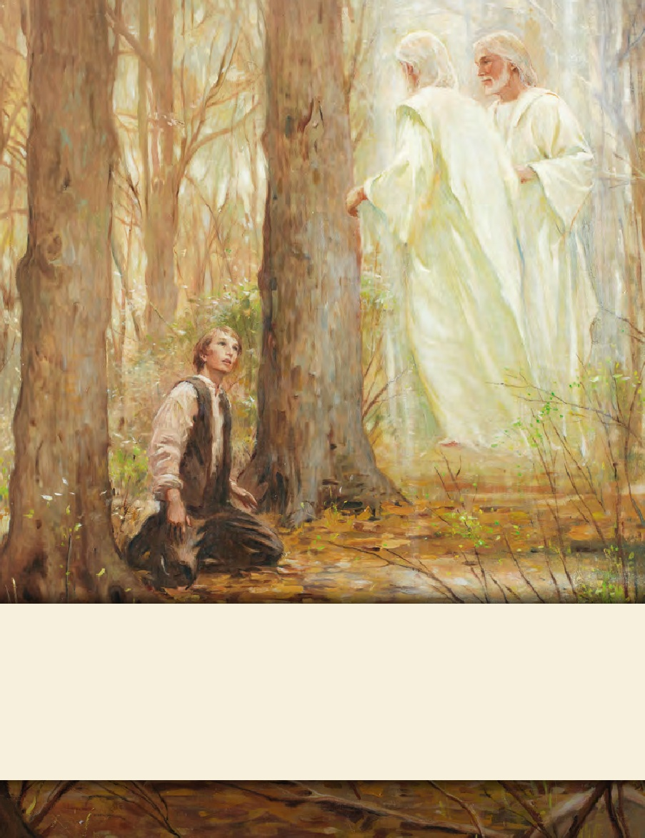
LESSON 15
SEMINARY
Doctrine and Covenants
and Church History

Slide 2
LESSON 106
Doctrine and Covenants 101:43-101.

Slide 3
LESSON 106
Doctrine and Covenants 101:43-62.
“The Lord gives the parable of the
nobleman and the olive trees”

Slide 4
LESSON 106
The parable of the
nobleman and the olive trees.
Doctrine and Covenants 101:43.
And now, I will show unto you a parable, that you may know my will concerning the redemption of Zion.
Doctrine and Covenants 101:44-45.
44 A certain nobleman had a spot of land, very choice; and he said unto his servants: Go ye unto my vineyard, even upon this very choice piece of land, and plant twelve olive trees;
45 And set watchmen round about them, and build a tower, that one may overlook the land round about, to be a watchman upon the tower, that mine olive trees may not be broken down when the enemy shall come to spoil and take upon themselves the fruit of my vineyard.
What did the nobleman instruct his servants to do?
Why did the nobleman want watchmen in his vineyard?
Why did he want a watchman on the tower?

Slide 5
LESSON 106
Doctrine and Covenants 101:46
-50.
46 Now, the servants of the nobleman went and did as their lord commanded them, and planted the olive trees, and built a hedge round about, and set watchmen, and began to build a tower.
47 And while they were yet laying the foundation thereof, they began to say among themselves: And what need hath my lord of this tower?
48 And consulted for a long time, saying among themselves: What need hath my lord of this tower, seeing this is a time of peace?
49 Might not this money be given to the exchangers? For there is no need of these things.
50 And while they were at variance one with another they became very slothful, and they hearkened not unto the commandments of their lord.
How well did the servants follow the instructions?
Why did the servants fail to build the tower?

Slide 6
LESSON 106
Doctrine and Covenants 101:51
-54.
51 And the enemy came by night, and broke down the hedge; and the servants of the nobleman arose and were affrighted, and fled; and the enemy destroyed their works, and broke down the olive trees.
52 Now, behold, the nobleman, the lord of the vineyard, called upon his servants, and said unto them, Why! what is the cause of this great evil?
53 Ought ye not to have done even as I commanded you, and—after ye had planted the vineyard, and built the hedge round about, and set watchmen upon the walls thereof—built the tower also, and set a watchman upon the tower, and watched for my vineyard, and not have fallen asleep, lest the enemy should come upon you?
54 And behold, the watchman upon the tower would have seen the enemy while he was yet afar off; and then ye could have made ready and kept the enemy from breaking down the hedge thereof, and saved my vineyard from the hands of the destroyer.
Why was the nobleman upset that his servants had not built a tower?
How do the events described in this parable relate to what happened to the Saints in Missouri?

Slide 7
LESSON 106
How might the tower in the parable relate to the temple that the Saints had failed to build?
What are some principles in this parable that we can apply in our lives?
When we obey the Lord’s commandments, we are strengthened to withstand spiritual and physical enemies. Prophets serve as watchmen on the tower, warning us of coming dangers. Through temple work, we prepare to withstand the adversary.

Slide 8
LESSON 106
Doctrine and Covenants 101:55-62.
55 And the lord of the vineyard said unto one of his servants: Go and gather together the residue of my servants, and take all the strength of mine house, which are my warriors, my young men, and they that are of middle age also among all my servants, who are the strength of mine house, save those only whom I have appointed to tarry;
56 And go ye straightway unto the land of my vineyard, and redeem my vineyard; for it is mine; I have bought it with money.
57 Therefore, get ye straightway unto my land; break down the walls of mine enemies; throw down their tower, and scatter their watchmen.
58 And inasmuch as they gather together against you, avenge me of mine enemies, that by and by I may come with the residue of mine house and possess the land.
59 And the servant said unto his lord: When shall these things be?
60 And he said unto his servant: When I will; go ye straightway, and do all things whatsoever I have commanded you;
61 And this shall be my seal and blessing upon you—a faithful and wise steward in the midst of mine house, a ruler in my kingdom.
62 And his servant went straightway, and did all things whatsoever his lord commanded him; and after many days all things were fulfilled.
What did the nobleman tell His servant to do?
Gather an army and redeem the vineyard.

Slide 9
LESSON 106
Doctrine and Covenants 101:63-75.
“The Lord admonishes the Saints to continue the work of gathering”

Slide 10
LESSON 106
Doctrine and Covenants 101:63-64
-66.
63 Again, verily I say unto you, I will show unto you wisdom in me concerning all the churches, inasmuch as they are willing to be guided in a right and proper way for their salvation—
64 That the work of the gathering together of my saints may continue, that I may build them up unto my name upon holy places; for the time of harvest is come, and my word must needs be fulfilled.
65 Therefore, I must gather together my people, according to the parable of the wheat and the tares, that the wheat may be secured in the garners to possess eternal life, and be crowned with celestial glory, when I shall come in the kingdom of my Father to reward every man according as his work shall be;
66 While the tares shall be bound in bundles, and their bands made strong, that they may be burned with unquenchable fire.
What do the wheat and the tares represent in this parable?
The wheat represents the faithful members of the Church, and the tares represent the wicked people of the world.
Elder David A. Bednar of the Quorum of the Twelve Apostles explained, “The garners are the holy temples”

Slide 11
LESSON 106
What blessings will we receive by gathering to temples and serving there?
As we gather to the temple, we receive protection and prepare ourselves for eternal life.
How do you think temple ordinances and covenants can protect us and prepare us for eternal life?

Slide 12
LESSON 106
Doctrine and Covenants 101:76-101.
“The Lord counsels the Saints to continue to seek a way to return to their homes in Missouri”

Slide 13
LESSON 106
Doctrine and Covenants 101:76-80.
76 And again I say unto you, those who have been scattered by their enemies, it is my will that they should continue to importune for redress, and redemption, by the hands of those who are placed as rulers and are in authority over you—
77 According to the laws and constitution of the people, which I have suffered to be established, and should be maintained for the rights and protection of all flesh, according to just and holy principles;
78 That every man may act in doctrine and principle pertaining to futurity, according to the moral agency which I have given unto him, that every man may be accountable for his own sins in the day of judgment.
79 Therefore, it is not right that any man should be in bondage one to another.
80 And for this purpose have I established the Constitution of this land, by the hands of wise men whom I raised up unto this very purpose, and redeemed the land by the shedding of blood.
Why does He want this constitution to be maintained?
Why is accountability—responsibility for our actions—an important part of agency?
How would you respond to someone who says “I am free to do whatever I want”?
Why do you think it is important that people not be in bondage?

Slide 14
LESSON 106
God has given us moral agency, the power to choose, but we are
accountable for our choices.
-88.
Doctrine and Covenants 101:81-84
81 Now, unto what shall I liken the children of Zion? I will liken them unto the parable of the woman and the unjust judge, for men ought always to pray and not to faint, which saith—
82 There was in a city a judge which feared not God, neither regarded man.
83 And there was a widow in that city, and she came unto him, saying: Avenge me of mine adversary.
84 And he would not for a while, but afterward he said within himself: Though I fear not God, nor regard man, yet because this widow troubleth me I will avenge her, lest by her continual coming she weary me.
85 Thus will I liken the children of Zion.
86 Let them importune at the feet of the judge;
87 And if he heed them not, let them importune at the feet of the governor;
88 And if the governor heed them not, let them importune at the feet of the president;
Who might the widow represent?
Members of the Church.
Who could the judge represent?
The judge could represent judges and government leaders whom the Saints would ask for help.

Slide 15
LESSON 106
What specific things did the Lord instruct the Saints to do?
-95.
Doctrine and Covenants 101:89-91
89 And if the president heed them not, then will the Lord arise and come forth out of his hiding place, and in his fury vex the nation;
90 And in his hot displeasure, and in his fierce anger, in his time, will cut off those wicked, unfaithful, and unjust stewards, and appoint them their portion among hypocrites, and unbelievers;
91 Even in outer darkness, where there is weeping, and wailing, and gnashing of teeth.
92 Pray ye, therefore, that their ears may be opened unto your cries, that I may be merciful unto them, that these things may not come upon them.
93 What I have said unto you must needs be, that all men may be left without excuse;
94 That wise men and rulers may hear and know that which they have never considered;
95 That I may proceed to bring to pass my act, my strange act, and perform my work, my strange work, that men may discern between the righteous and the wicked, saith your God.
What does verse 92 teach us about the Lord?
“He does not want to punish people. He wants all people to repent so He can be merciful to them”

