Slide 1
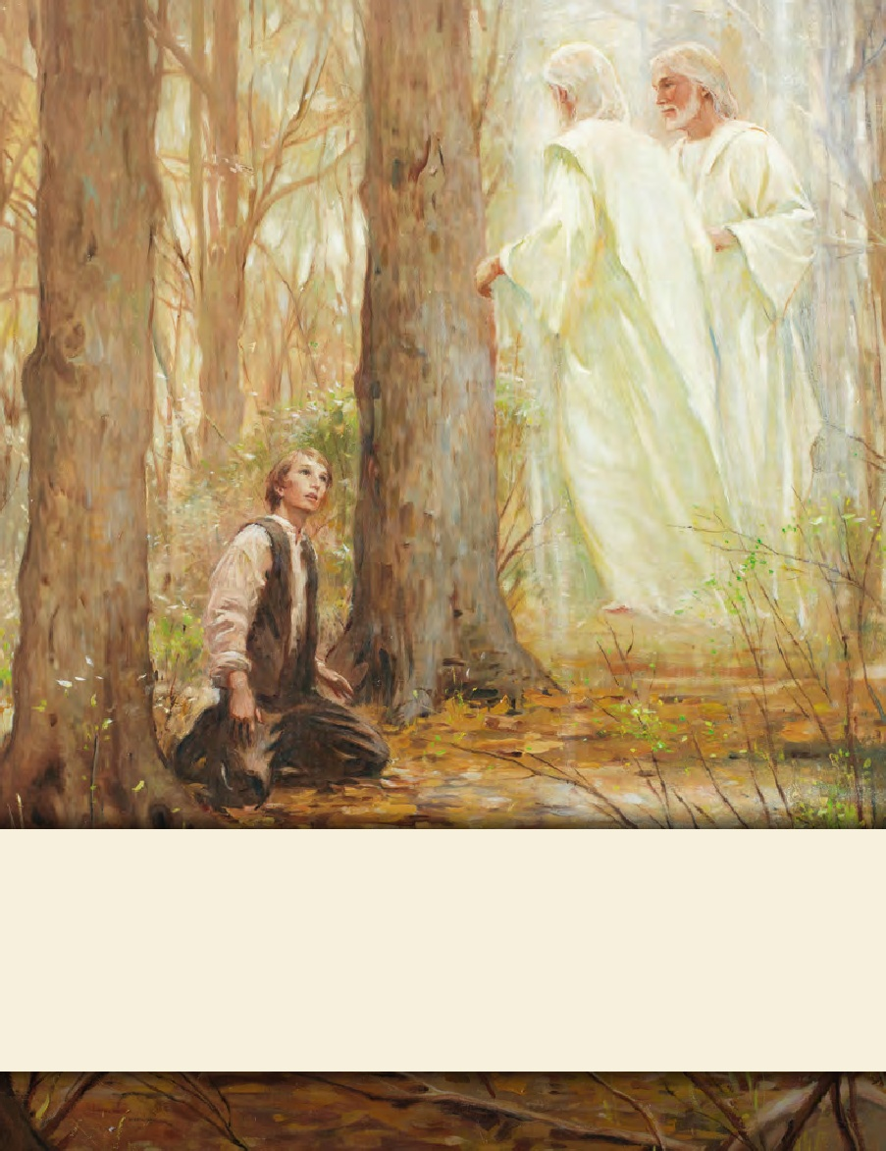
LESSON 15
SEMINARY
Doctrine and Covenants
and Church History

Slide 2
LESSON 104
Doctrine and Covenants 101:1-16.

Slide 3
LESSON 104
Doctrine and Covenants 101:1-8.
“The Lord explains why He allows
His people to experience trials”

Slide 4
LESSON 104
What are some examples of persecution the Saints suffered in Jackson County, Missouri?

Slide 5
LESSON 104
Due to mob violence in Jackson County, Missouri, in July 1833, Church leaders in Missouri agreed to leave the county. However, in August 1833, a council of general Church leaders in Kirtland met to discuss the difficulties in Missouri. They sent instruction that the Saints in Missouri should not sell their land or move from the county unless they had already signed agreements to do so. Church leaders petitioned the government and used available legal channels to maintain their lands in Missouri and seek justice for those responsible for the violence. After hearing of these actions, and believing that the Saints were not planning to leave as expected, non–Latter-day Saint settlers attacked the Saints again. On the night of October31, 1833, a mob of about 50 horsemen raided the Whitmer Settlement, west of Independence. They unroofed 13 houses and whipped several men, almost killing them. These attacks continued for the next two nights in Independence and other places where the Saints lived. Men were beaten, and women and children were terrorized.
What questions do you think the Saints in Missouri might have had at this time?

Slide 6
LESSON 104
Introduction to Doctrine and Covenants 101.
Revelation given to Joseph Smith the Prophet, at Kirtland, Ohio, December 16 and 17, 1833. At this time the Saints who had gathered in Missouri were suffering great persecution. Mobs had driven them from their homes in Jackson County; and some of the Saints had tried to establish themselves in Van Buren, Lafayette, and Ray Counties, but persecution followed them. The main body of the Saints was at that time in Clay County, Missouri. Threats of death against individuals of the Church were many. The Saints in Jackson County had lost household furniture, clothing, livestock, and other personal property; and many of their crops had been destroyed.
Doctrine and Covenants 101:1-2.
1 Verily I say unto you, concerning your brethren who have been afflicted, and persecuted, and cast out from the land of their inheritance—
2 I, the Lord, have suffered the affliction to come upon them, wherewith they have been afflicted, in consequence of their transgressions;
What can we learn from verse 2 about the consequences of violating the commandments of God?
When we violate the commandments, God allows us to suffer.
Why do you think it is important to understand this principle?

Slide 7
LESSON 104
Doctrine and Covenants 101:3-5.
3 Yet I will own them, and they shall be mine in that day when I shall come to make up my jewels.
4 Therefore, they must needs be chastened and tried, even as Abraham, who was commanded to offer up his only son.
5 For all those who will not endure chastening, but deny me, cannot be sanctified.
Why does the Lord chasten and try His people?
If we will not endure chastening, we cannot be sanctified.
How can chastening help us become sanctified?
How might the message in these verses have influenced the Missouri Saints?

Slide 8
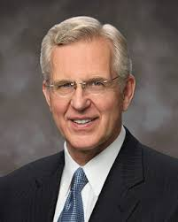
LESSON 104
“In addition to stimulating our repentance, the very experience of enduring chastening can refine us and prepare us for greater spiritual privileges” (“As Many as I Love, I Rebuke and Chasten,” Ensign or Liahona, May 2011,98).
Elder
D. Todd Christofferson
How can this truth help us during difficult times?

Slide 9
LESSON 104
Doctrine and Covenants 101:6-8.
6 Behold, I say unto you, there were jarrings, and contentions, and envyings, and strifes, and lustful and covetous desires among them; therefore by these things they polluted their inheritances.
7 They were slow to hearken unto the voice of the Lord their God; therefore, the Lord their God is slow to hearken unto their prayers, to answer them in the day of their trouble.
8 In the day of their peace they esteemed lightly my counsel; but, in the day of their trouble, of necessity they feel after me.
What do you learn from verses 7–8?
What do some people tend to do when their lives are peaceful?
What do some people begin to do in their afflictions?
What do you think it means to “feel after” the Lord?

Slide 10
LESSON 104
Doctrine and Covenants 101:9-16.
“The Lord counsels and comforts the Saints”

Slide 11
LESSON 104
Doctrine and Covenants 101:9.
Verily I say unto you, notwithstanding their sins, my bowels are filled with compassion towards them. I will not utterly cast them off; and in the day of wrath I will remember mercy.
What message does the Lord give in verse 9 that can help us when we suffer the consequences of our sins?
Even when we have sinned, the Lord will have compassion toward us.
How can this truth bring us hope?

Slide 12
LESSON 104
The mob in Jackson County continued persecuting the Saints until all members of the Church were driven out of the county. Lyman Wight reported, “I saw one hundred and ninety women and children driven thirty miles across the prairie, with three decrepit men only in their company, in the month of November, the ground thinly crusted with sleet; and I could easily follow on their trail by the blood that flowed from their lacerated feet on the stubble of the burnt prairie!” (in History of the Church,3:439). Most of the Saints fled north, where they had to cross the Missouri River. The shores of the river near the ferry were lined with refugees. Some people were fortunate enough to escape with some of their household goods, but many lost everything. Parley P. Pratt wrote: “Hundreds of people were seen in every direction, some in tents and some in the open air around their fires, while the rain descended in torrents. Husbands were inquiring for their wives, wives for their husbands; parents for children, and children for parents. … The scene was indescribable, and, I am sure, would have melted the hearts of any people on the earth, except our blind oppressors, and a blind and ignorant community” (Autobiography of Parley P. Pratt, ed. Parley P. Pratt Jr. [1938],102).

Slide 13
LESSON 104
Which aspects of these trials would have been especially difficult for you to witness or experience?
How do you think you might respond if you experienced such afflictions?
Doctrine and Covenants 101:12-16.
12 And in that day all who are found upon the watch-tower, or in other words, all mine Israel, shall be saved.
13 And they that have been scattered shall be gathered.
14 And all they who have mourned shall be comforted.
15 And all they who have given their lives for my name shall be crowned.
16 Therefore, let your hearts be comforted concerning Zion; for all flesh is in mine hands; be still and know that I am God.
What principle do you learn from verses 12–16?
When we live righteously, we can find comfort in the knowledge that all people are in the Lord’s hands.
What do you think is the meaning of the command to “be still and know that I am God”?
How can being “still” help us receive comfort from the Lord?

